Slide 1

Dance Hall Days
A slideshow of images and objects from Museums Victoria's collection
relating to social dancing and dance halls in Victoria.

Slide 2
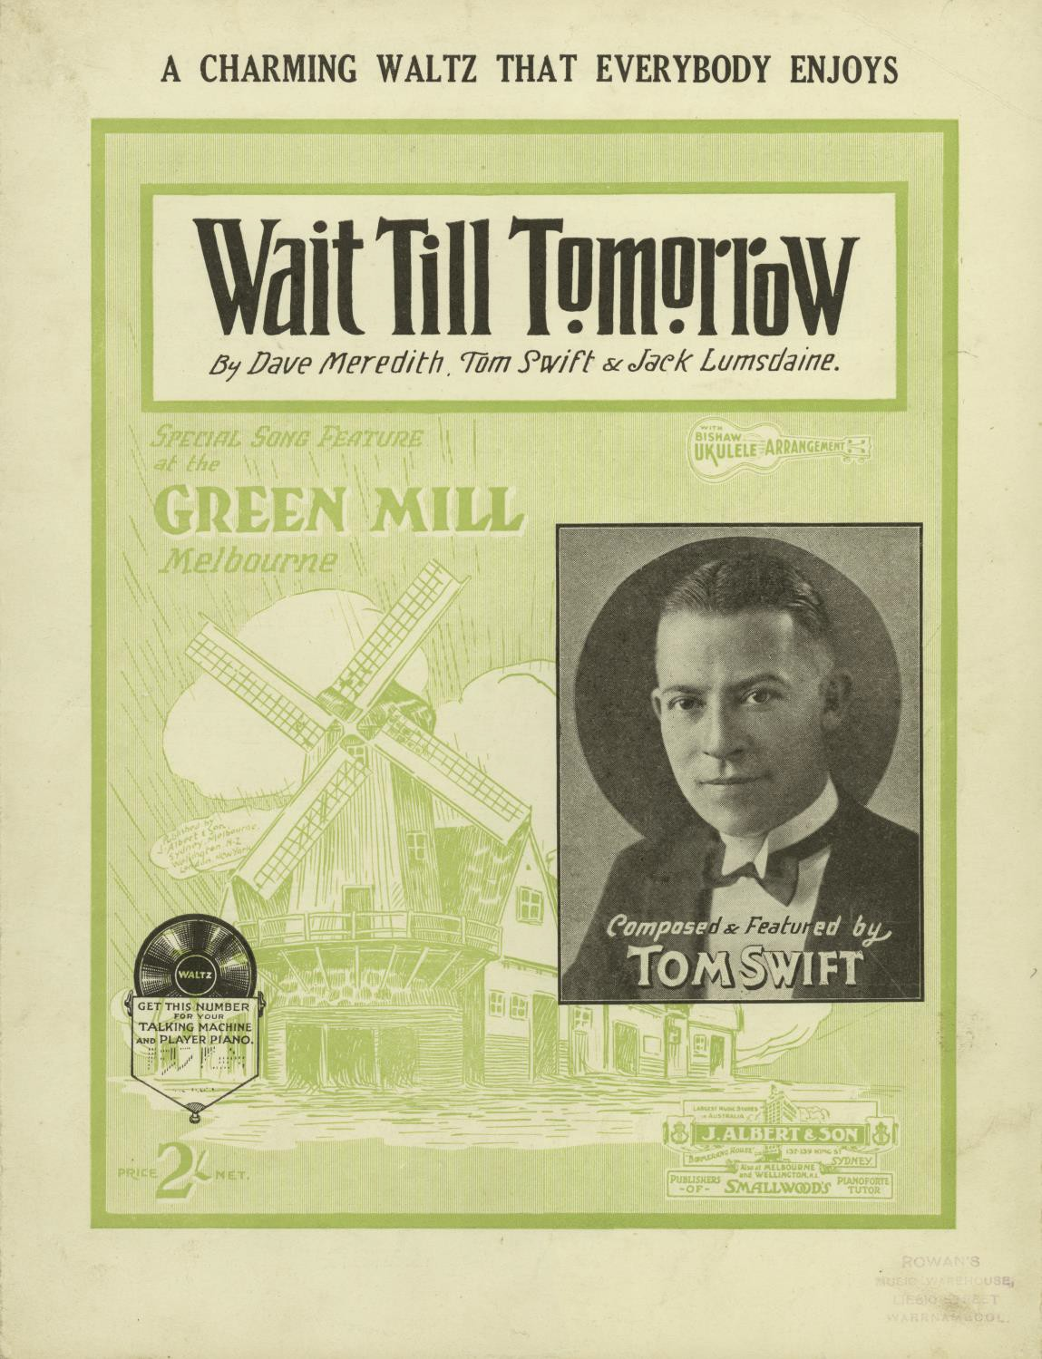
Dance Sheet Music Booklet, 'Wait Till Tomorrow’ (front page)
By Dave Meredith. Tom Swift and Jack Lumsdaine

Slide 3
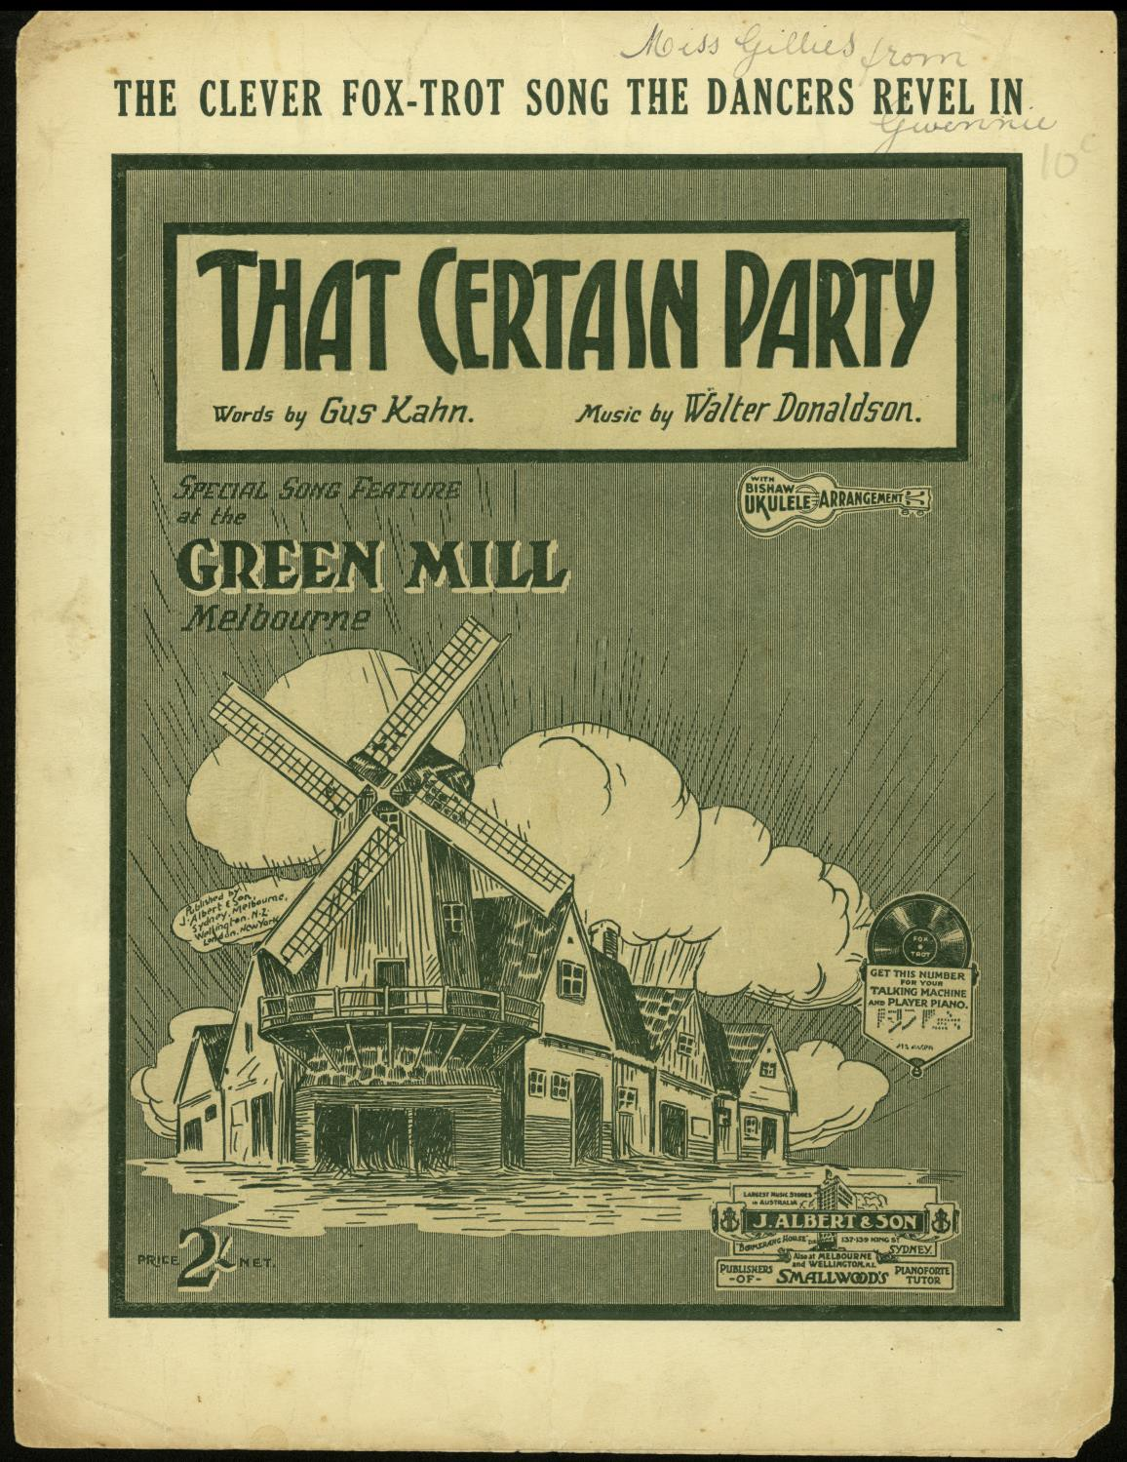
Dance Sheet Music Booklet, 'That Certain Party'
Words by Gus Kahn and music by Walter Donaldson for the Green Mill.

Slide 4
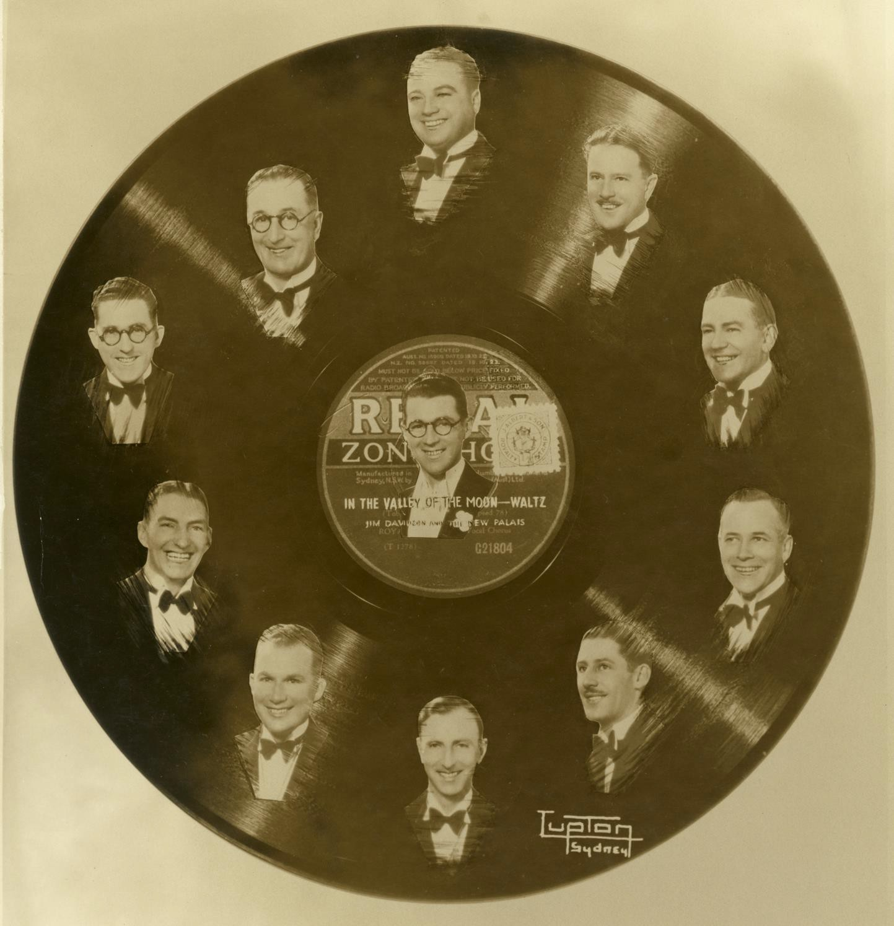
In the Valley of the Moon – Waltz Jim Davidson and
Band Vinyl Record with faces
Unknown creator

Slide 5
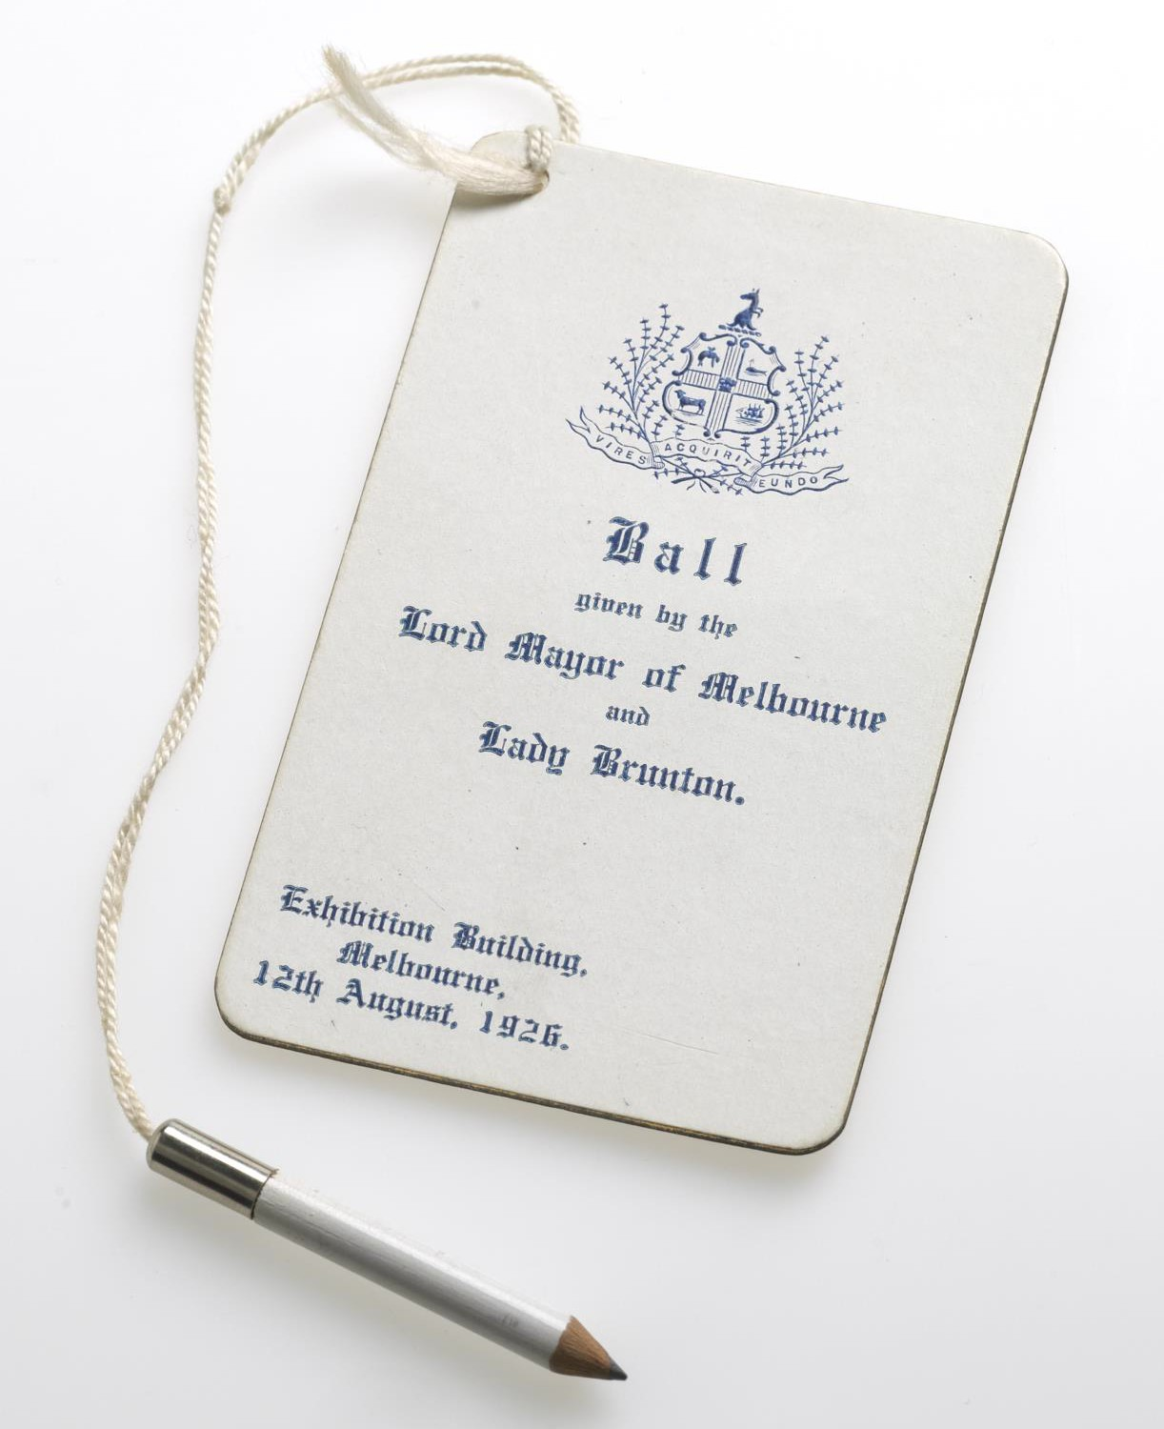
Dance card and pencil
Photographer: Michelle McFarlane

Slide 6
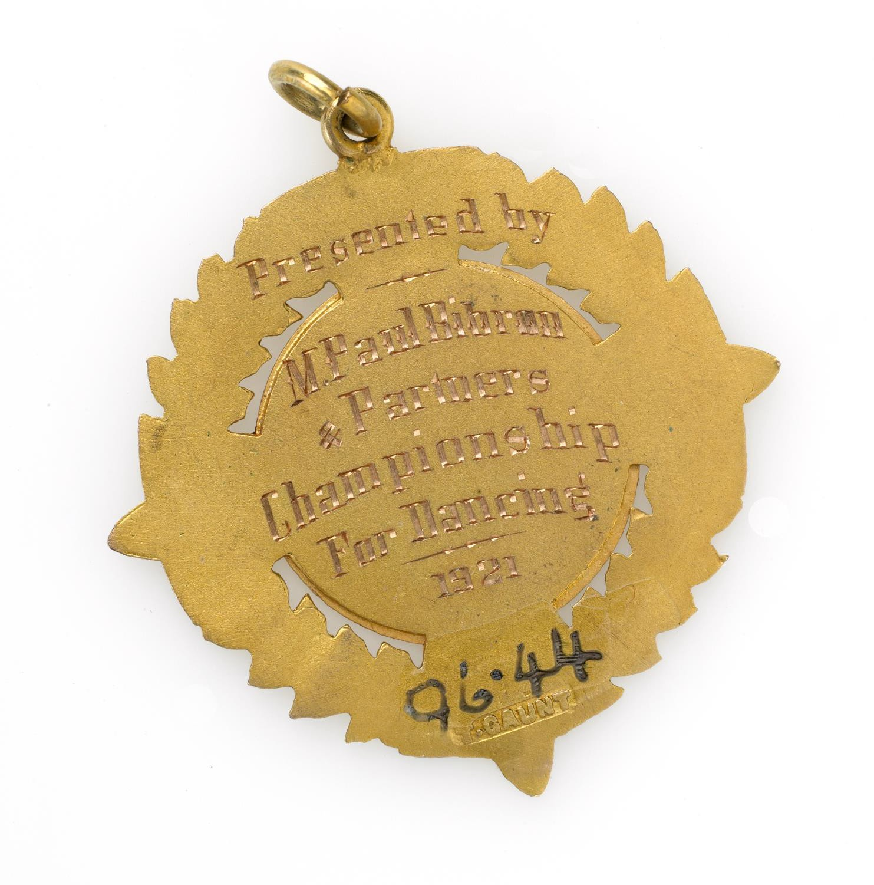
Dancing Championship Badge
Photographer: Michelle McFarlane

Slide 7
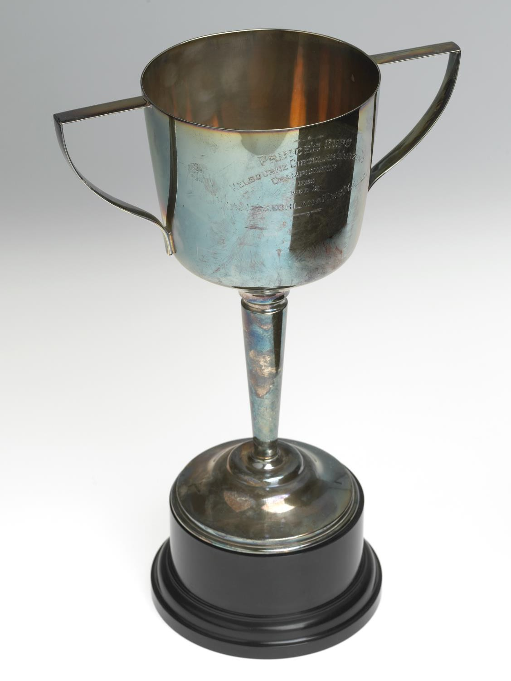
Silver plated presentation cup, Circular Waltzing Championship
Photographer: Michelle McFarlane

Slide 8
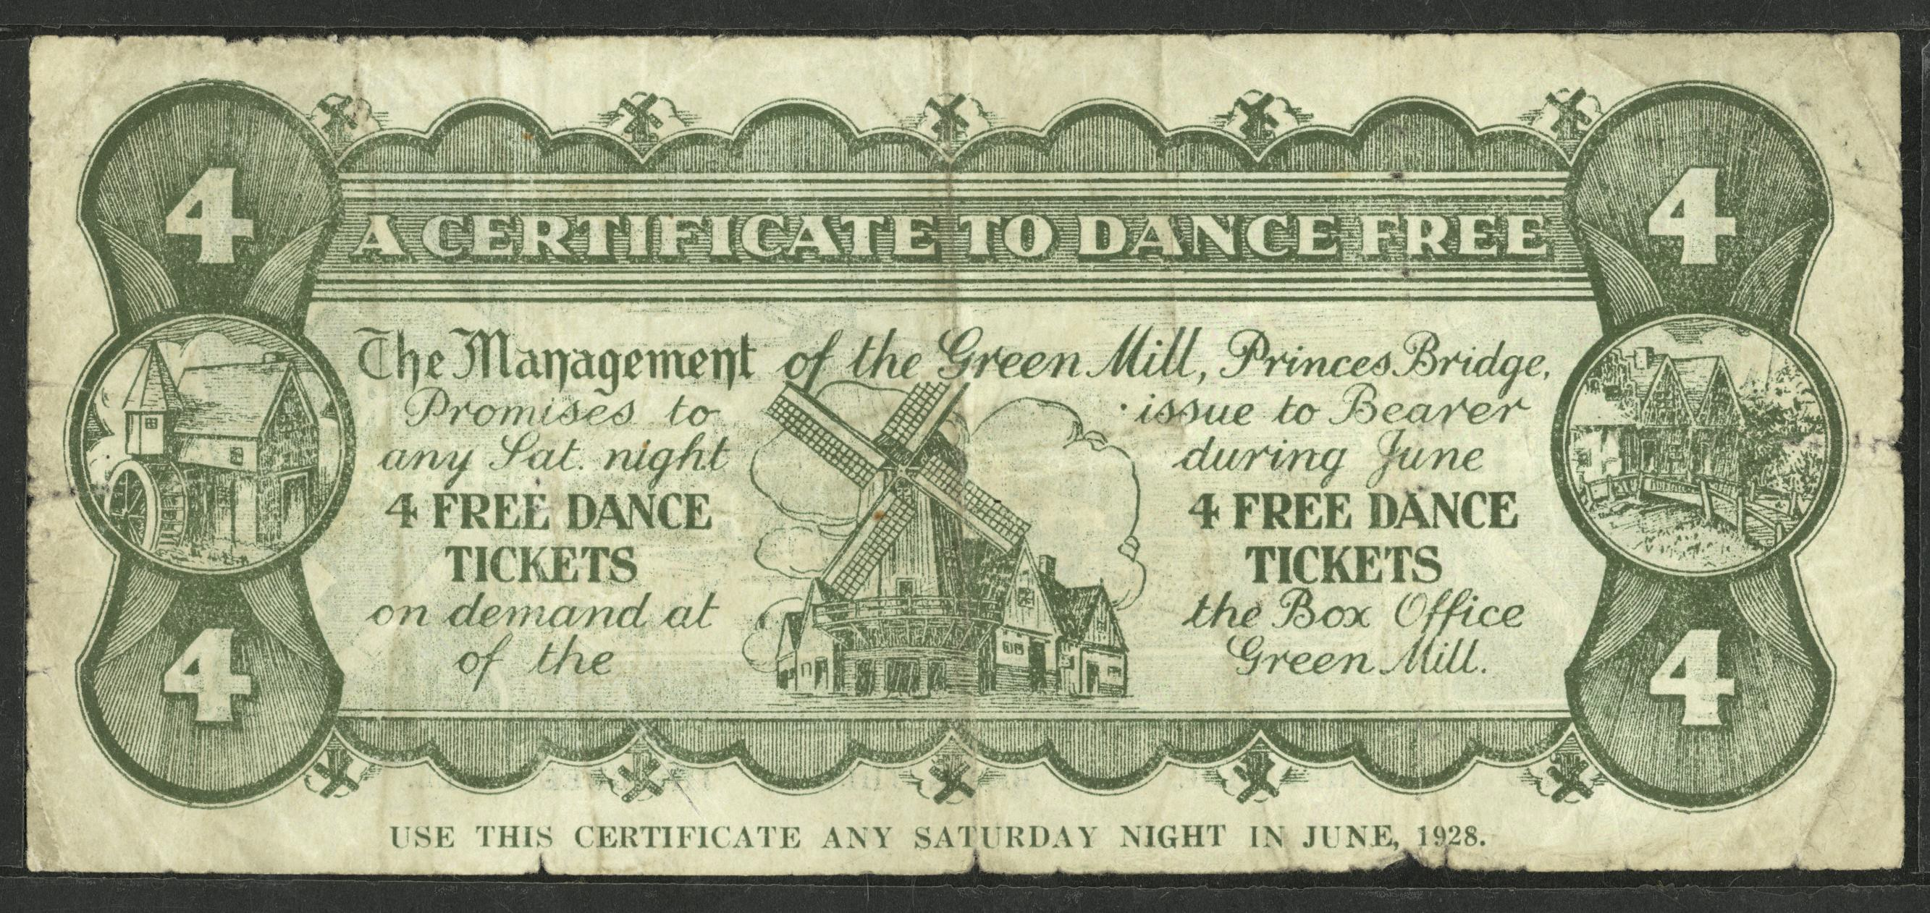
Voucher offering for Free Dancing, Melbourne, ca 1920s
Unknown creator

Slide 9
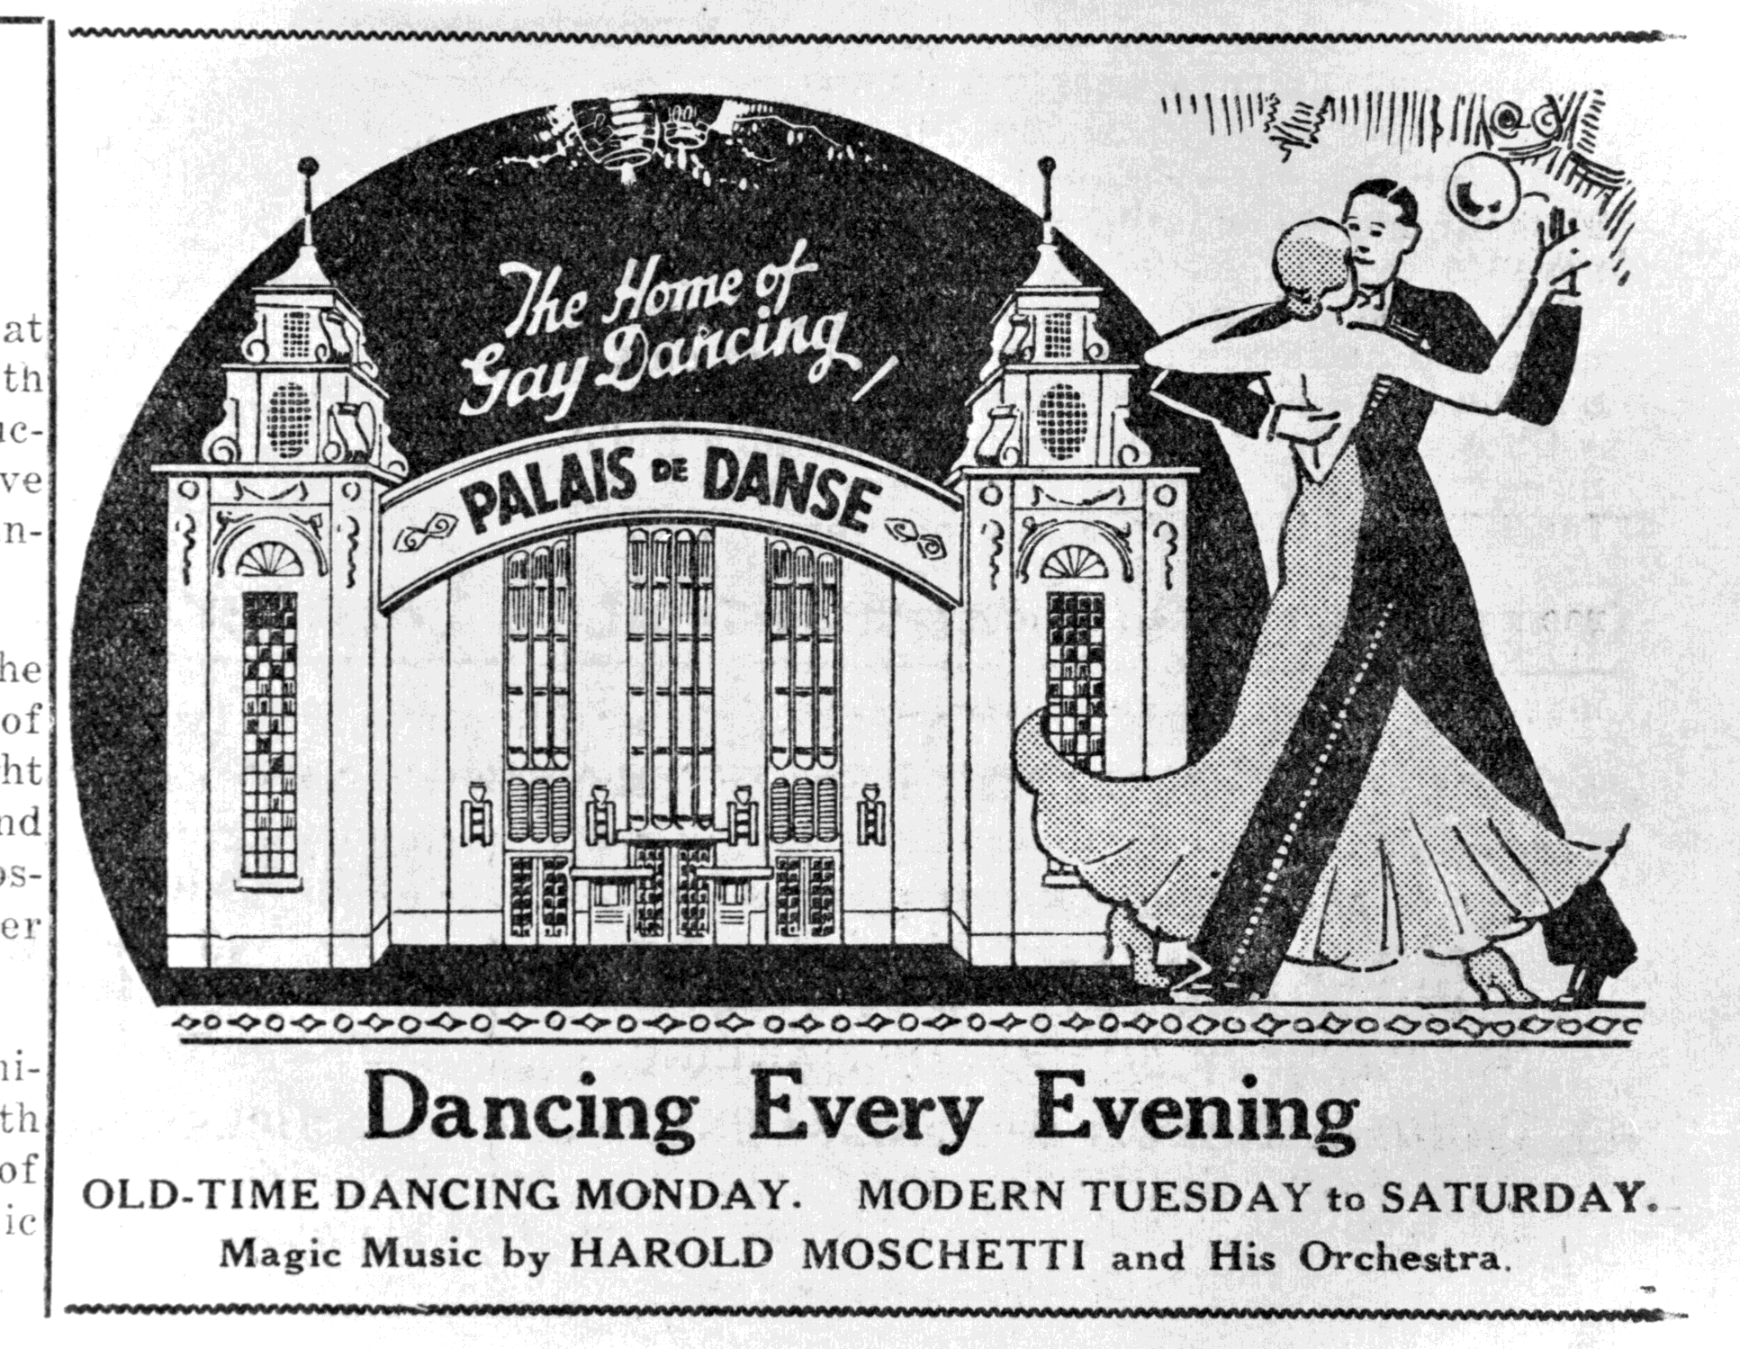
Poster Advertising Dancing at the 'Palais de Danse' Melbourne, 1920s
Unknown creator

Slide 10
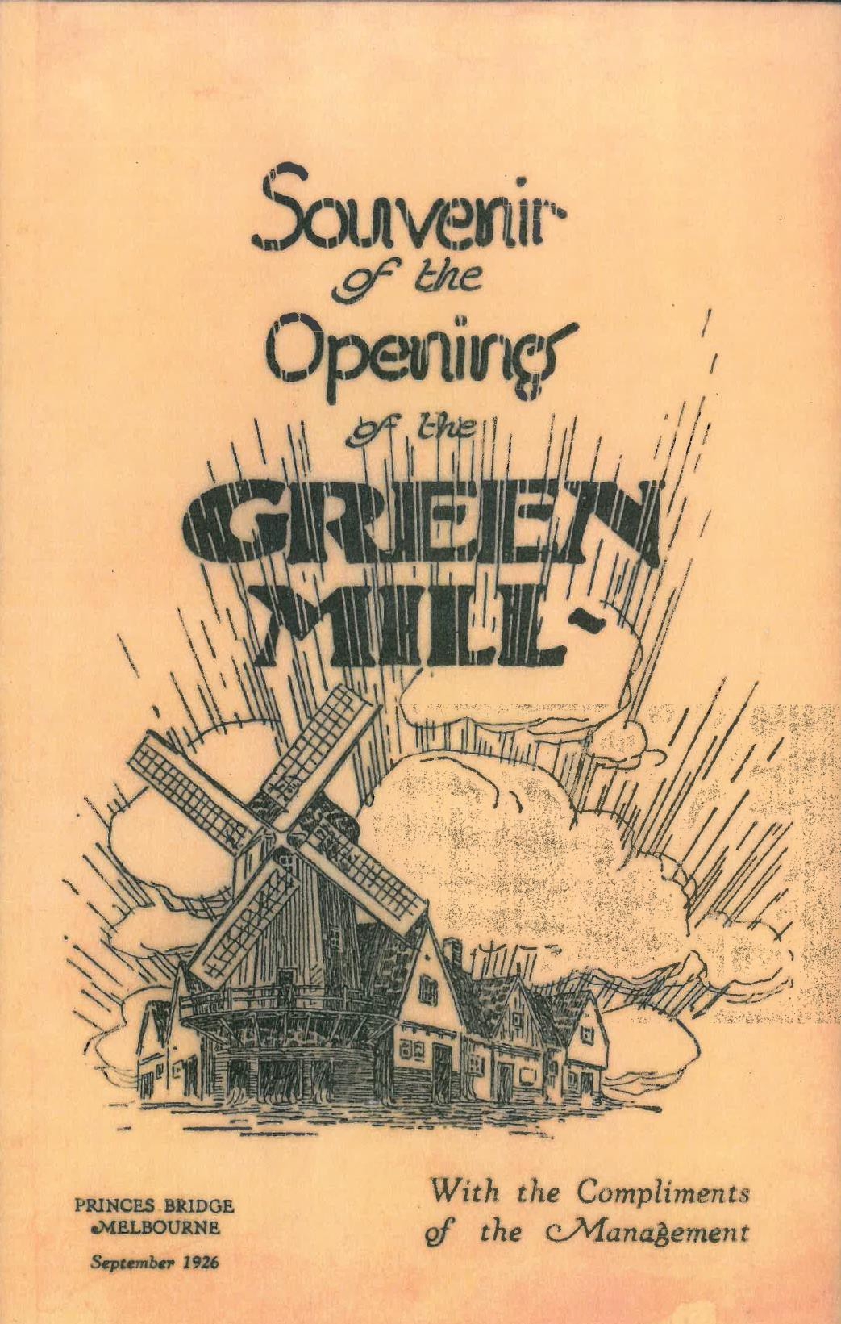
Souvenir Poster Advertising 'The Green Mill' Dancehall, Melbourne, 1926
Unknown creator

Slide 11
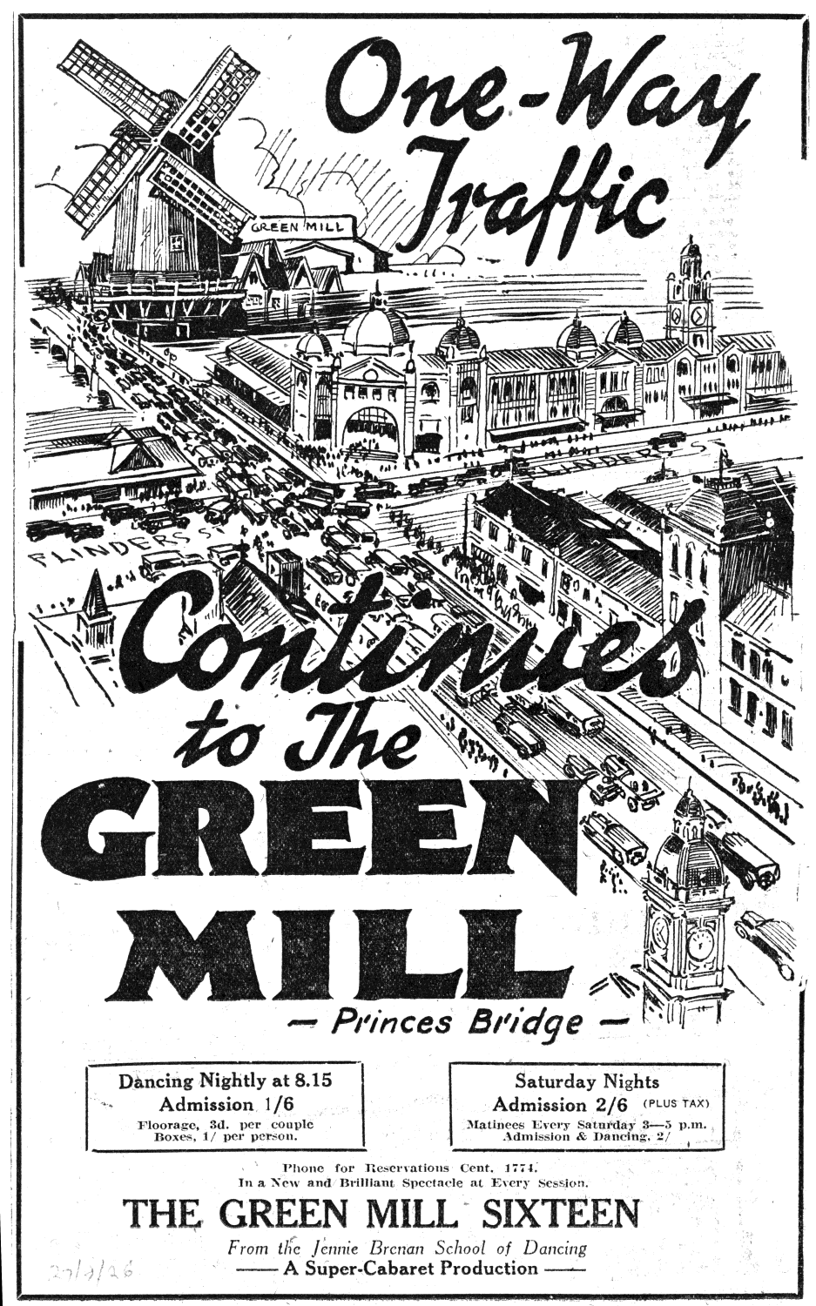
Poster Advertising 'The Green Mill' Dancehall, Melbourne
Unknown creator

Slide 12
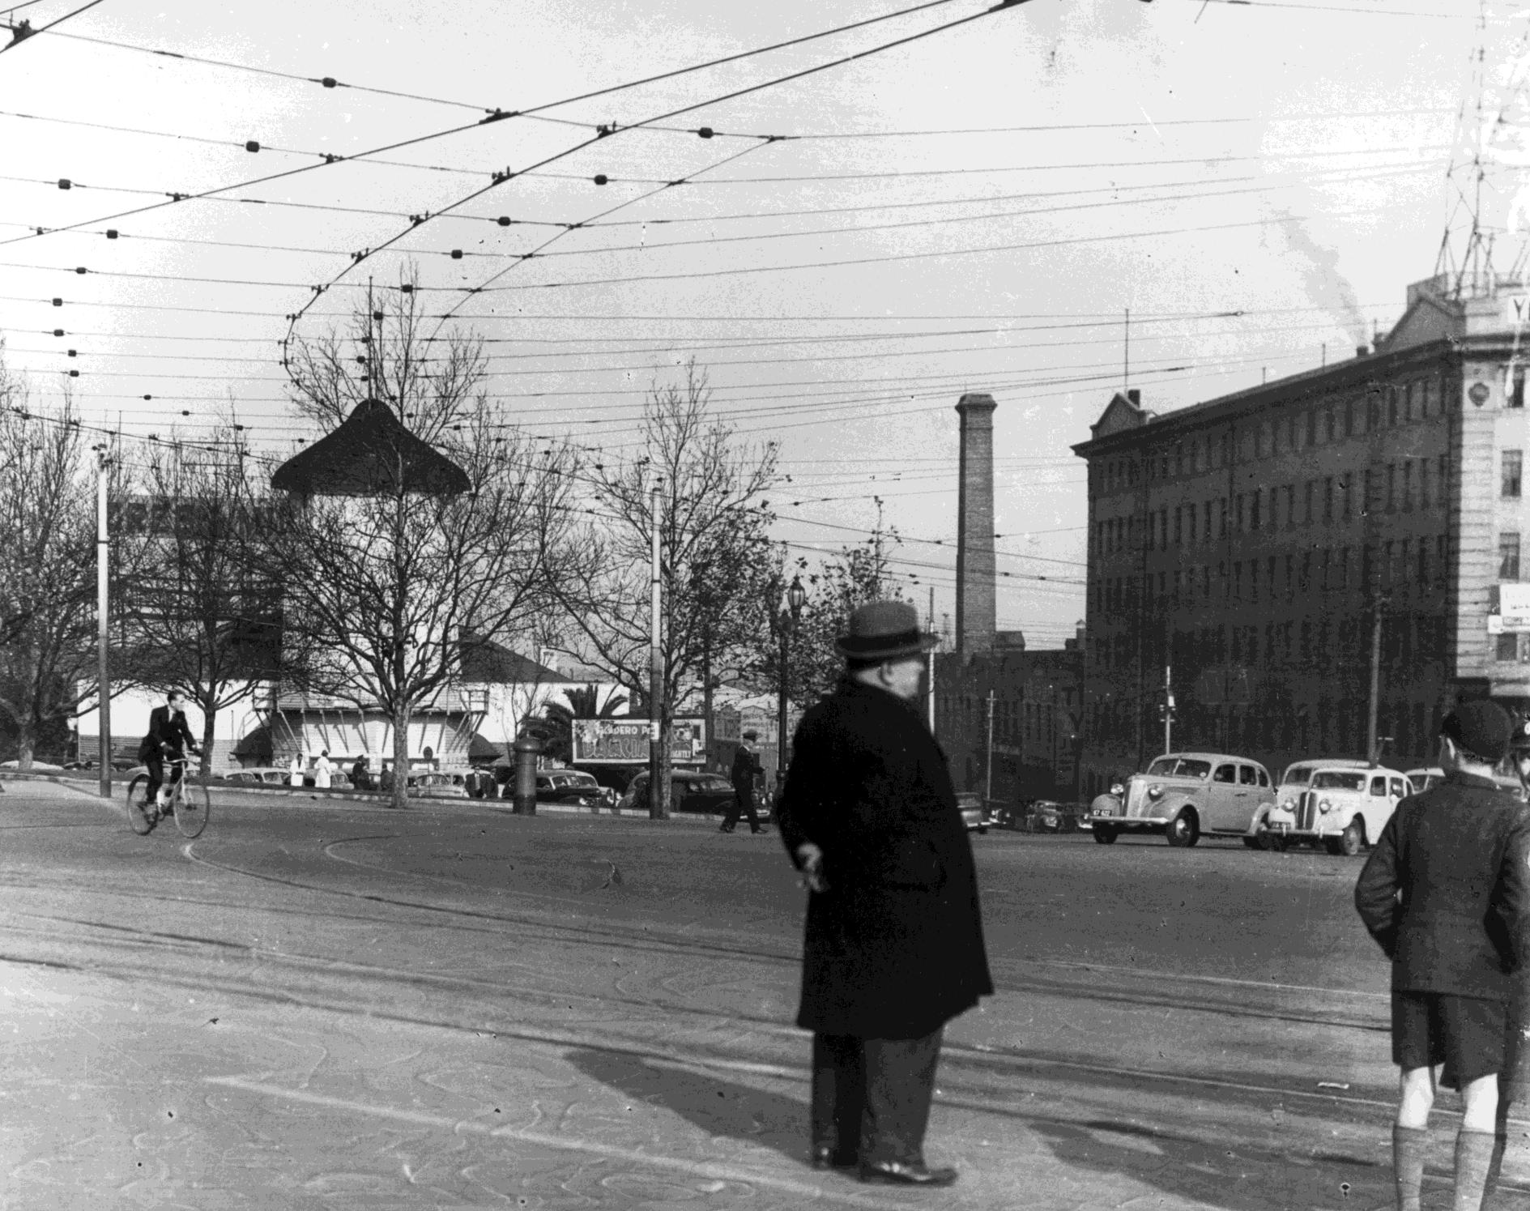
Trocadero Dancehall exterior, Melbourne, late- 1940s
Photographer: Julie Millowick

Slide 13
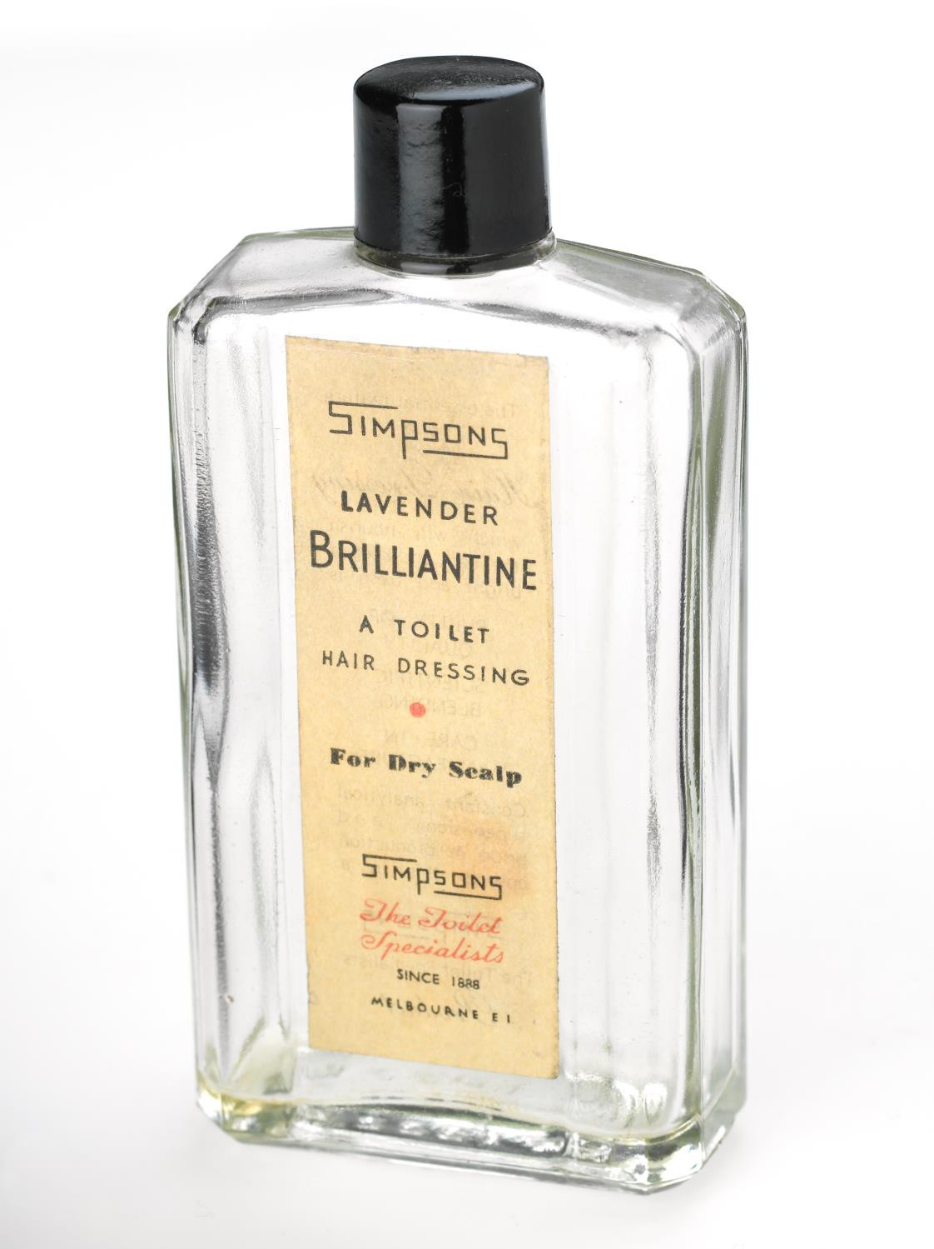
Lavender Brilliantine Bottle Simpsons, 1940s
Photographer: unknown

Slide 14
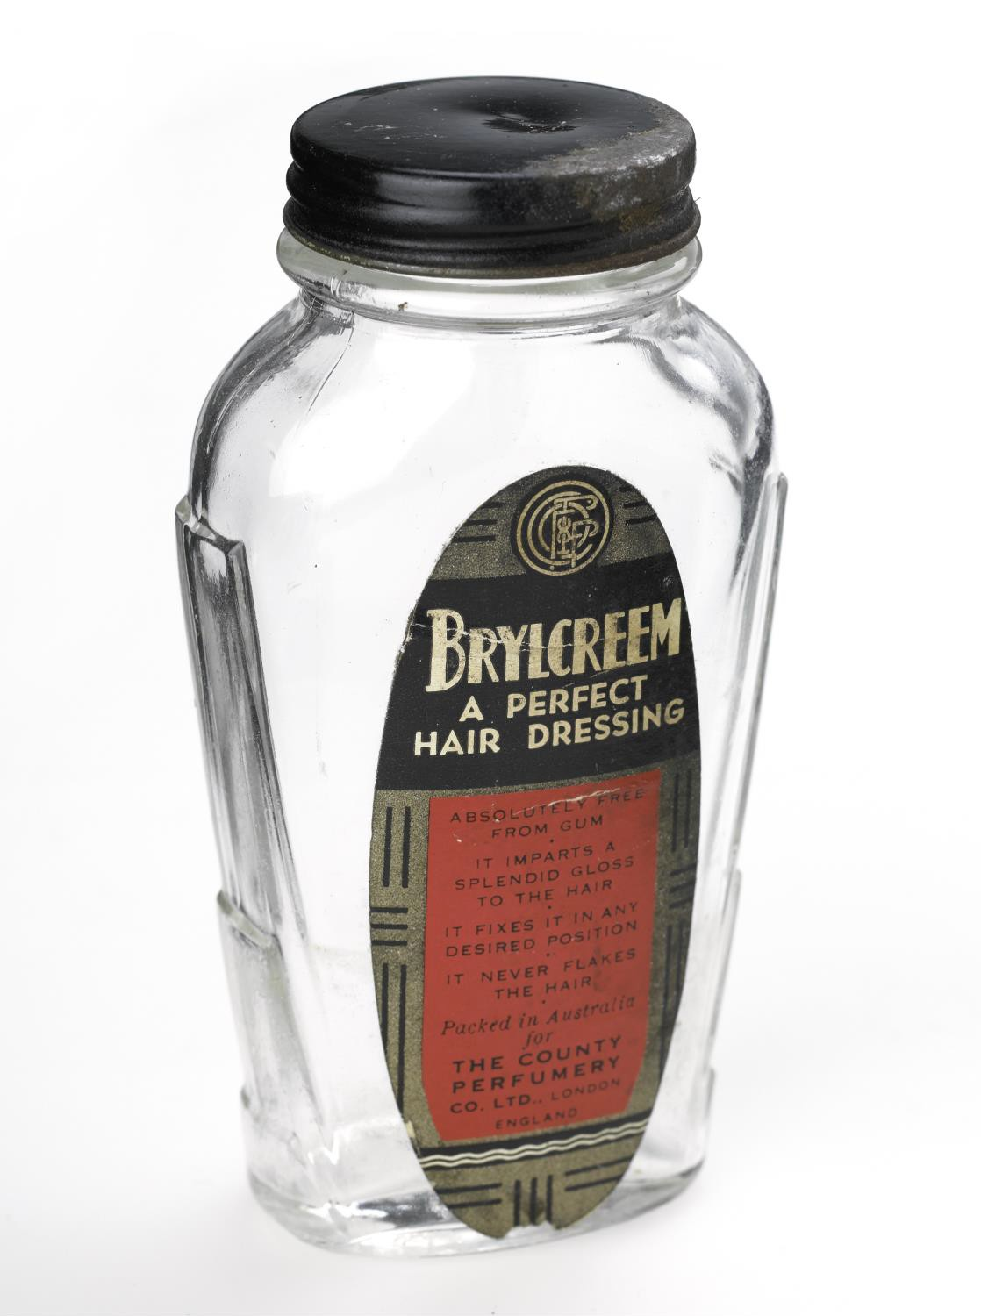
Brylcreem hair dressing jar
Photographer: unknown

Slide 15
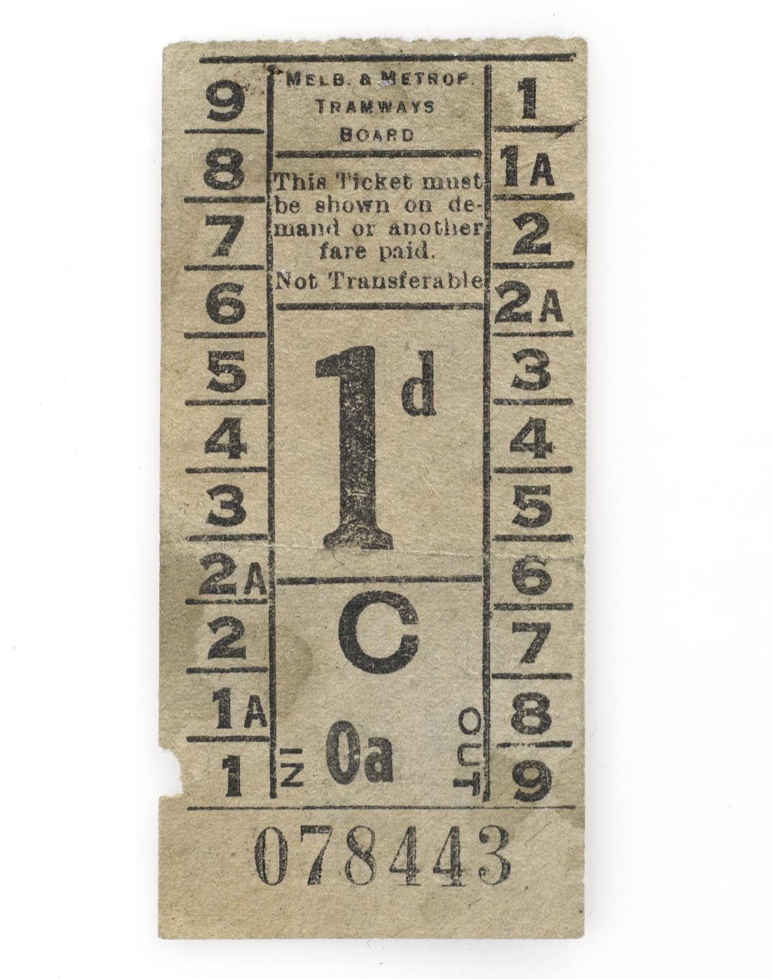
Ticket-Tram 1d
Photographer: unknown

Slide 16
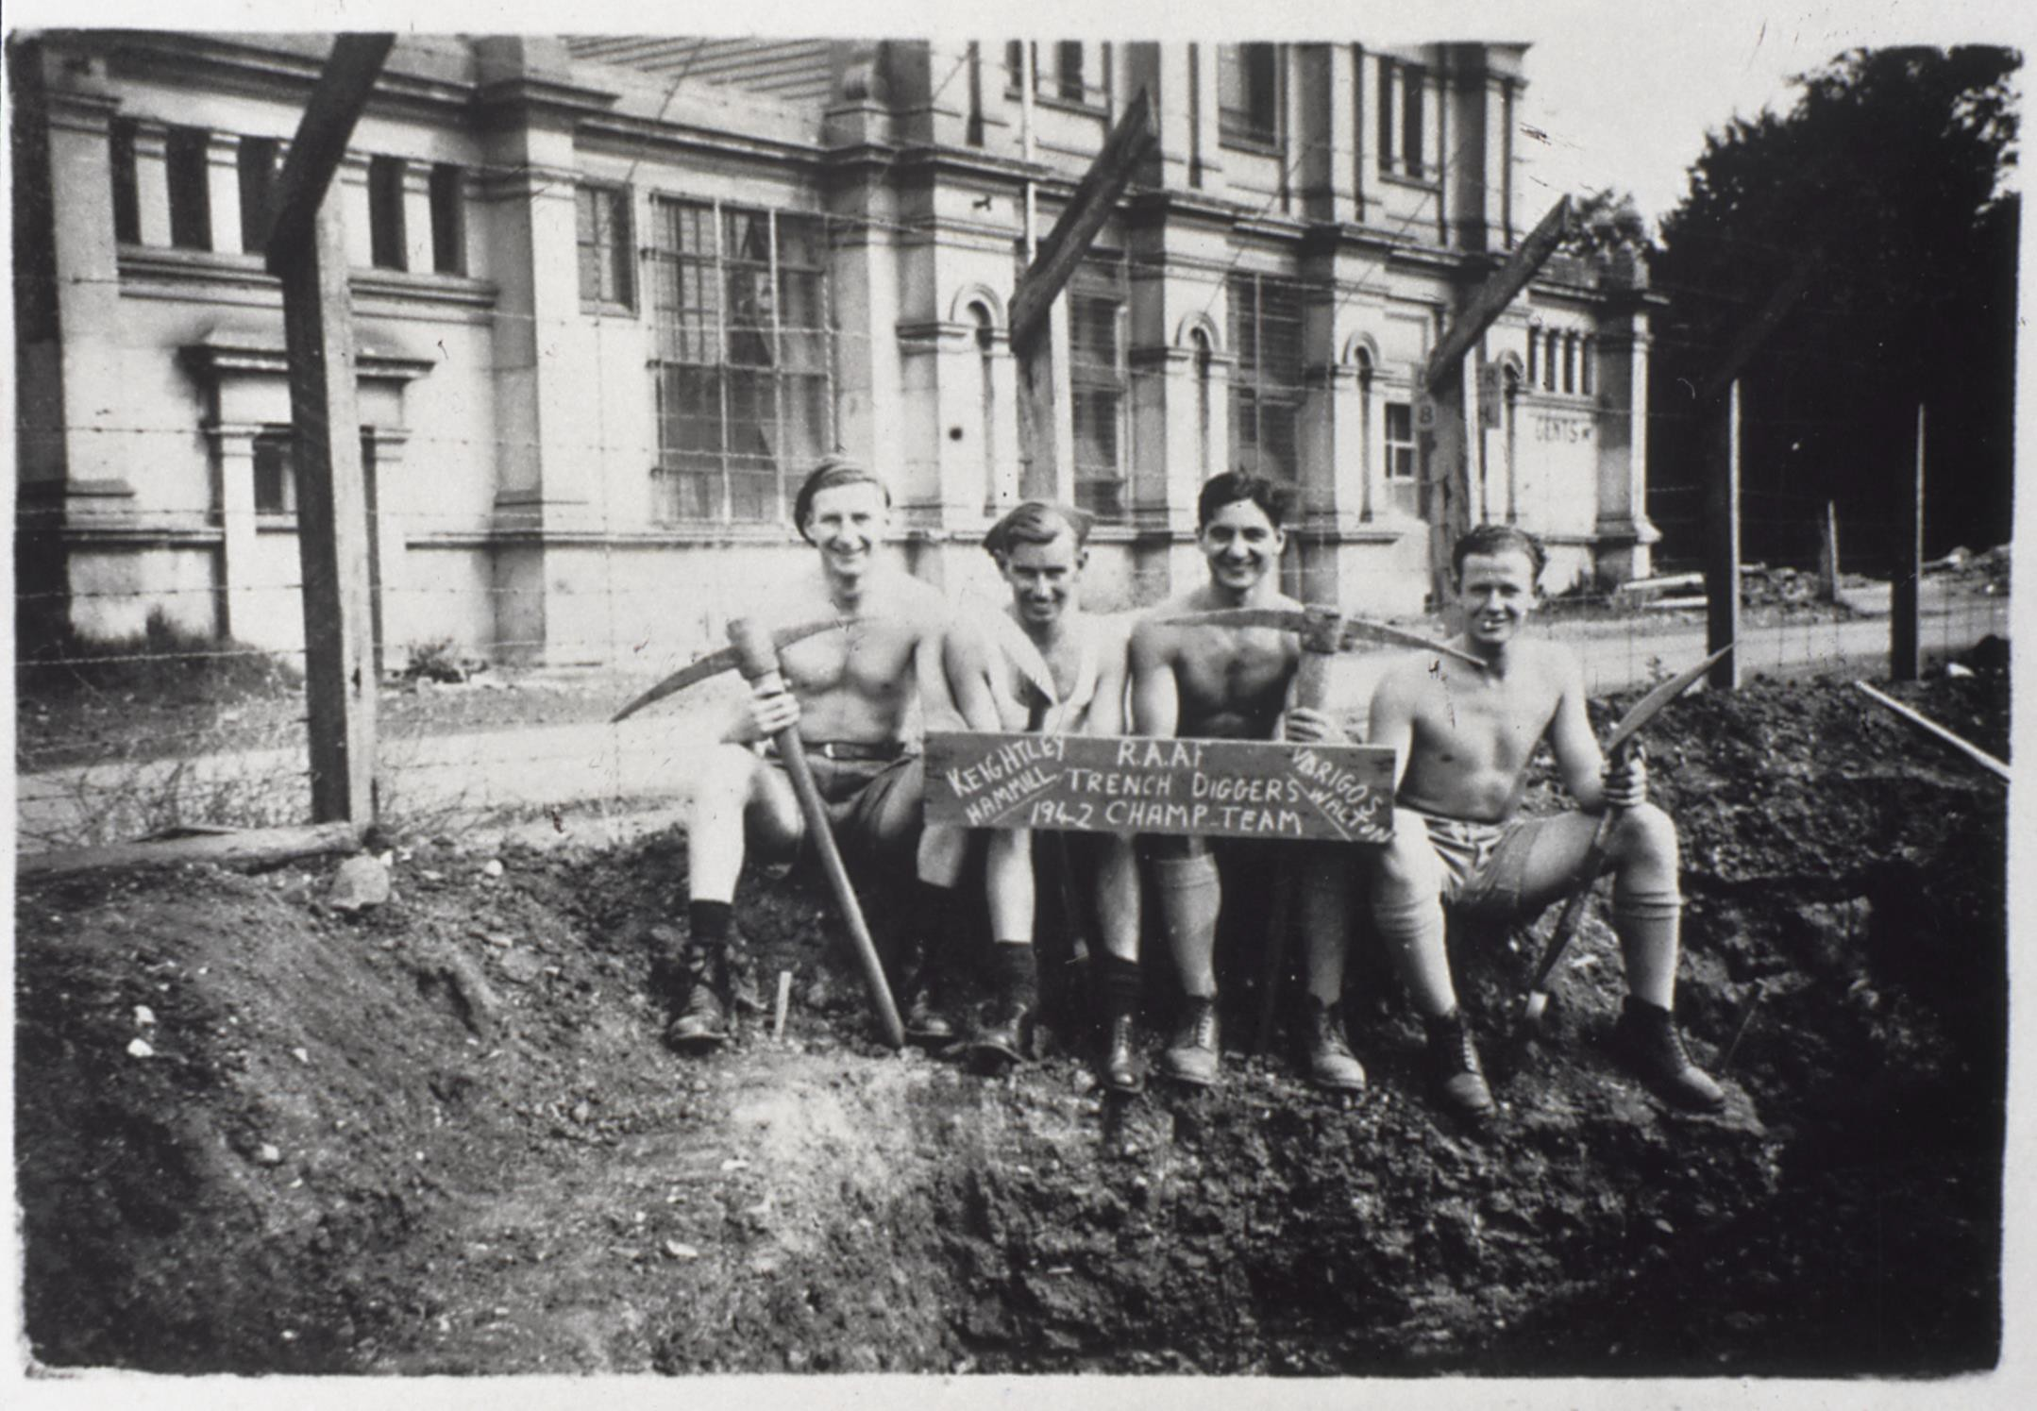
'RAAF Trench Diggers Champ Team': Royal Exhibition Building
Photographer: unknown

Slide 17
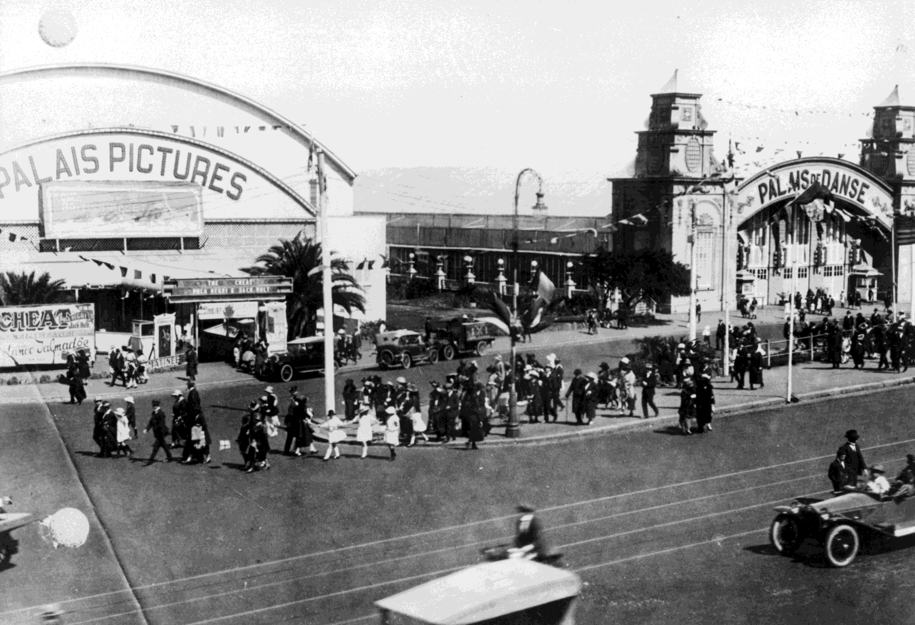
Street-view of Palais Pictures and Palais de Danse, Melbourne
Photographer: unknown

Slide 18
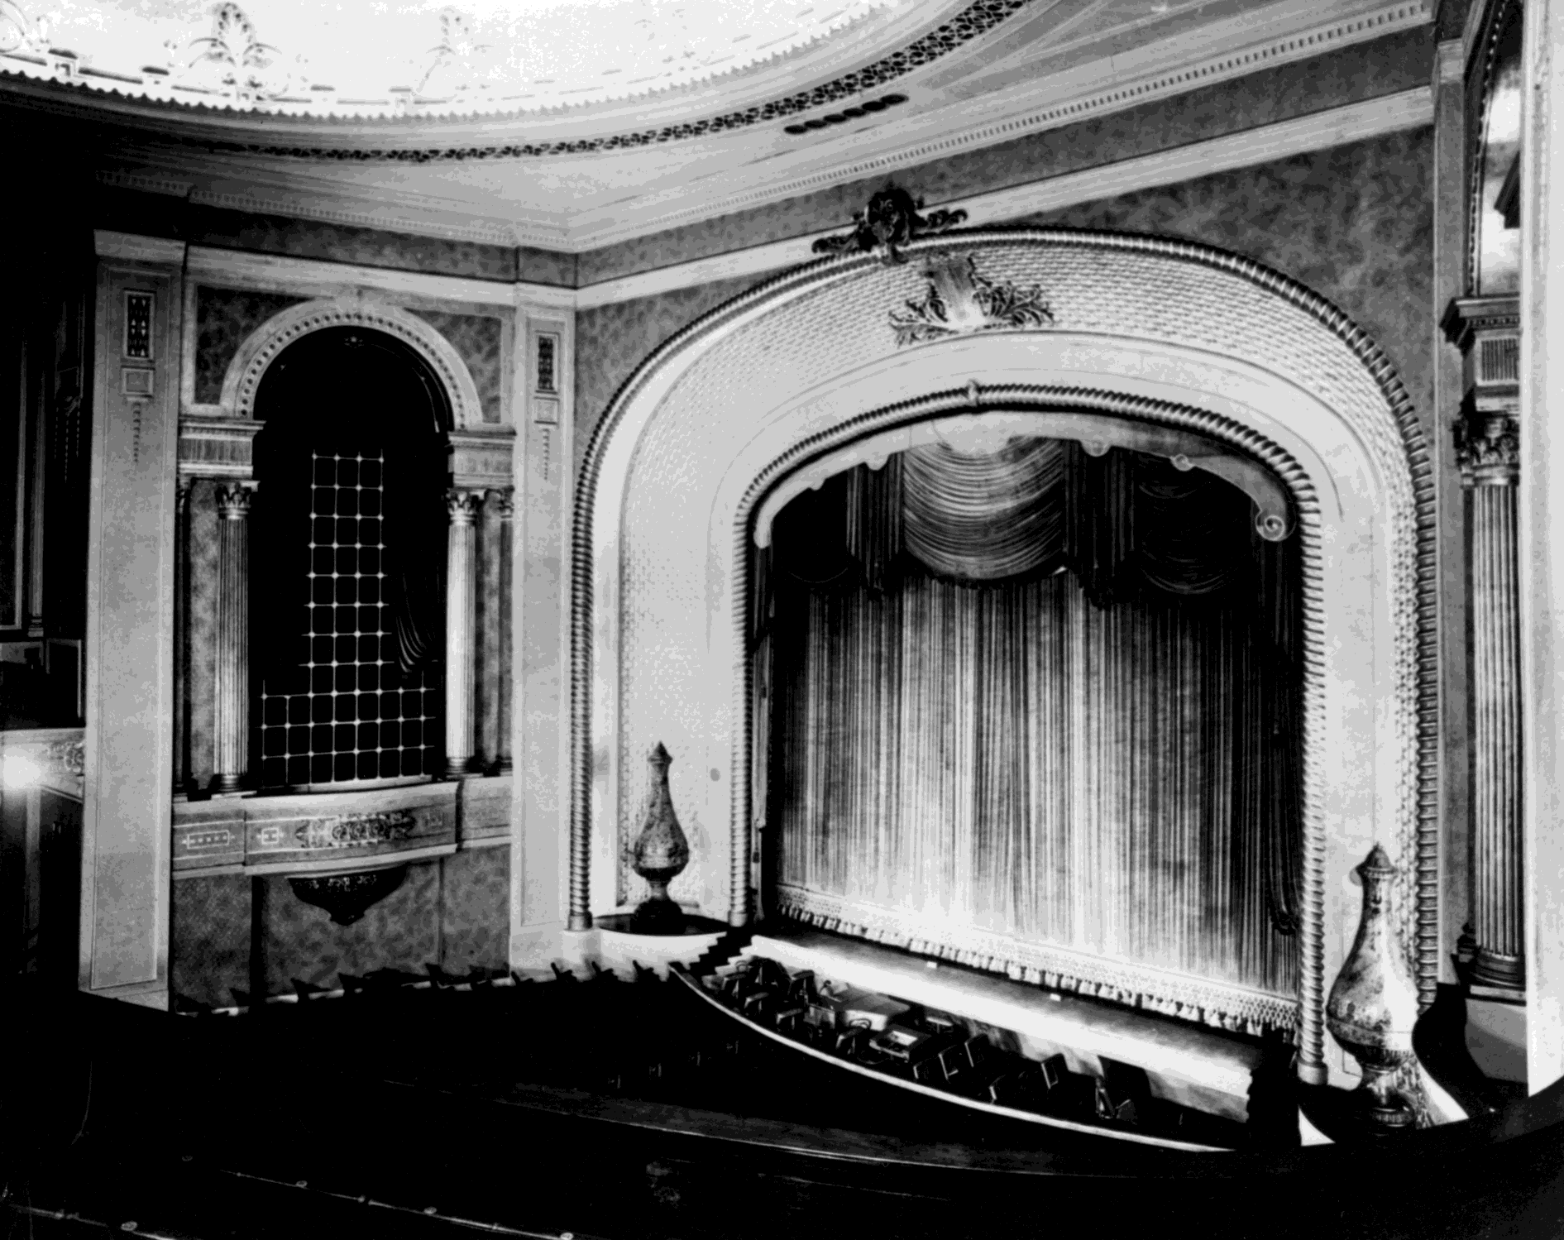
Interior showing curtain and band pit at the Palais Theatre in St.
Kilda 1920s
Photographer: unknown

Slide 19
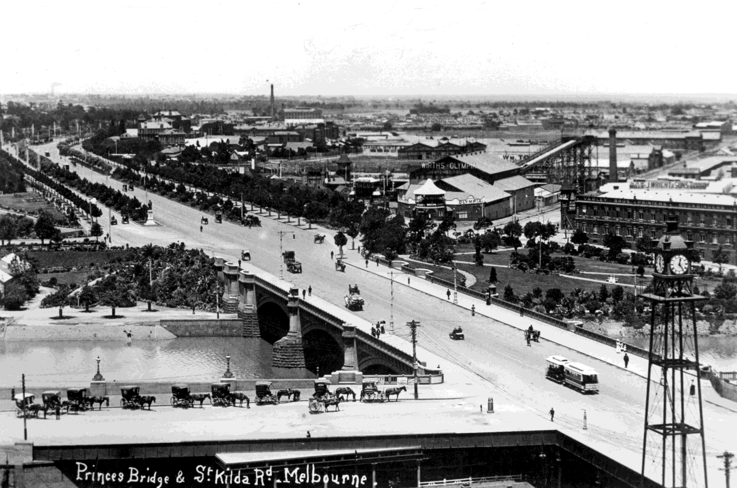
Wirths
Olympia. Princes
Bridge and St Kilda Road, Melbourne
Early 1900s
Photographer: unknown

Slide 20
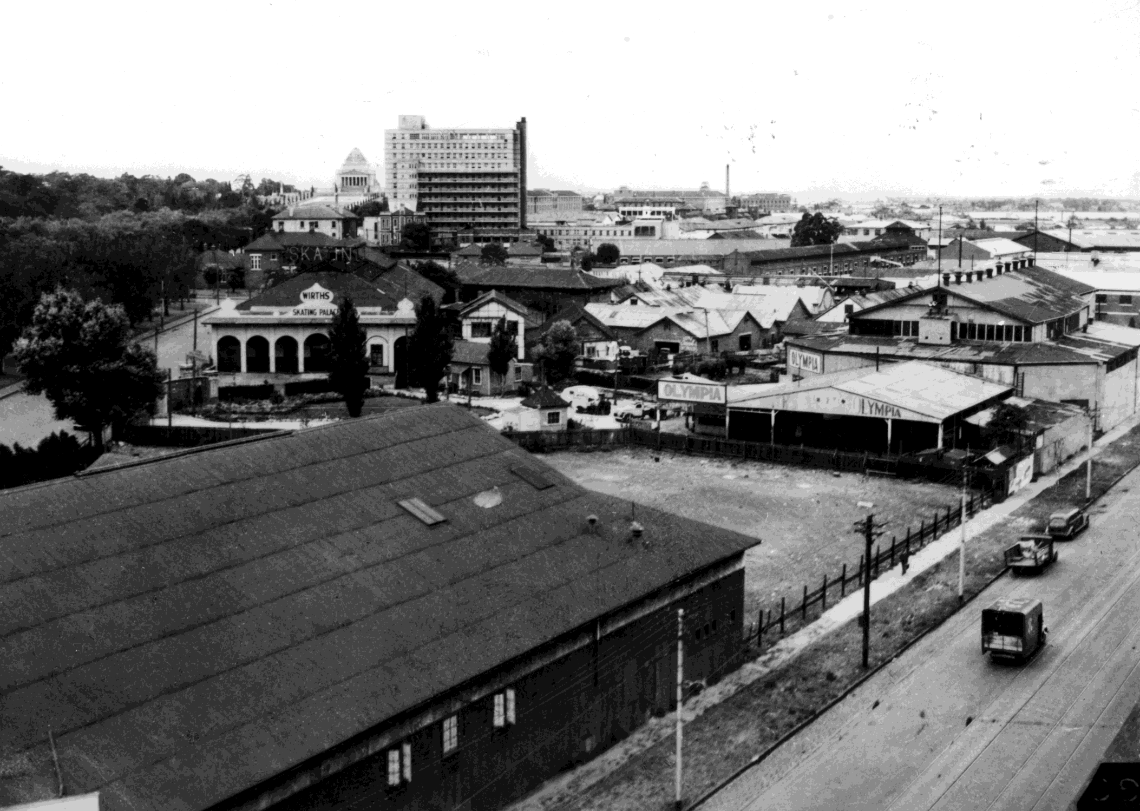
Wirths Skating Palace
St Kilda Road with the Shrine in the distance
Photographer: unknown

Slide 21
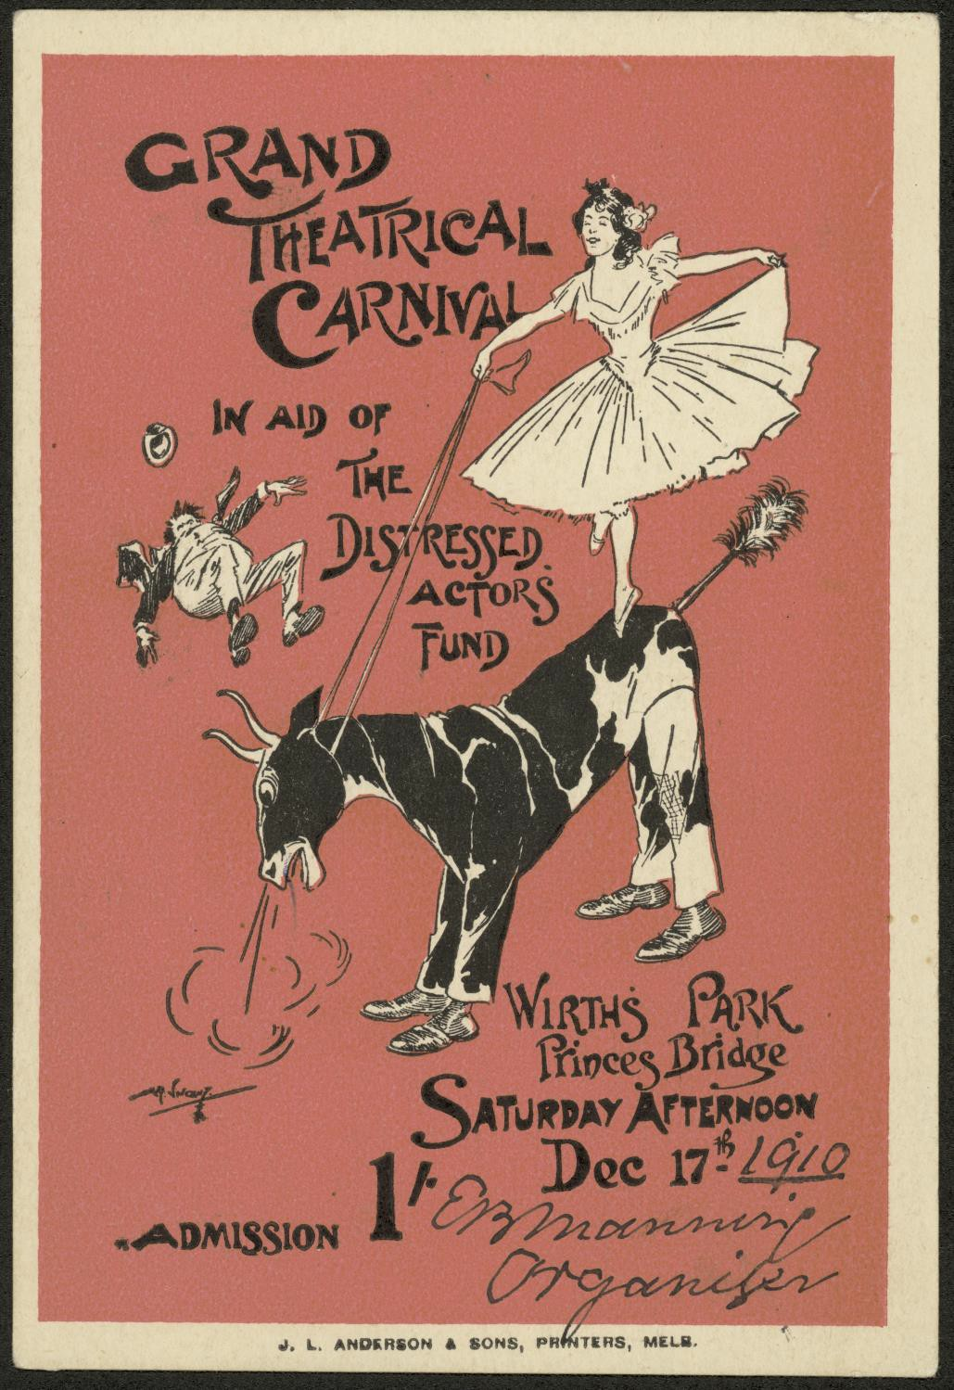
“Grand Theatrical Carnival in aid of the Distressed Actor’s Fund.” Promotional Flyer
Creator: unknown

Slide 22
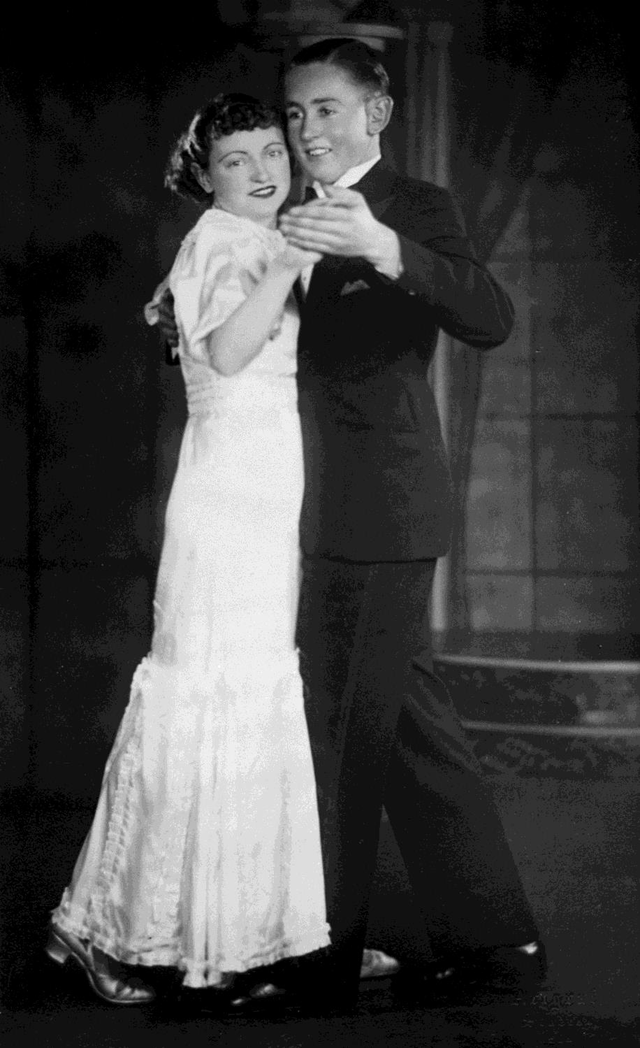
A man and a woman dancing
By Sally Rogers-Davidson

Slide 23
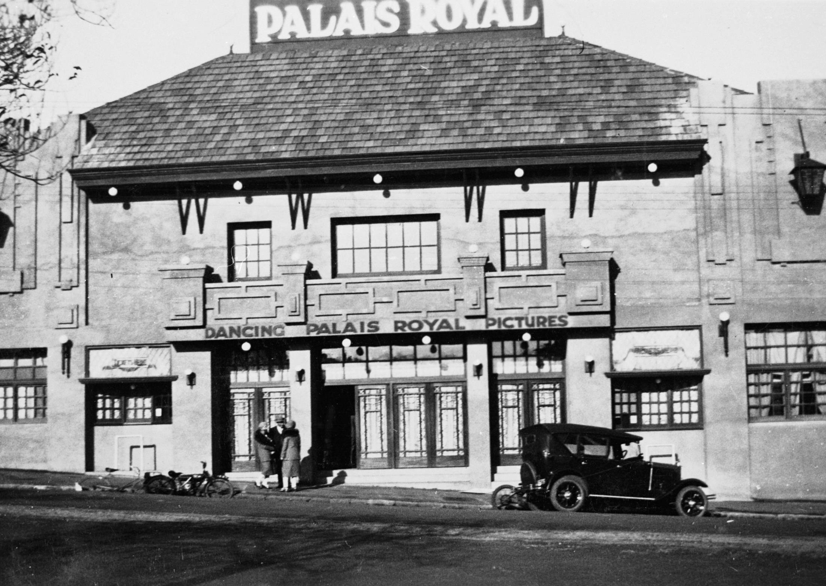
The Palais Royal Theatre, advertising dancing and pictures in Geelong.
Photographer: unknown

Slide 24
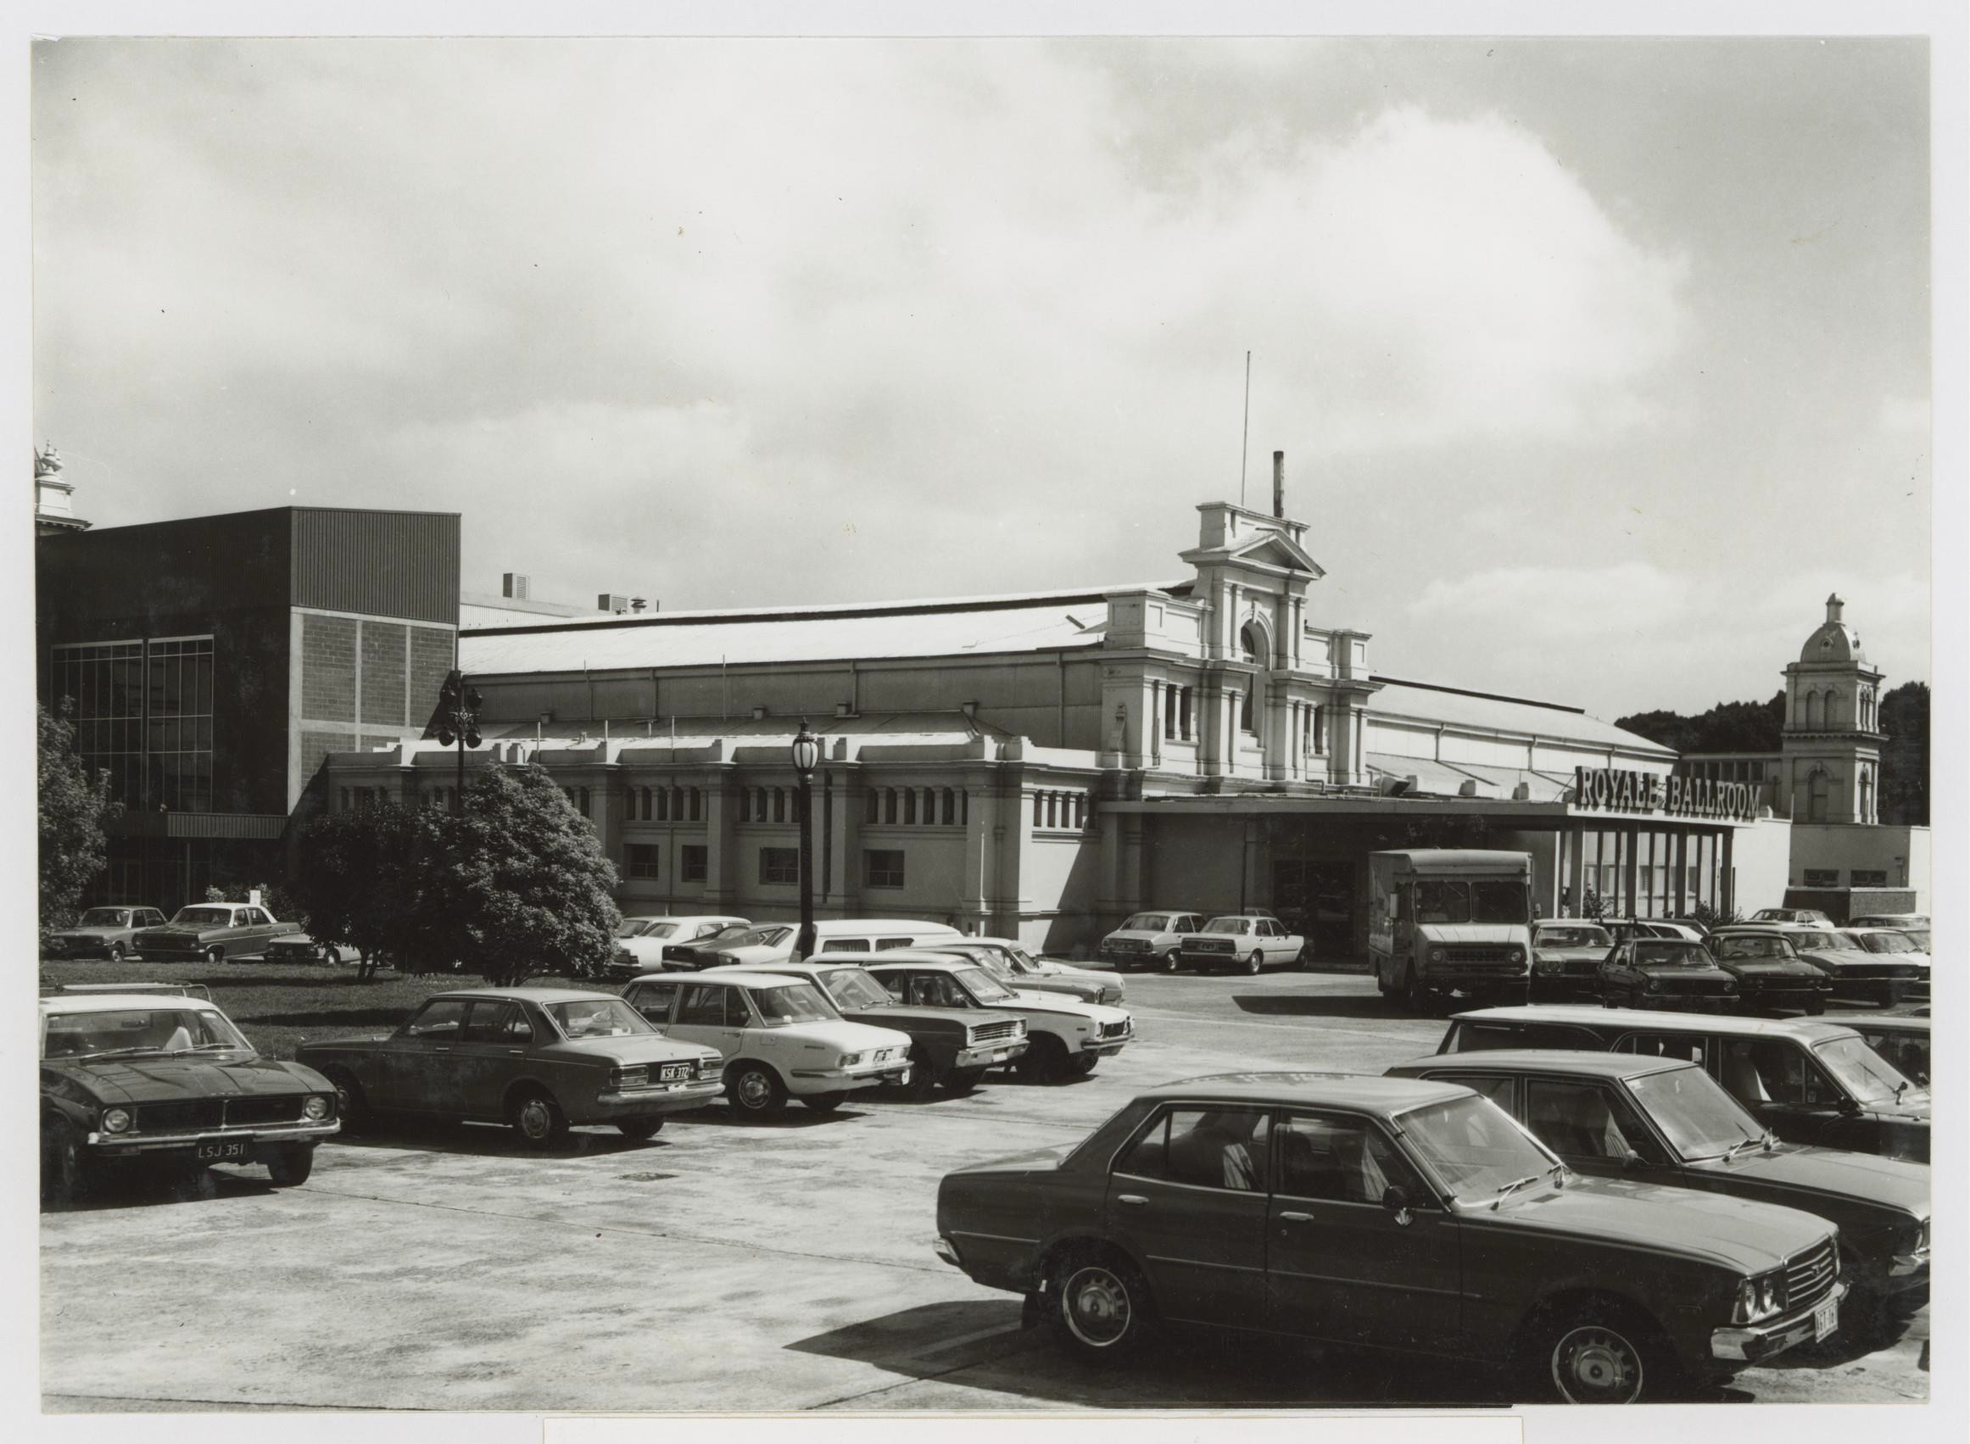
Royale Ballroom from Nicholson Street, Exhibition Building, Melbourne
Photographer: unknown

Slide 25
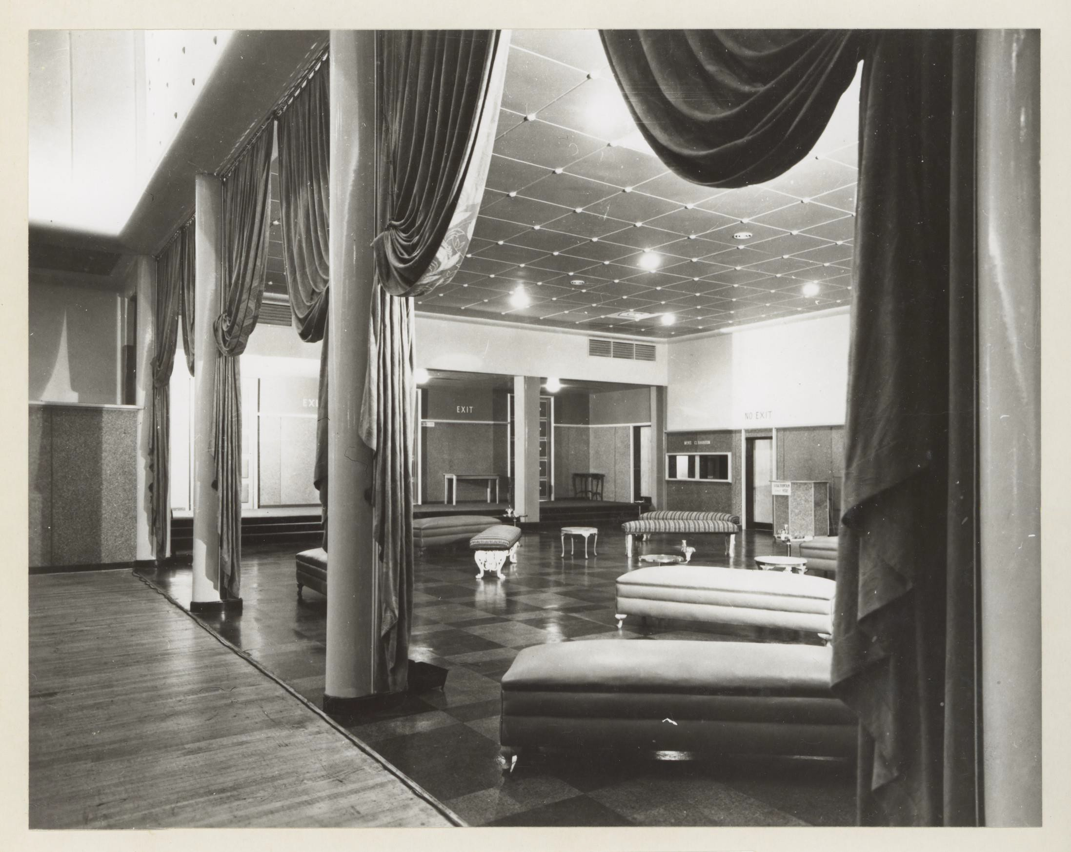
Foyer and Small Hall of Royale Ballroom, Royal Exhibition Building, Melbourne, 1952
Photographer: unknown

Slide 26
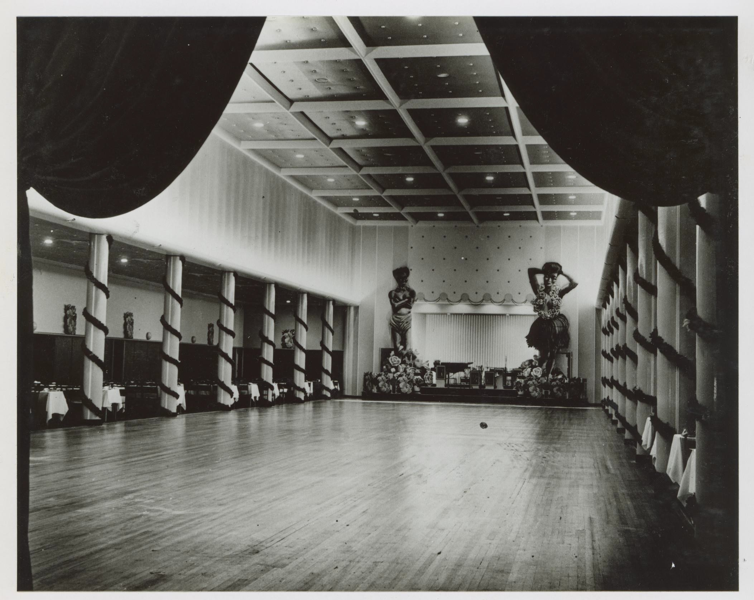
Interior of Royale Ballroom, Exhibition Building
Photographer: unknown

Slide 27
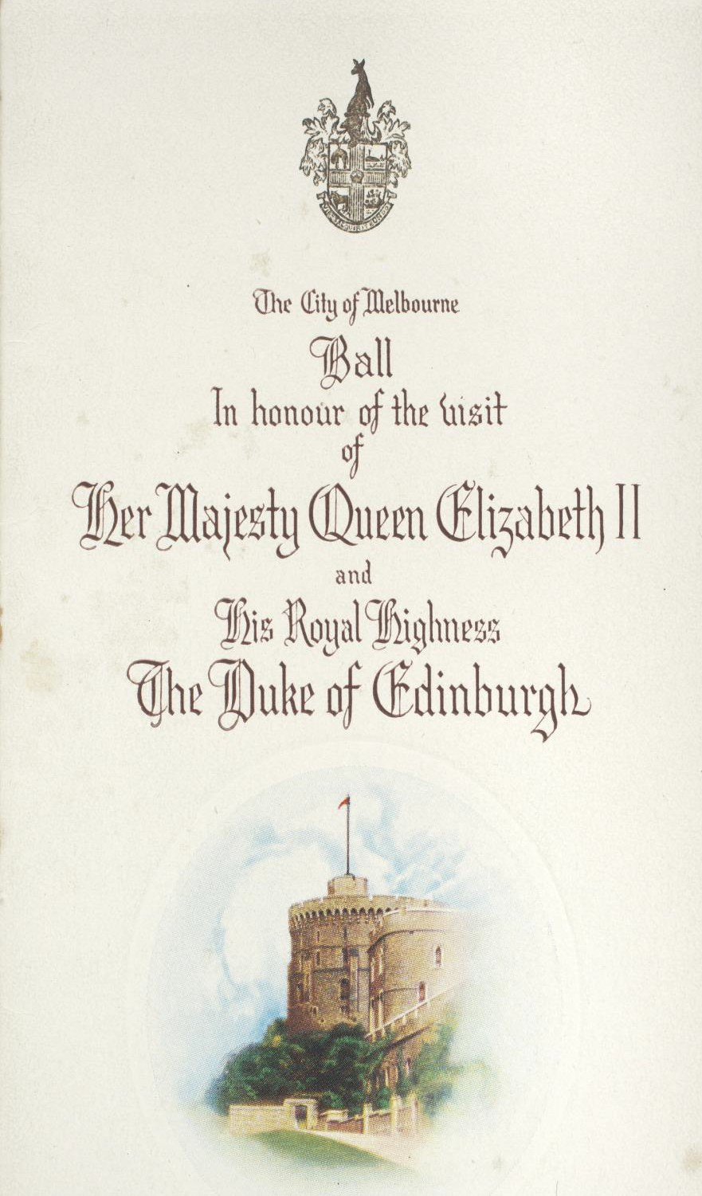
Programme for a Ball held by The City of Melbourne, in honour of the visit of Her Majesty Queen Elizabeth II and His Royal Highness The Duke of Edinburgh, March 2, 1954, at the Exhibition Building, Melbourne
Creator: unknown

Slide 28
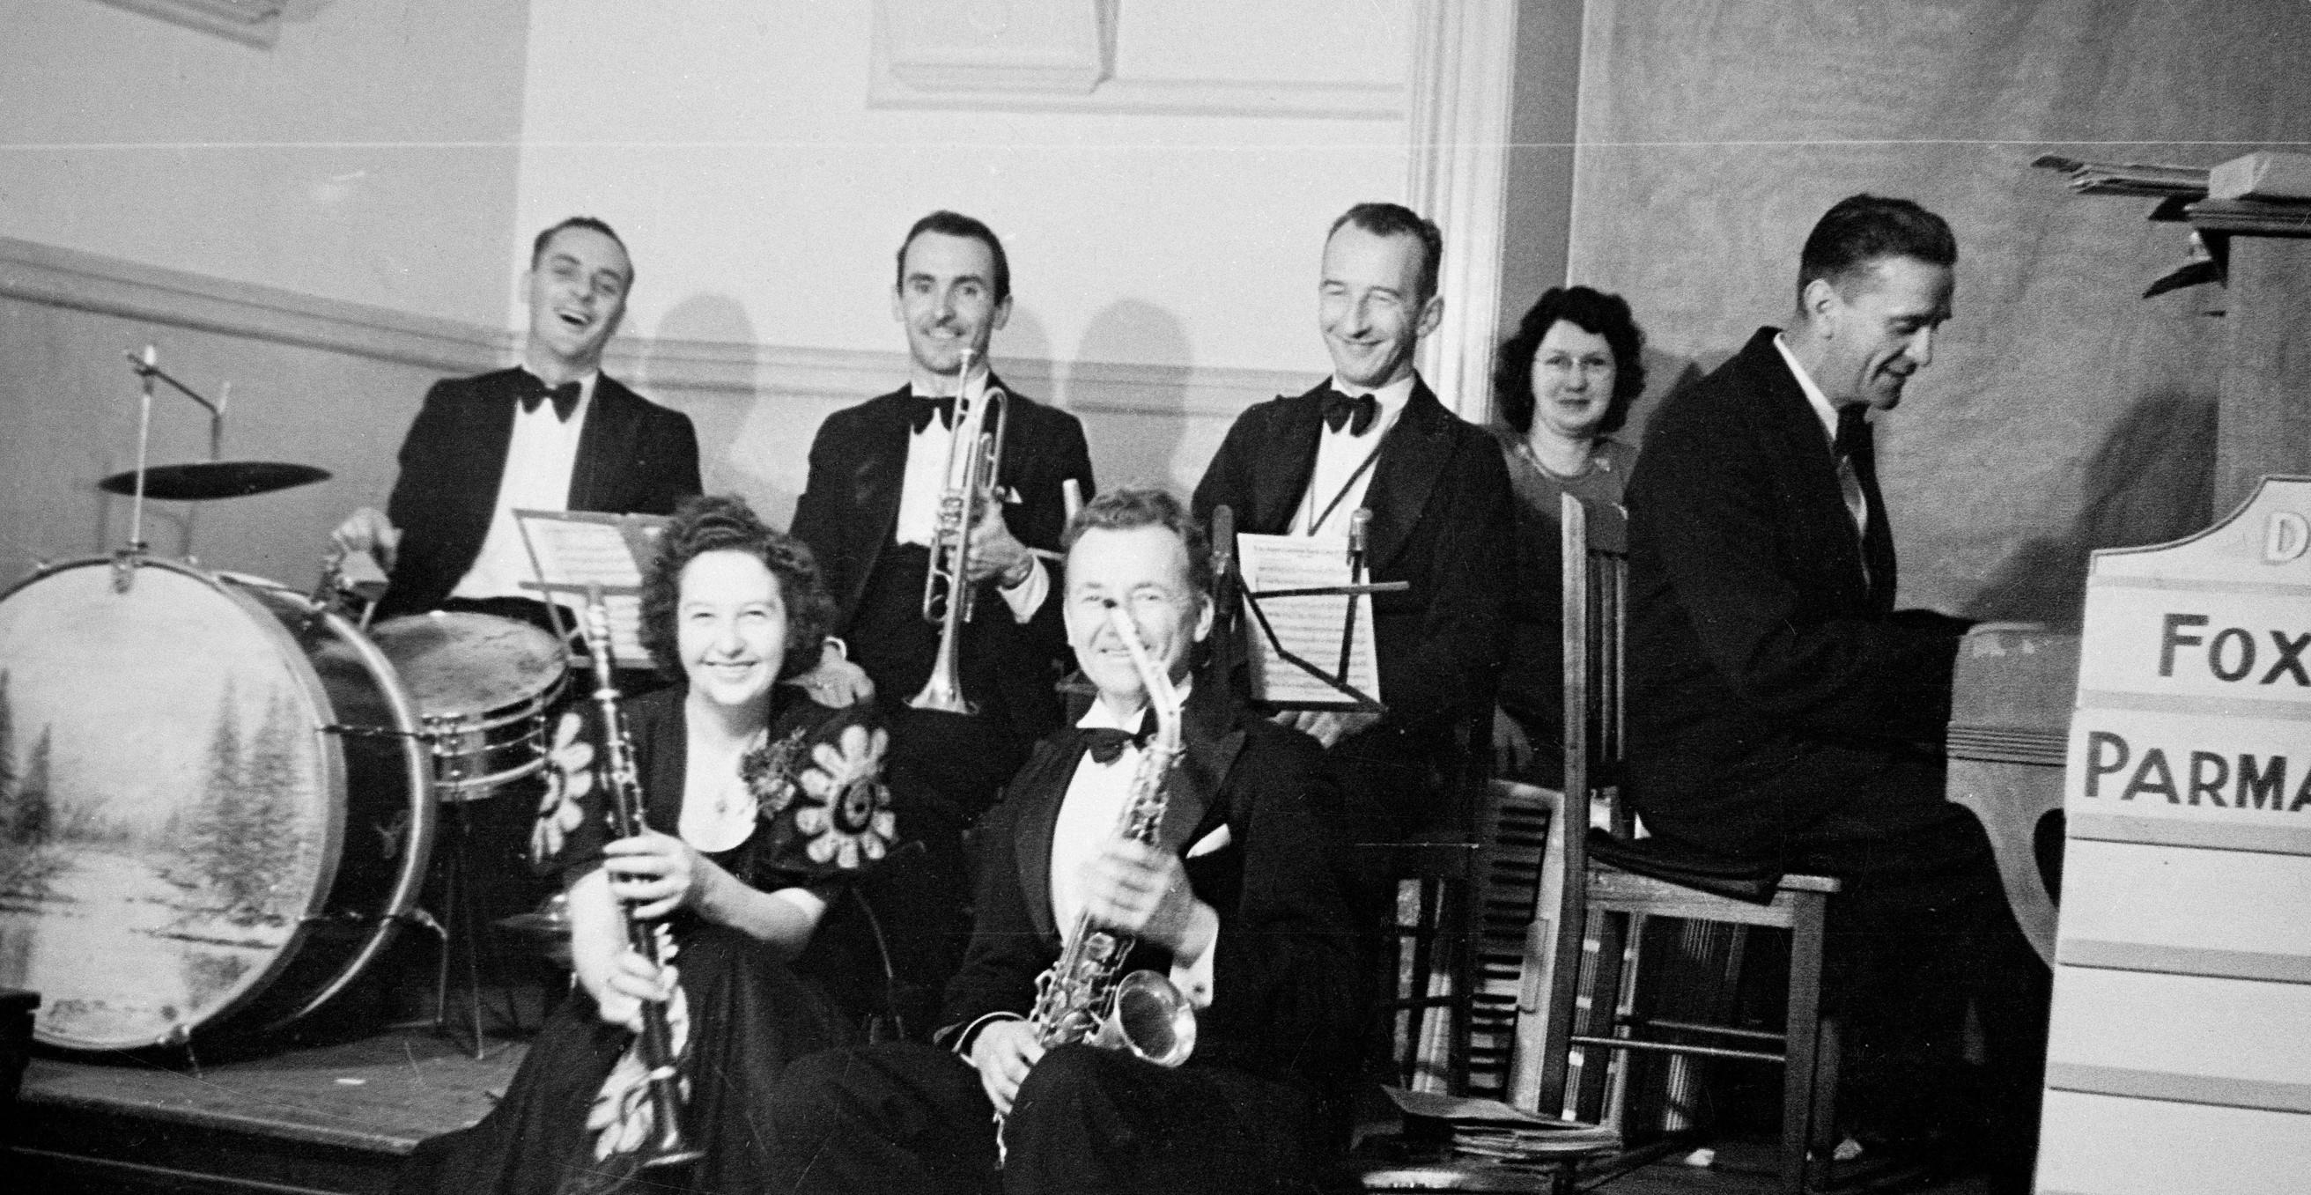
Members of a dance band. Instruments include: piano, drums, clarinet, saxophone and trumpet.
By:
Sally Rogers-Davidson

Slide 29
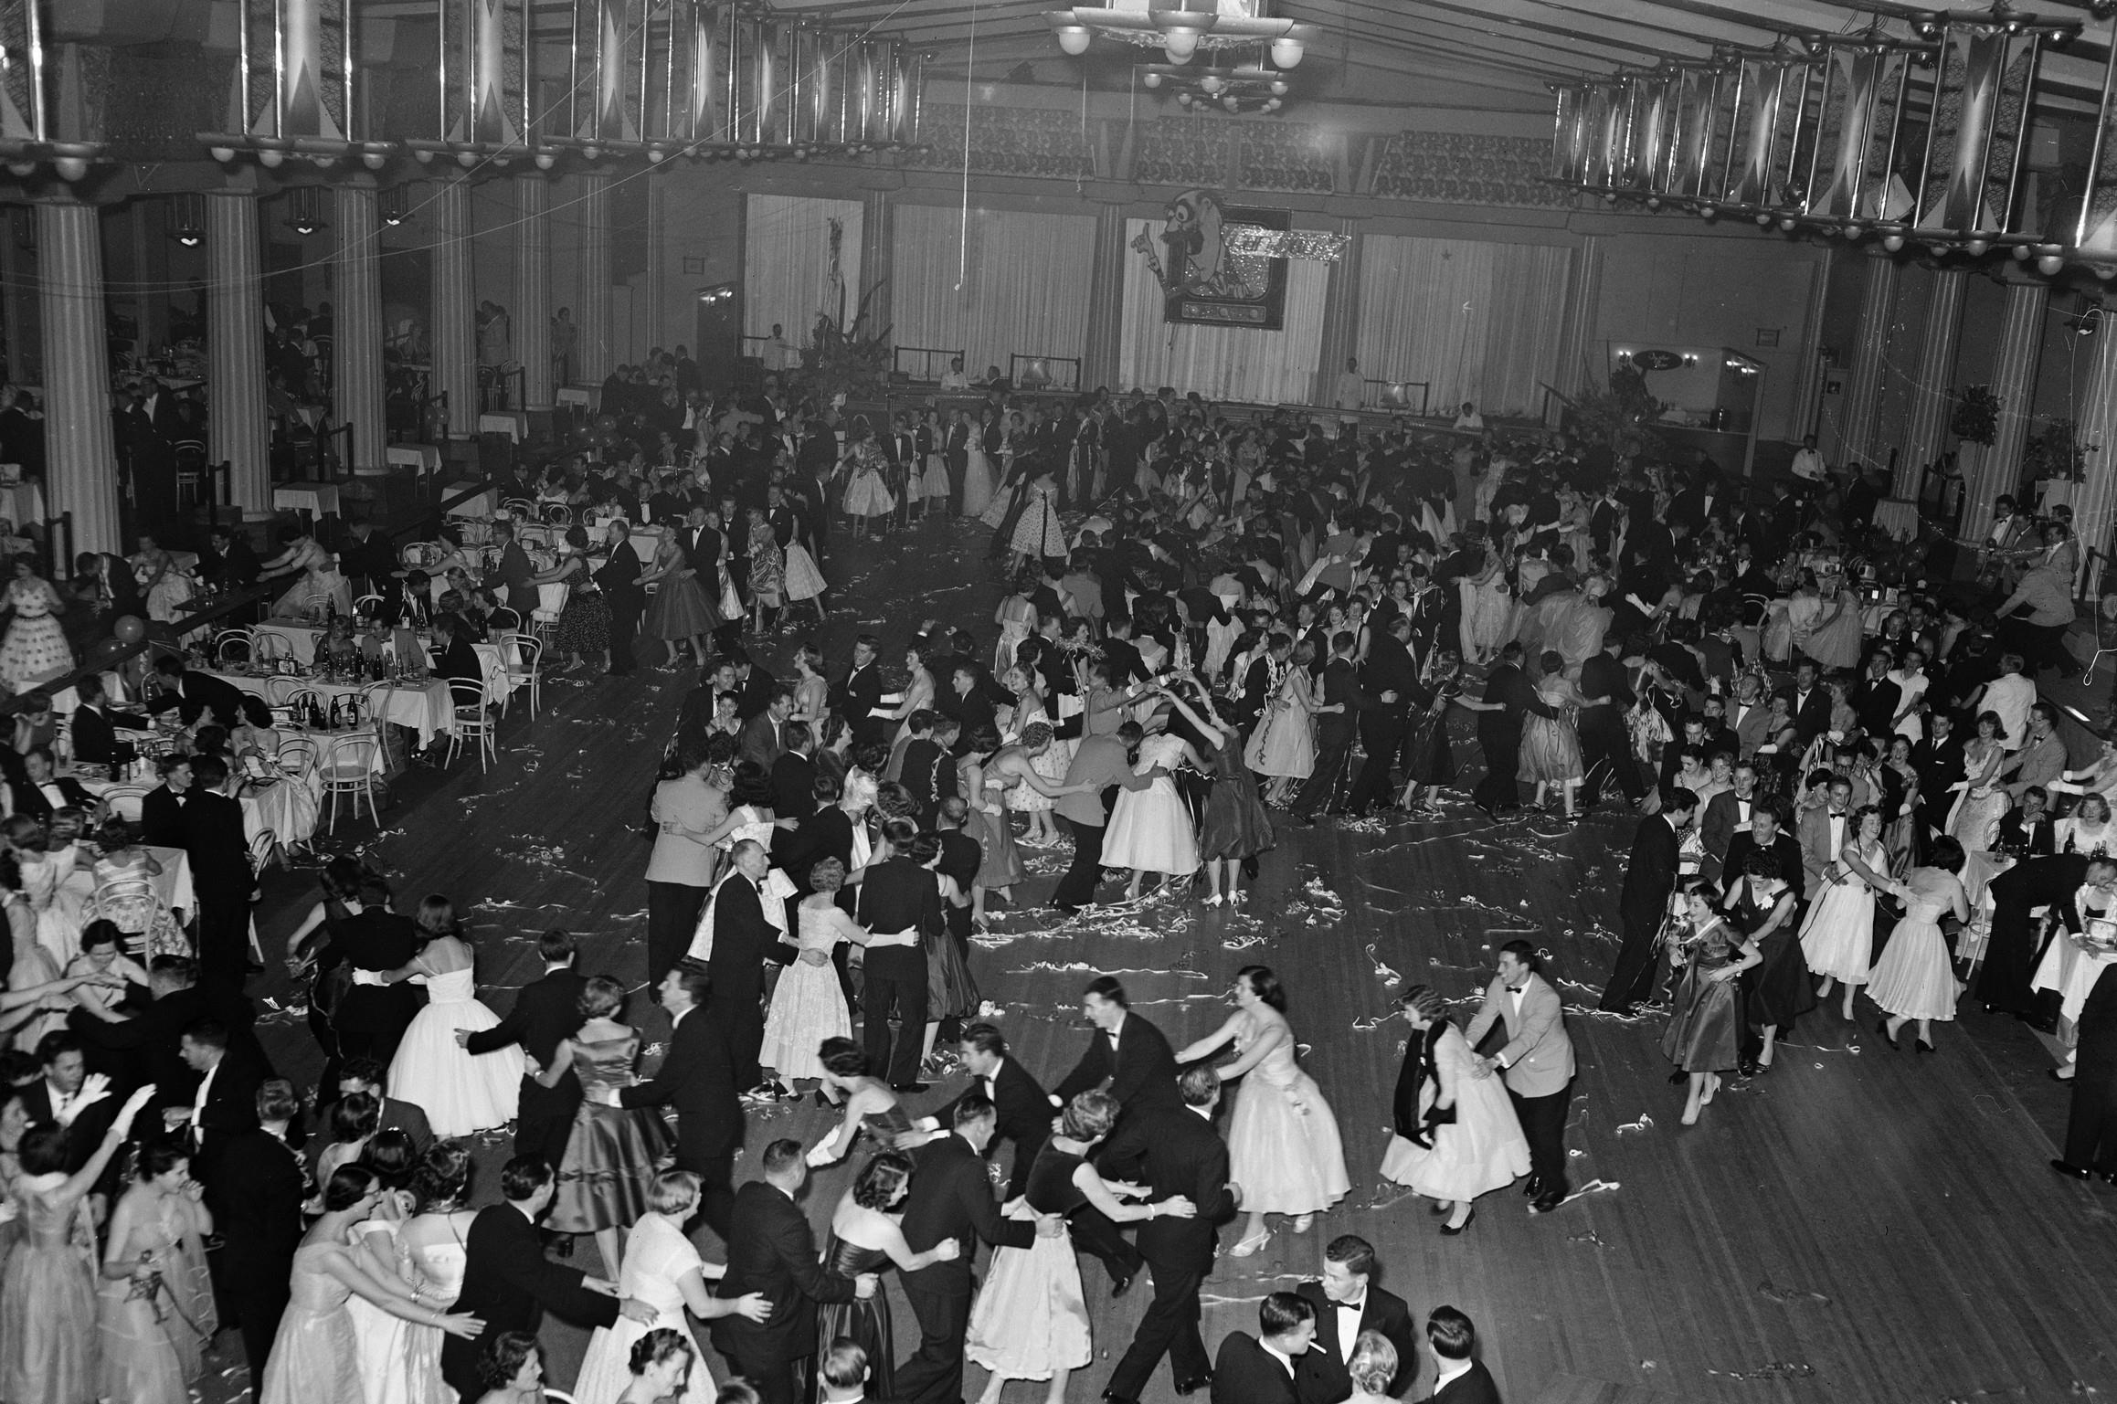
Shell company ball showing people dancing in conga lines. Dining tables are pictured around the outside of the dance floor
By: Laurie Richards Studios

Slide 30
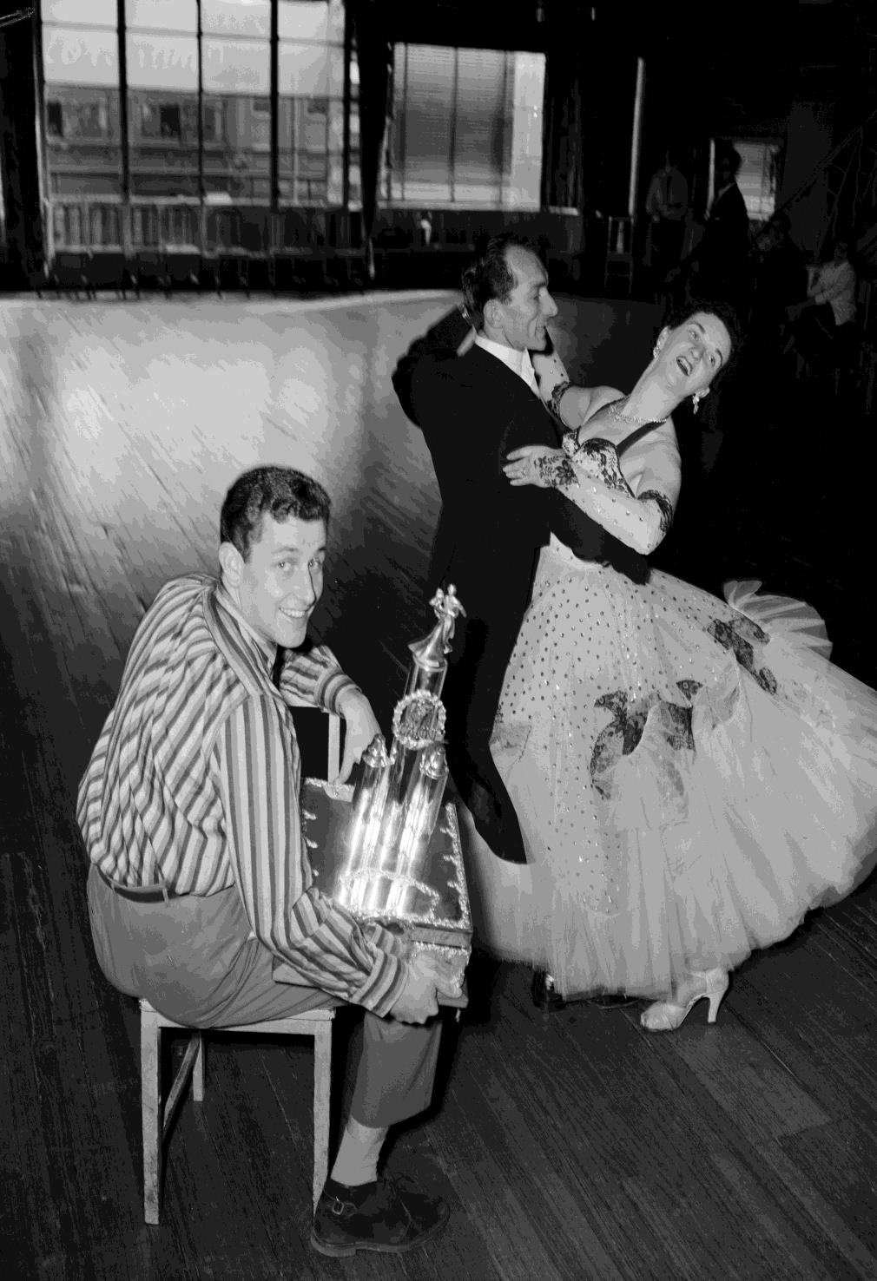
Ballroom Dancers at Mickey Powell's Studio, Melbourne
By: Laurie Richards Studio

Slide 31
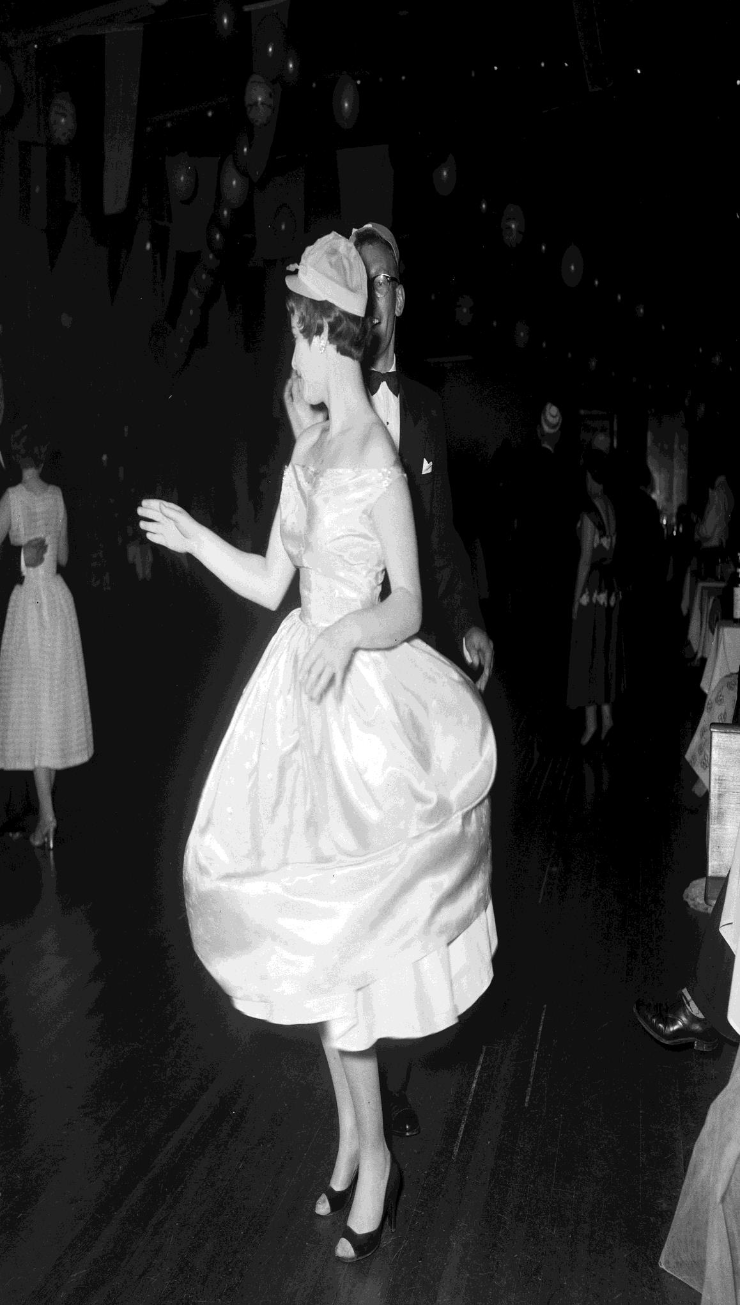
Woman Dancing at a Ball
By: Laurie Richards Studios

Slide 32
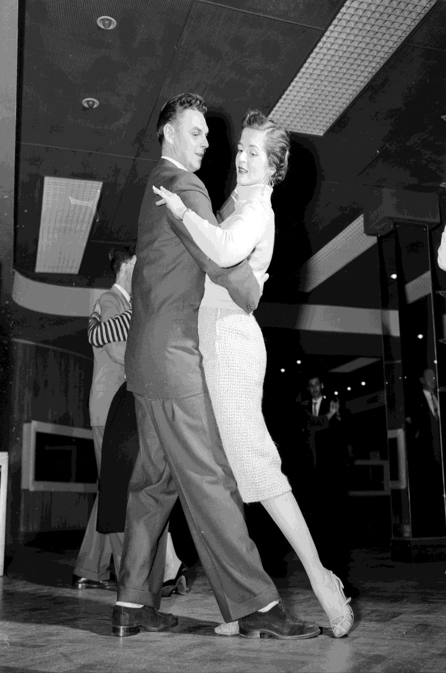
Man & Woman Dancing
By: Laurie Richards Studios

Slide 33
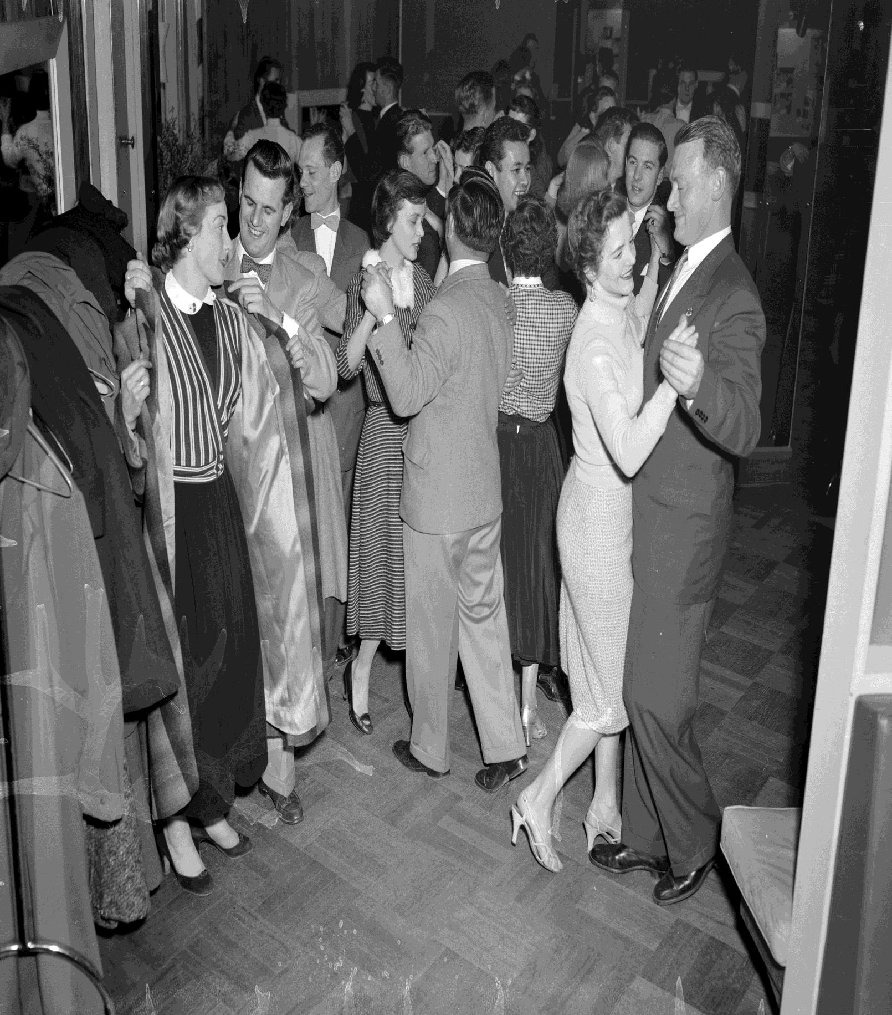
People Dancing in Pairs
By: Laurie Richards Studios

Slide 34
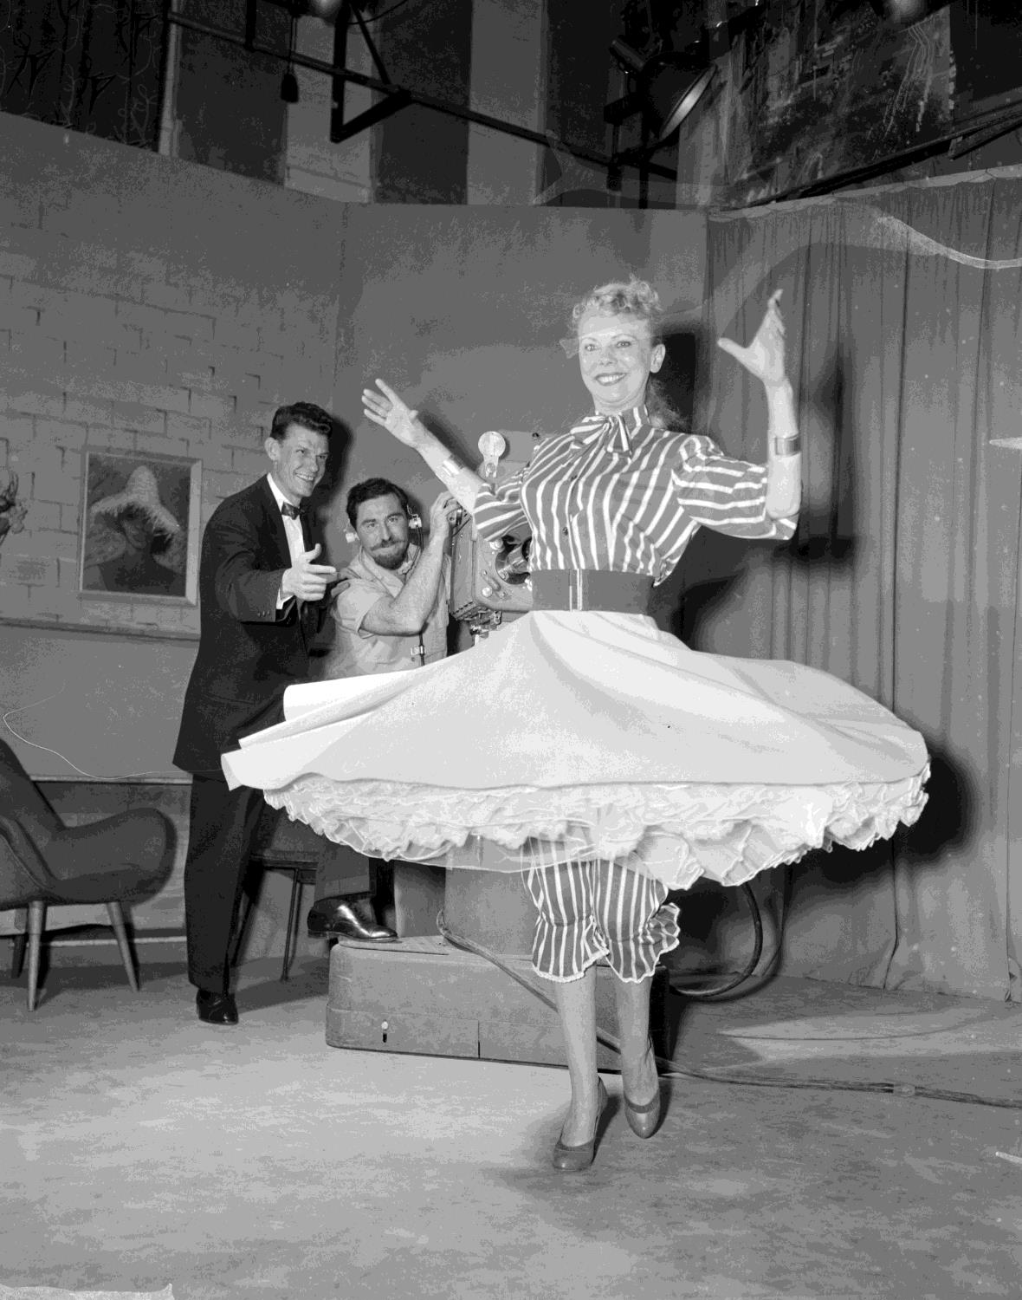
Woman Dancing in the Arthur Murray Dance Studio
By: Laurie Richards Studios

Slide 35
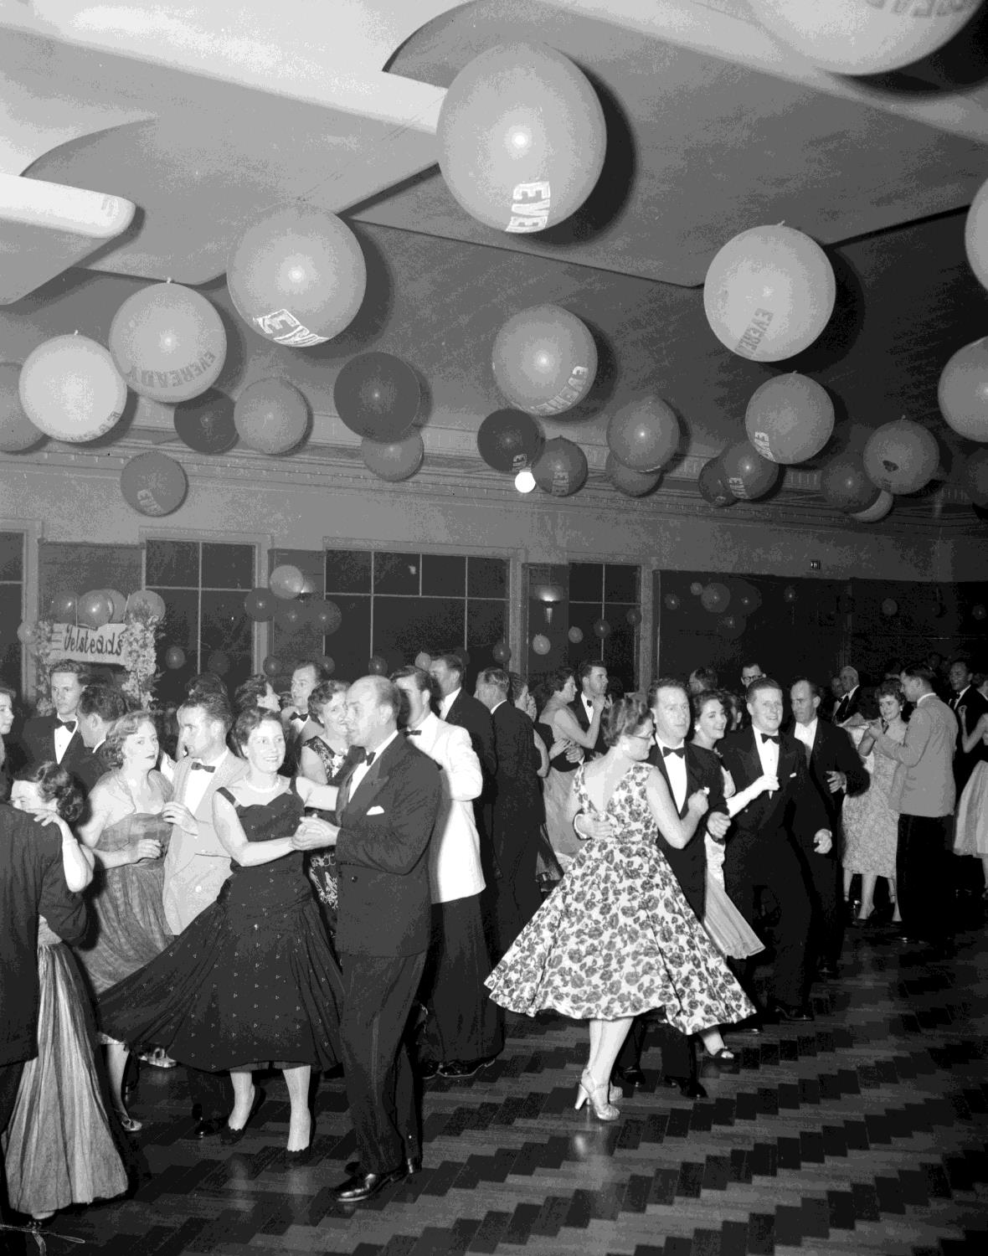
Couples Dancing, Town Hall, St Kilda
By: Laurie Richards Studios

Slide 36
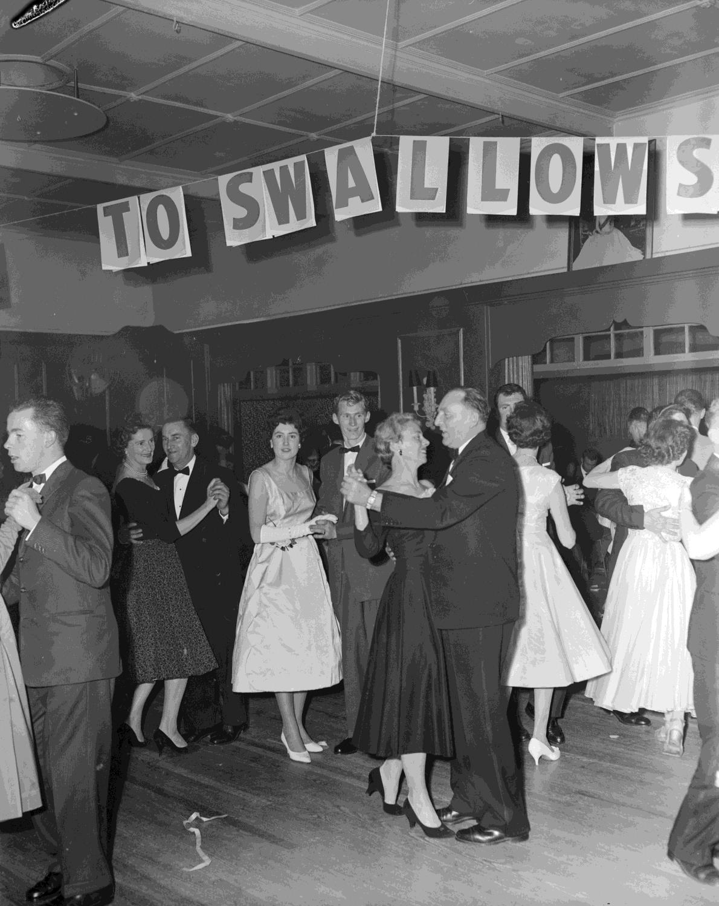
Swallow & Ariell Ltd, Couples Dancing in South Yarra
By: Laurie Richards Studios

Slide 37
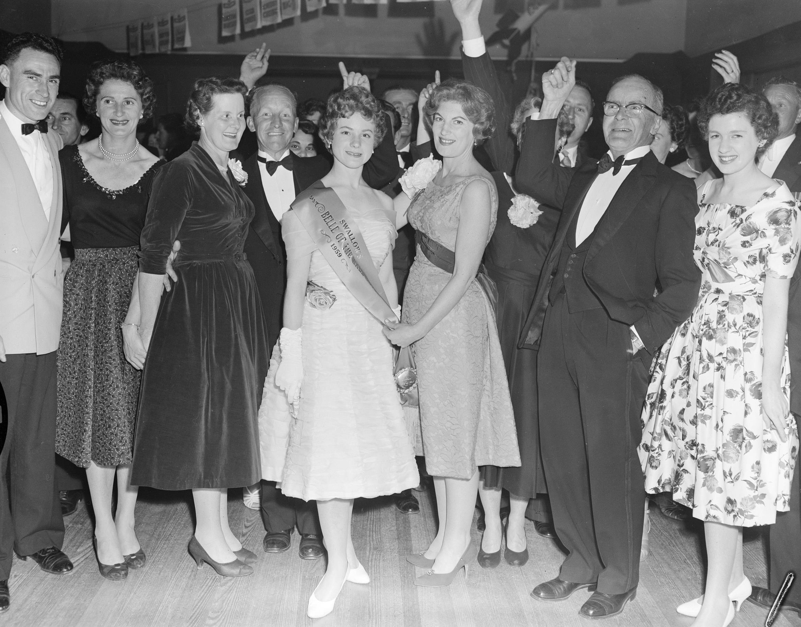
Swallow & Ariell Ltd, Group with the Belle of the Ball Winner
By: Laurie Richards Studios

Slide 38
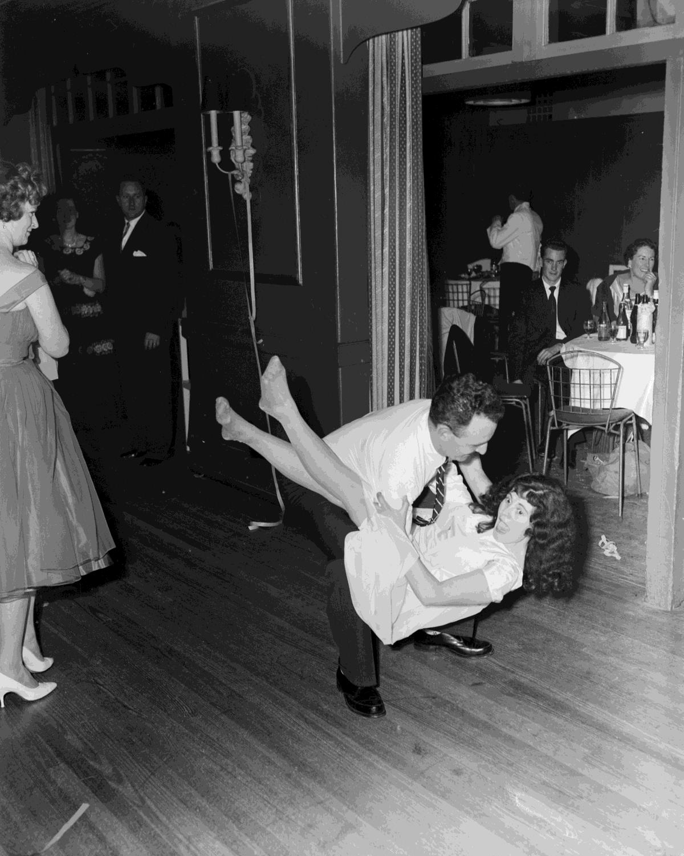
Swallow & Ariell Ltd, Couple Dancing
By: Laurie Richards Studios

Slide 39
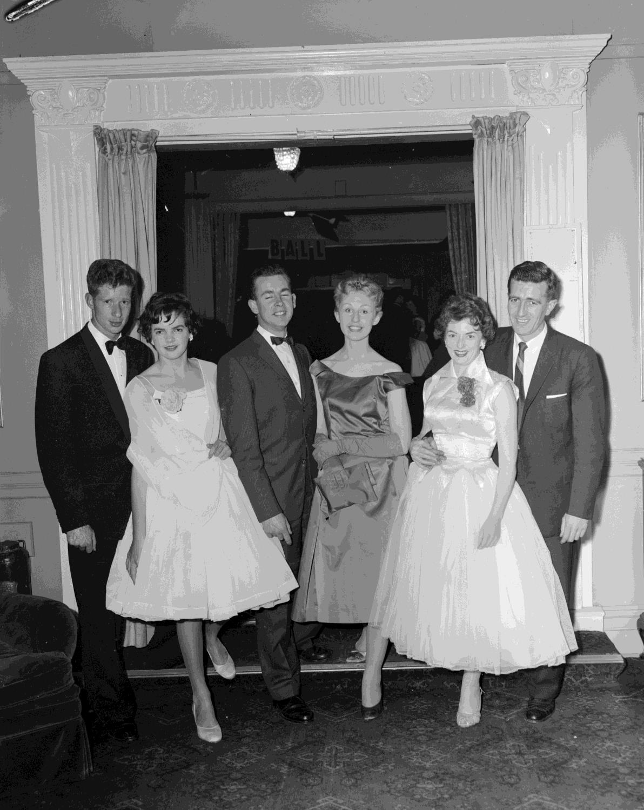
Three Couples at a Ball
By: Laurie Richards Studios

Slide 40
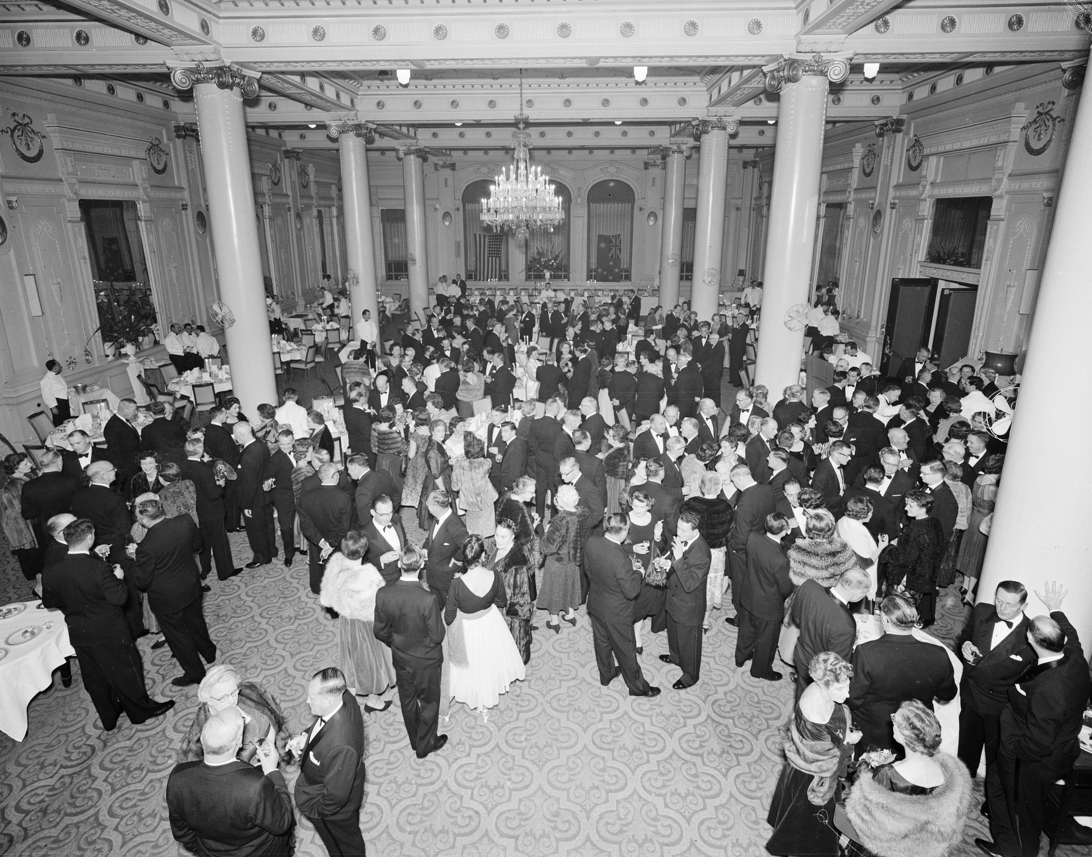
Crowd at a Function, Menzies Hotel, Melbourne
By: Laurie Richards Studios

Slide 41
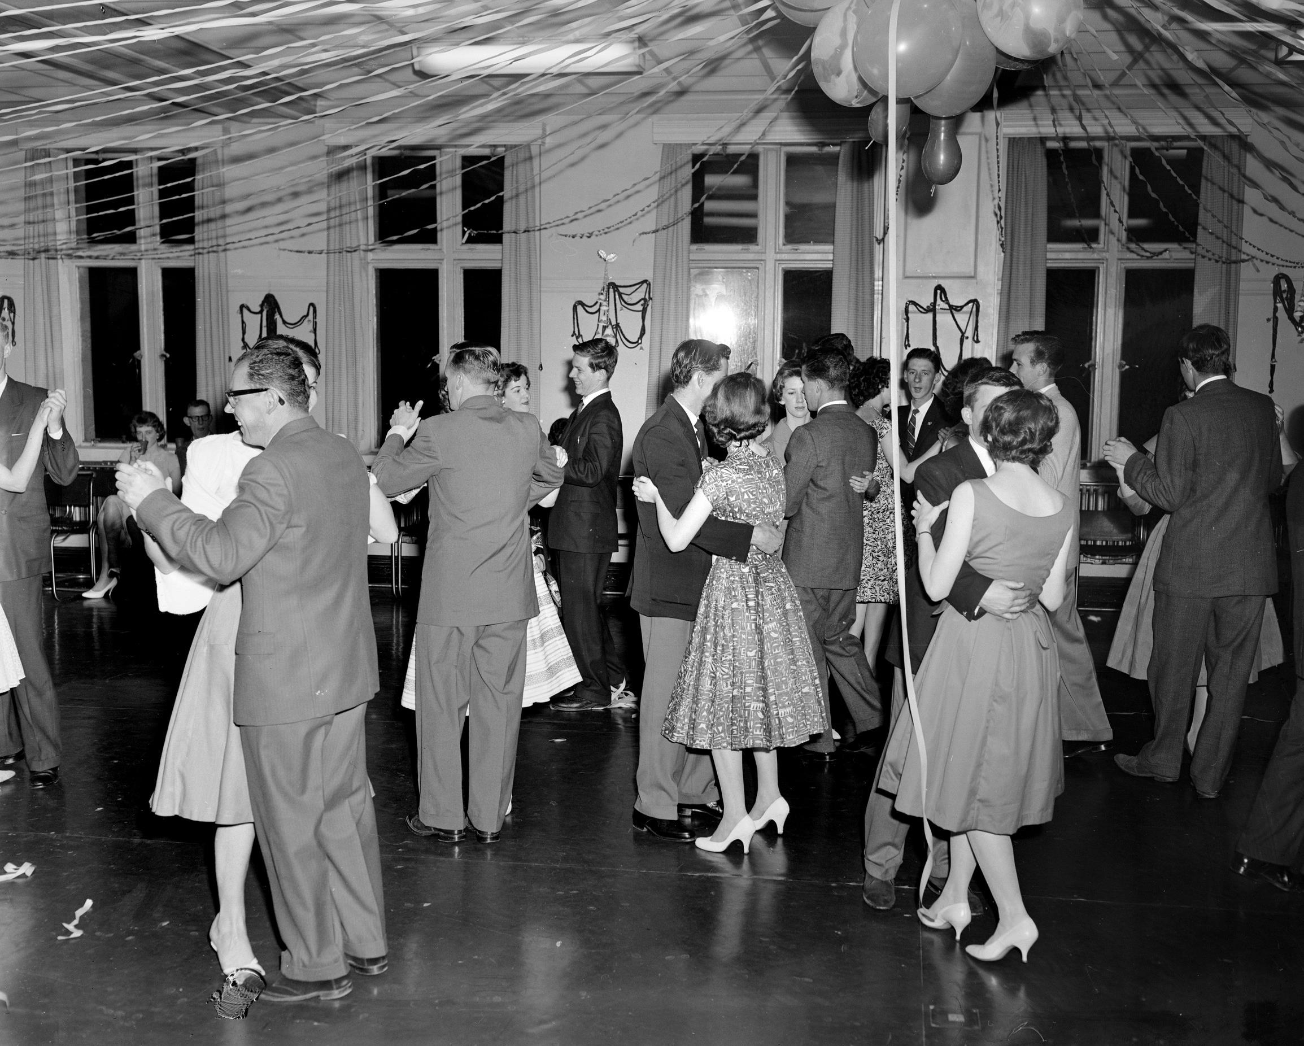
Couples Dancing, Melbourne
By: Laurie Richards Studios

Slide 42
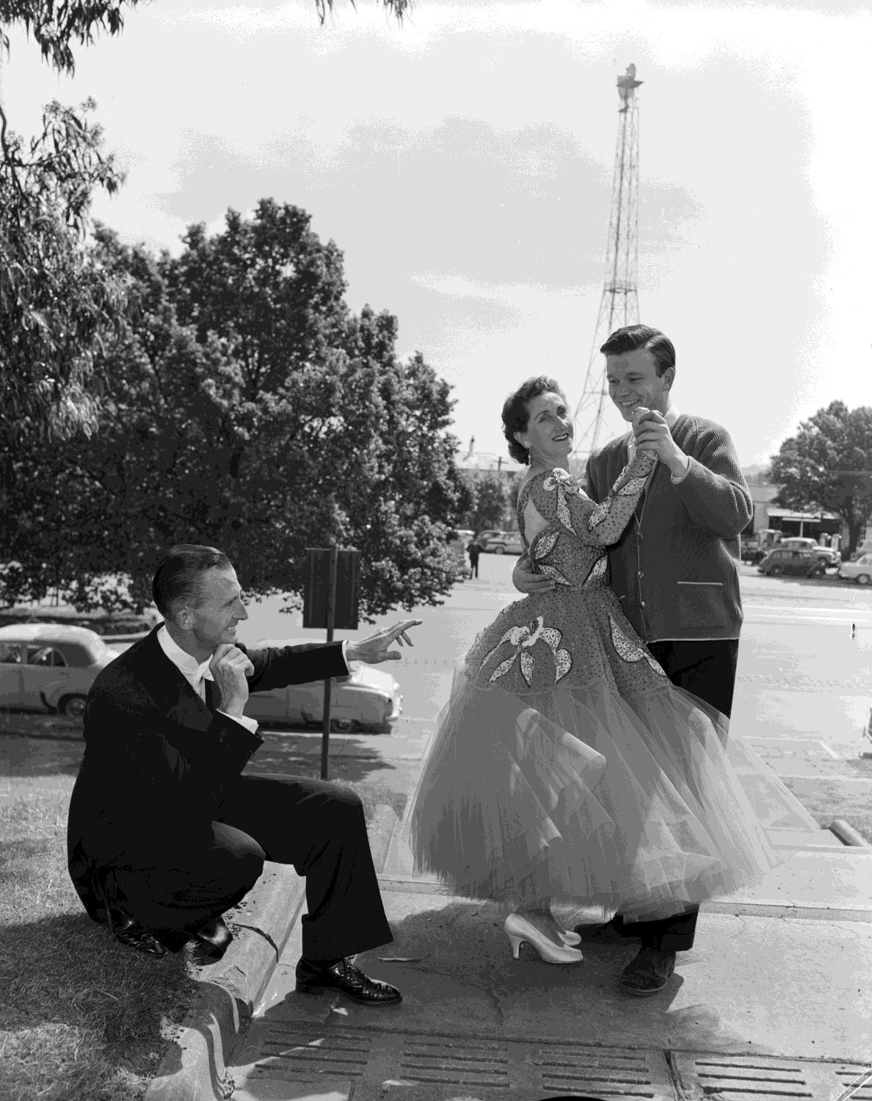
Couple Dancing in the Street, Melbourne
By: Laurie Richards Studios

Slide 43
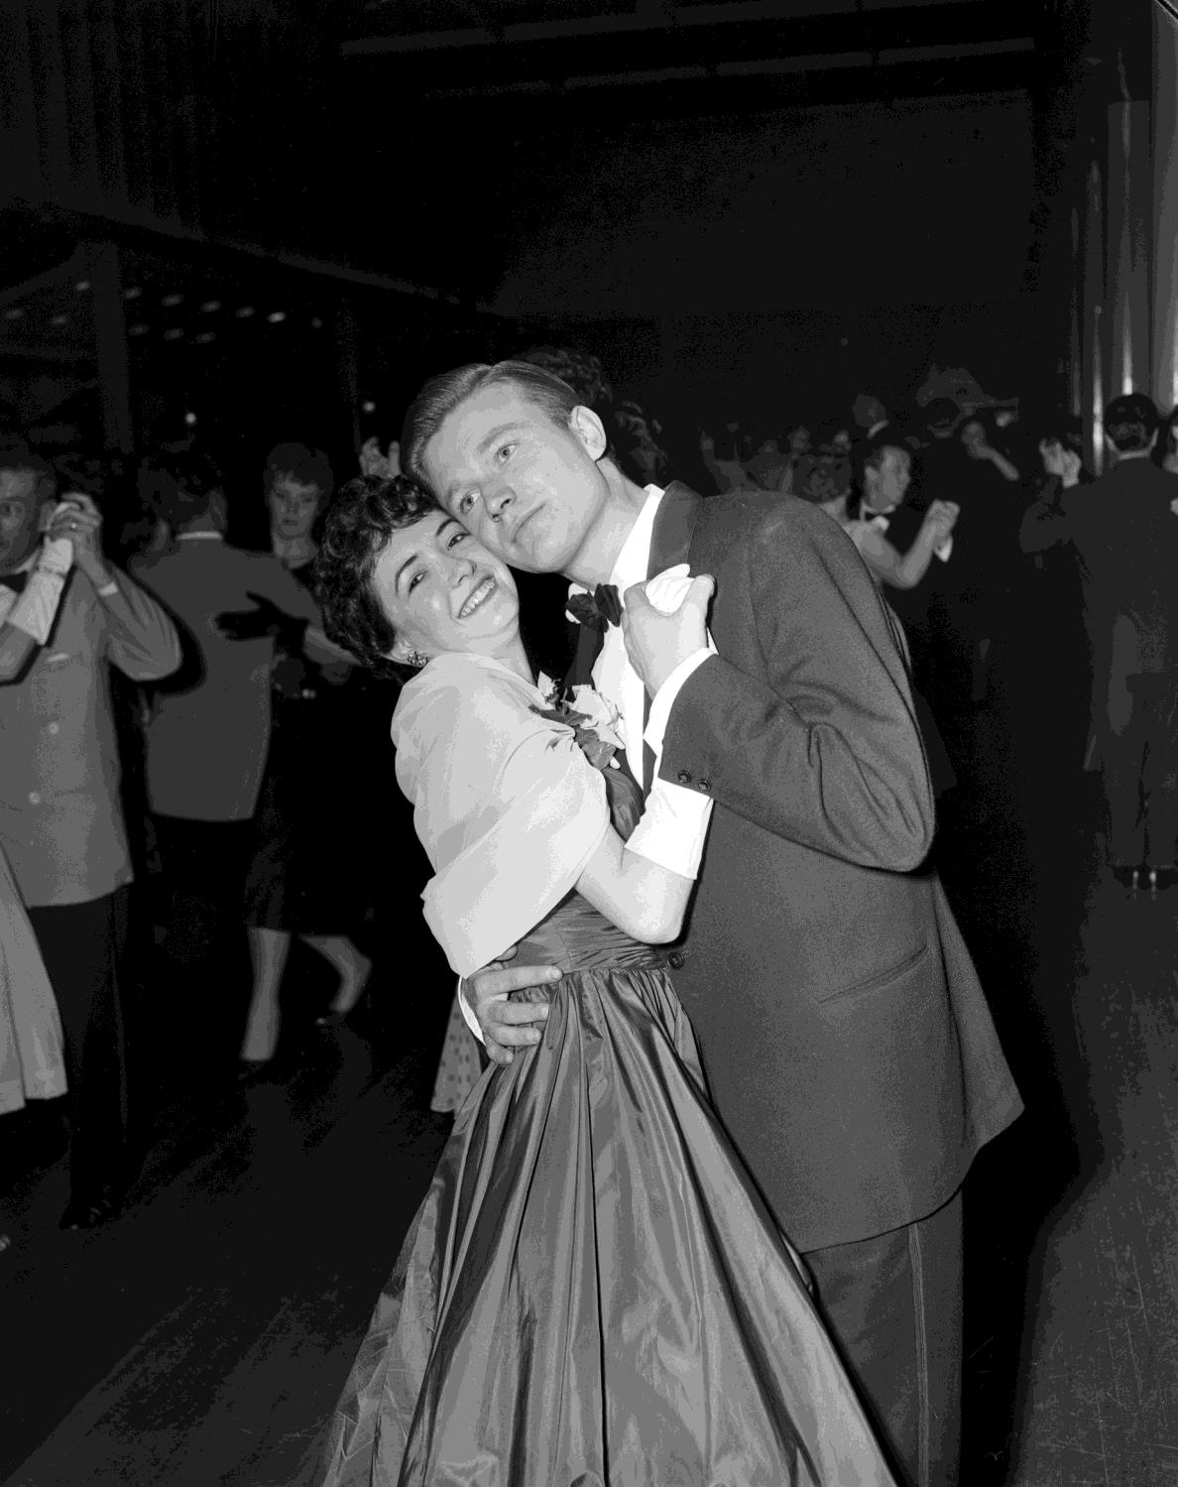
Couple Dancing, Royale Ballroom, Exhibition Building, Carlton
By: Laurie Richards Studios

Slide 44
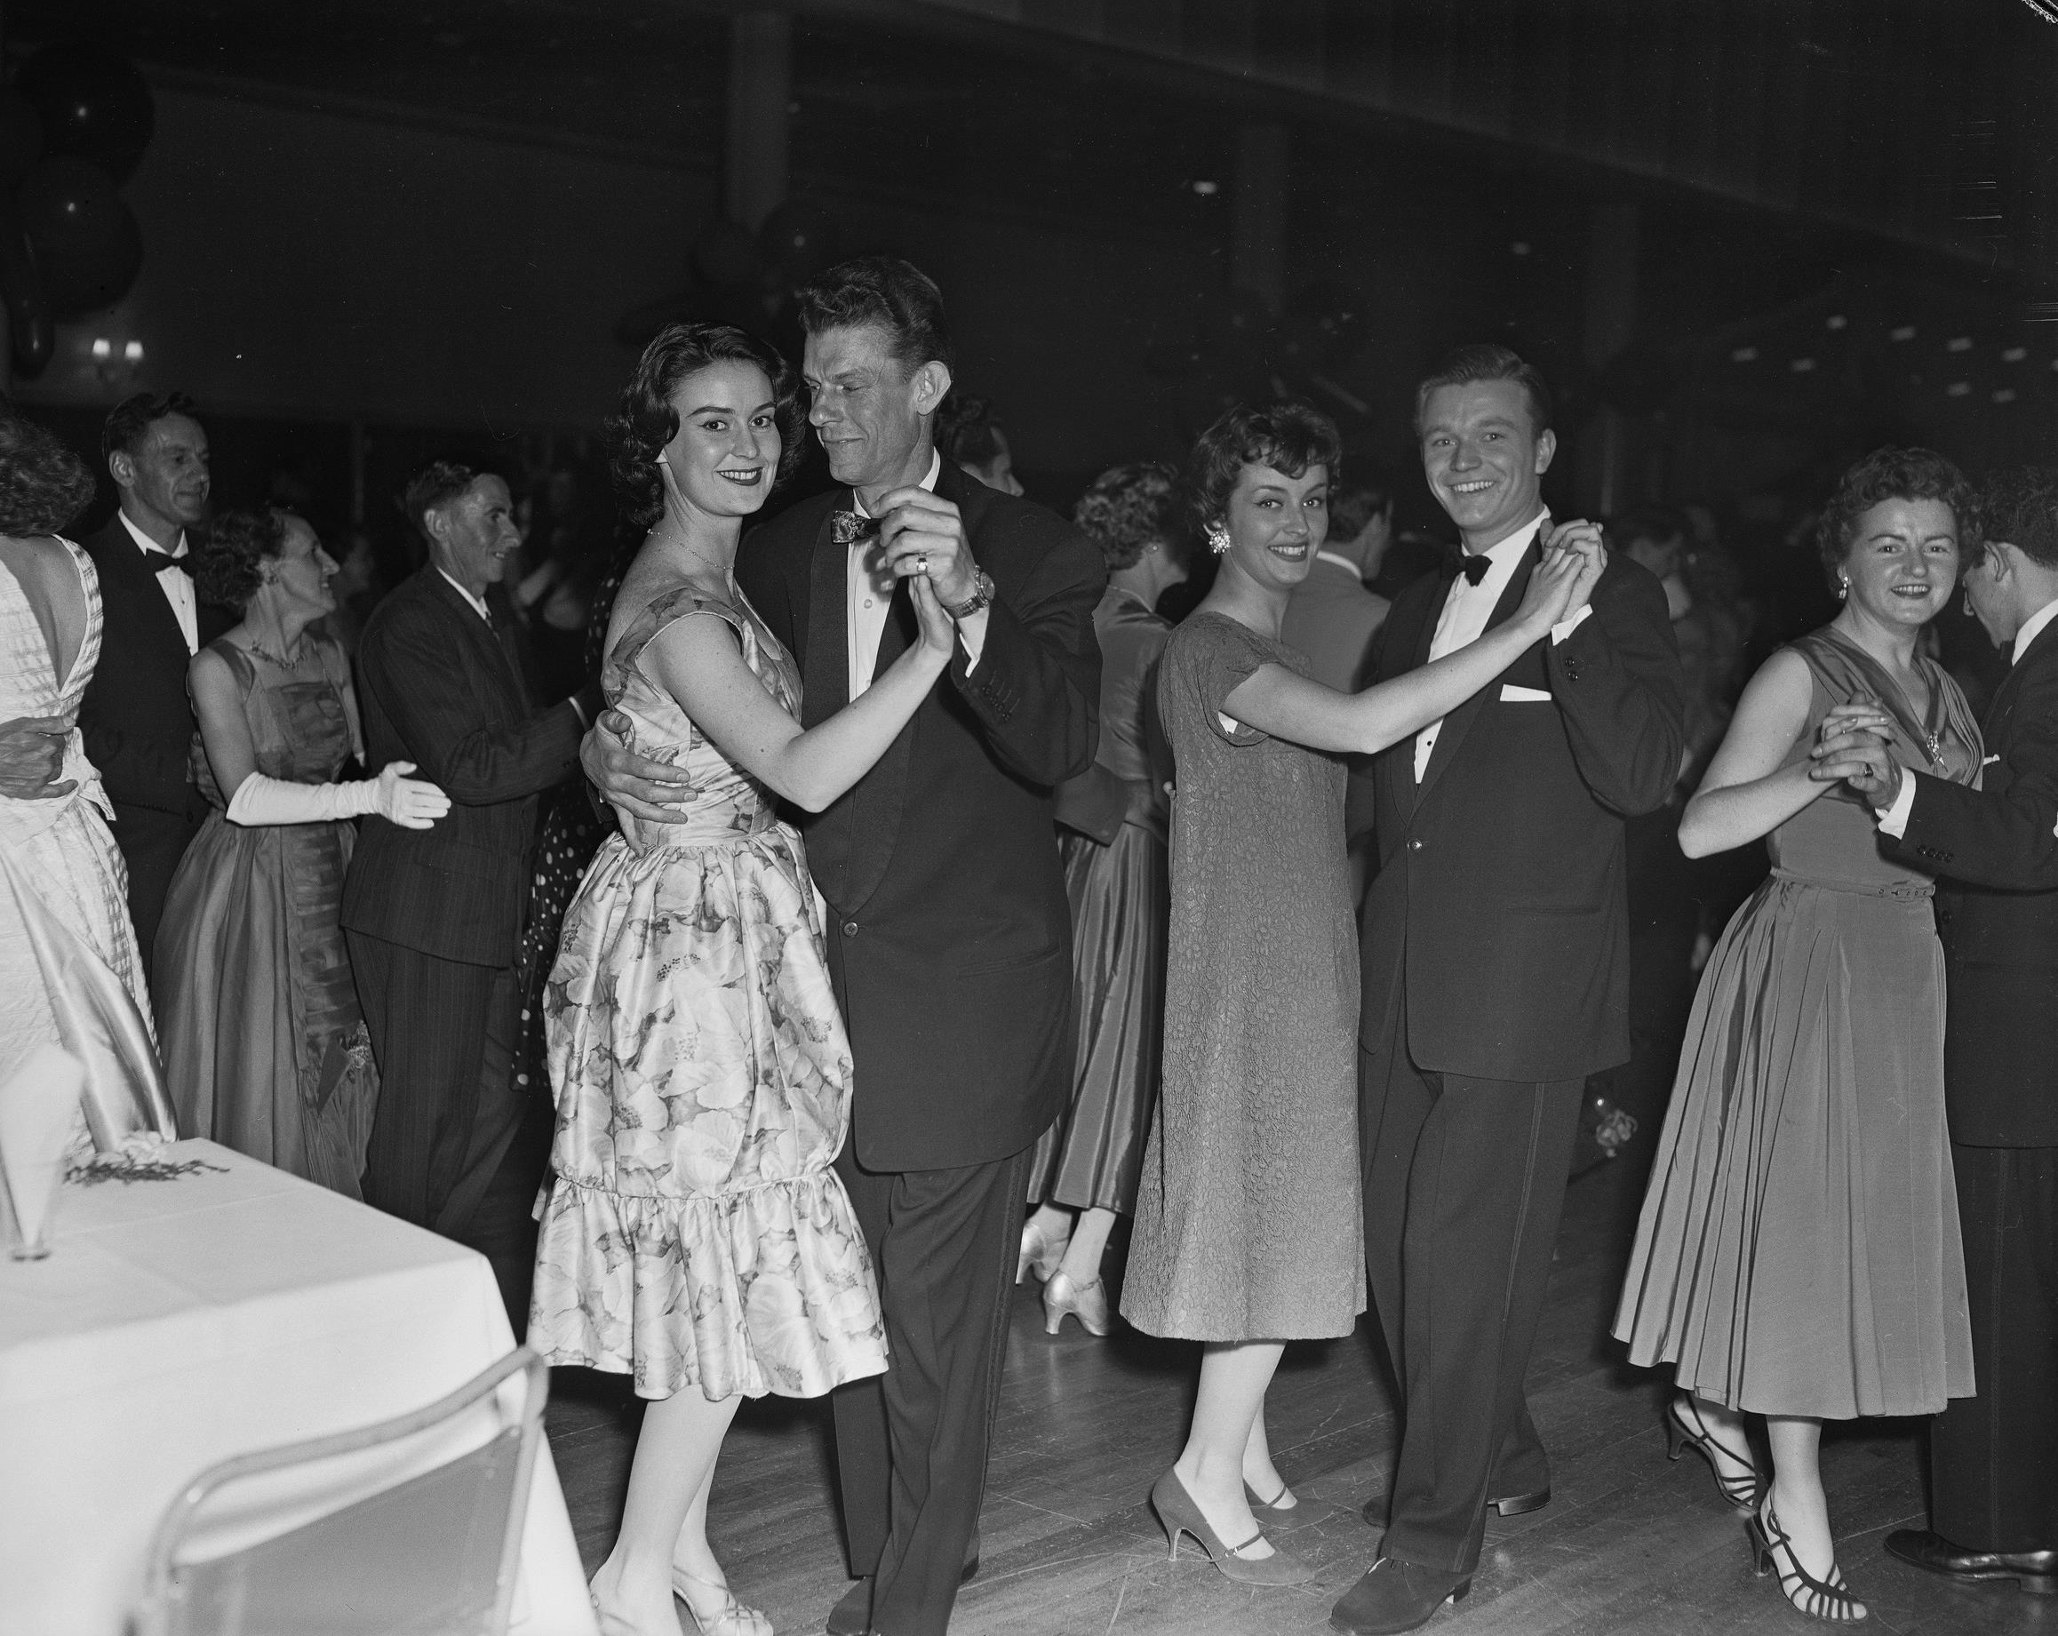
Couples Dancing, Royale Ballroom, Exhibition Building
By: Laurie Richards Studios

Slide 45
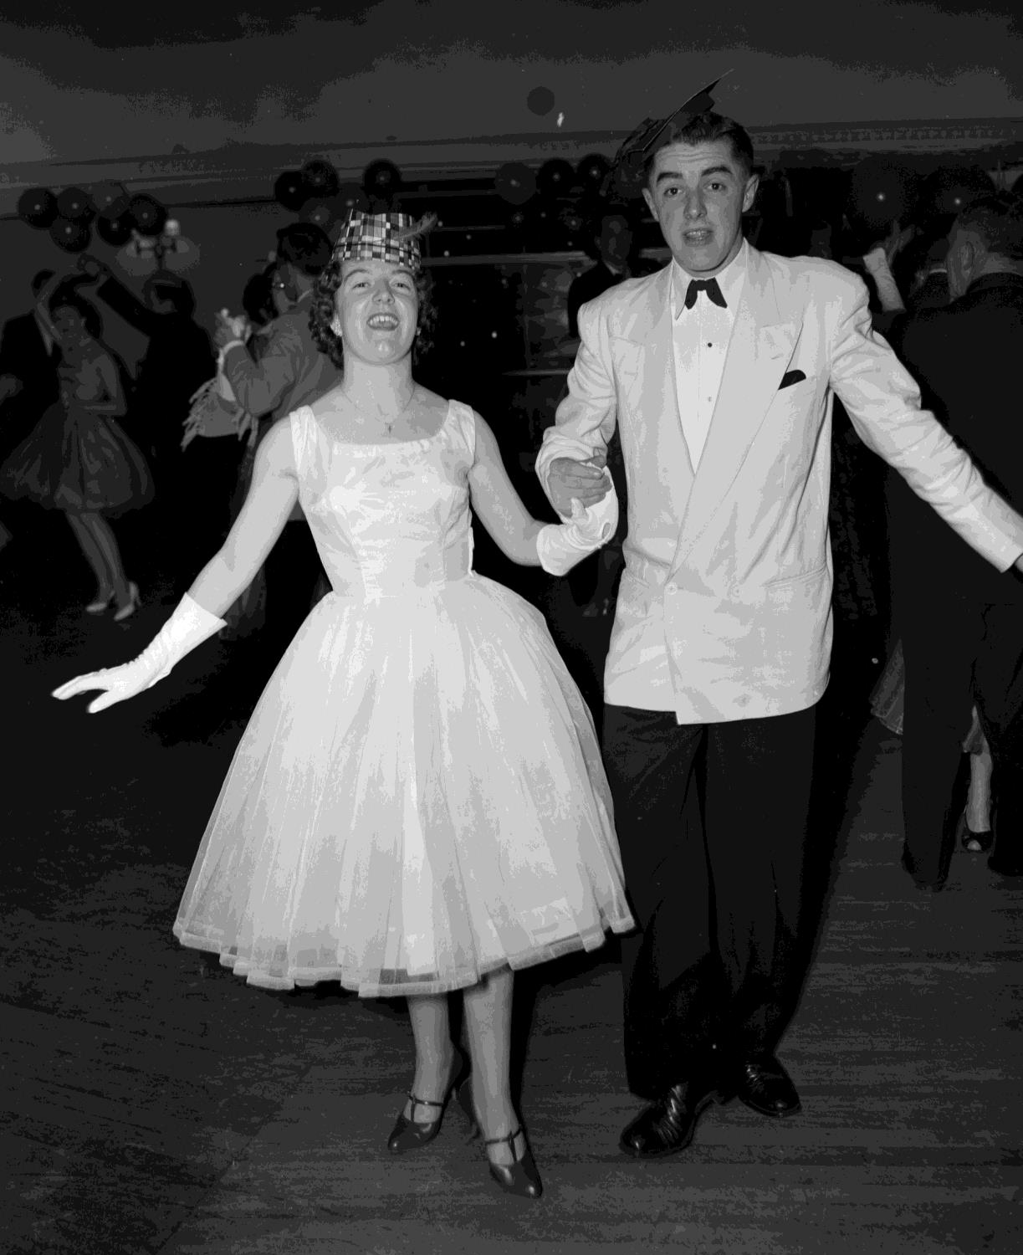
Man & Woman Dancing
By: Laurie Richards Studios

Slide 46
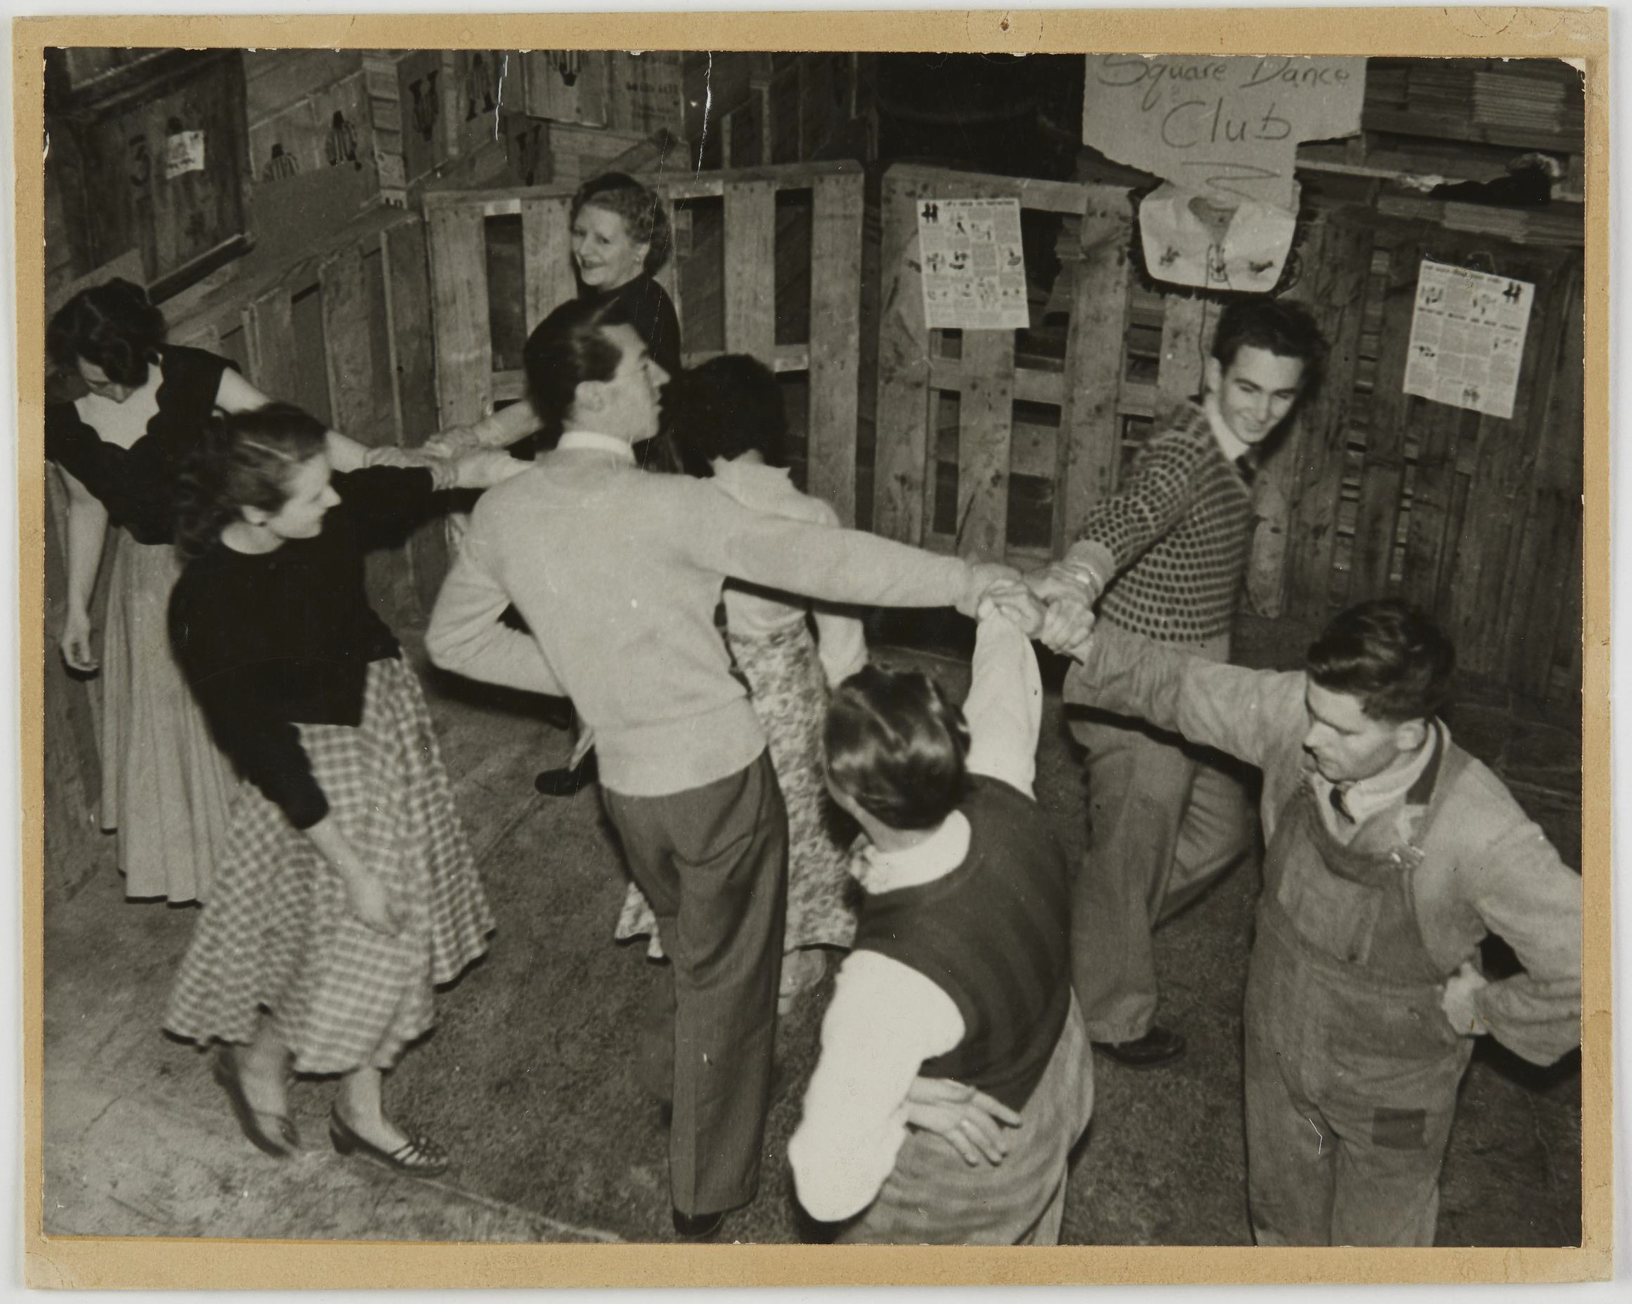
Double K Square Dance Club
Photographer: unknown

Slide 47
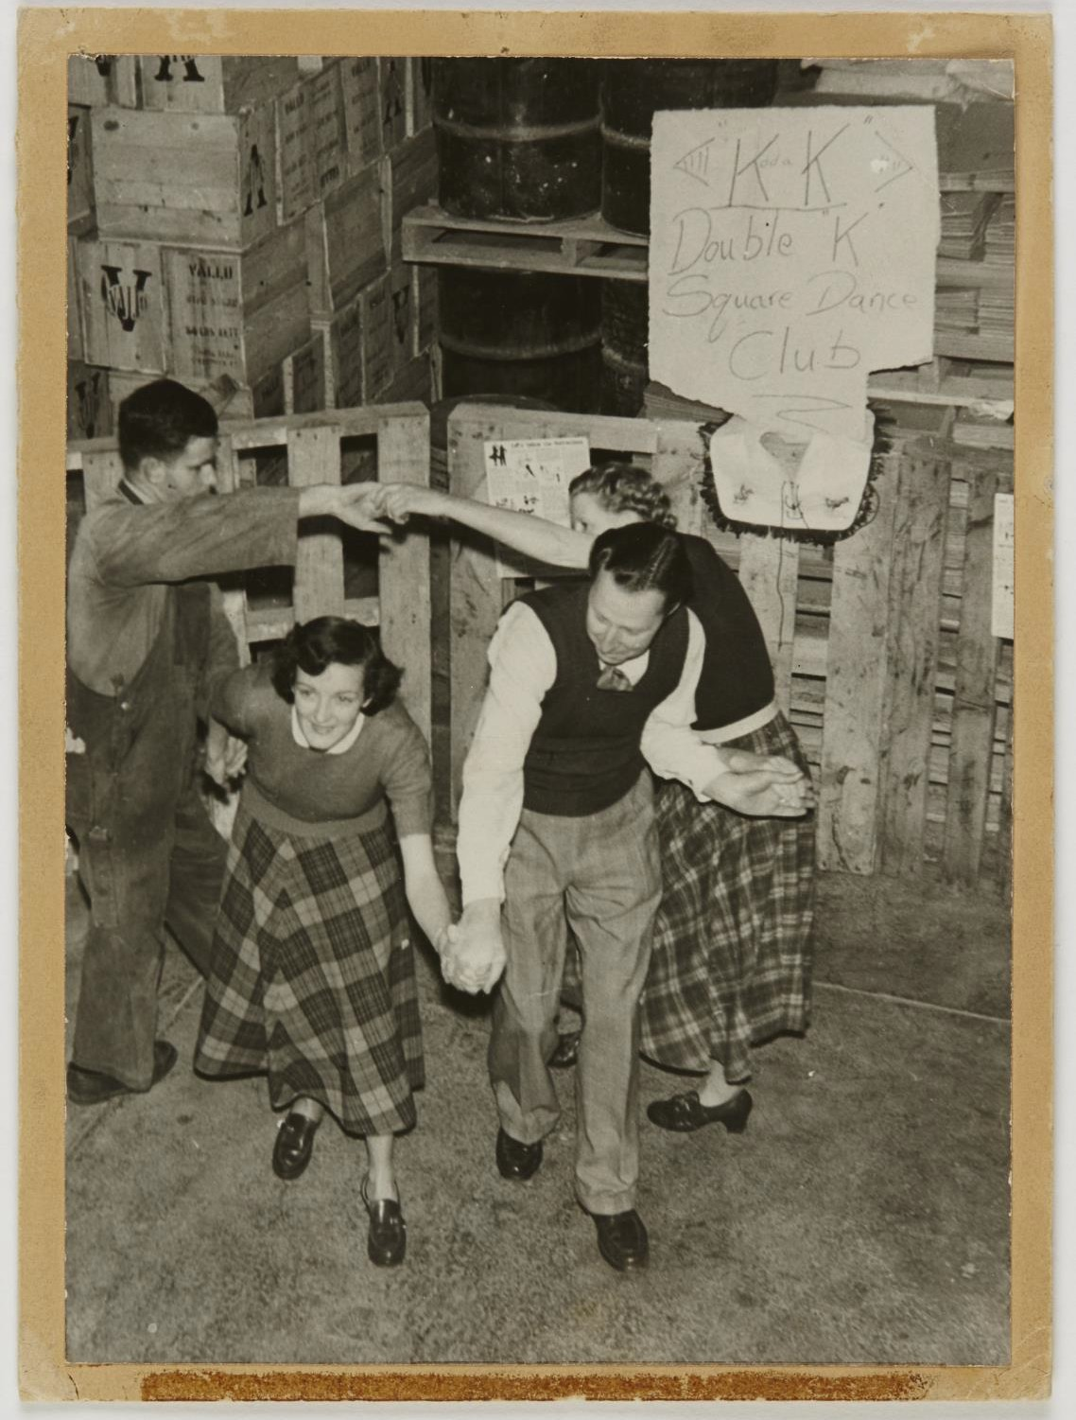
Double K Square Dance Club.
Photographer: unknown

Slide 48
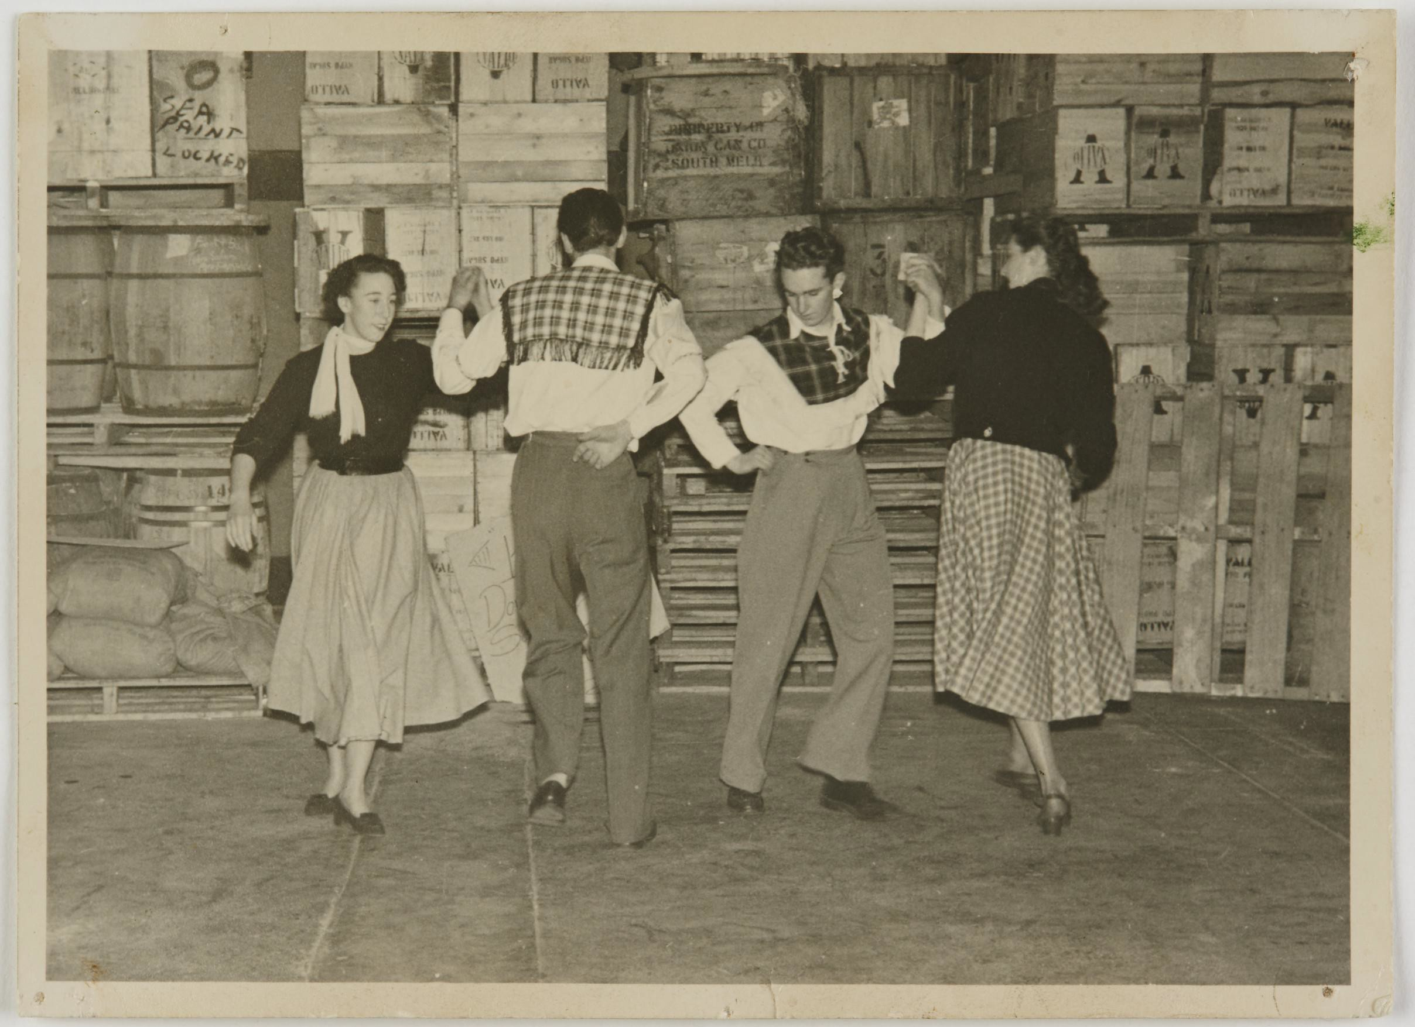
Double K
Square Dance Club. Two couples dancing in a factory storeroom, spinning in a circle holding their hands high
Photographer: unknown

