Slide 1

Stitches Through Time
A slideshow of images from Museums Victoria's collection relating to sewing, fashion, caring for garments and other popular handicrafts.

Slide 2
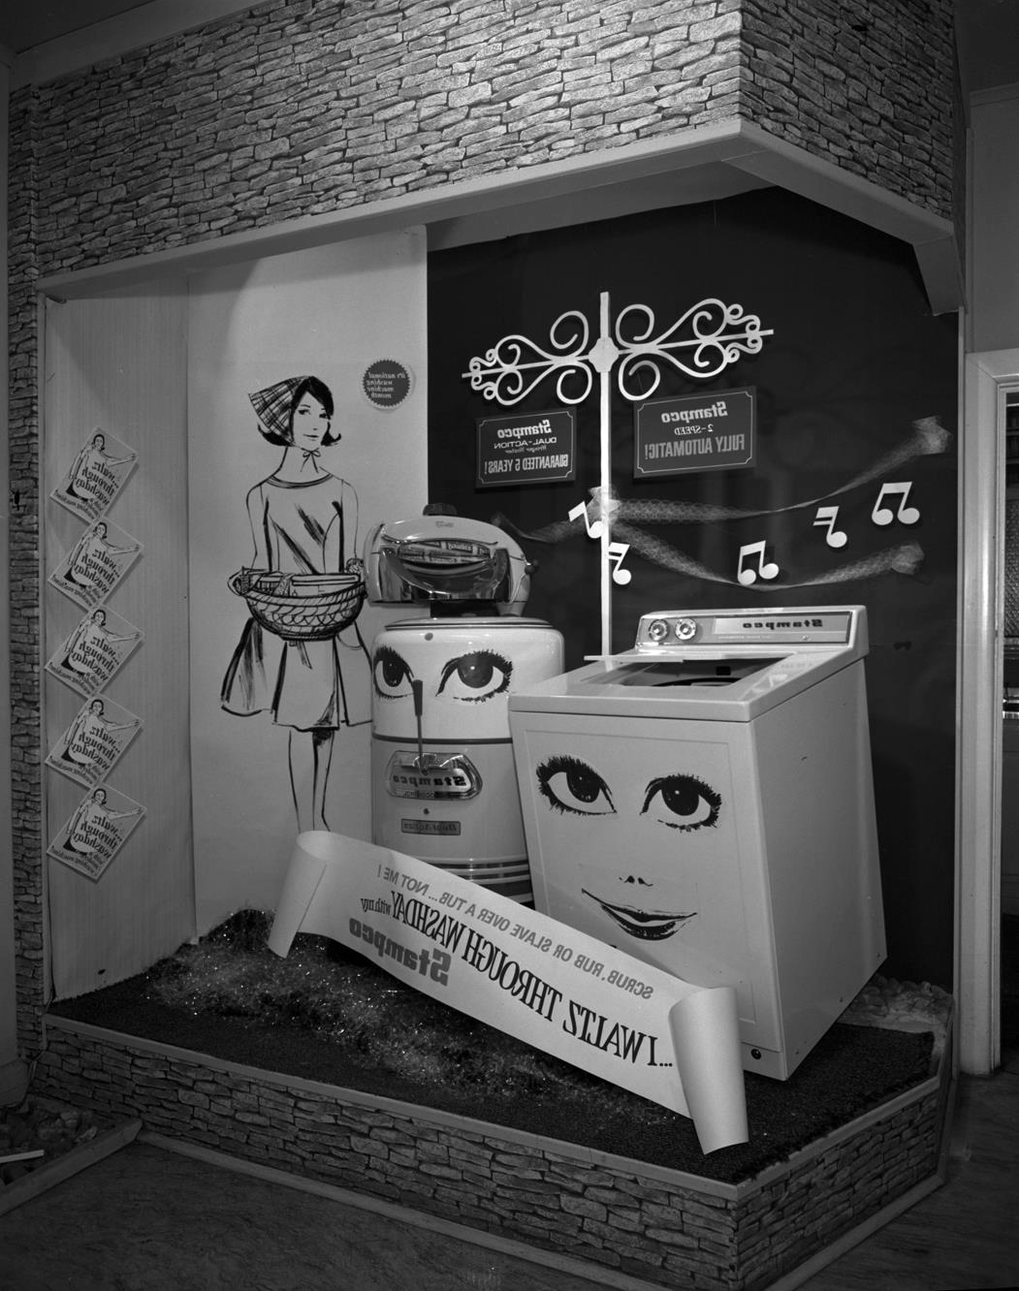
I WALTZ THROUGH
WASHDAY - advertisement
for Stampco washing machines.
Laurie Richards Studio

Slide 3
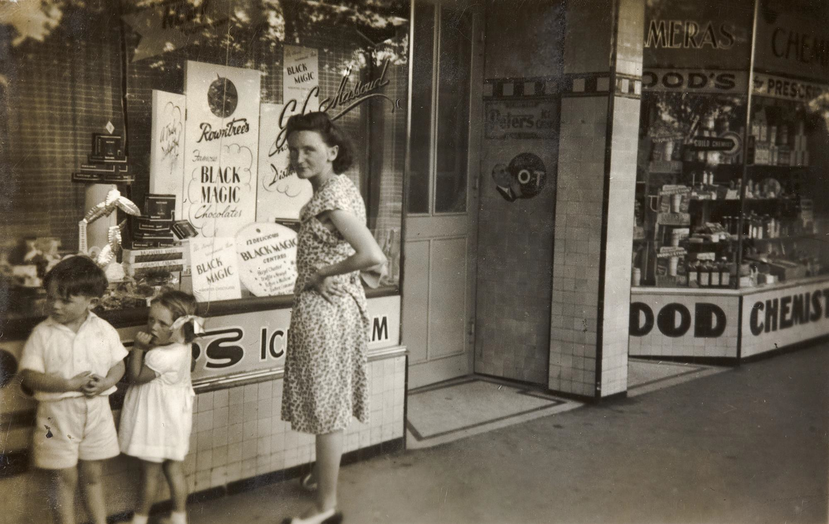
Mother, Boy & Girl Looking in Milk Bar Front Windows, Moonee Ponds, 1949
Photographer: Cliff Atkinson

Slide 4
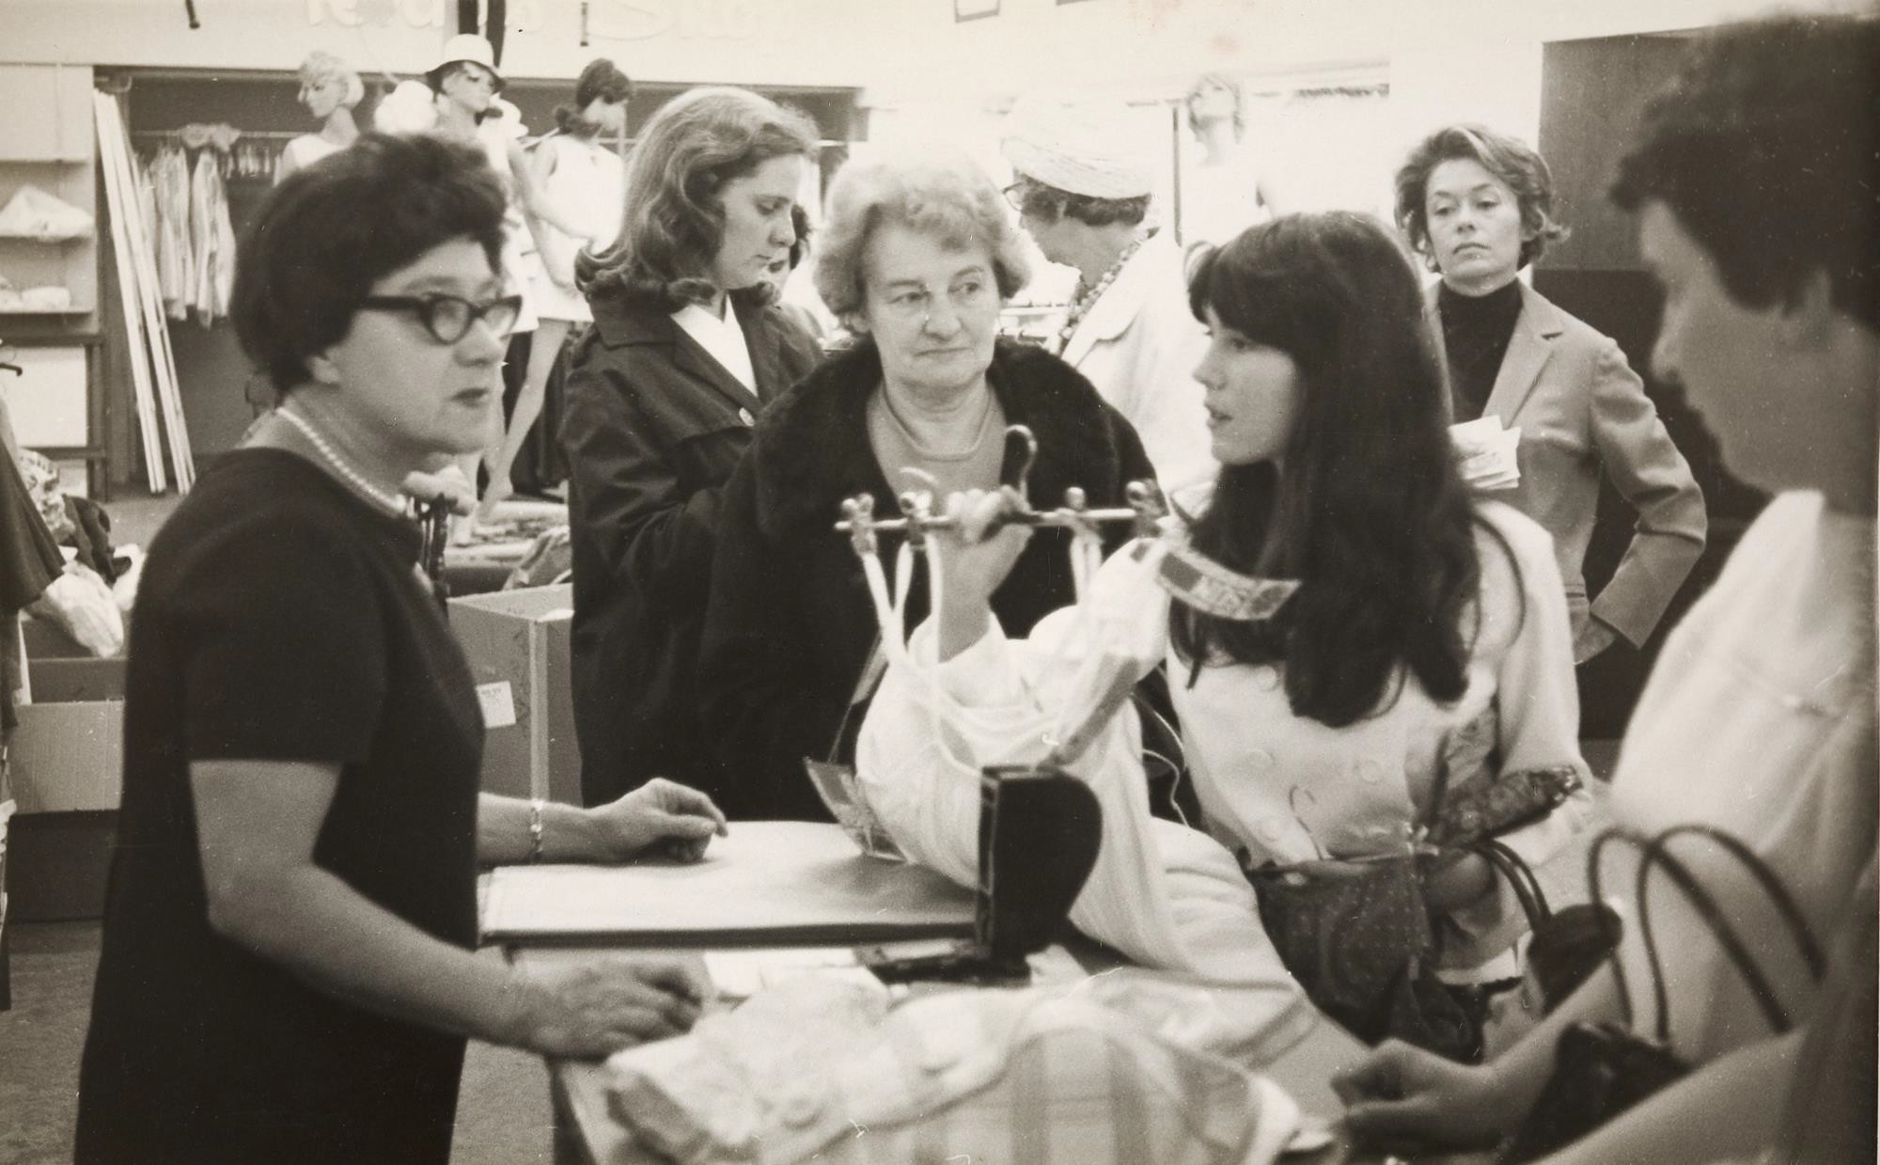
Women buying lingerie at Myers department store.
Photographer: Russell Beedles

Slide 5
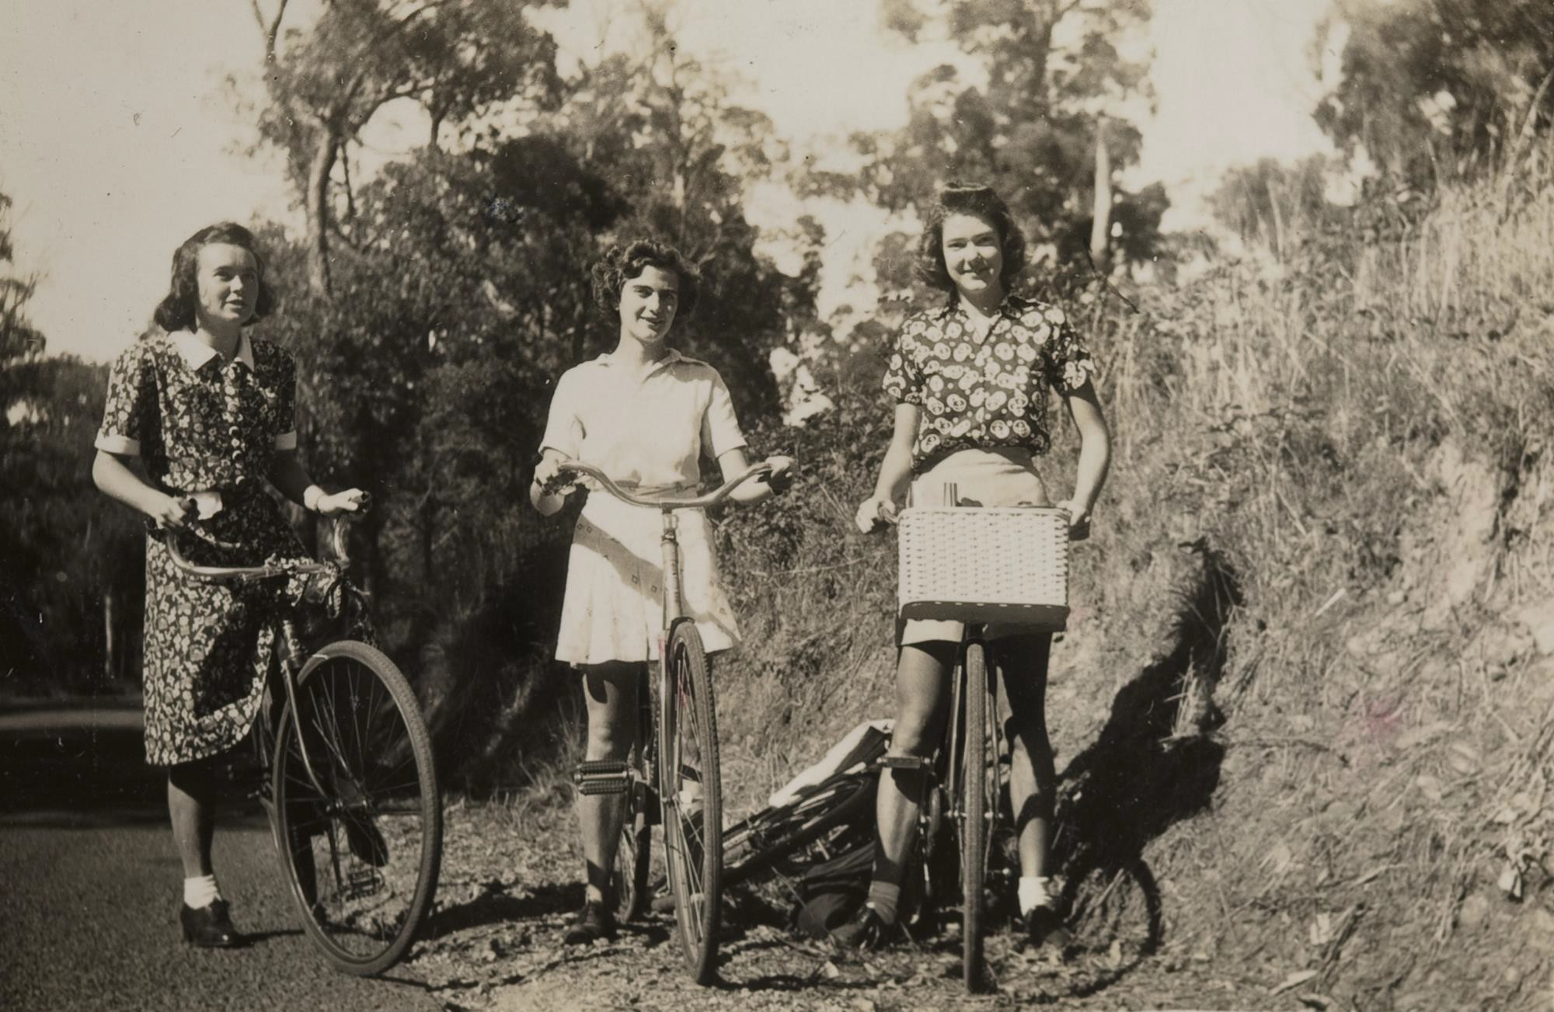
Three girls riding their bikes to Ferntree Gully.
Photographer: Kathleen Margaret Gawler

Slide 6
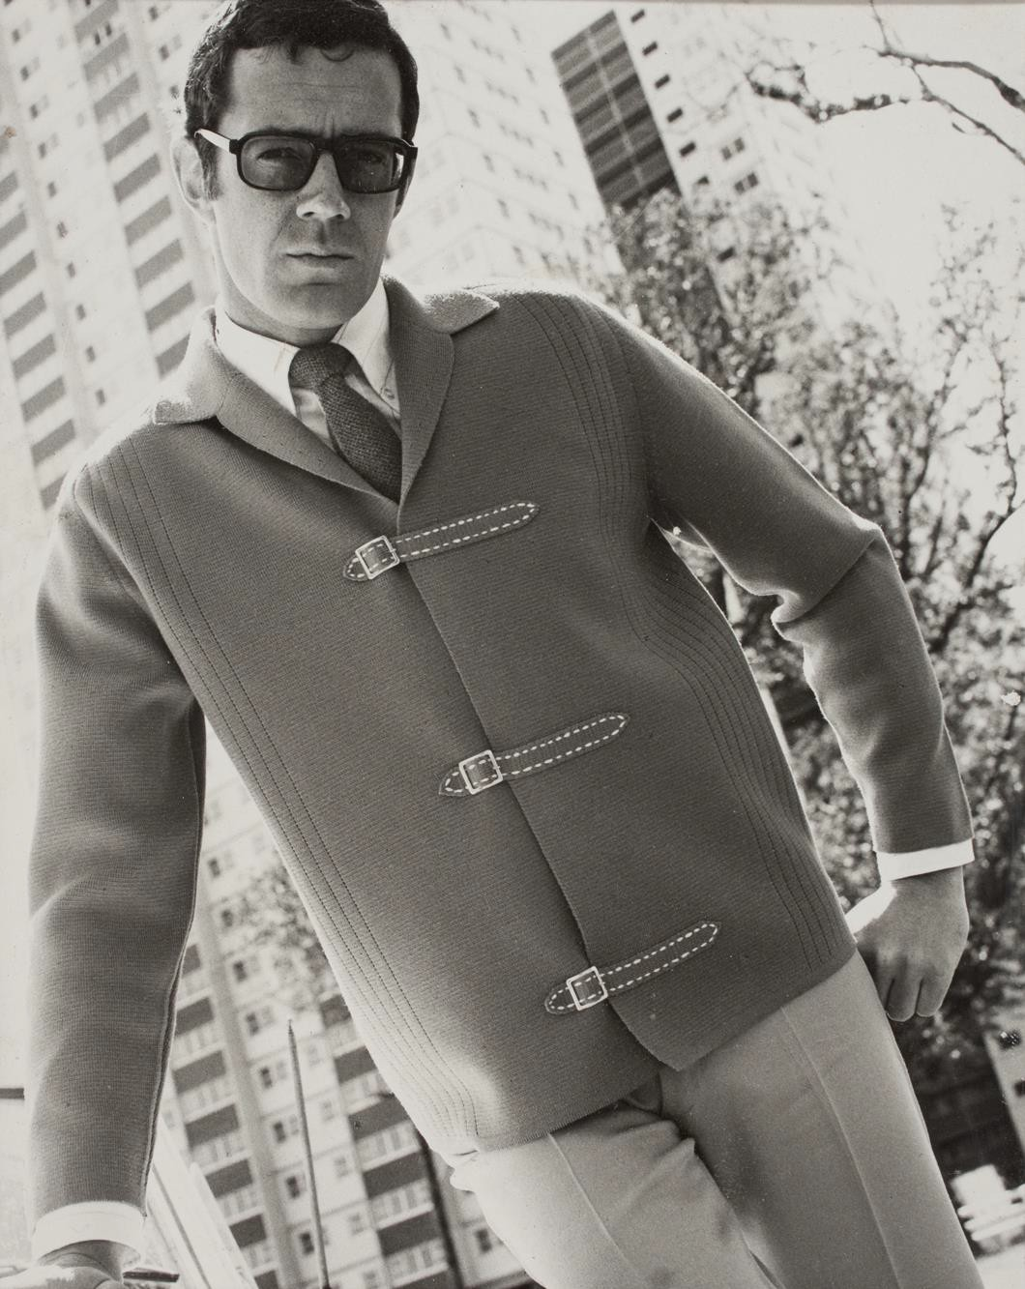
Ricardo Knitwear: Male model wearing woollen jacket with leather fastenings and trousers
Photographer: Unknown

Slide 7
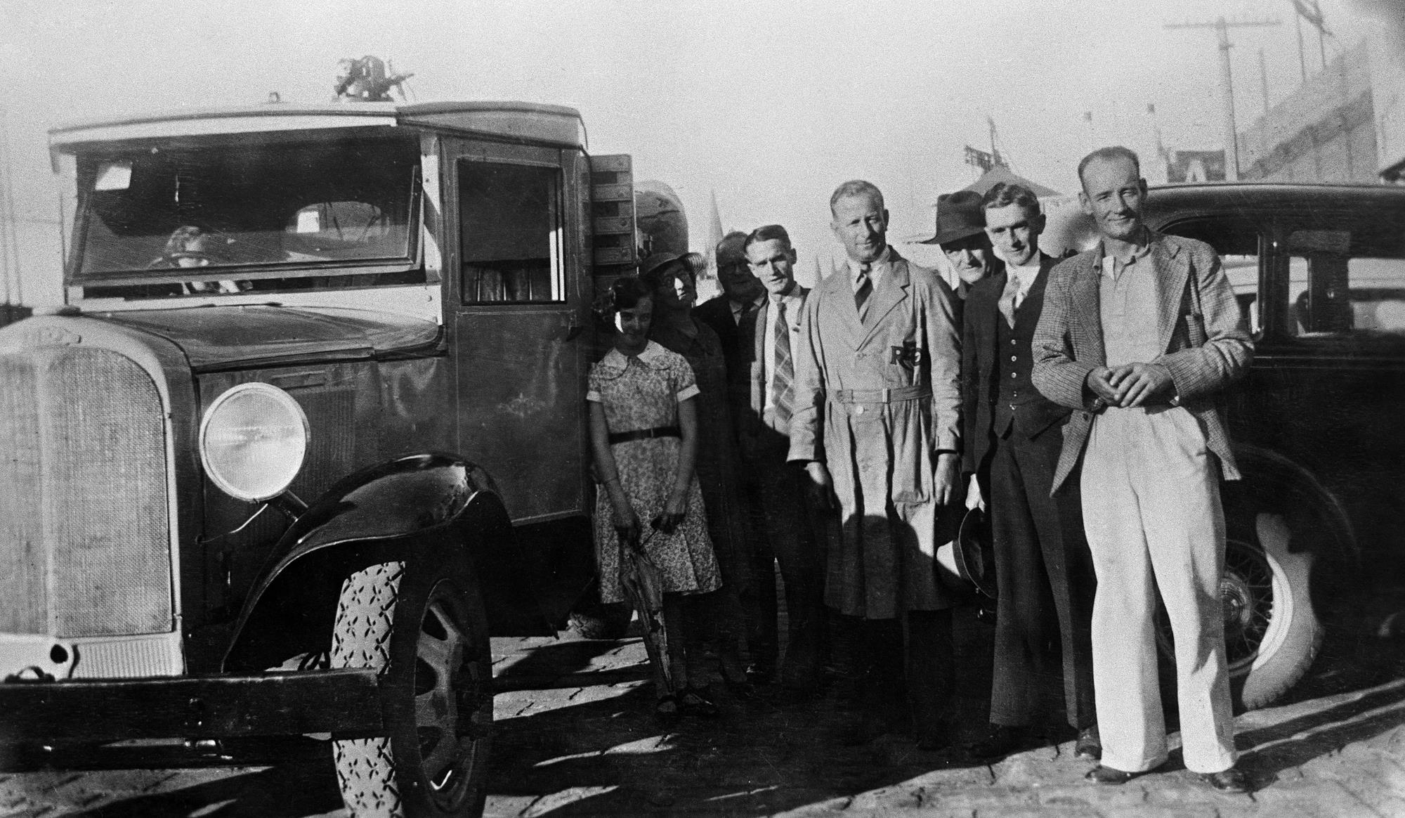
A group of finely dressed people next to large Morris truck, Melbourne, Victoria, 1937
Photographer: Chrystal

Slide 8
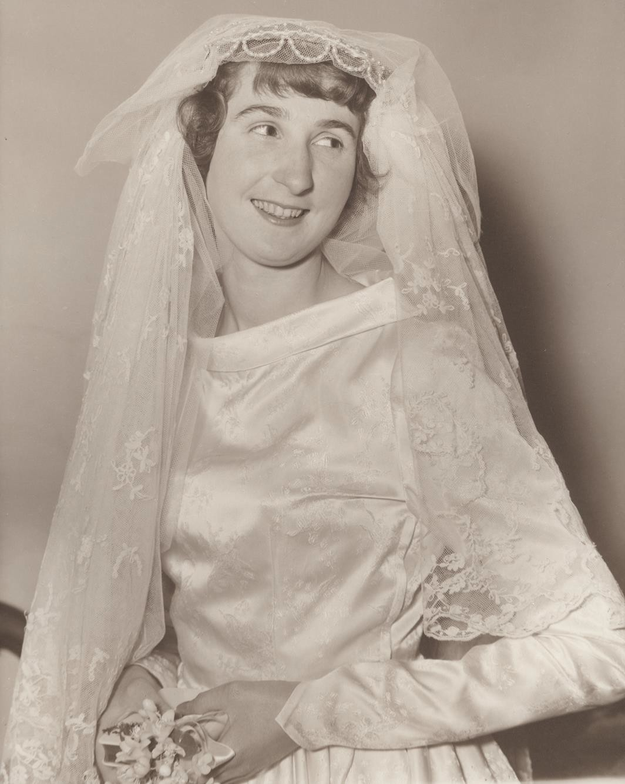
Nancy Jean Davies on her wedding day, wearing the family wedding veil.
Photographer: Unknown

Slide 9
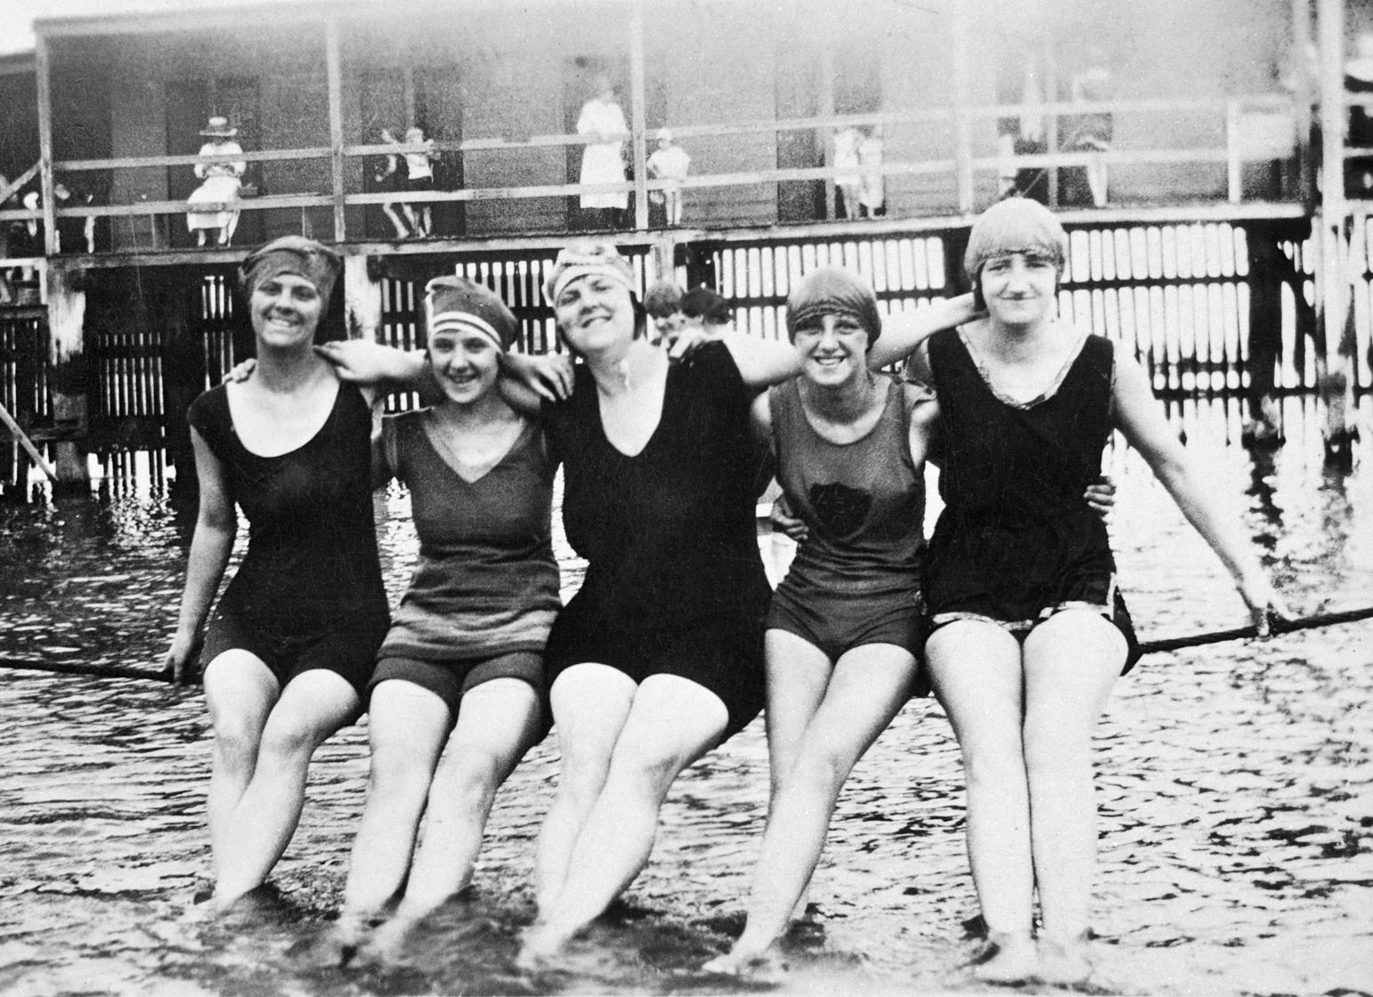
Five women sitting on a rope suspended over the water at the St Kilda Baths.
Photographer: Unknown

Slide 10
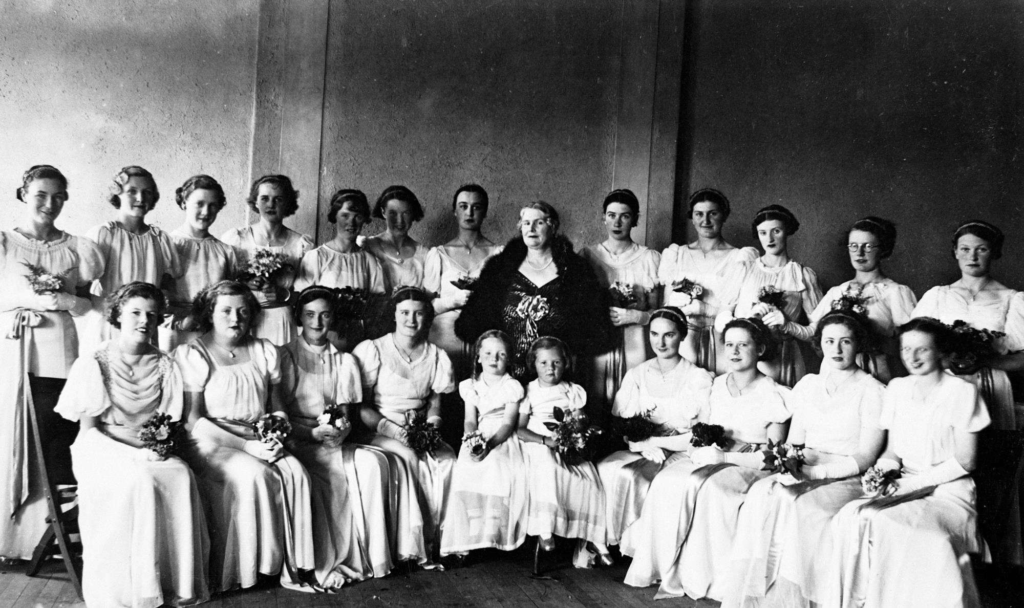
A group of debutantes presented to the Governor, Lord Huntingfield at a ball. Photographer: Unknown

Slide 11
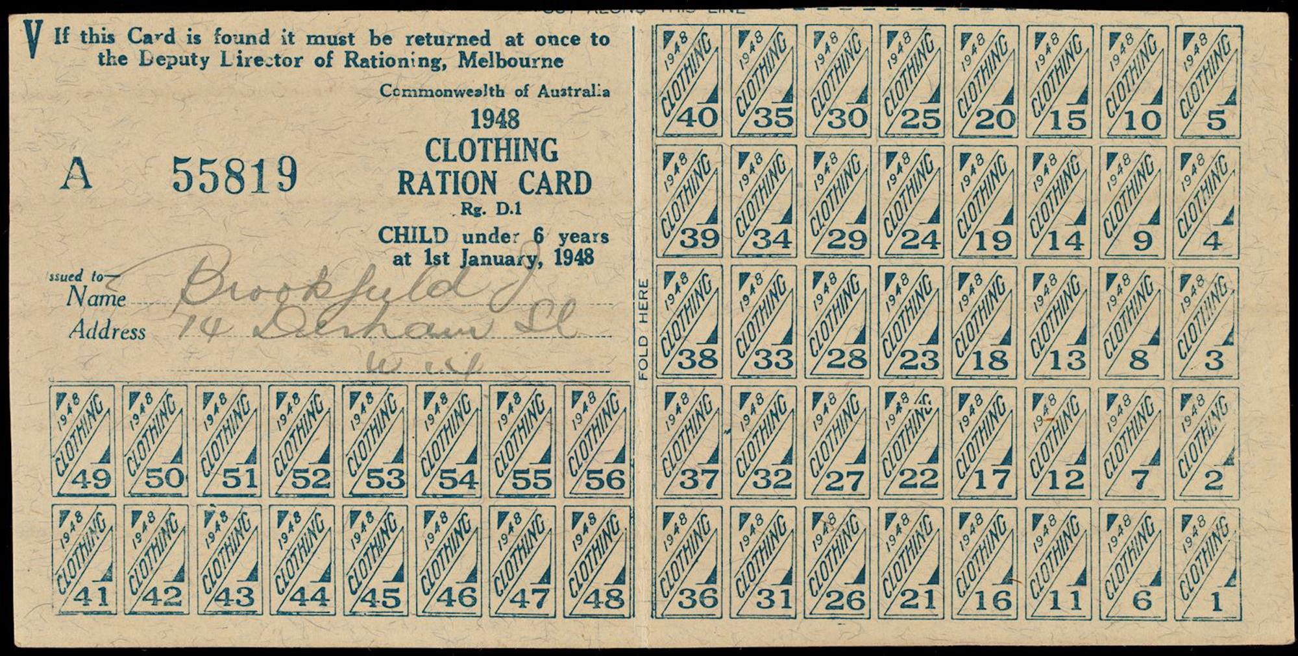
Clothing ration card issued to J Brookfield. Photographer: Unknown

Slide 12
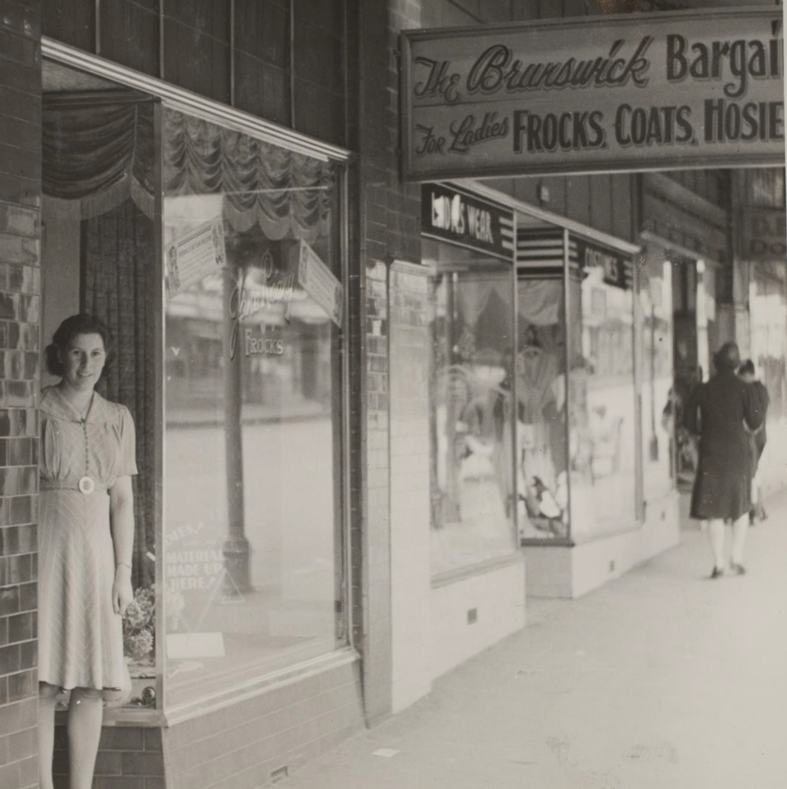
Woman outside her Clothing Shop 'Jane Regny' on Sydney Road.
Photographer: Roy Leibig

Slide 13
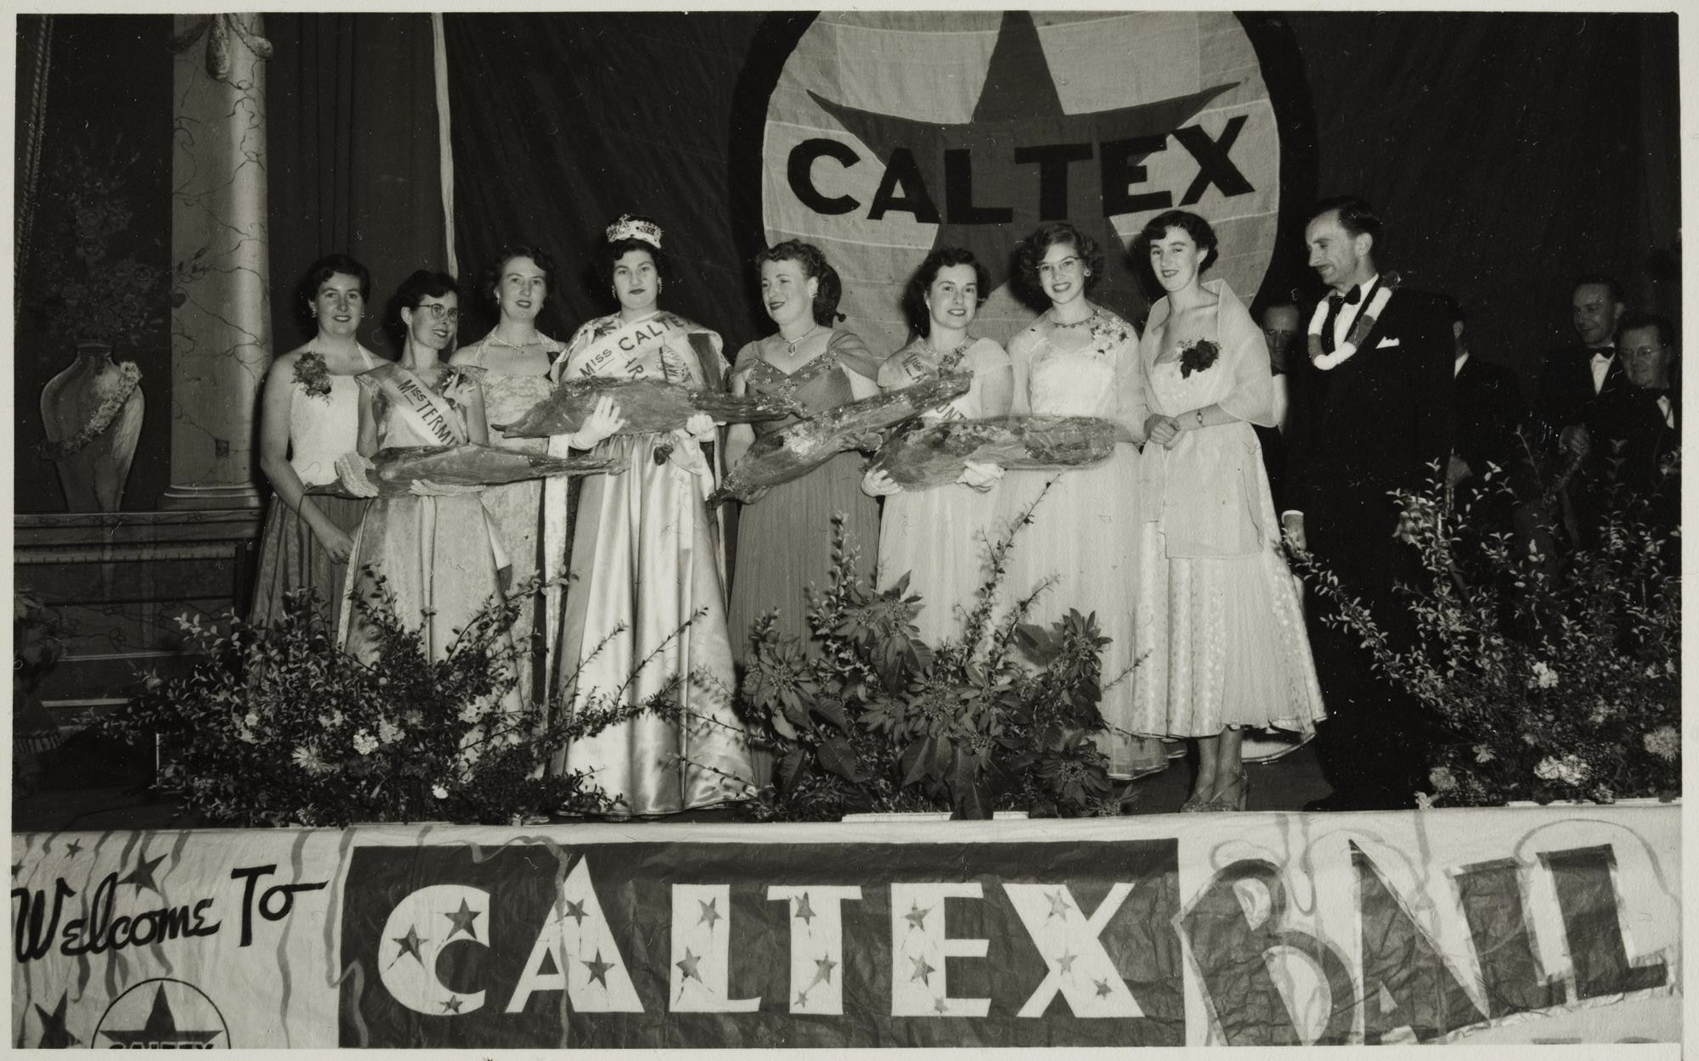
Female Staff in a Beauty Pageant at the Caltex Ball. Photographer: Unknown

Slide 14
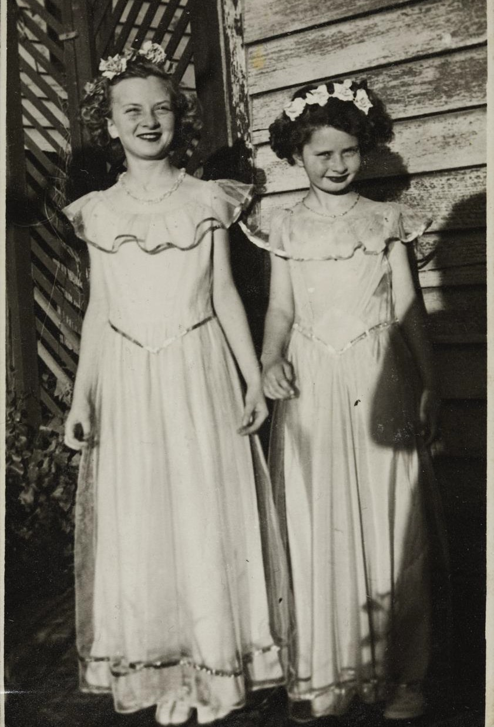
Two girls in long dresses & flower wreaths at a Kingsville Primary School concert.
Photographer: Unknown

Slide 15
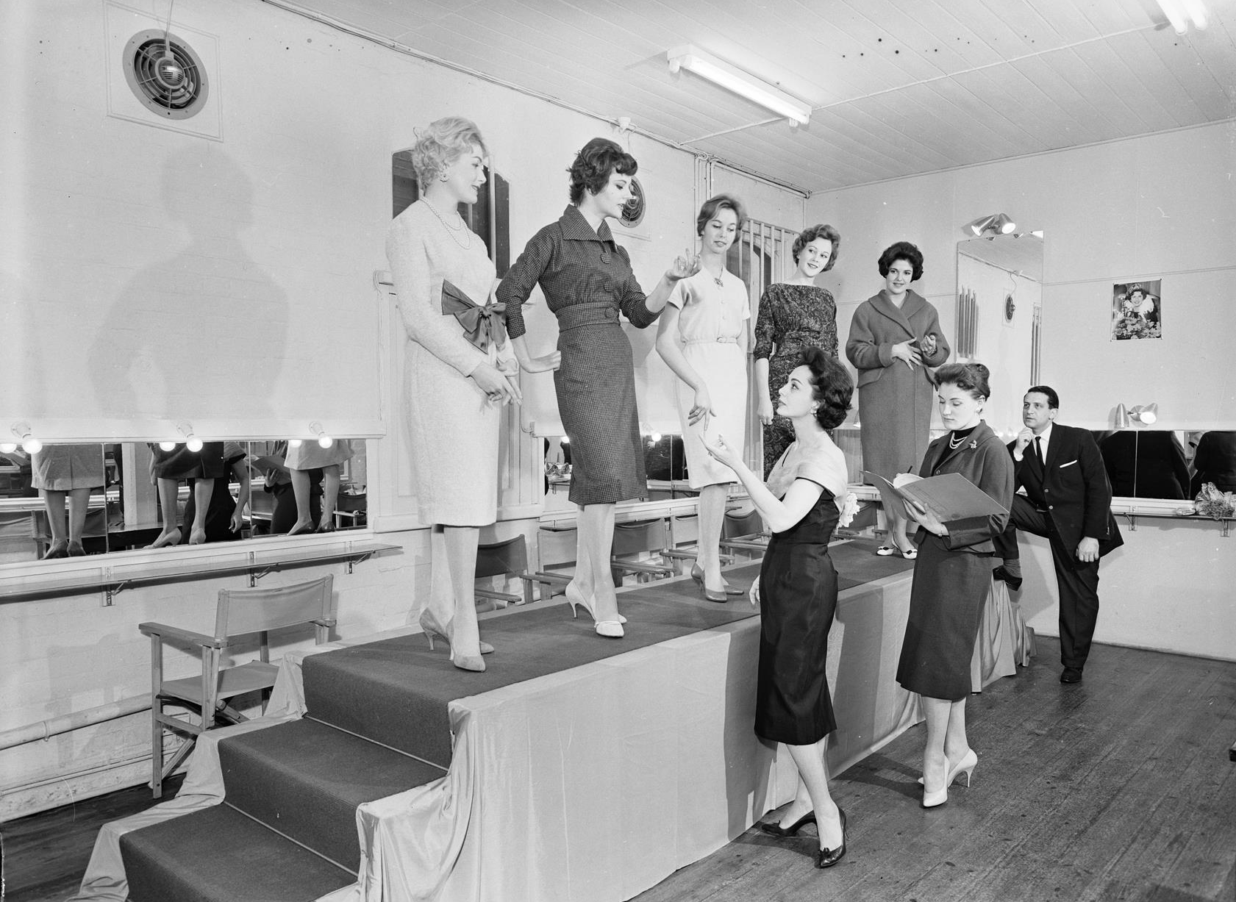
Five women being critiqued on a catwalk at the Elly Lukas Salon.
By: Laurie Richards Studio

Slide 16
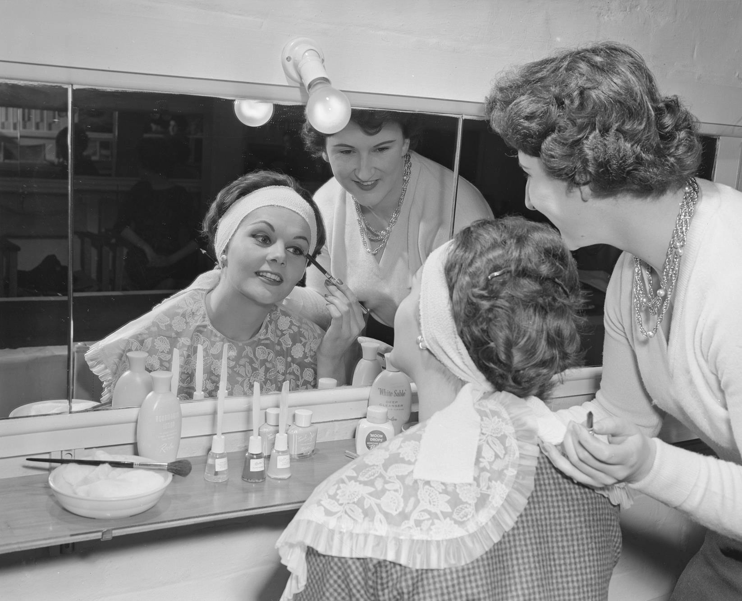
Woman applying make-up at the Elly Lukas Salon.
By: Laurie Richards Studio

Slide 17
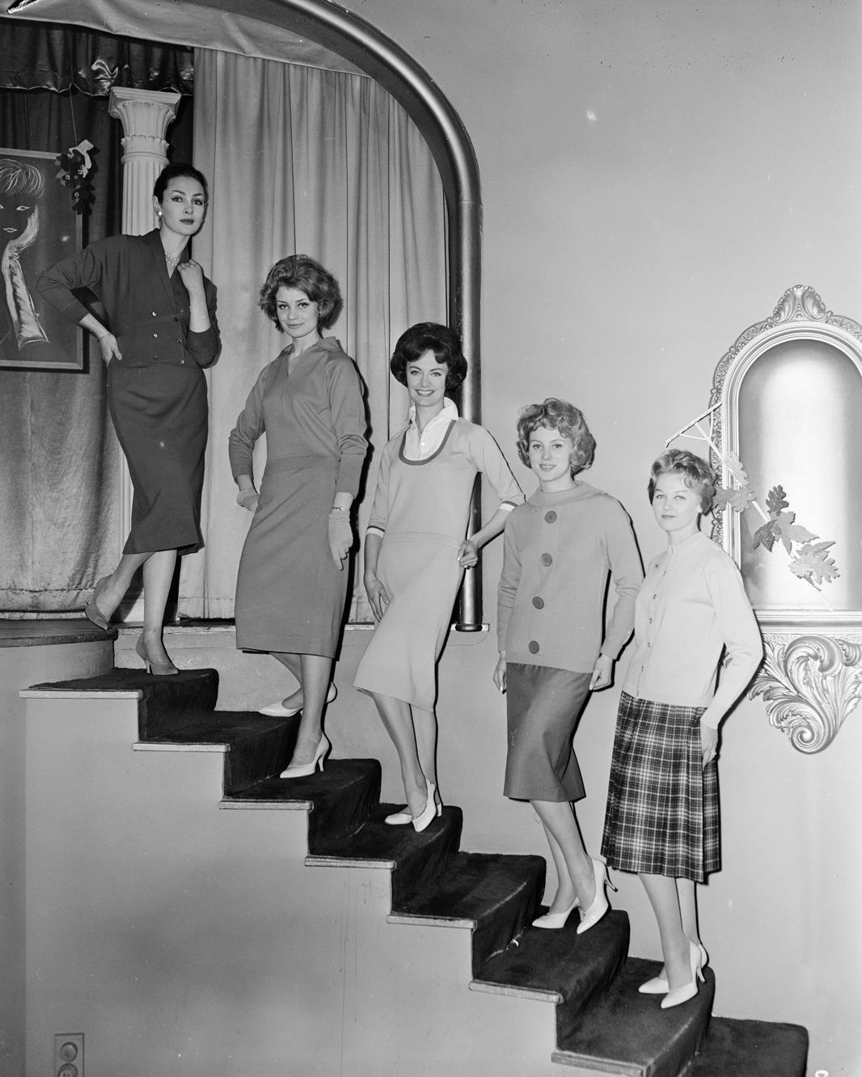
Five female models standing on the stairs of Ciro’s Nightclub.
By: Laurie Richards Studio

Slide 18
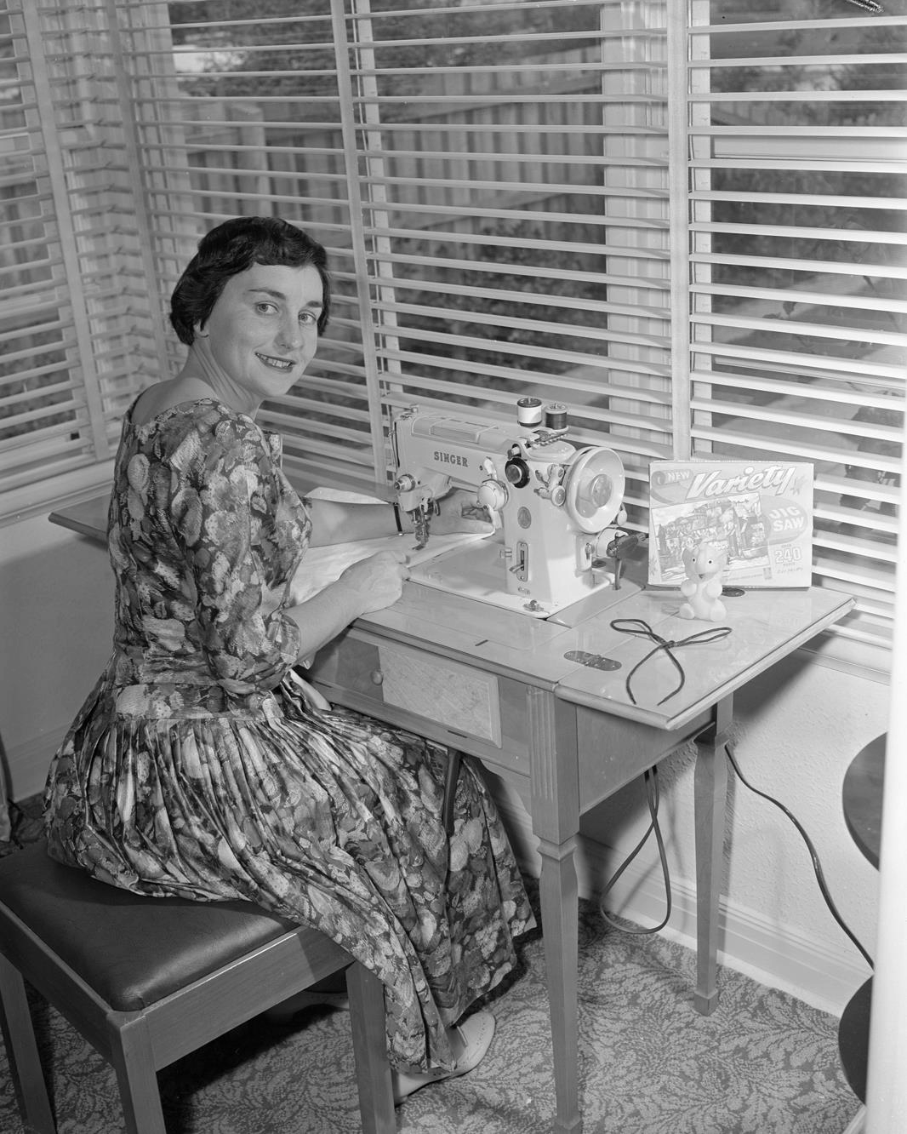
Woman using a sewing machine.
By: Laurie Richards Studio

Slide 19
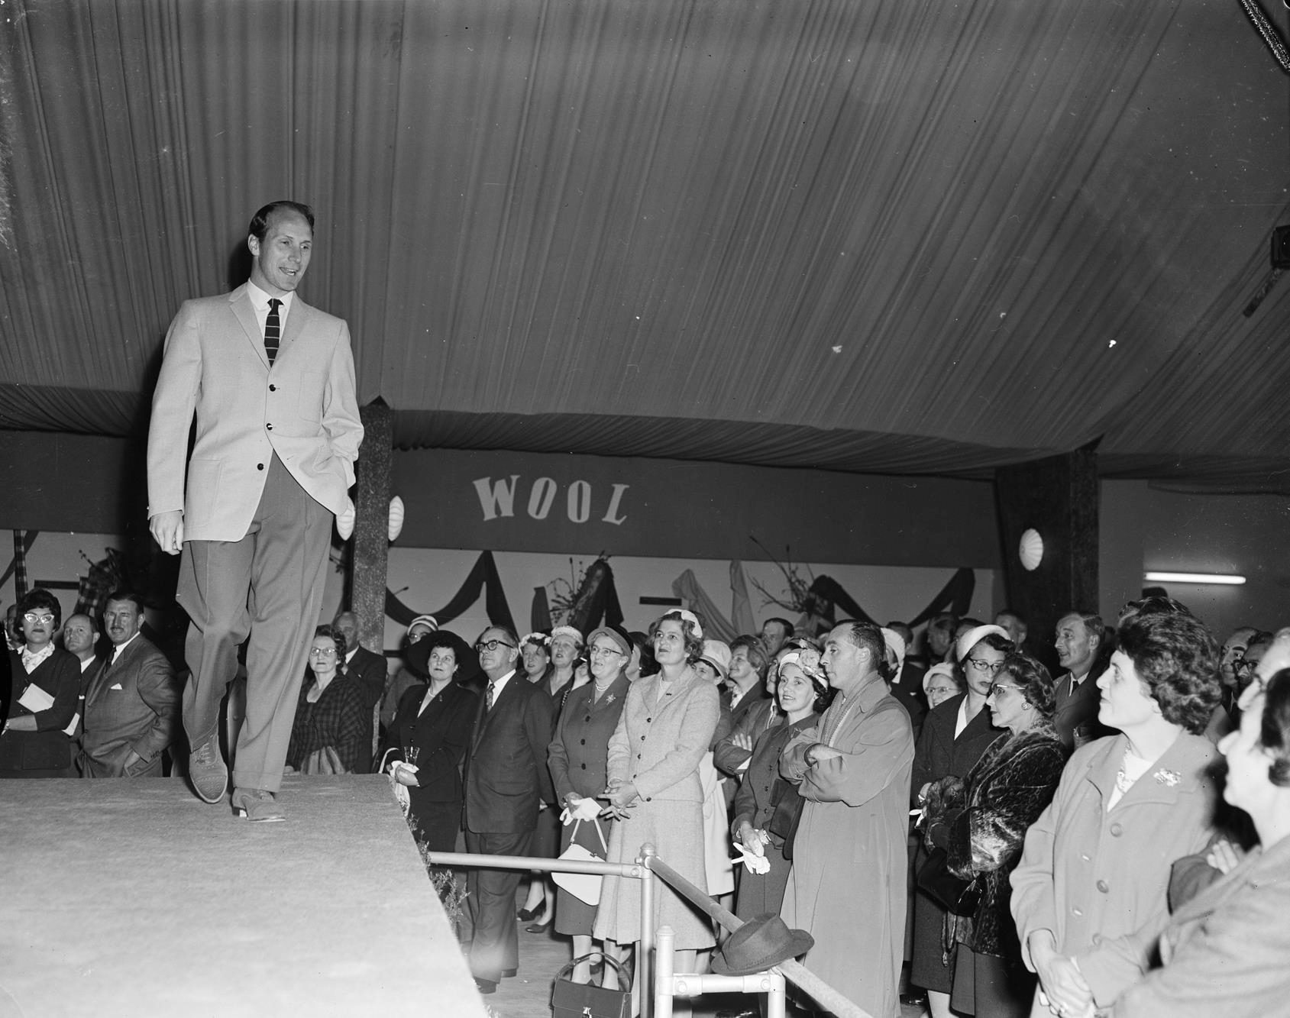
Male model dressed in a suit at the Royal Melbourne Showgrounds.
By: Laurie Richards Studio

Slide 20
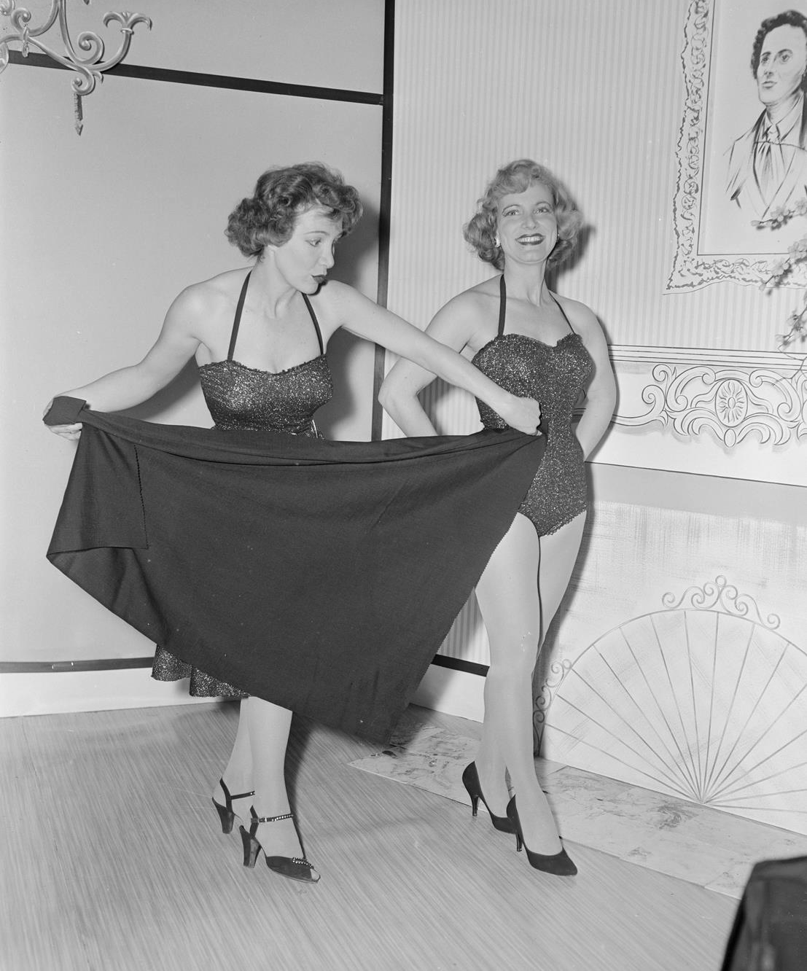
Two female models at the Australian Wool Board carnival at the Royal Melbourne Show.
By: Laurie Richards Studio

Slide 21
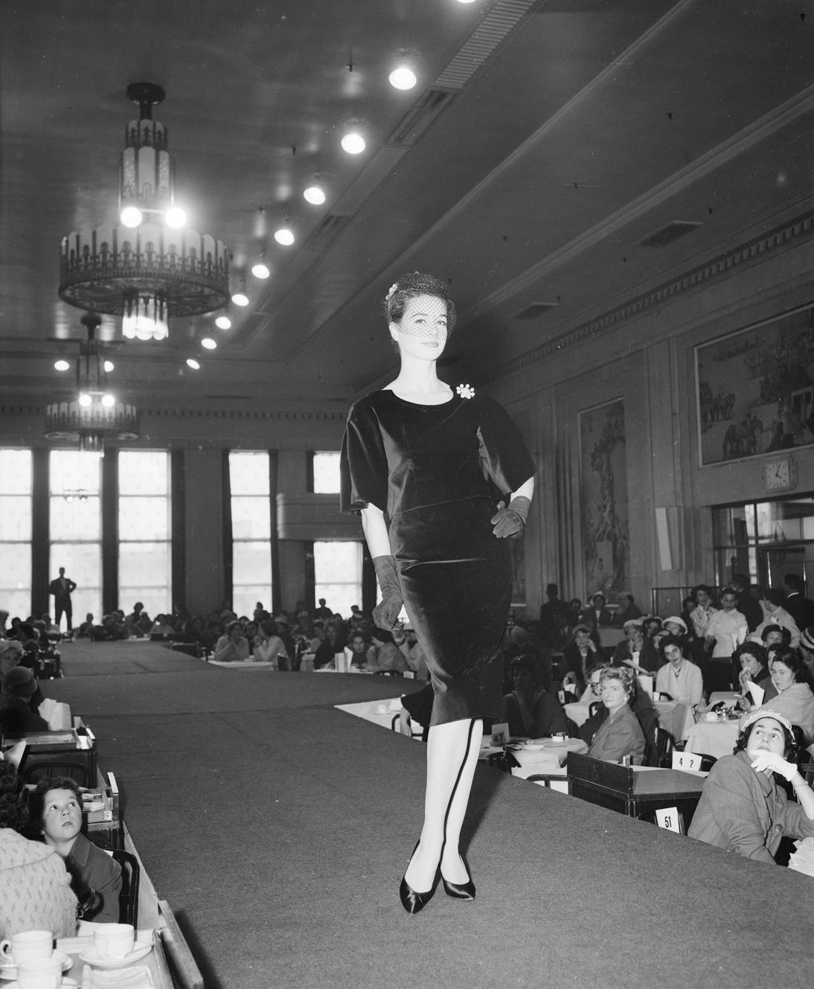
French fashion parade at the Myer department store.
By: Laurie Richards Studio

Slide 22
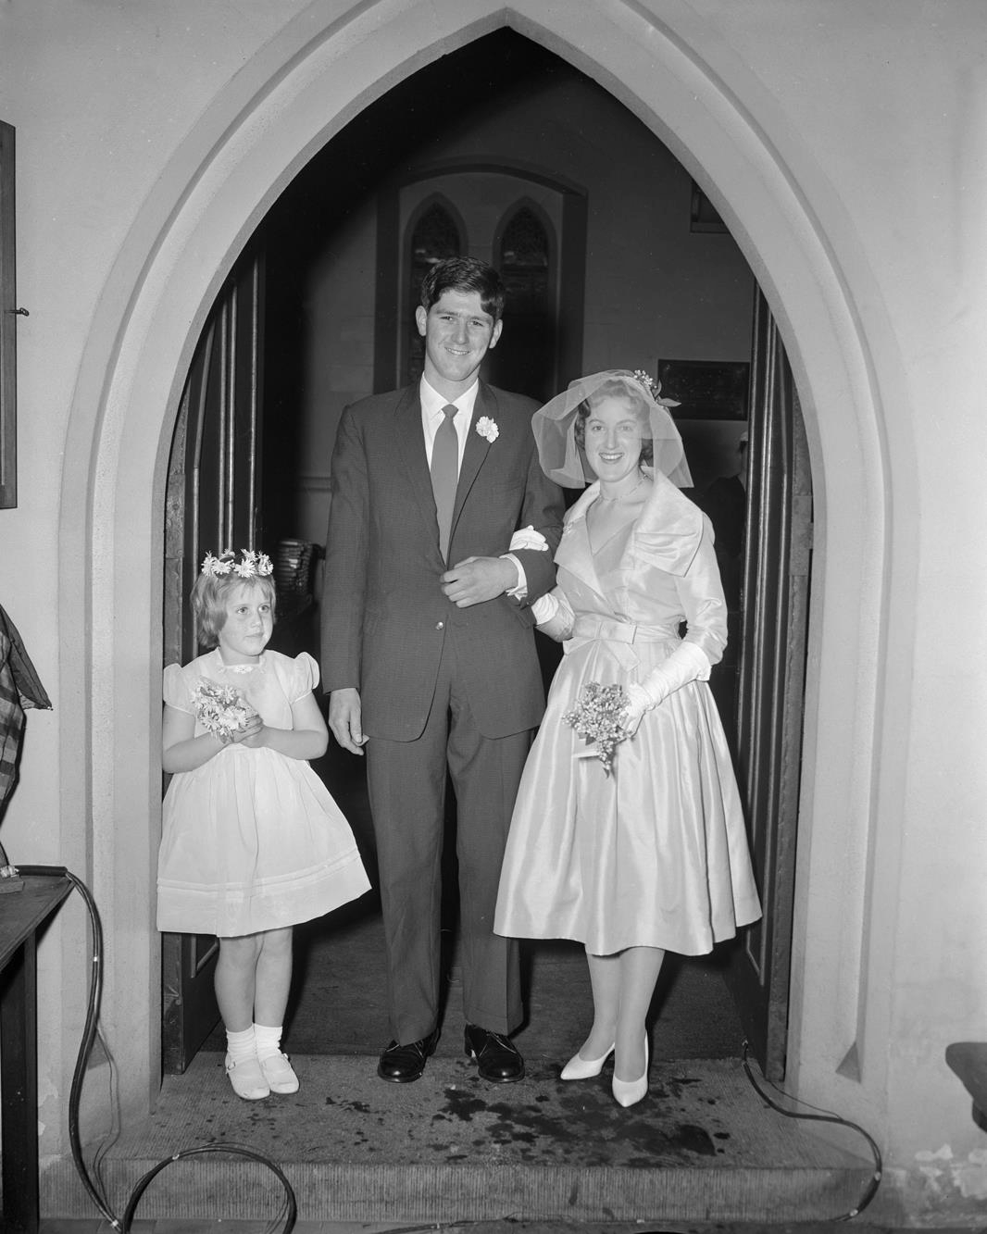
Bride, groom and flower girl standing under a church archway.
By: Laurie Richards Studio

Slide 23
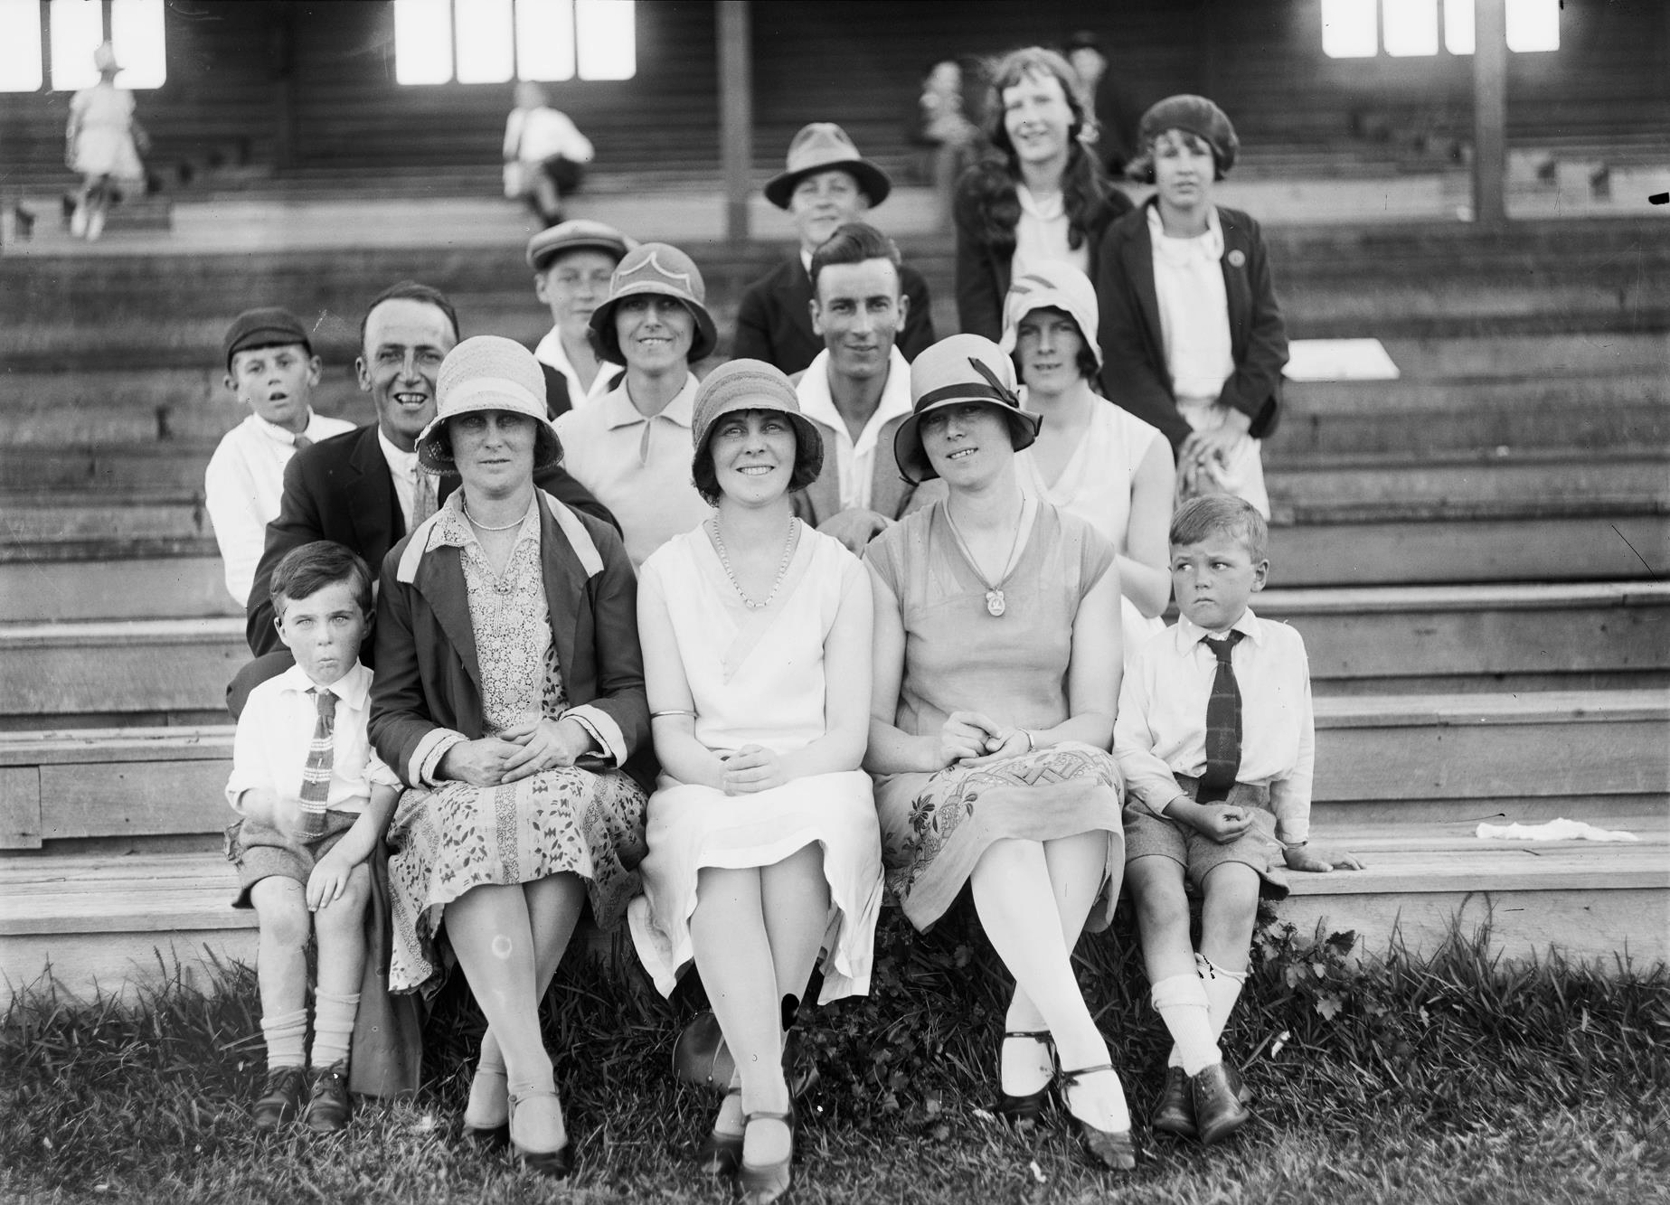
Group portrait seated at a sports stand.
Photographer: Unknown

Slide 24
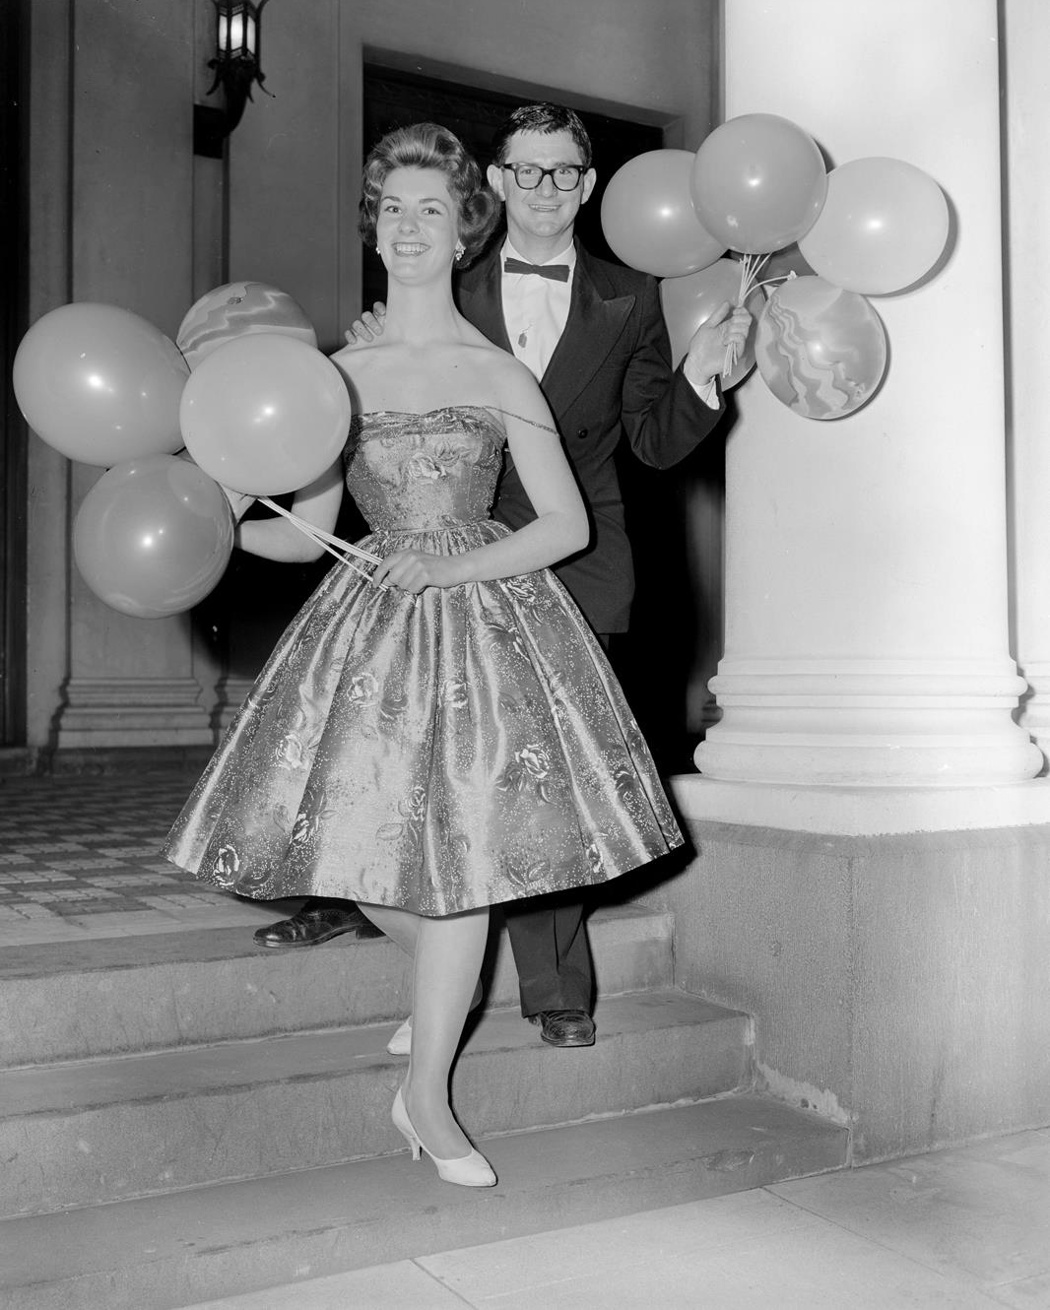
Couple holding a balloon at the Heinz Ball held at the Caulfield Town Hall.
By: Laurie Richards Studio

Slide 25
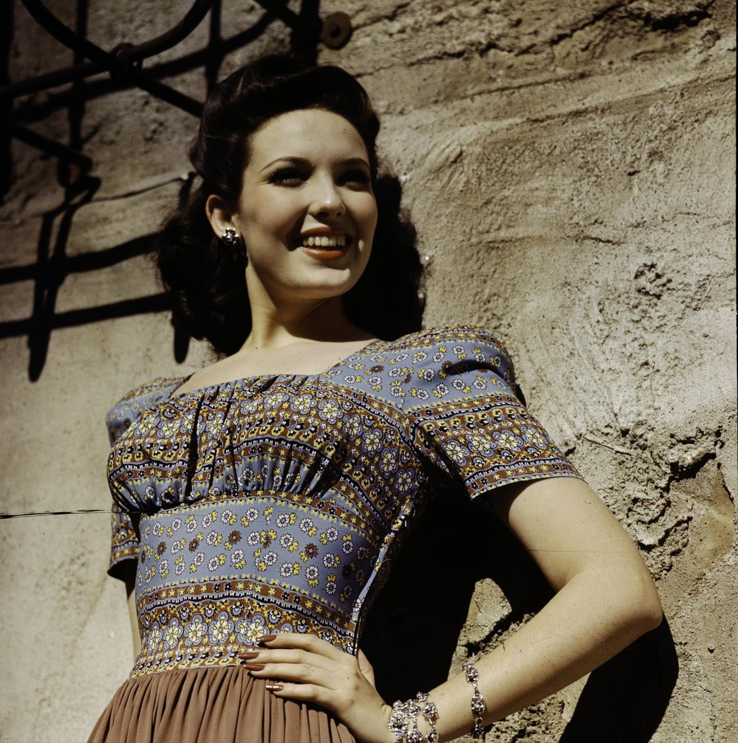
Woman wearing a bohemian print dress. 1950
Photographer: Unknown

Slide 26
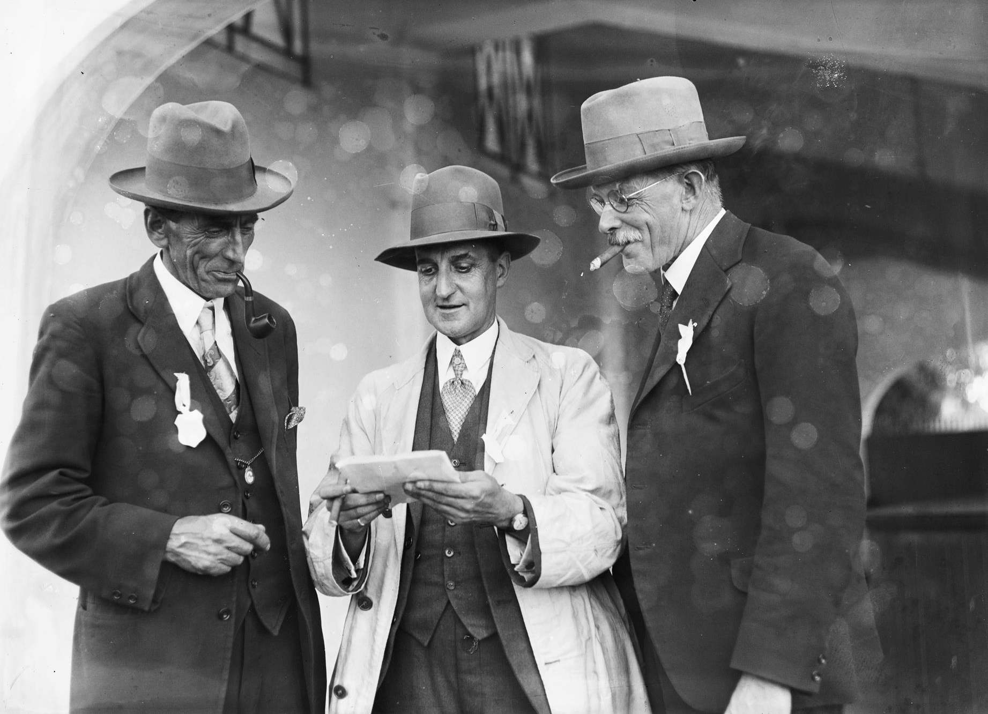
Three men smoking under an archway in suits, ties and hats.
Photographer: Unknown

Slide 27
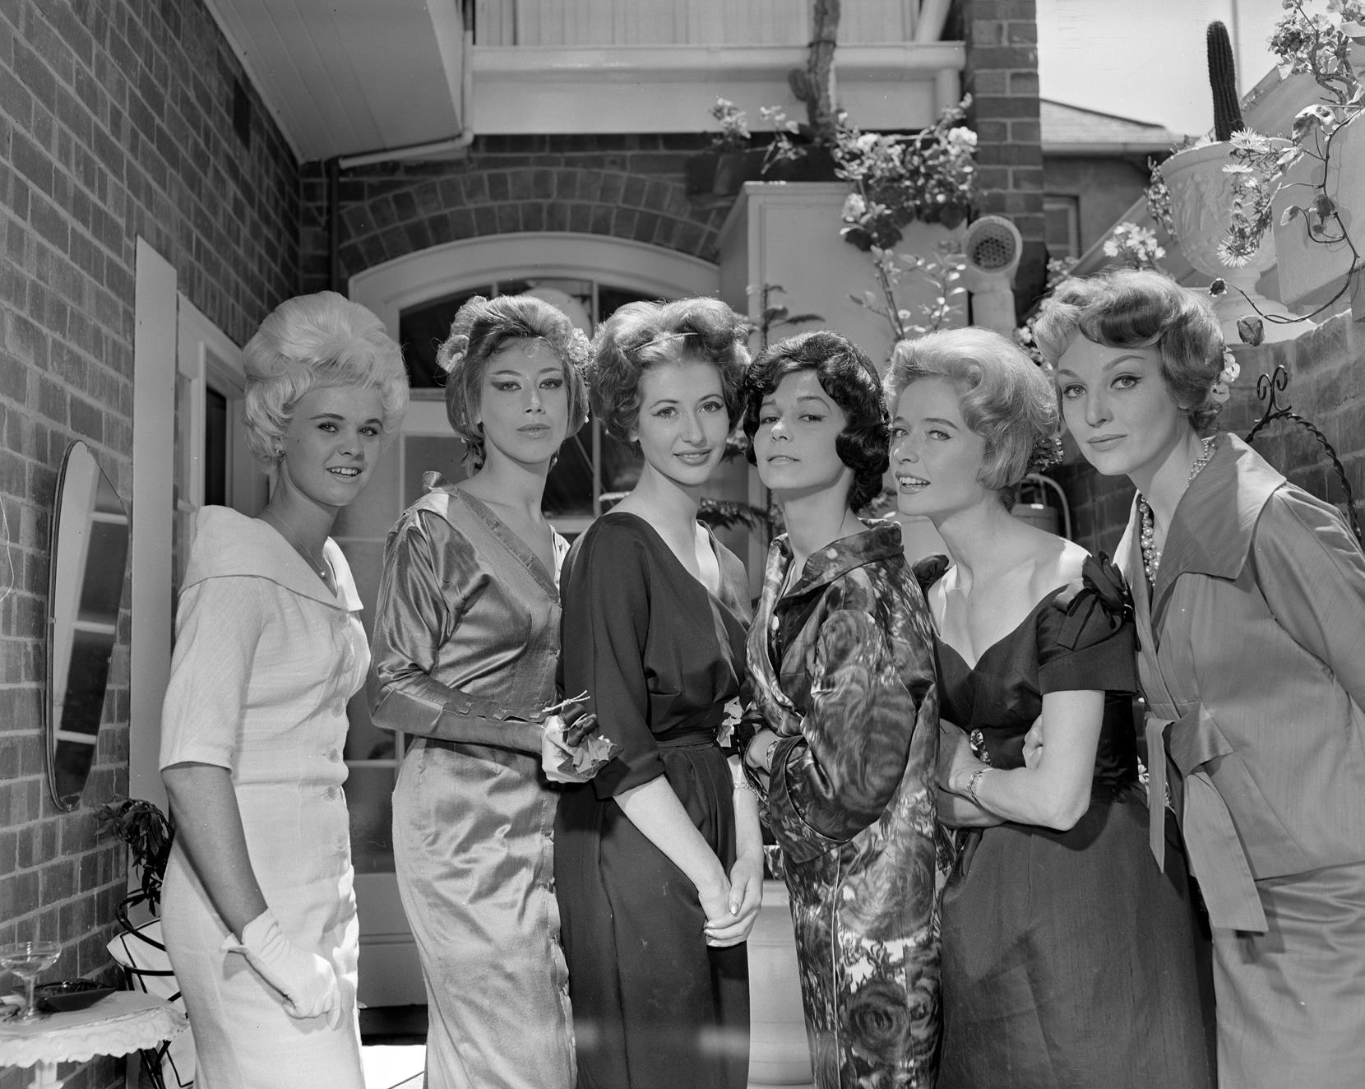
Six women in formal wear.
By: Laurie Richards Studio

Slide 28
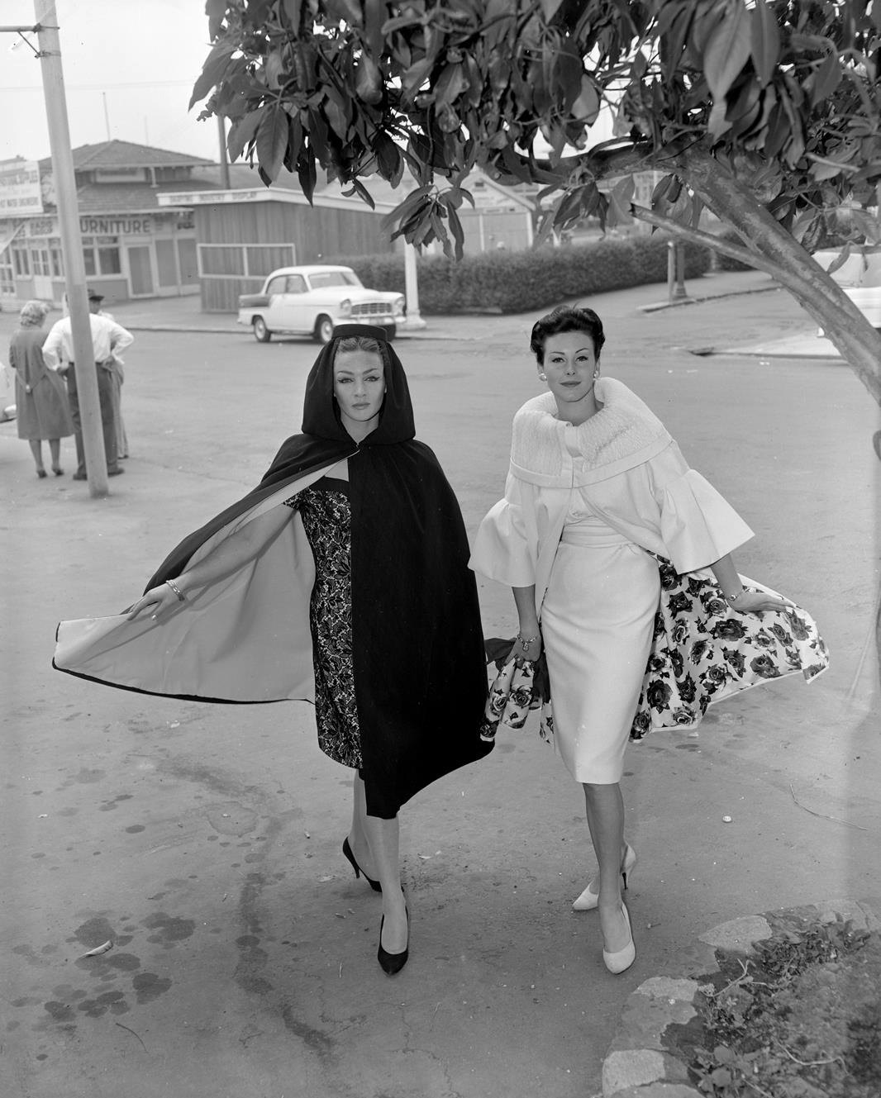
Two women modelling dresses and long capes.
By: Laurie Richards Studio

Slide 29
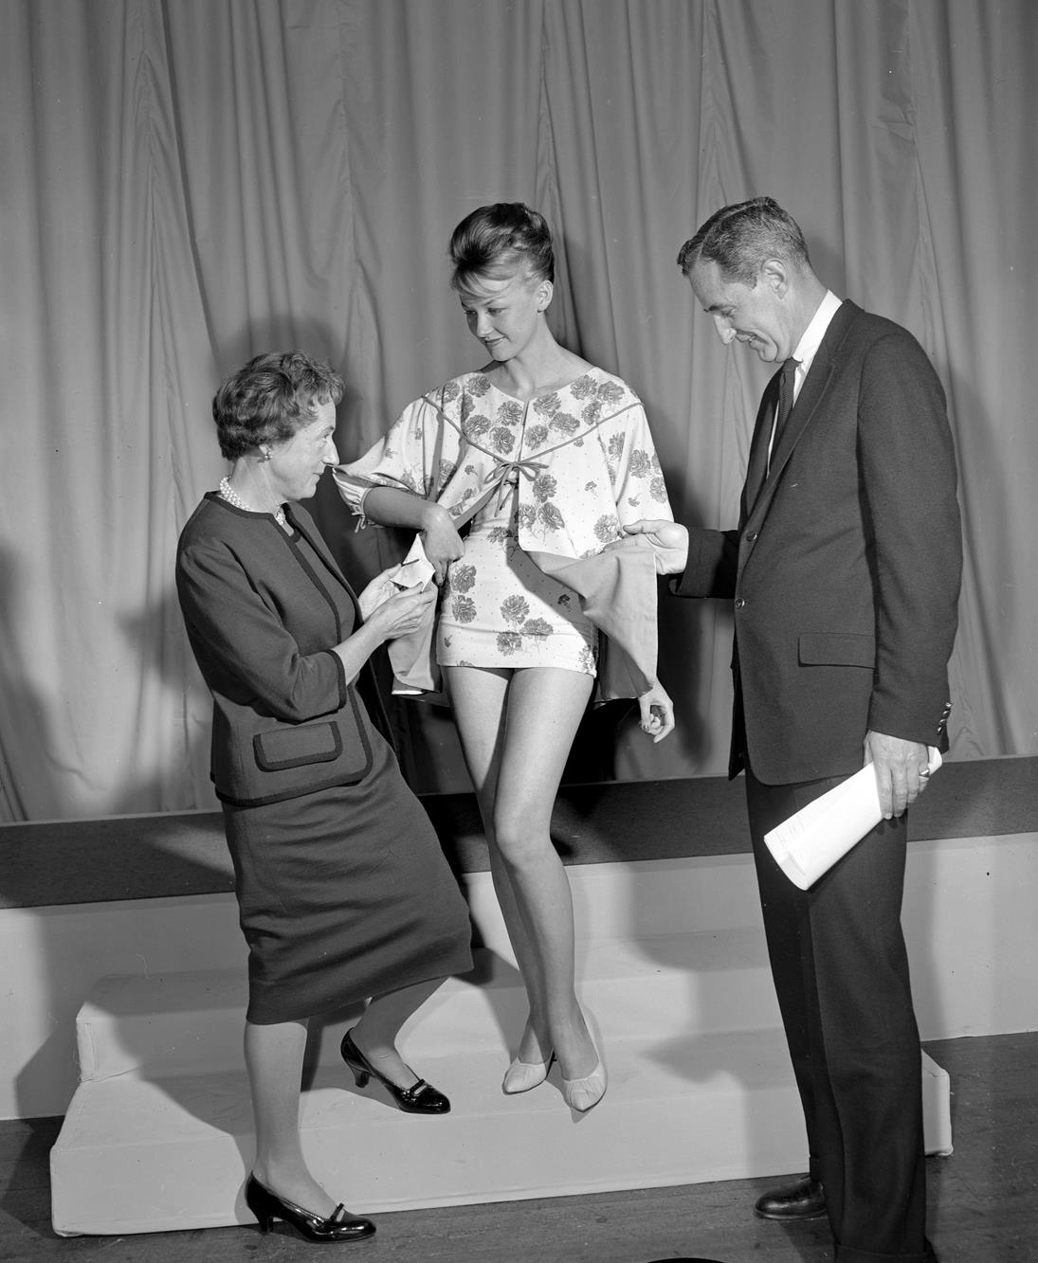
Judges critiquing the garments on a fashion model.
By: Laurie Richards

Slide 30
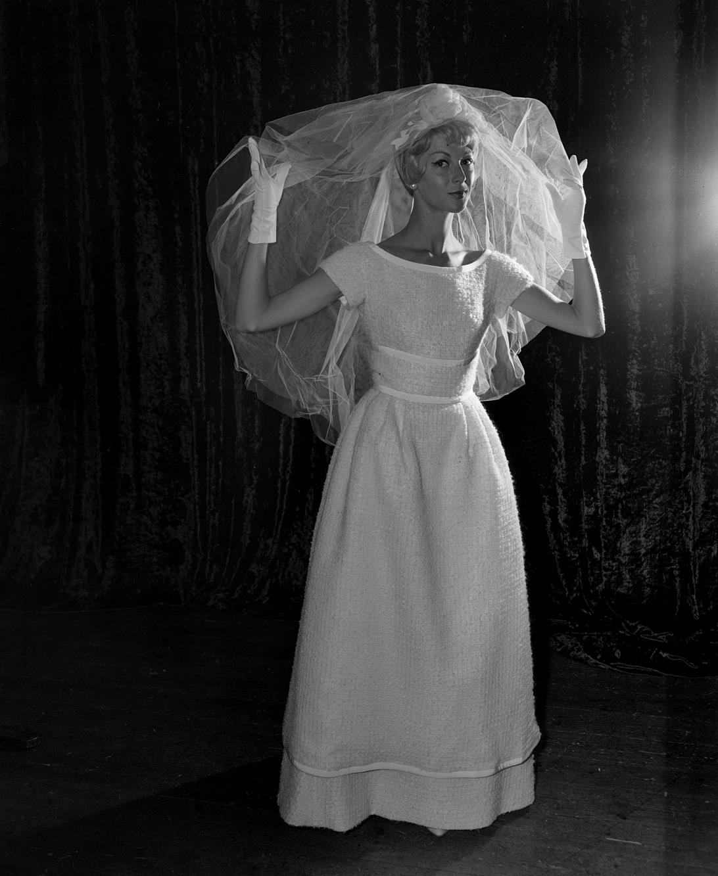
Woman modelling a wedding dress and veil.
By: Laurie Richards

Slide 31
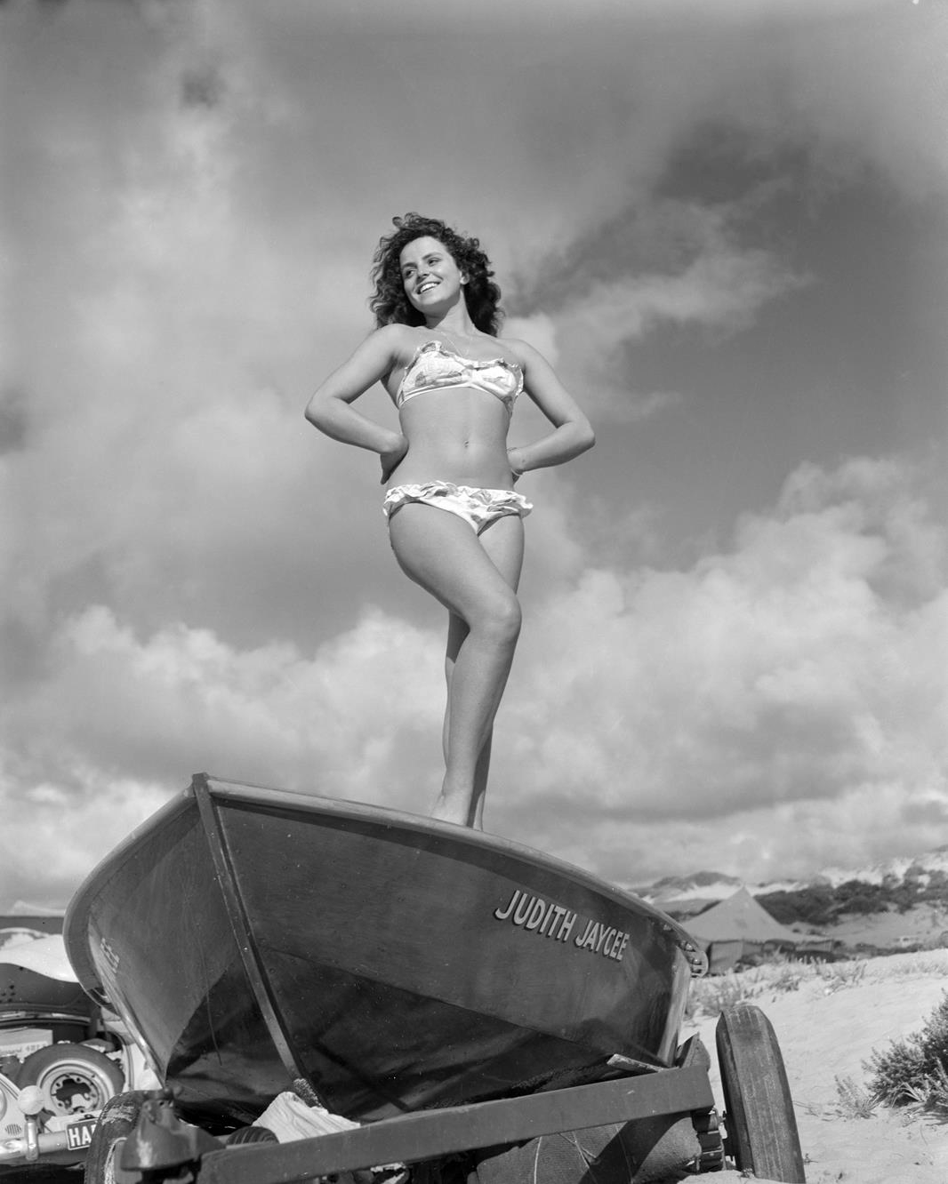
Woman standing on a motor boat wearing a bikini.
By: Laurie Richards Studio

Slide 32
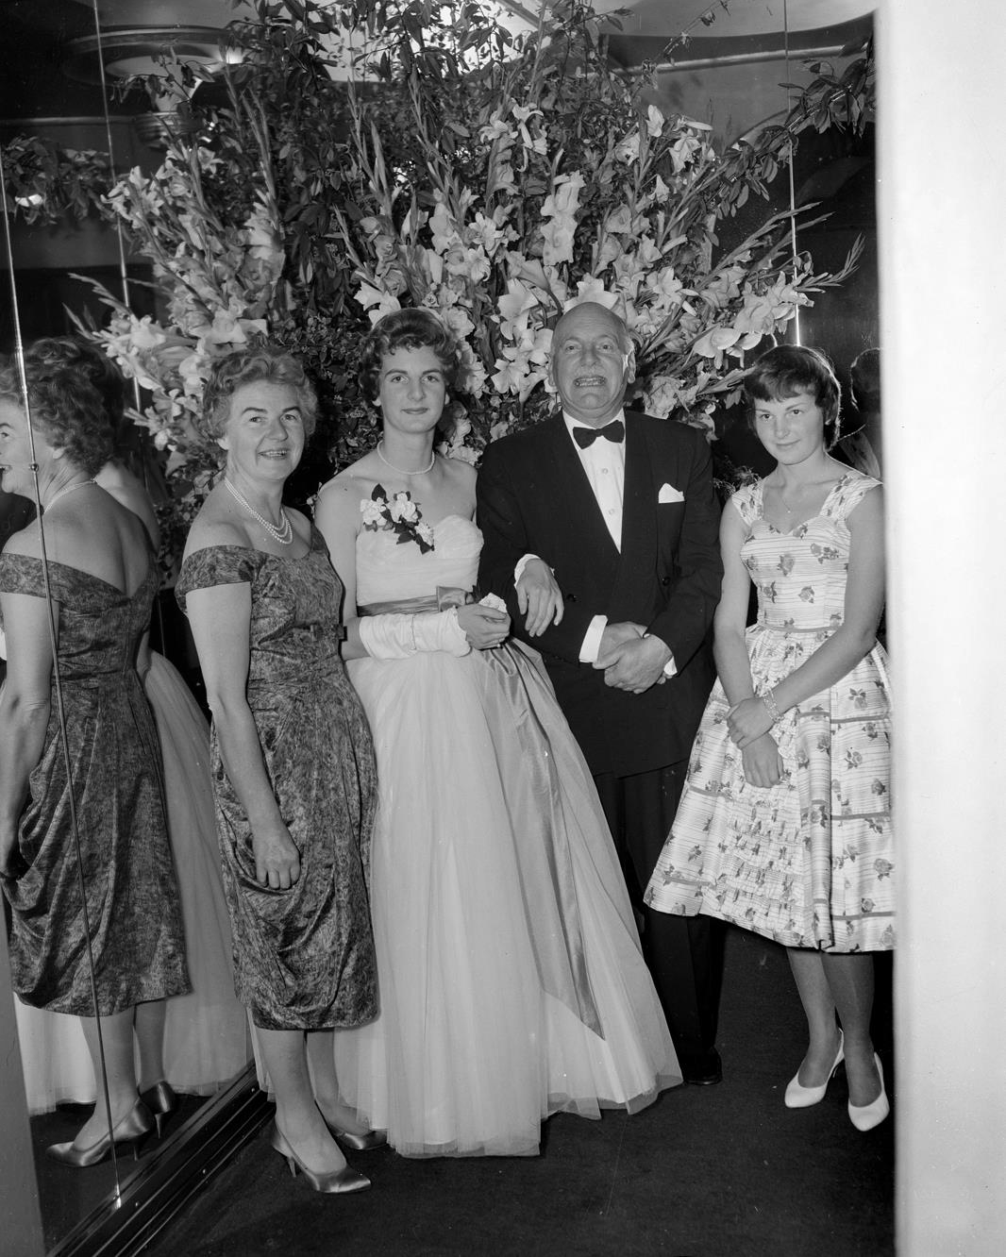
Group in formal wear at an A & G Gilbey Ltd event.
By: Laurie Richards Studio

Slide 33
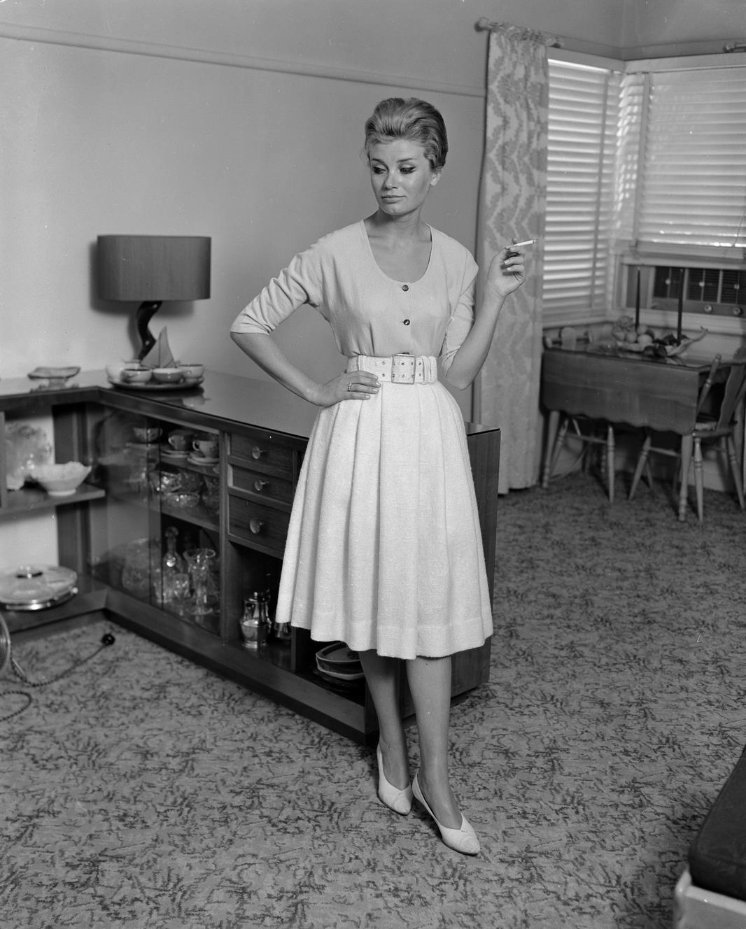
Model in a lounge room holding a cigarette.
By: Laurie Richards Studio

Slide 34
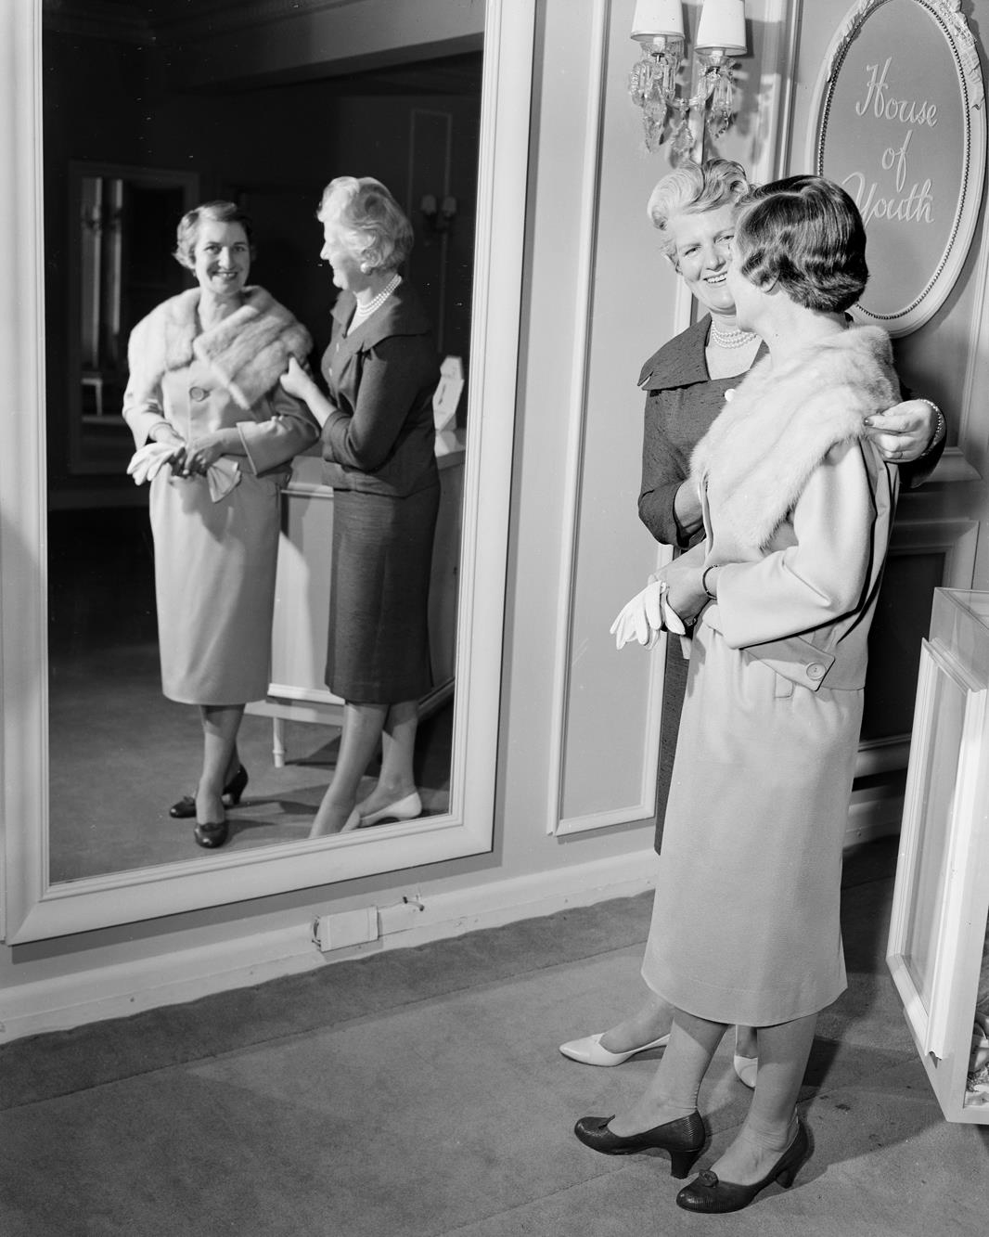
Two women looking into a mirror at the ‘House of Youth’.
By: Laurie Richards

Slide 35
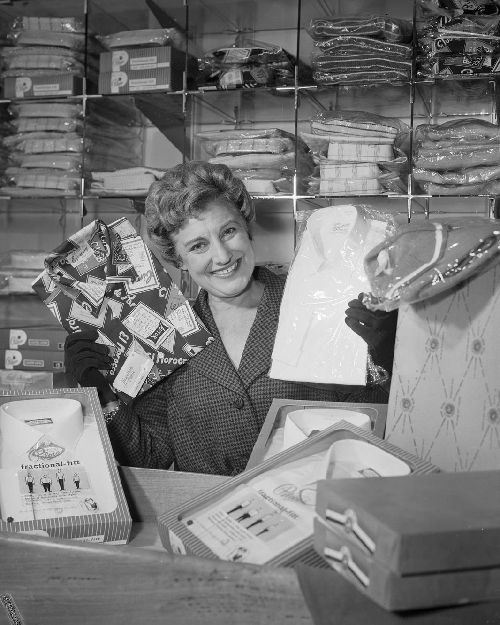
Staff member holding up packaged men’s shirts at Coltons General Drapery store.
By: Laurie Richards Studio

Slide 36
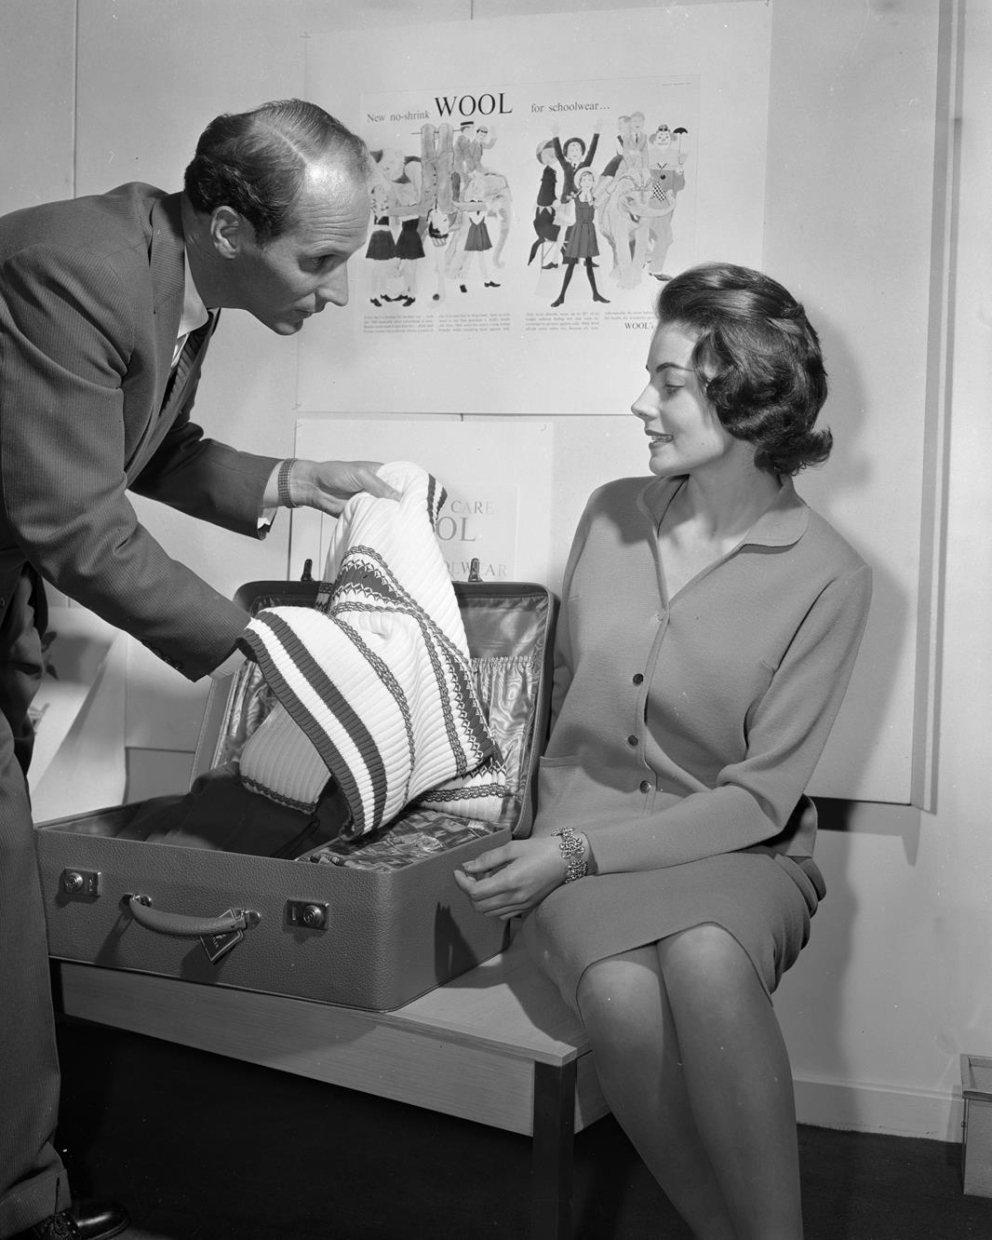
Pair looking at a woollen sweater.
By: Laurie Richards Studio

Slide 37
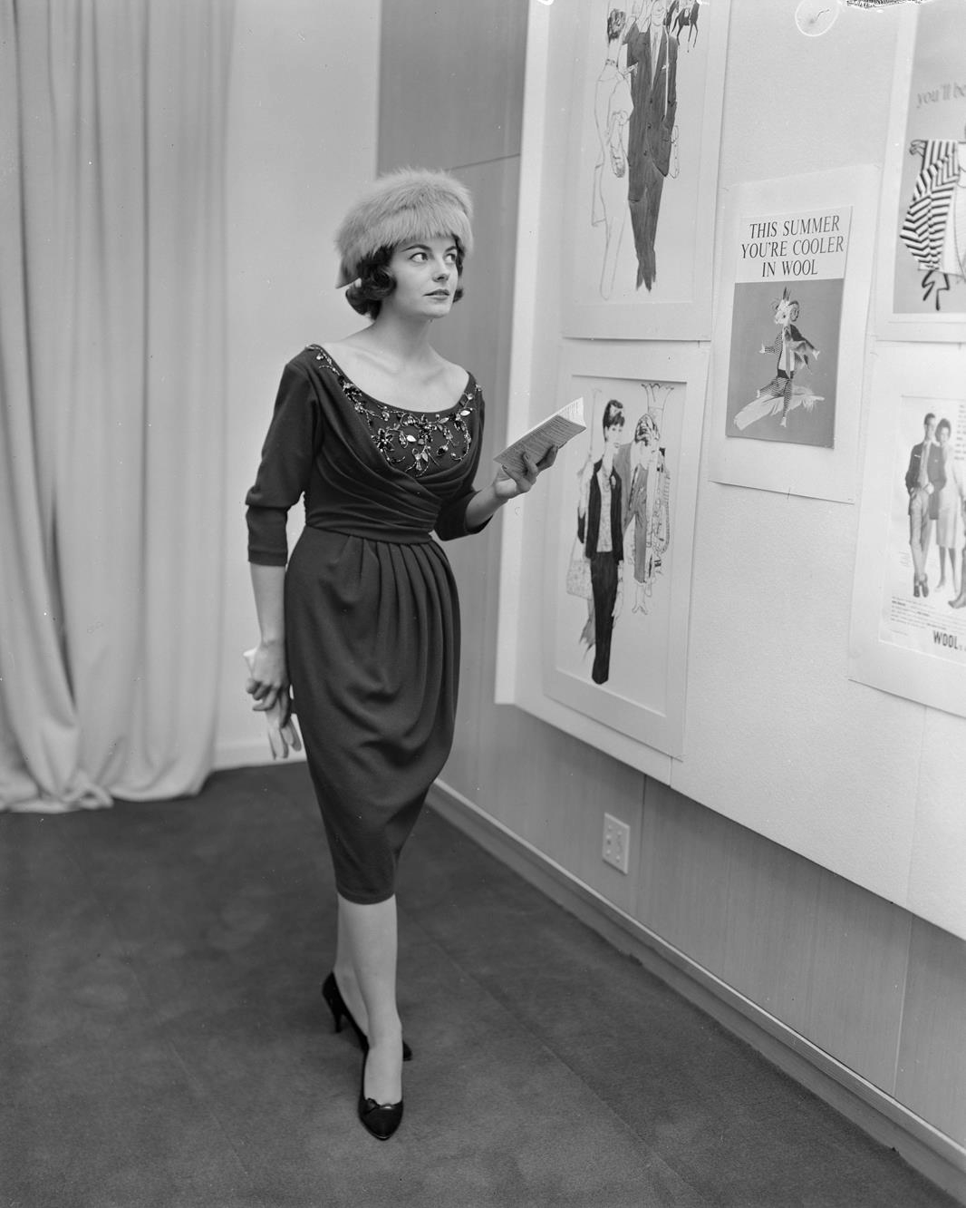
Women looking at fashion illustrations.
By: Laurie Richards Studio

Slide 38
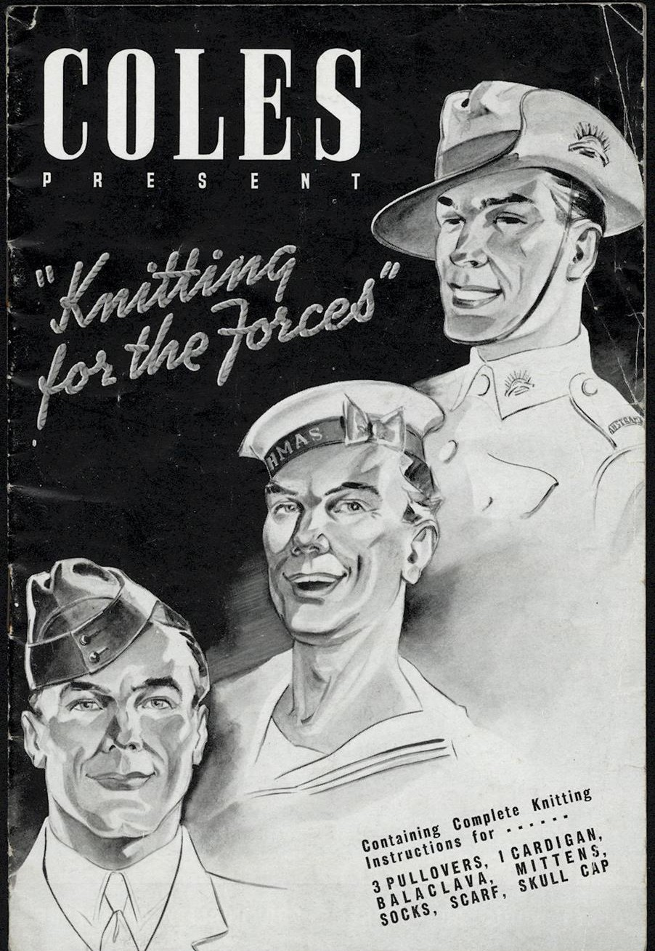
'Knitting for the Forces' Booklet.
Creator: G.J. Coles & Co Ltd

Slide 39
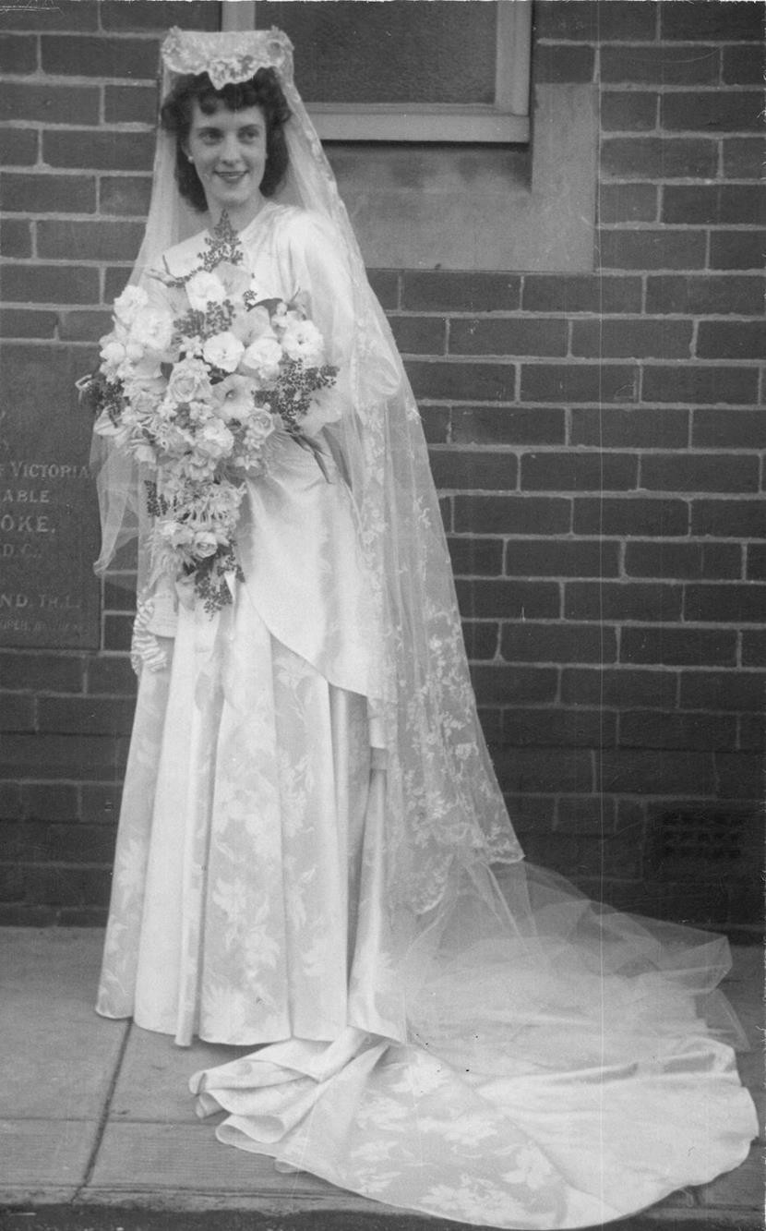
Wedding portrait of Eva Crocker.
Photographer: Unknown

Slide 40
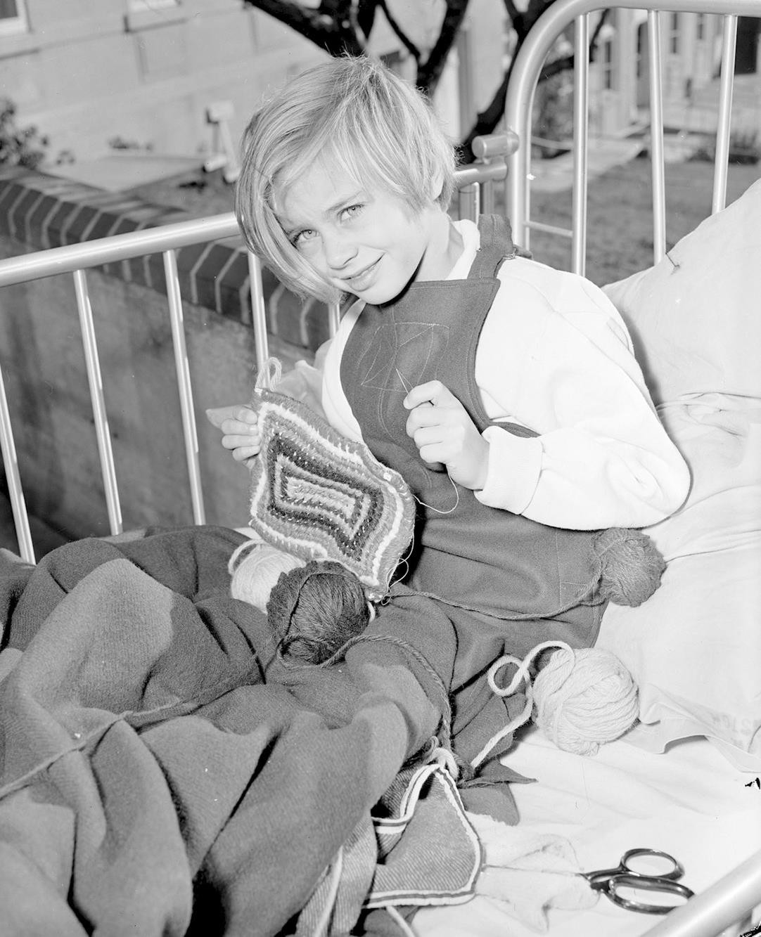
Young girl knitting in her hospital bed.
Laurie Richards Studio

Slide 41
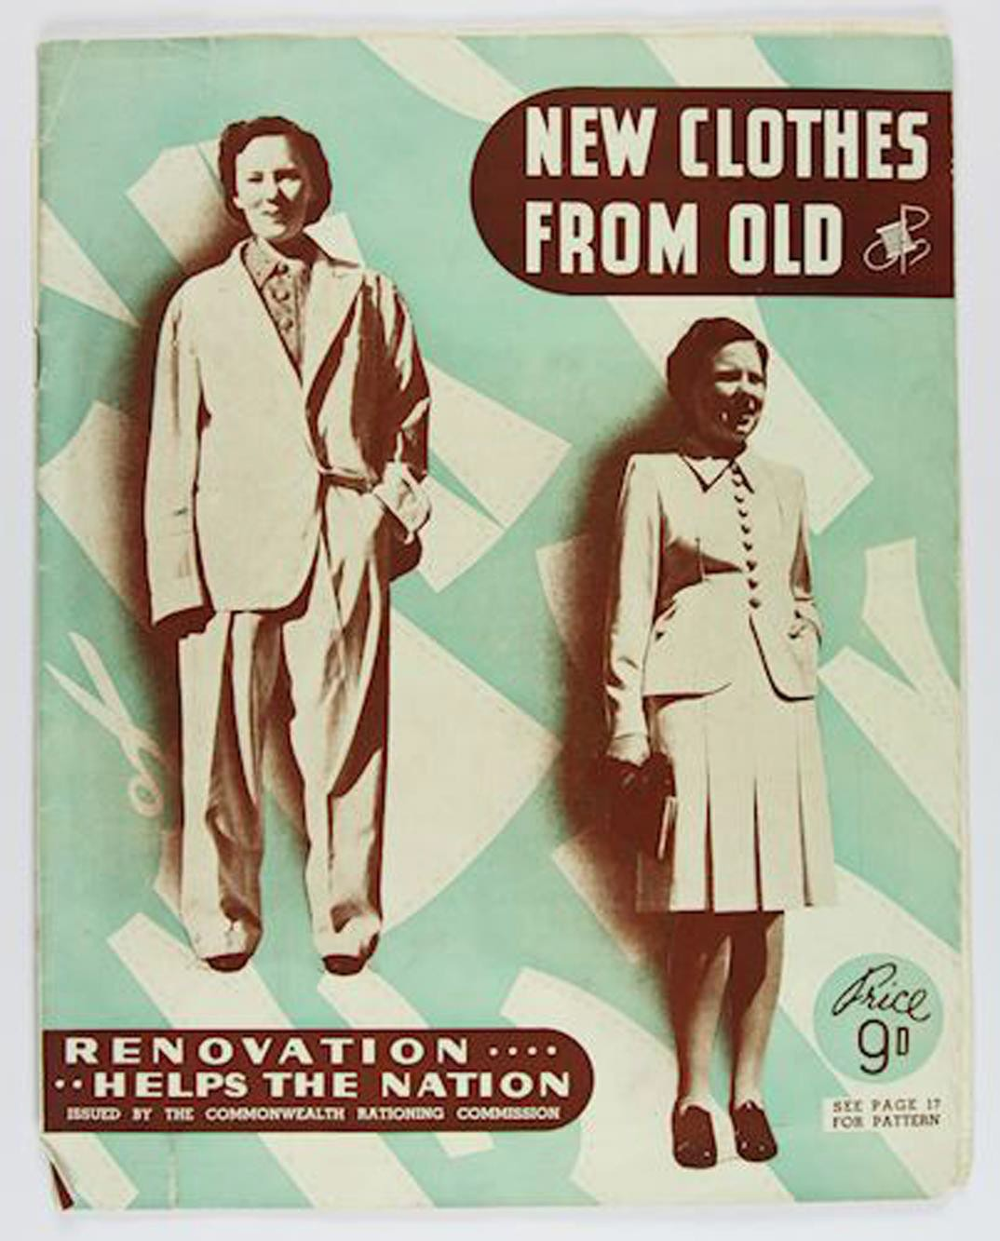
'New Clothes from Old' Booklet.
Commonwealth Rationing Commission

