Slide 1
Recipes for Remembering
A slideshow of images from Museums Victoria's collection relating to food,
cooking and culinary trends from last century.

Slide 2
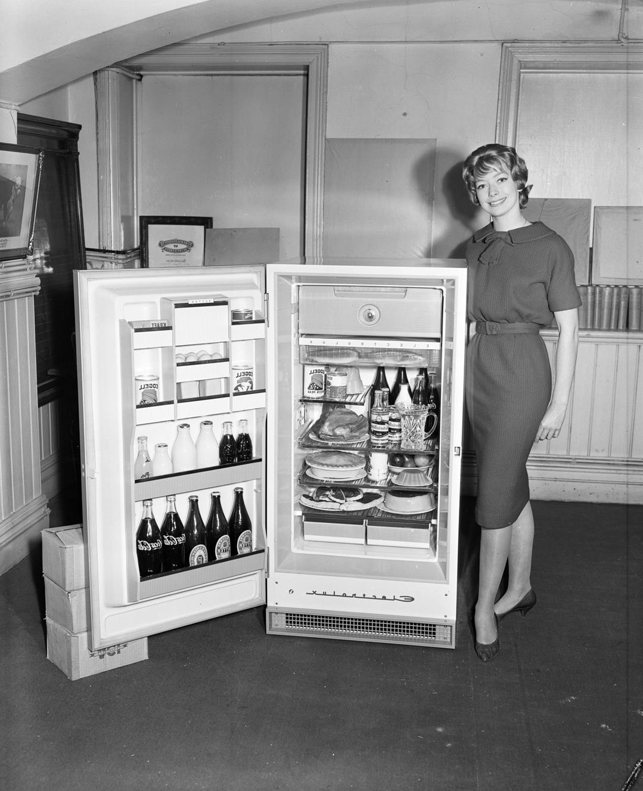
A woman standing next to a refrigerator to reveal a number of canned, bottled & baked food items
Photographer:
Laurie Richards

Slide 3
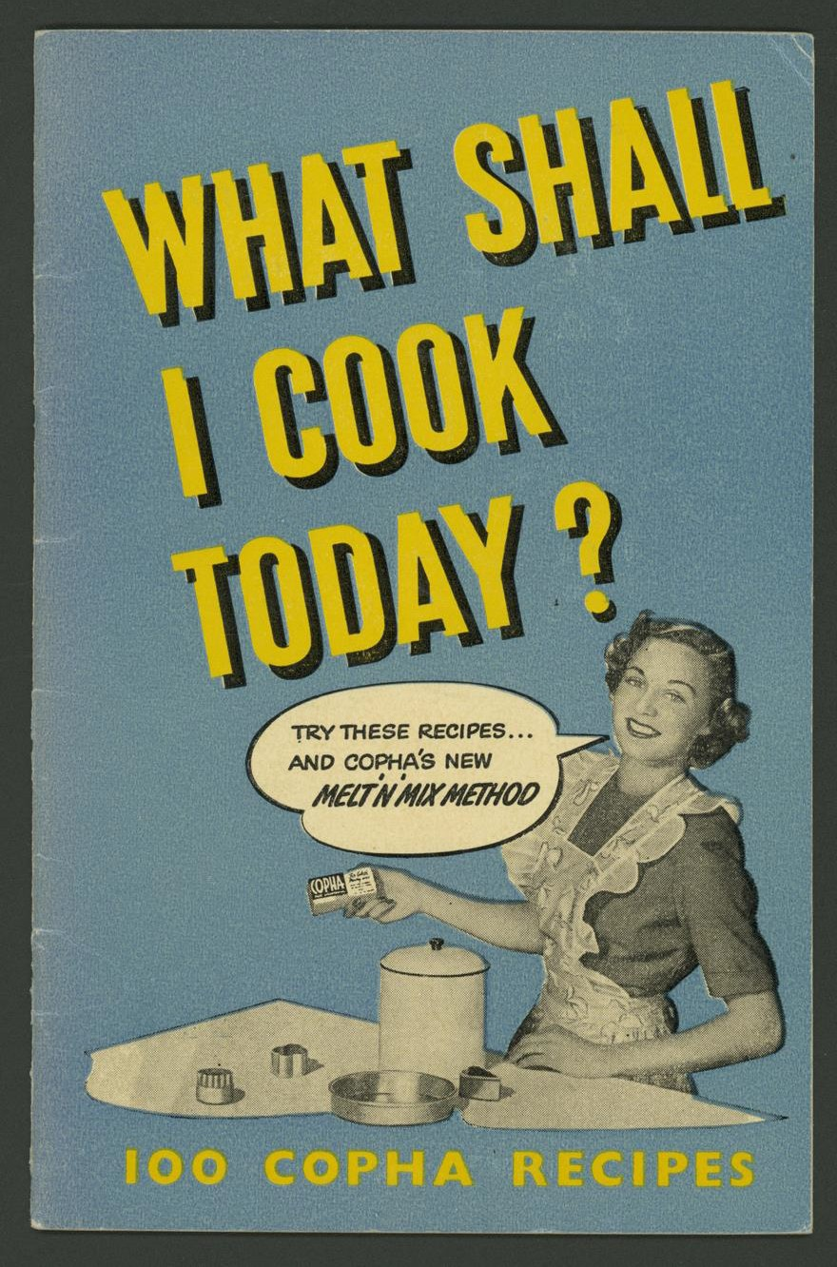
Front cover of cookery book featuring copha recipes. Image of a woman in an apron holding a block of copha, with a speach bubble saying 'Try these recipes... and copha's new MELT 'N' MIX METHOD'.

Slide 4
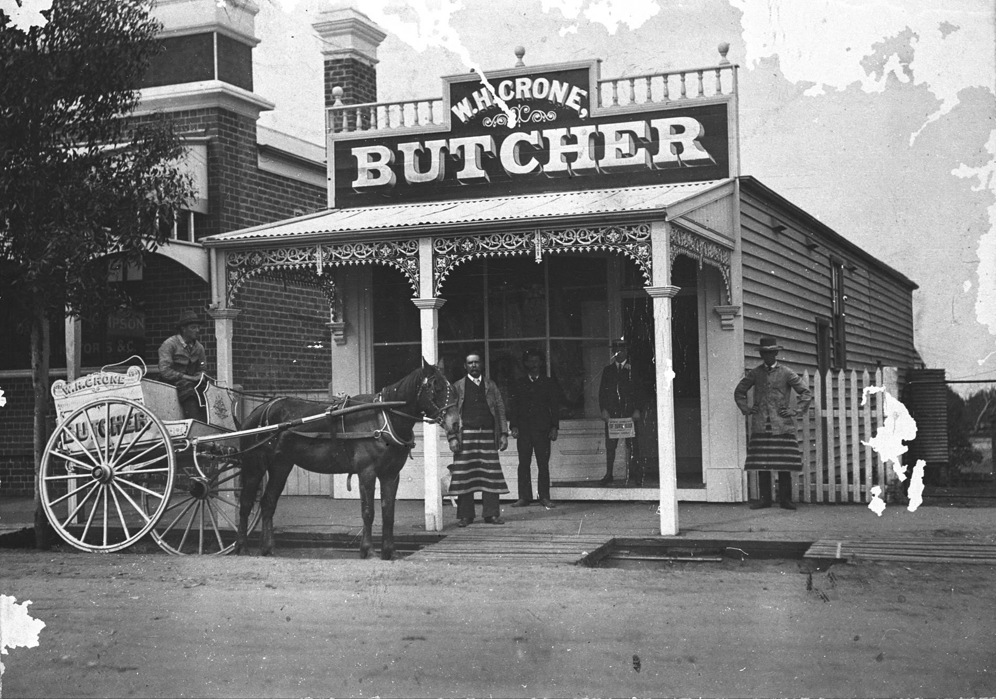
A delivery cart outside the shop of "W.H. Crone, Butcher”
Photographer: Unknown

Slide 5
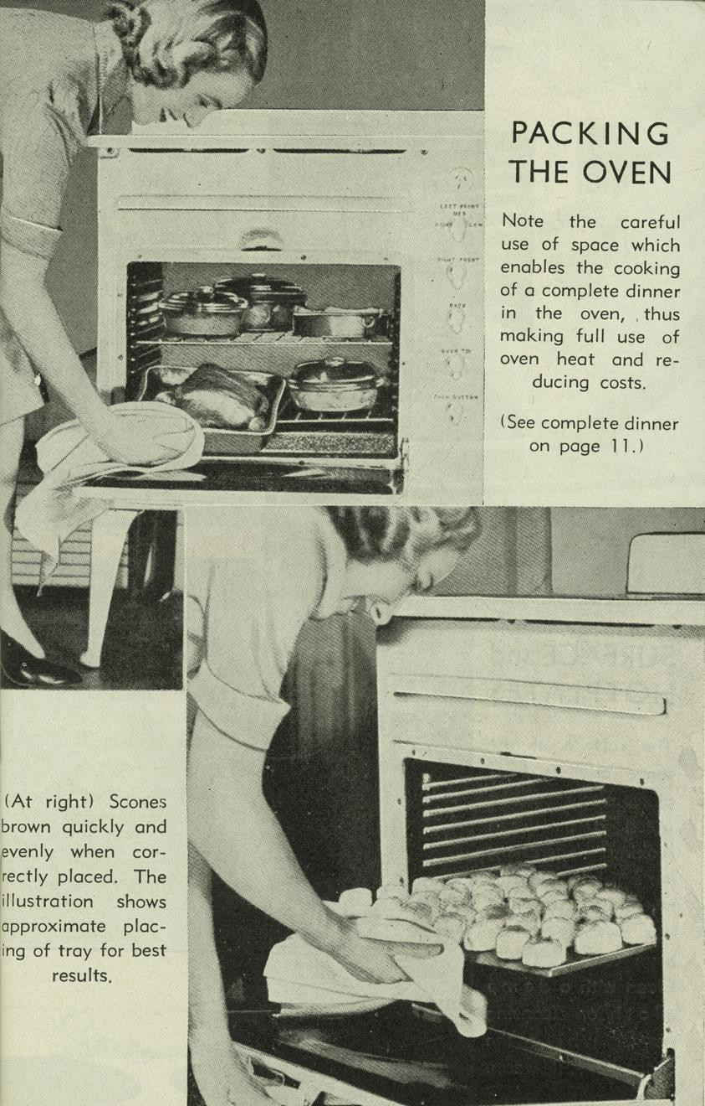
Page 9 from the 'Recipes for electric cooking' book accompanying Metters Moffat stove. Shows a woman placing pots and pans in an electric oven, and holding a tray of baked goods. Text gives instructions for 'Packing the Oven'.

Slide 6
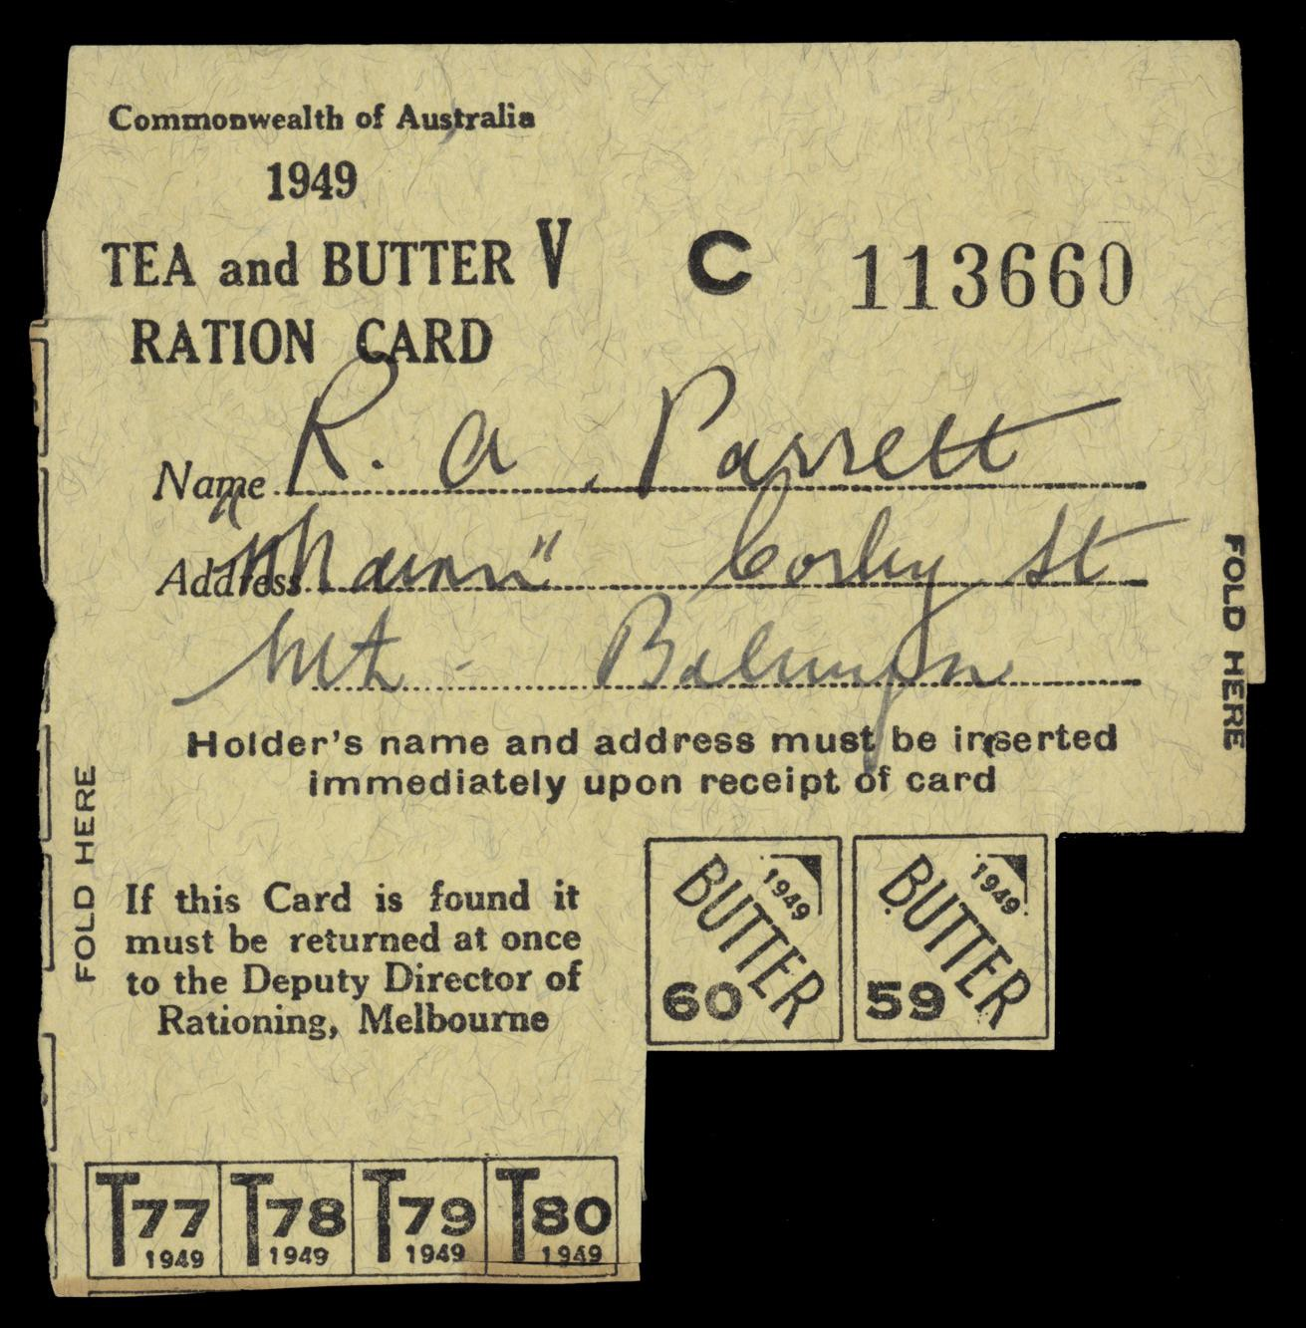
Brown cardboard ration card dated 1949 for tea and butter, issued to R.A. Parrett of Balwyn North.

Slide 7
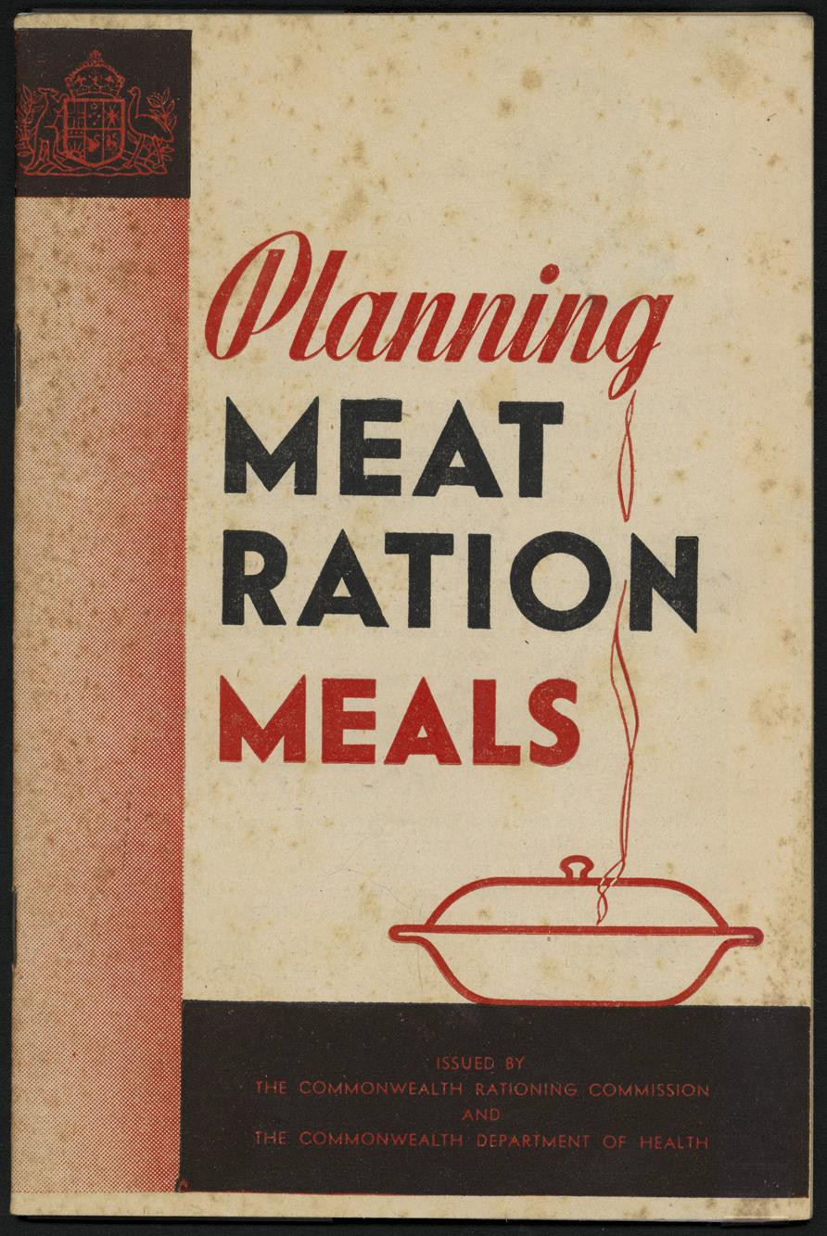
'Planning Meat Ration Meals' recipe book cover.

Slide 8
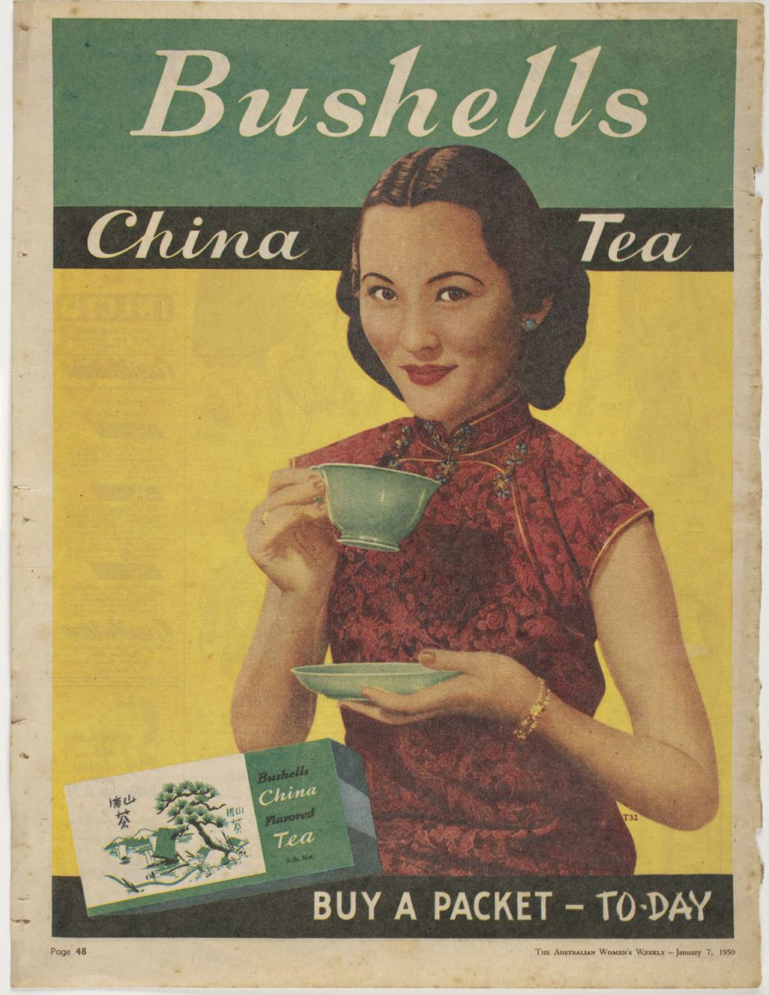
Paper Bushells China Tea advertisement cut out of The Australian Women's Weekly - January 7, 1950

Slide 9
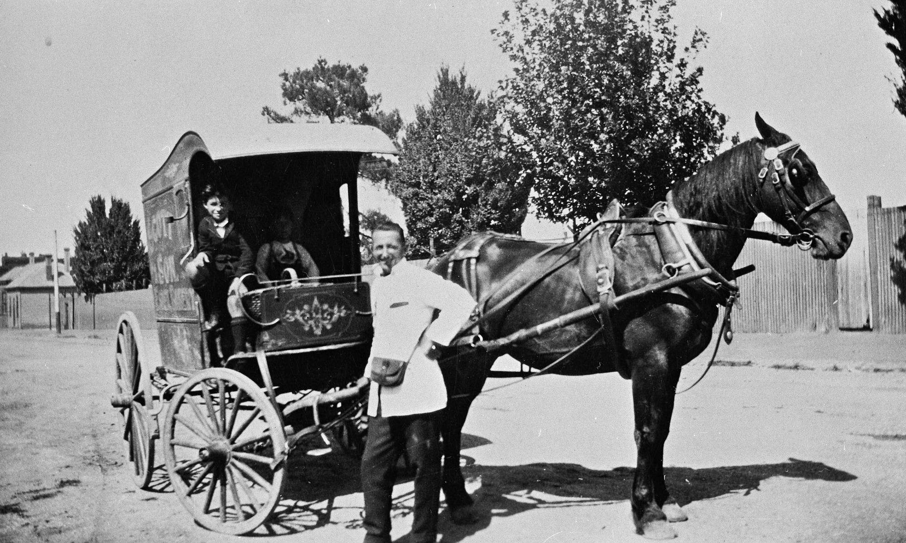
A baker 's horse and cart with the delivery man standing beside the horse and two children seated in the cart, Ballarat.
Photographer: Jane Holmes

Slide 10
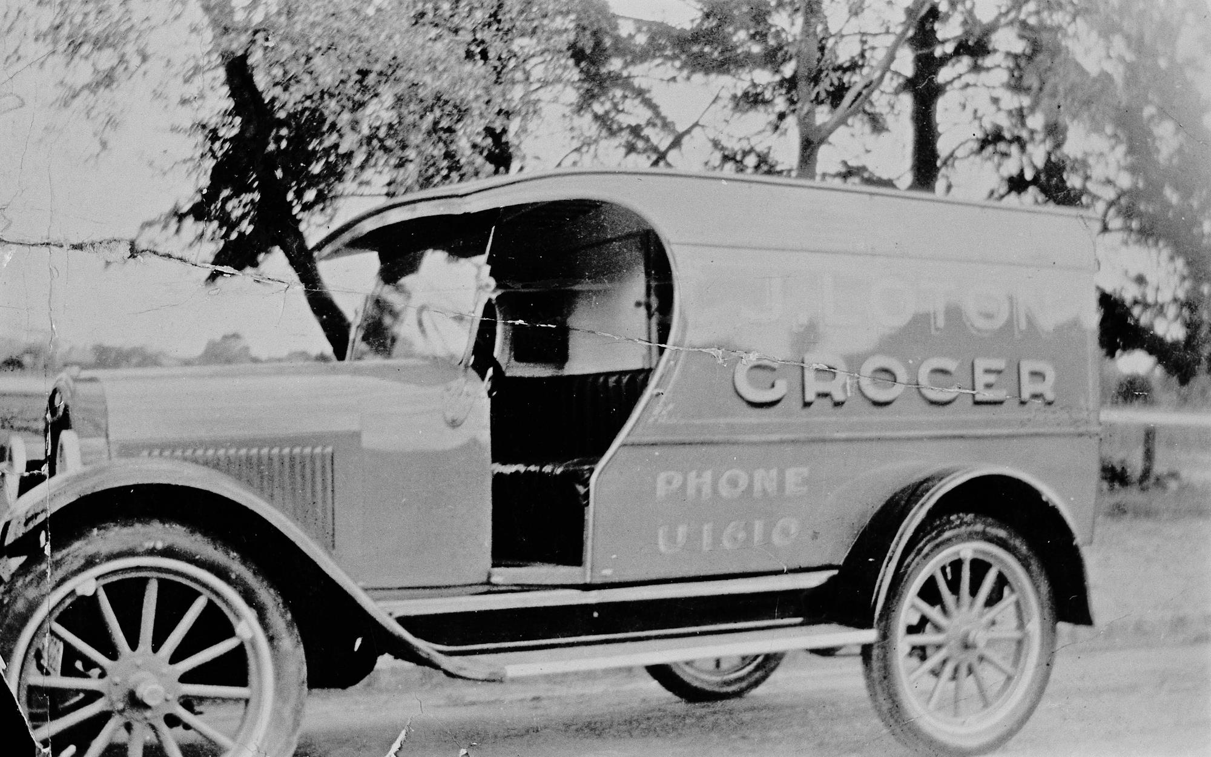
Loton 's grocery van. Malvern VIC
Photographer:
J. Loton

Slide 11
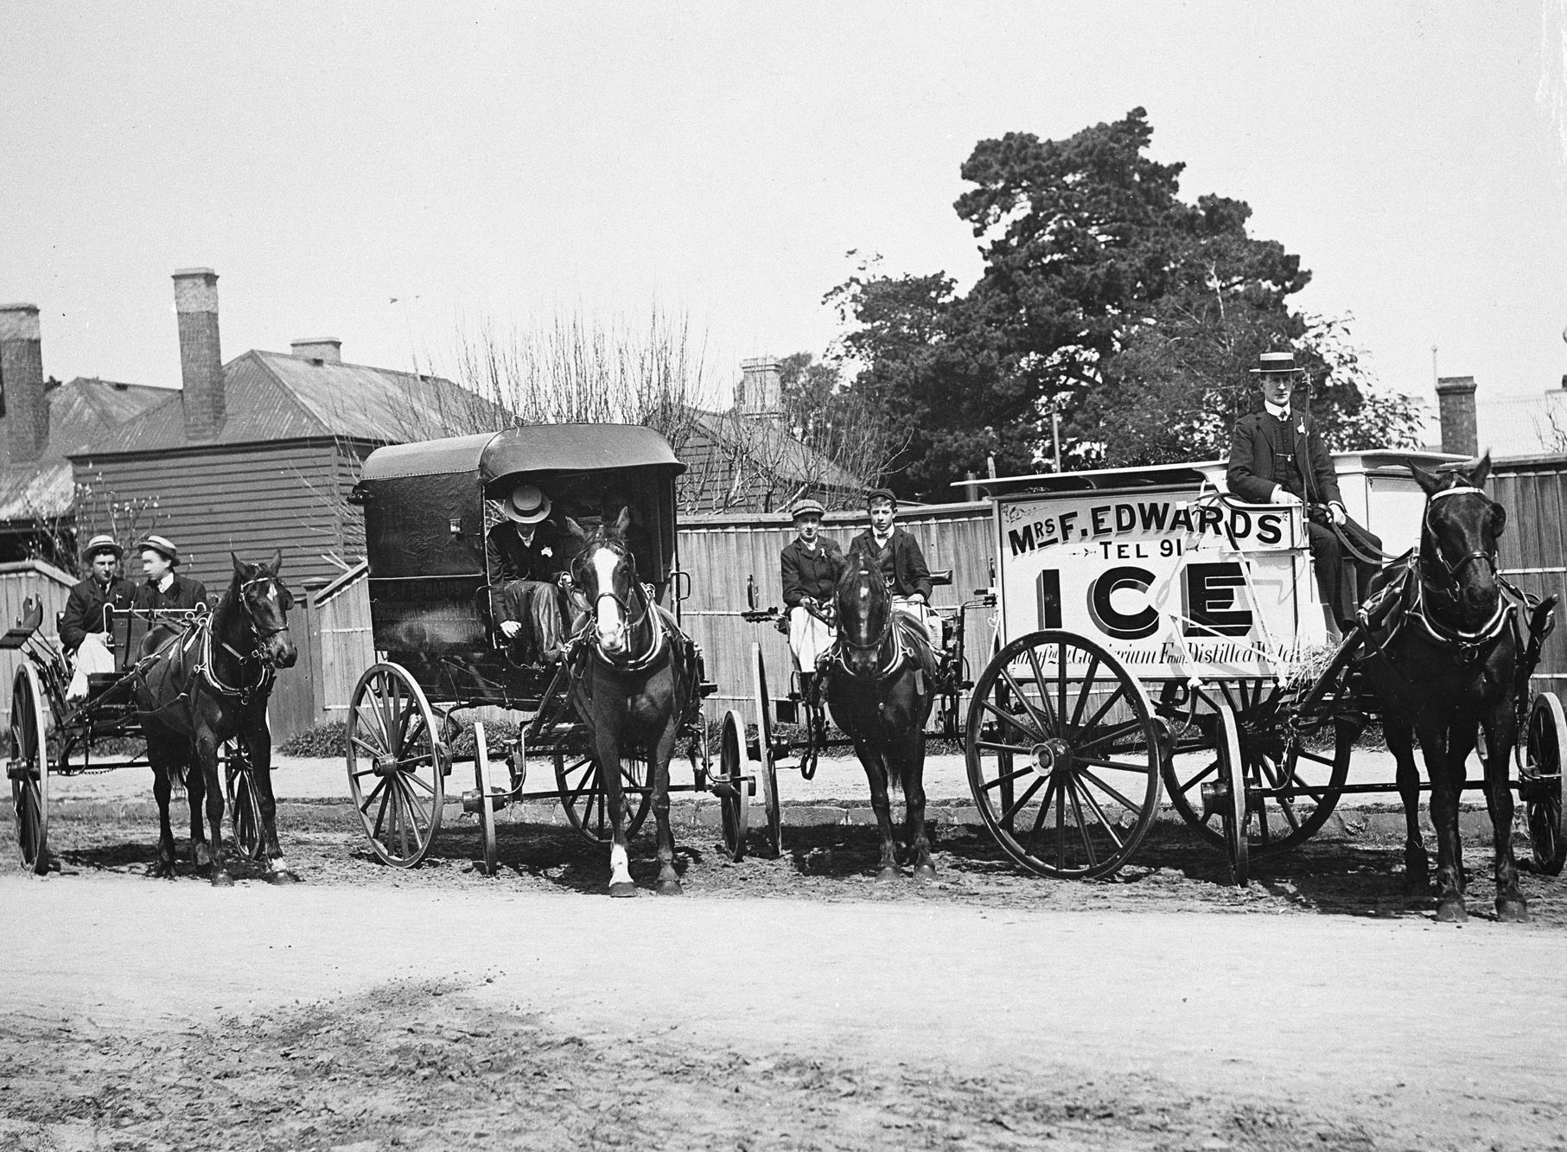
Ice carts belonging to Mrs F.
Edwards Ice Company.
Brighton, VIC
Photographer: B. Stewart

Slide 12
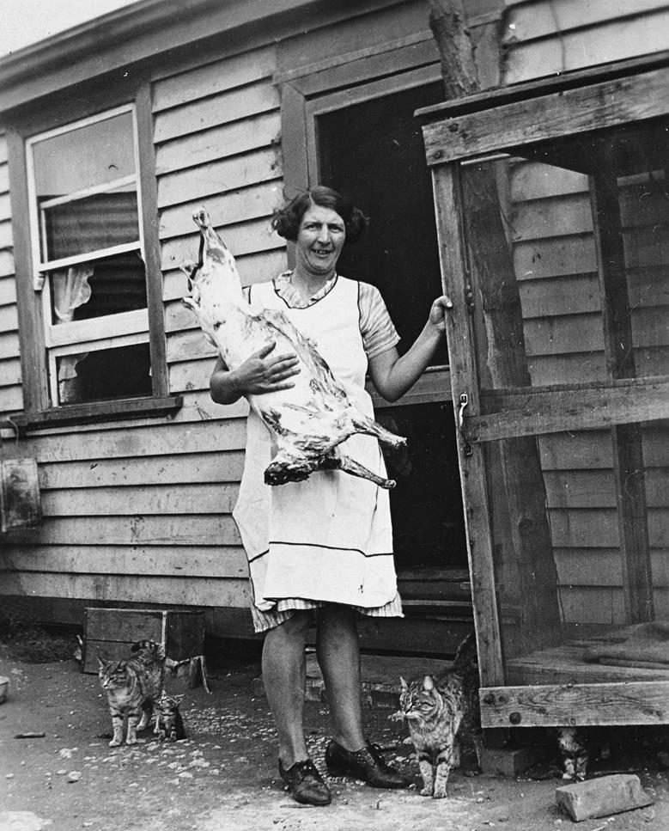
Woman stowing a side of lamb in the open air, fly proof meat safe.
Photographer: Myrtle Sharrock

Slide 13
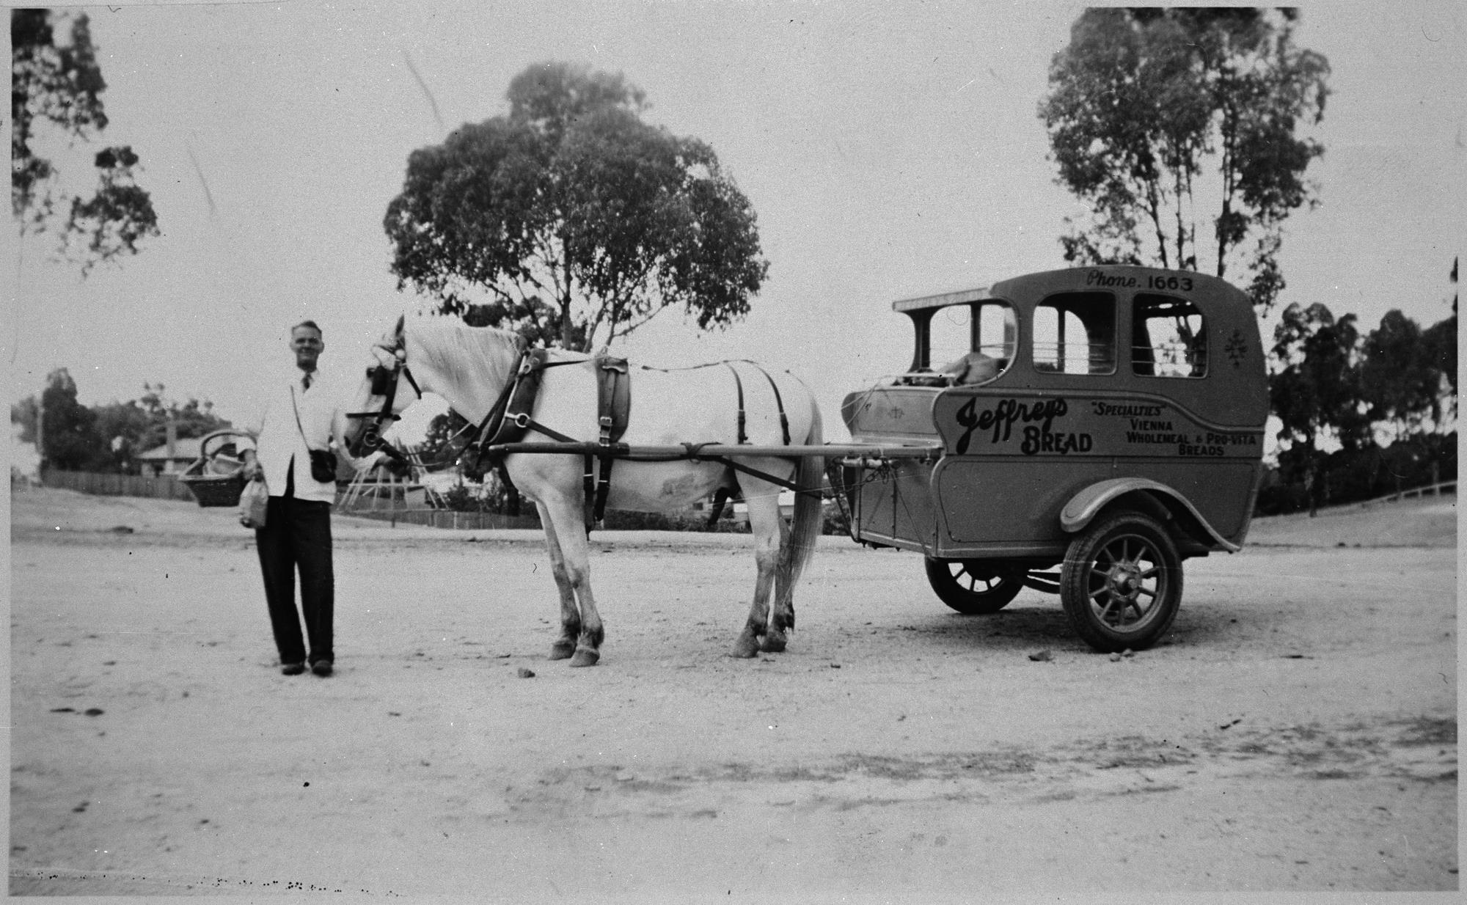
Baker with a baker 's cart advertising Jeffrey's Bread.
Photographer:
L. Neivant

Slide 14
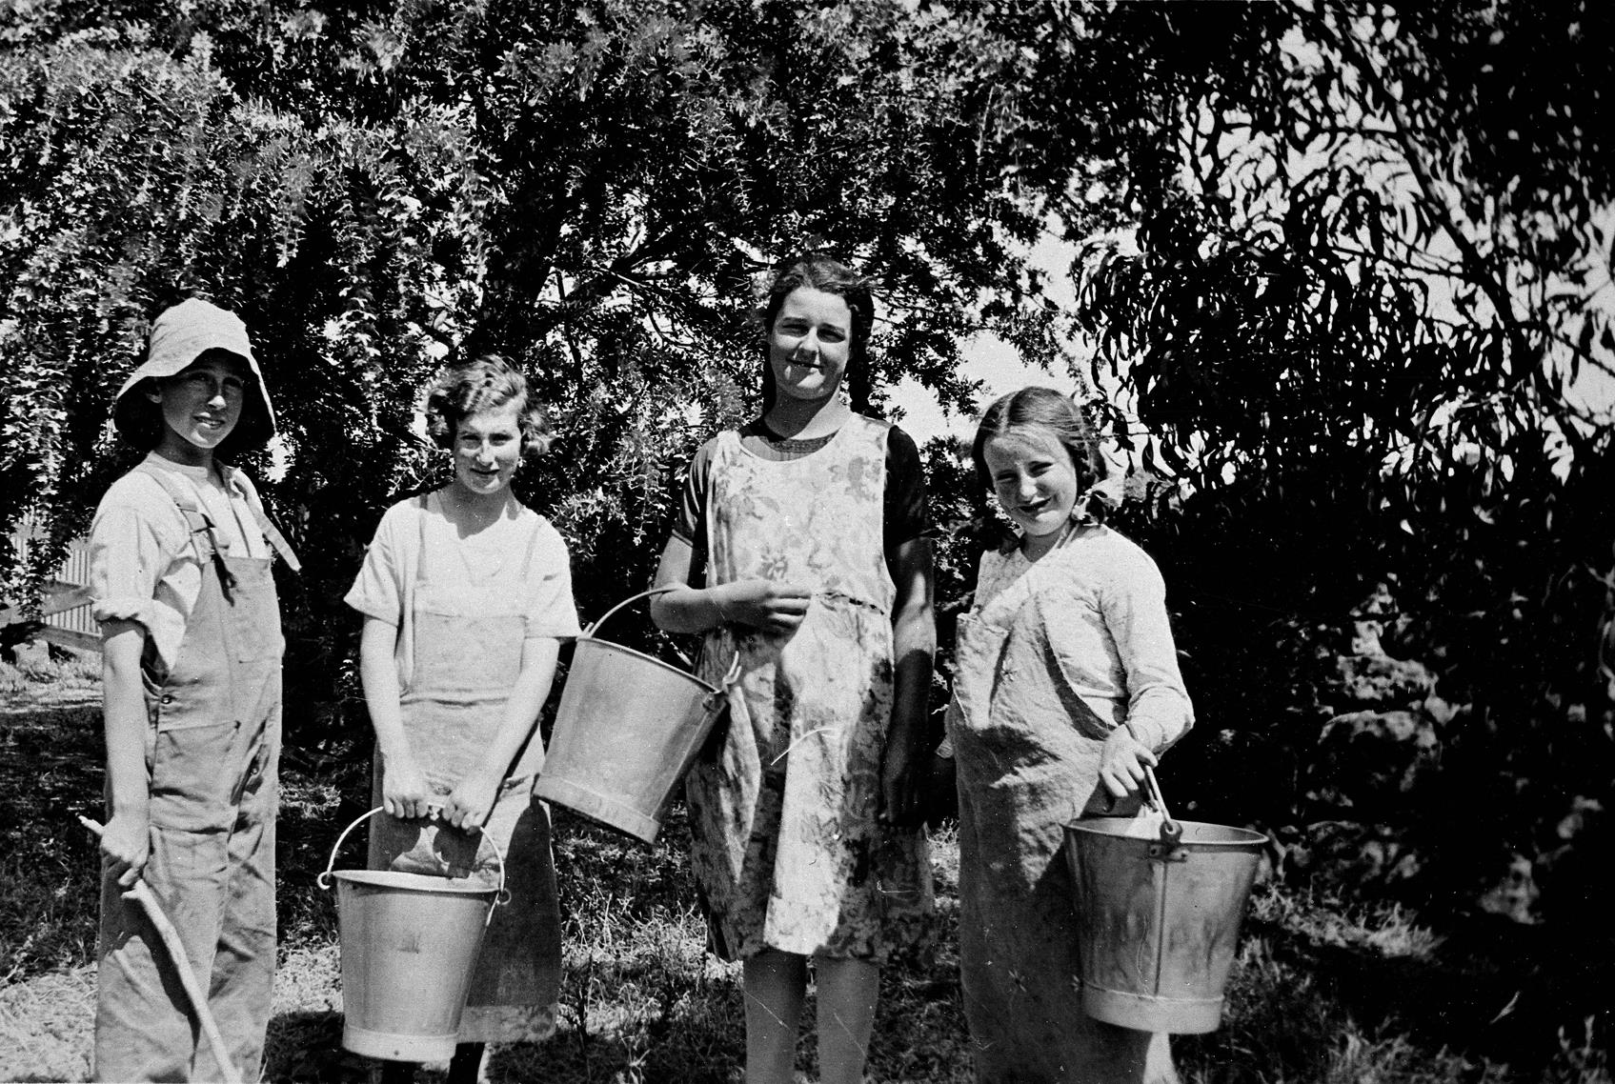
Four children on a farm holiday. The four girls hold milk buckets.
Photographer:
Unknown

Slide 15
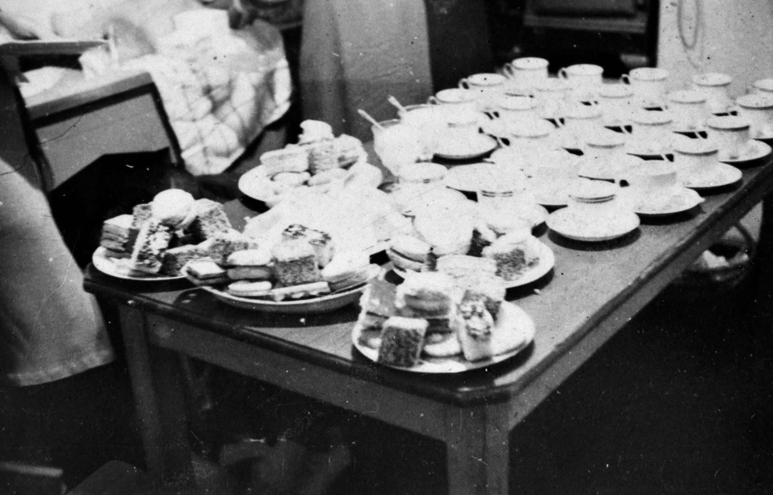
A table setting for afternoon tea with cups, saucers and plates of cakes.
Photographer:
C. Henshaw

Slide 16
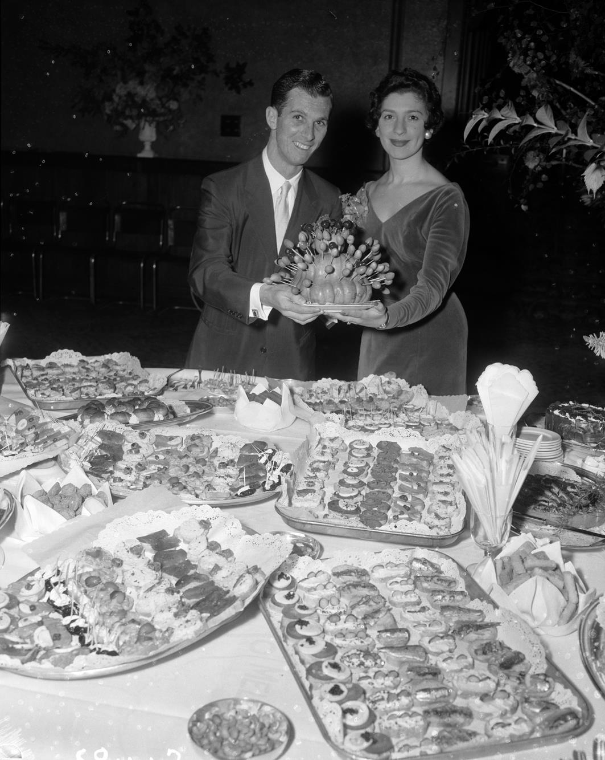
Social function picturing a man and woman holding a food platter.
Photographer: Laurie Richards

Slide 17
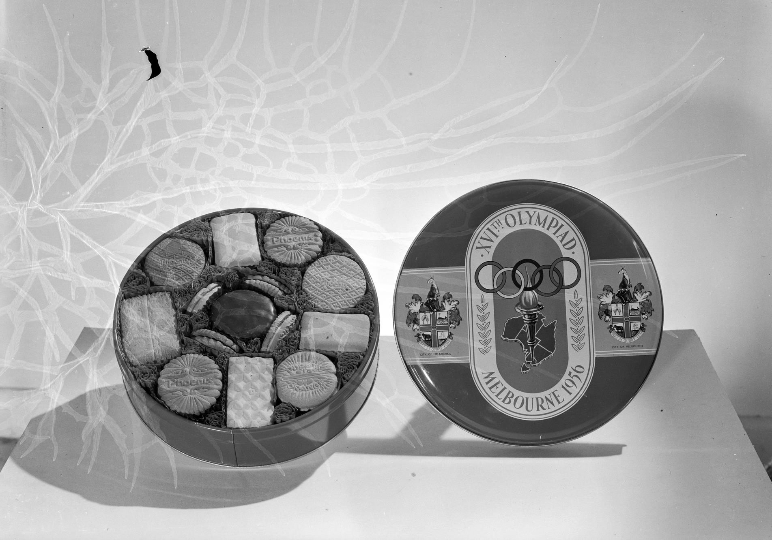
Pheonix 1956 Melbourne Olympic biscuits.
Photographer: Laurie Richards

Slide 18
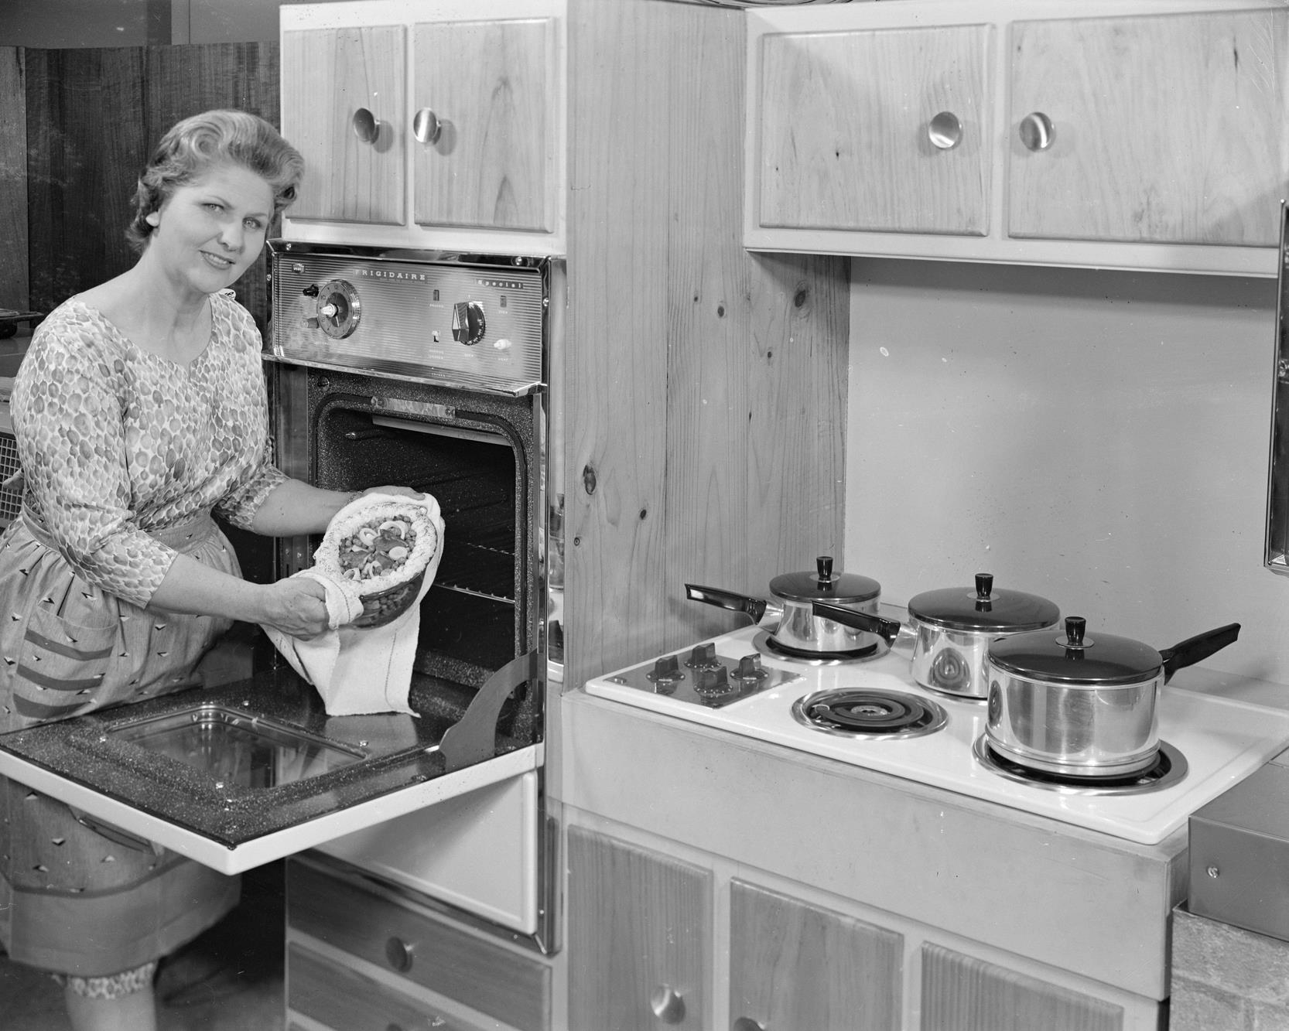
Woman demonstrating the use of a wall oven.
Photographer: Laurie Richards

Slide 19
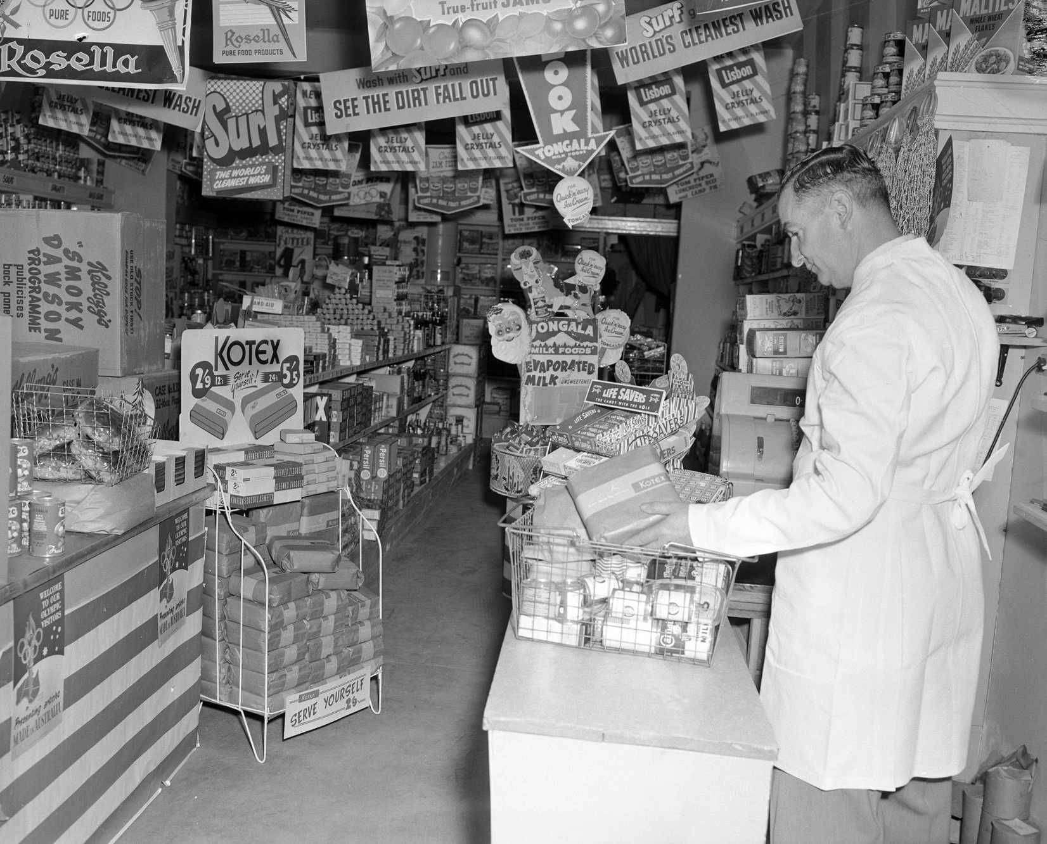
Supermarket Interior, Melbourne, Victoria, 1956
Photographer: Laurie
Richards

Slide 20
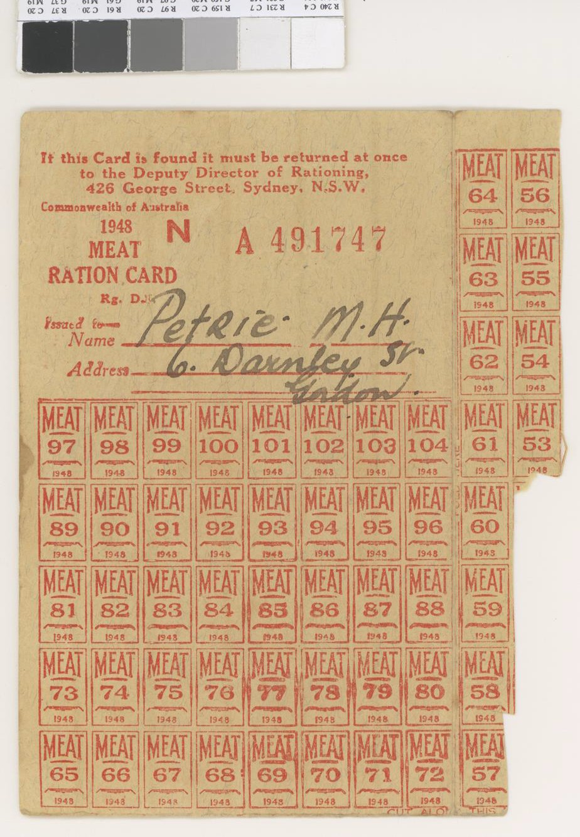
Australian meat ration card.

Slide 21
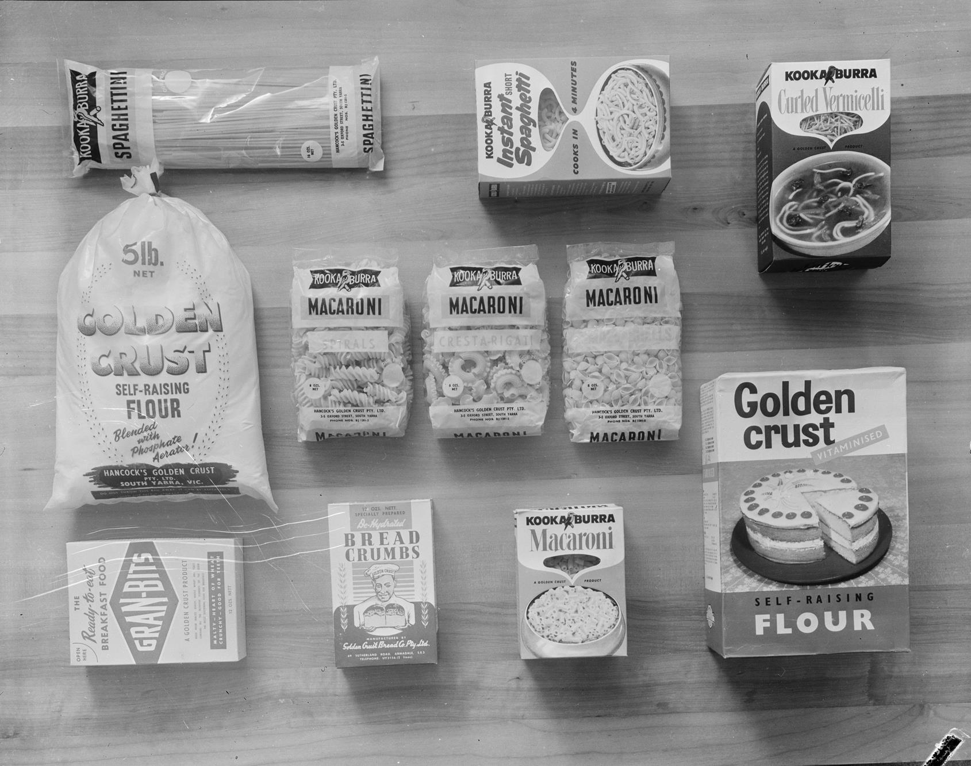
Studio product images of Kookaburra dried food goods, including pasta, flour and bread crumbs.
Photographer: Laurie Richards

Slide 22
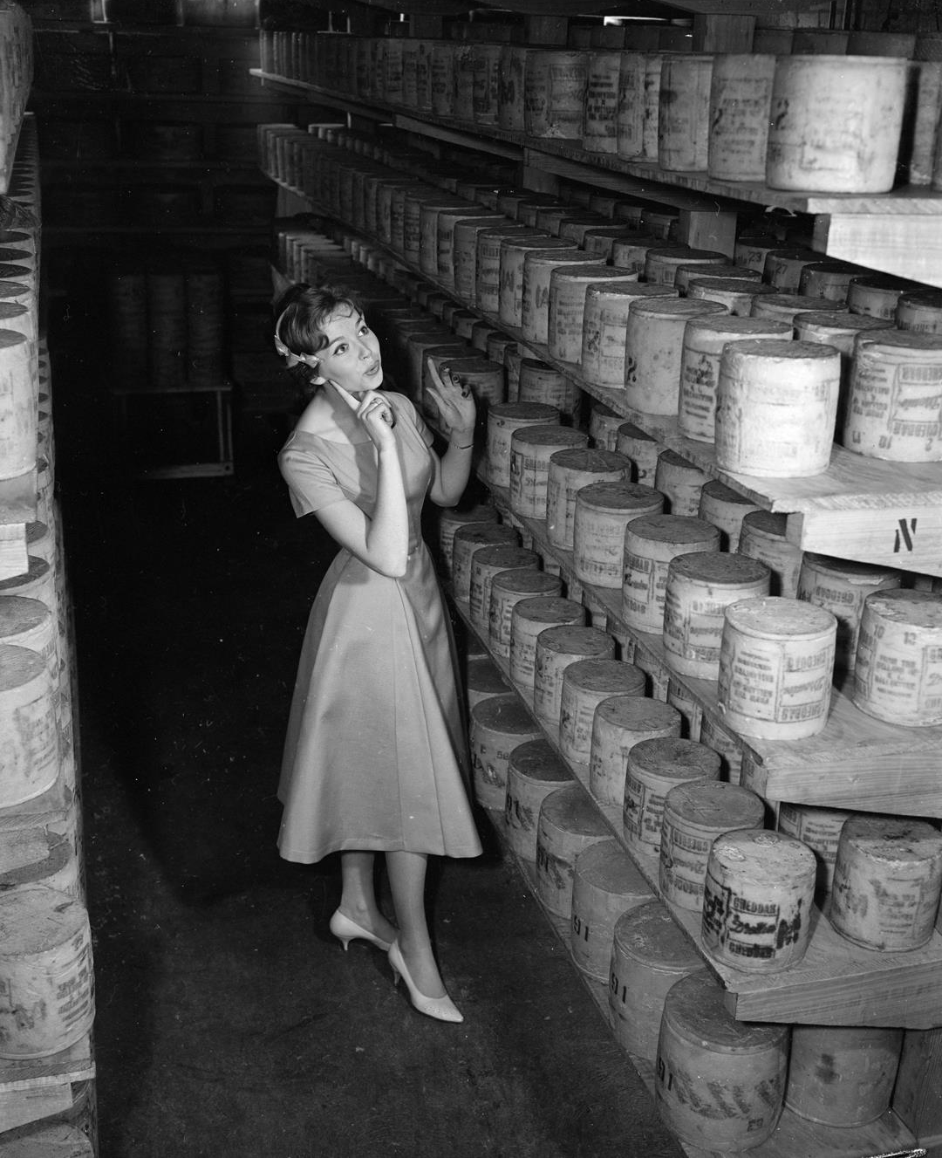
Woman selecting a cheese barrel storage area at Ballantyne food company.
Photographer: Laurie
Richards

Slide 23
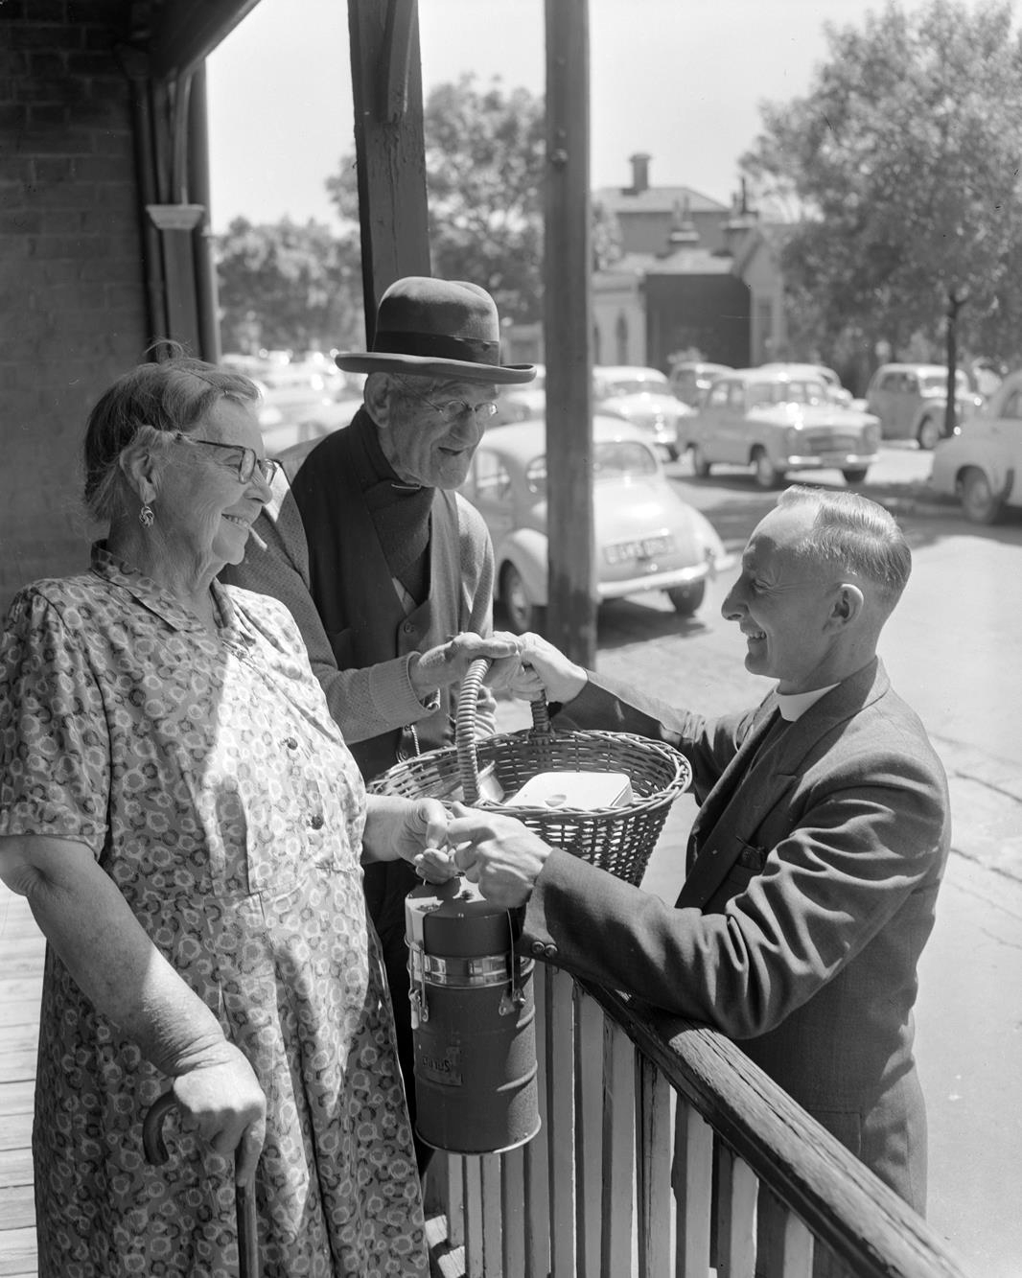
Man delivering a meal to an elderly couple.
Photographer: Laurie Richards

Slide 24
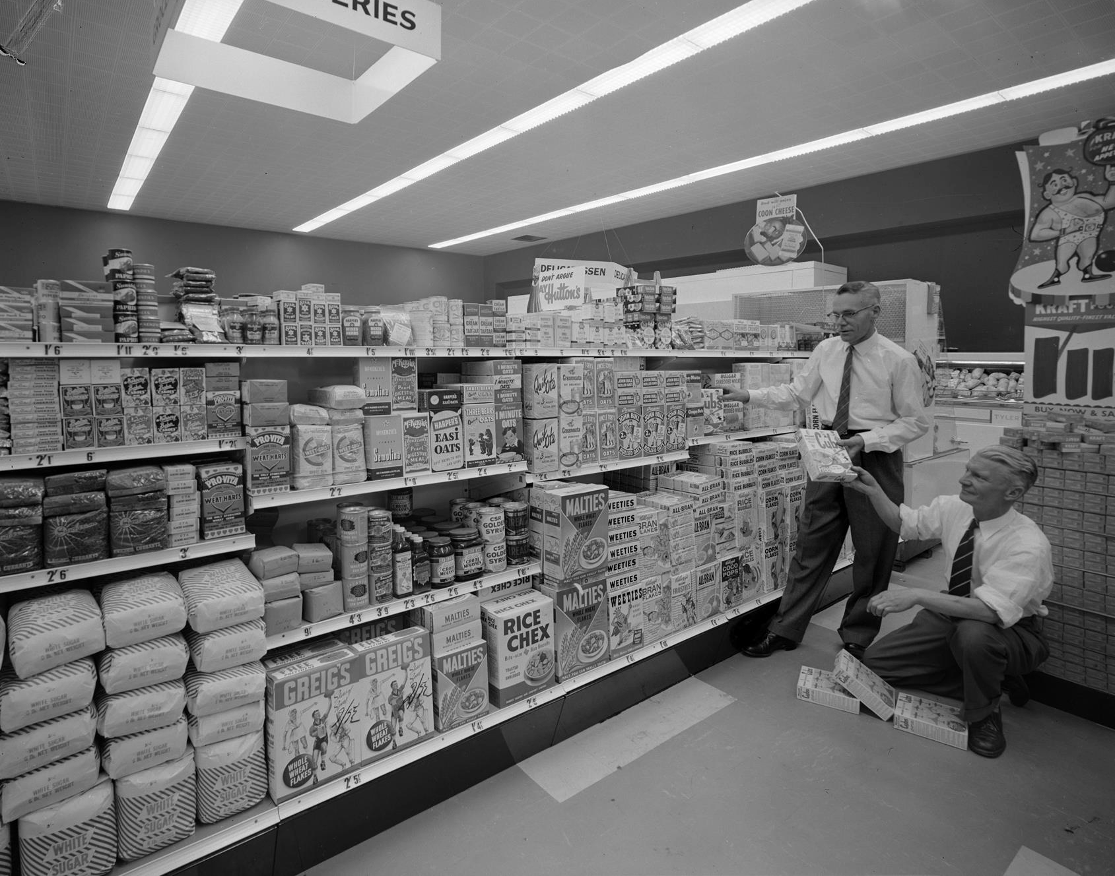
Two men stacking cereal onto shelves at the Mutual Supermarket in Toorak. Some of the cereal brands include Greig's Whole Wheat Flakes, Rice Chex Rice Biscuits and Kelloggs Corn Flakes.
Photographer: Laurie Richards

Slide 25
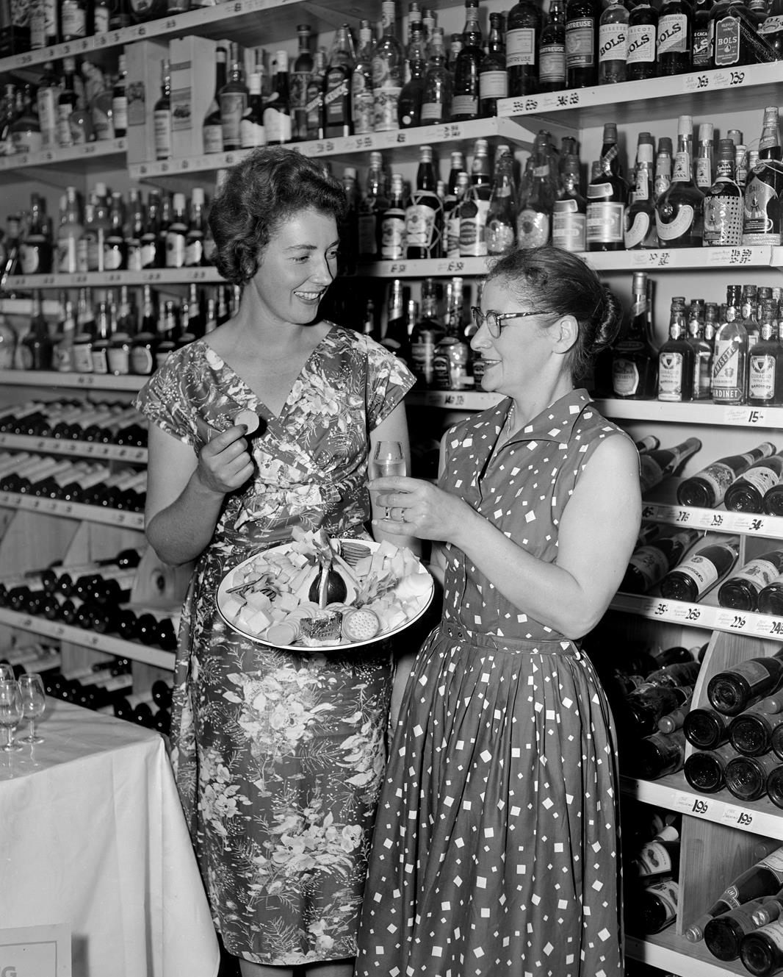
Women sampling cheese and wine at
Crittenden’s Fine Wine
Merchants in Toorak.
Photographer: Laurie
Richards

Slide 26
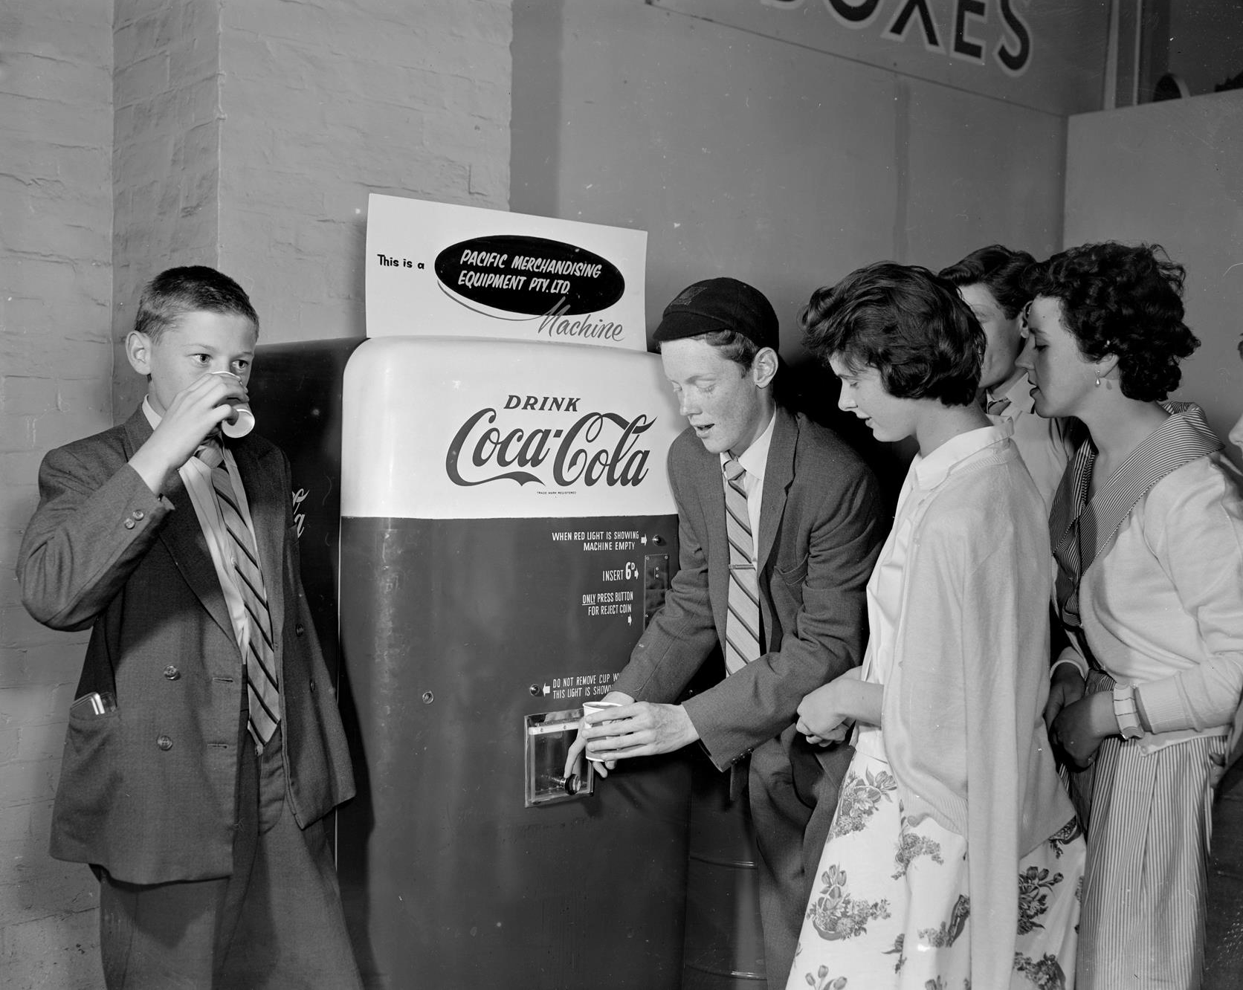
Children with Coca-Cola vending machine.
Photographer: Laurie Richards

Slide 27
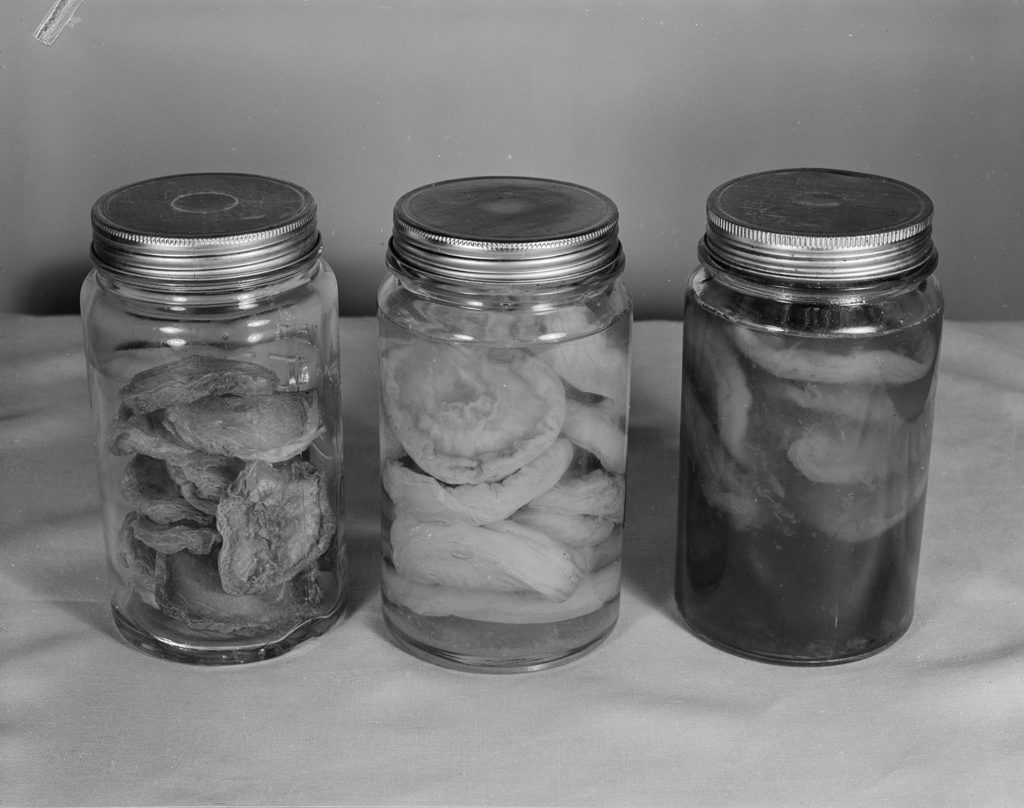
Jars of dried fruit.
Photographer: Laurie Richards

Slide 28
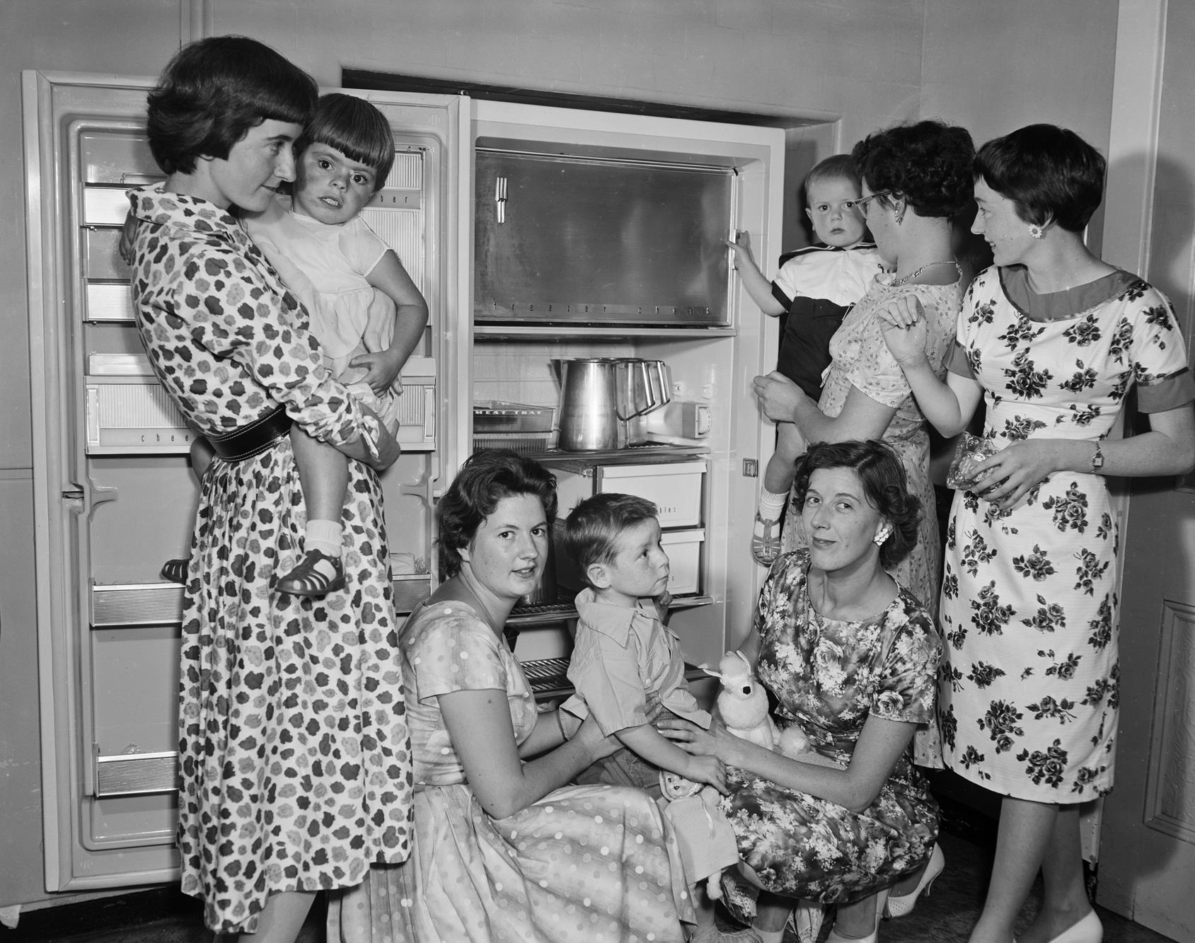
Women and children admiring a new refrigerator.
Photographer: Laurie Richards

Slide 29
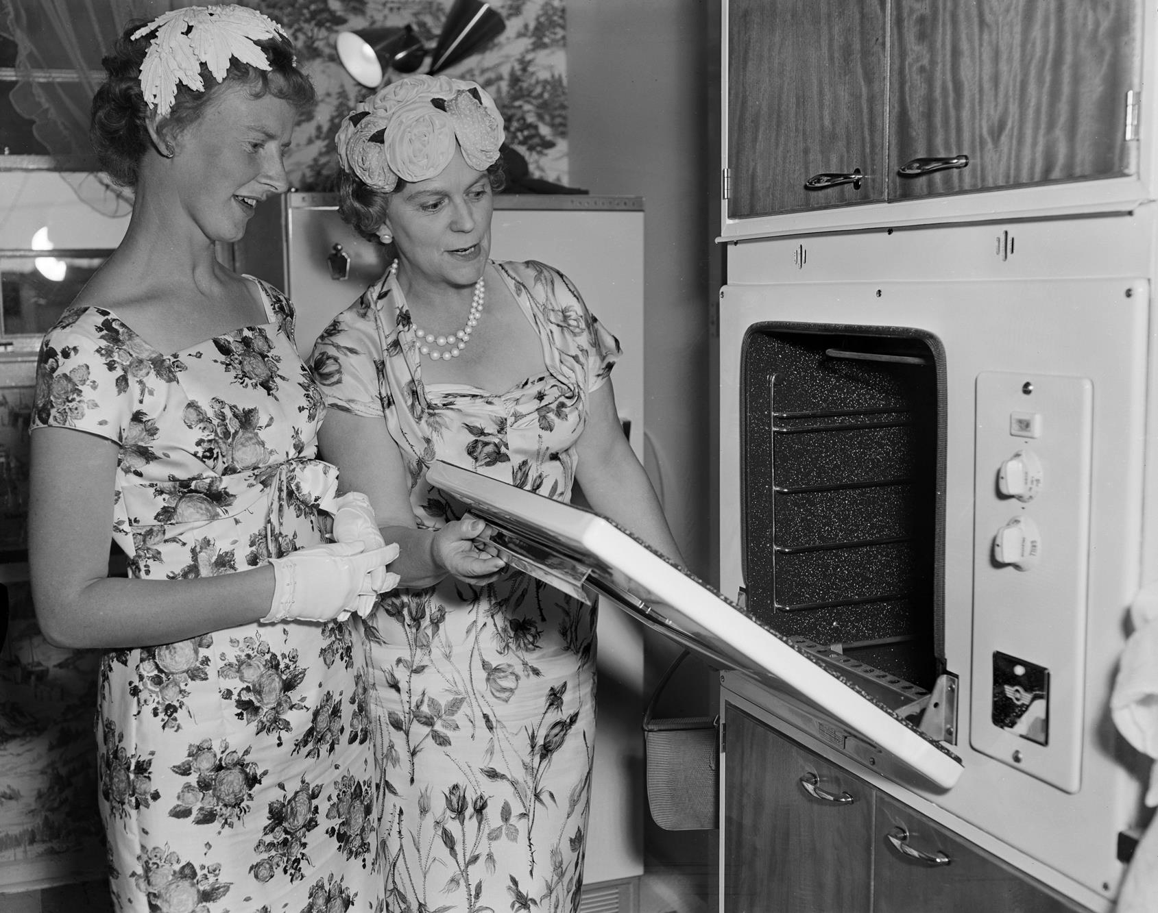
Two women looking in an oven.
Photographer: Laurie Richards

Slide 30
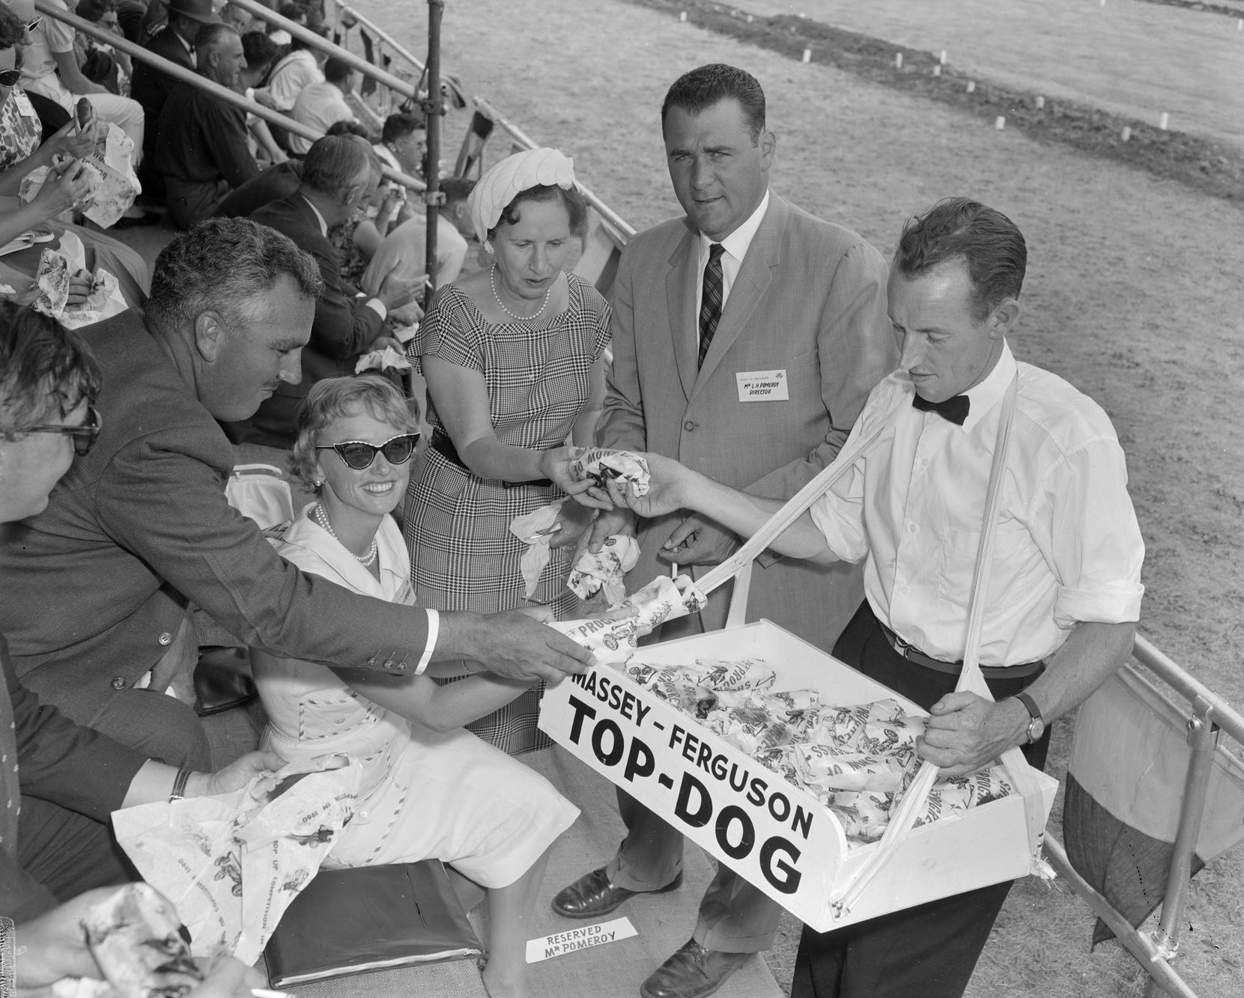
Hot dog vendor, Melton VIC
Photographer: Laurie Richards

Slide 31
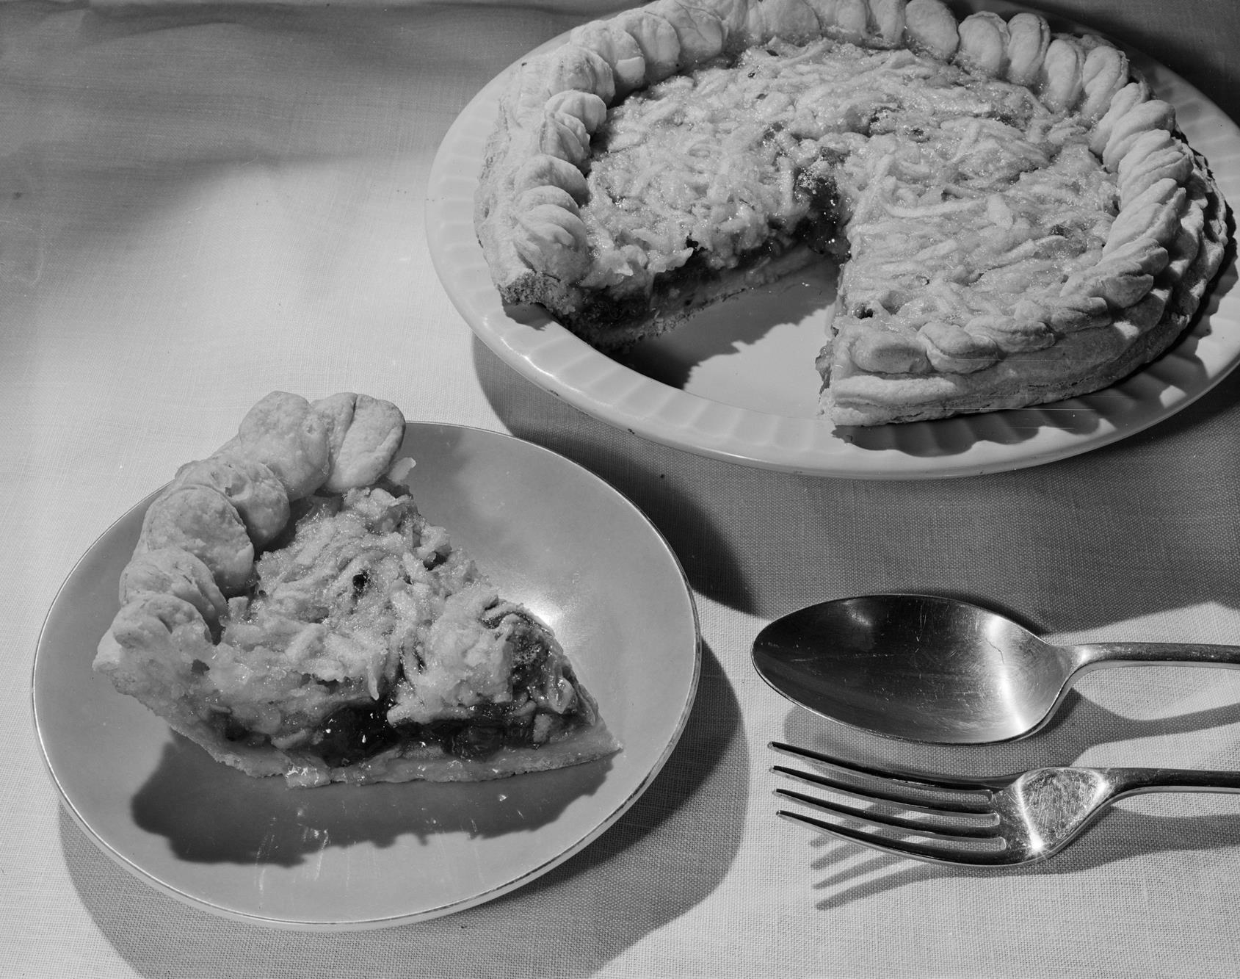
Home made apple pie.
Photographer: Laurie Richards

Slide 32
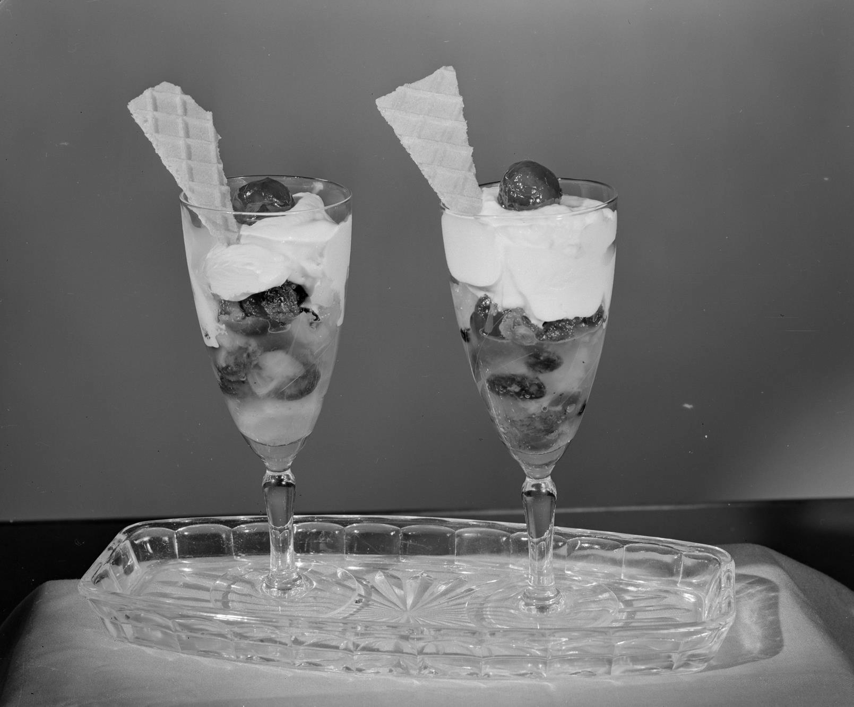
Ice cream sundaes with waffle
wedges.
Photographer: Laurie Richards

Slide 33
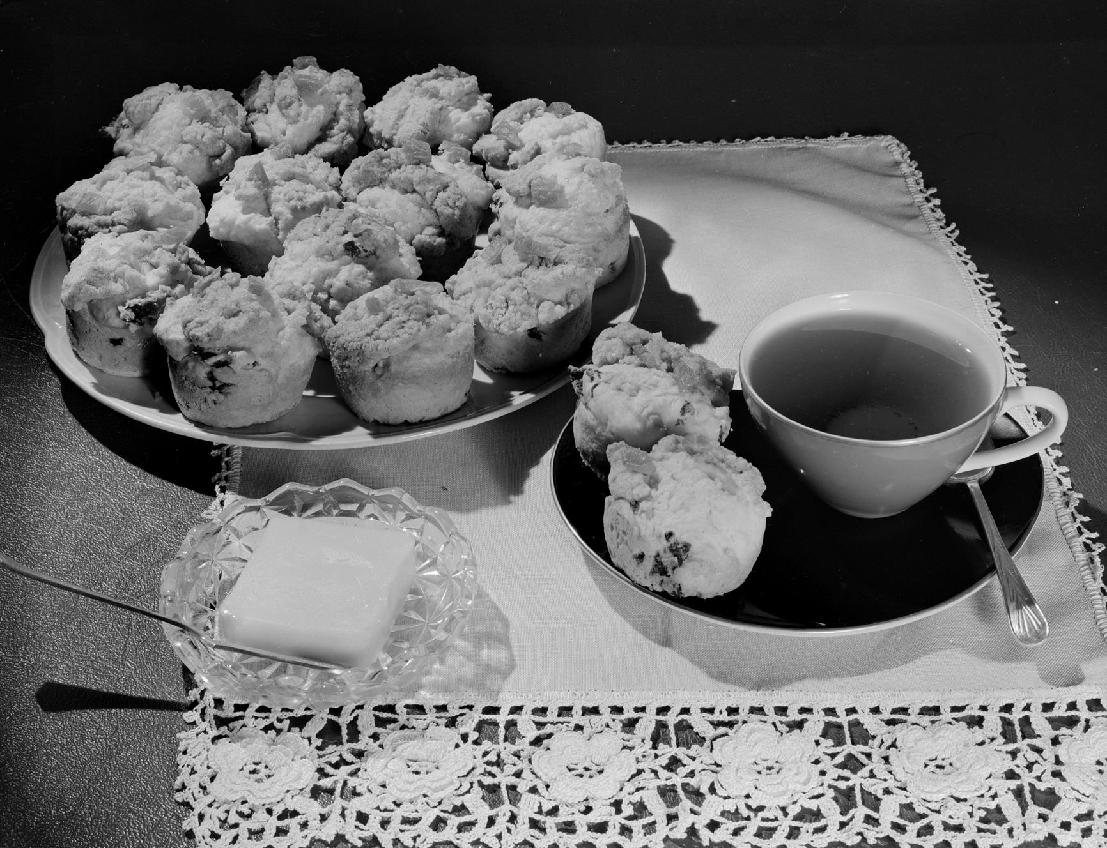
Tea and scones.
Photographer: Laurie Richards

Slide 34
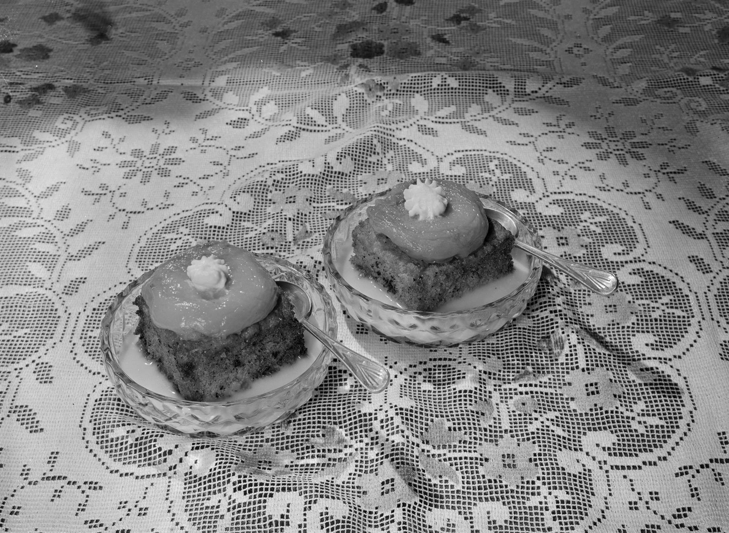
Desserts made from dried fruits on a table with a decorative table cloth.
Photographer:
Laurie Richards

