Slide 1
Childhood Games and Pastimes
A slideshow of images from Museums Victoria's collection depicting
childhood games, toys and experiences from last century.

Slide 2
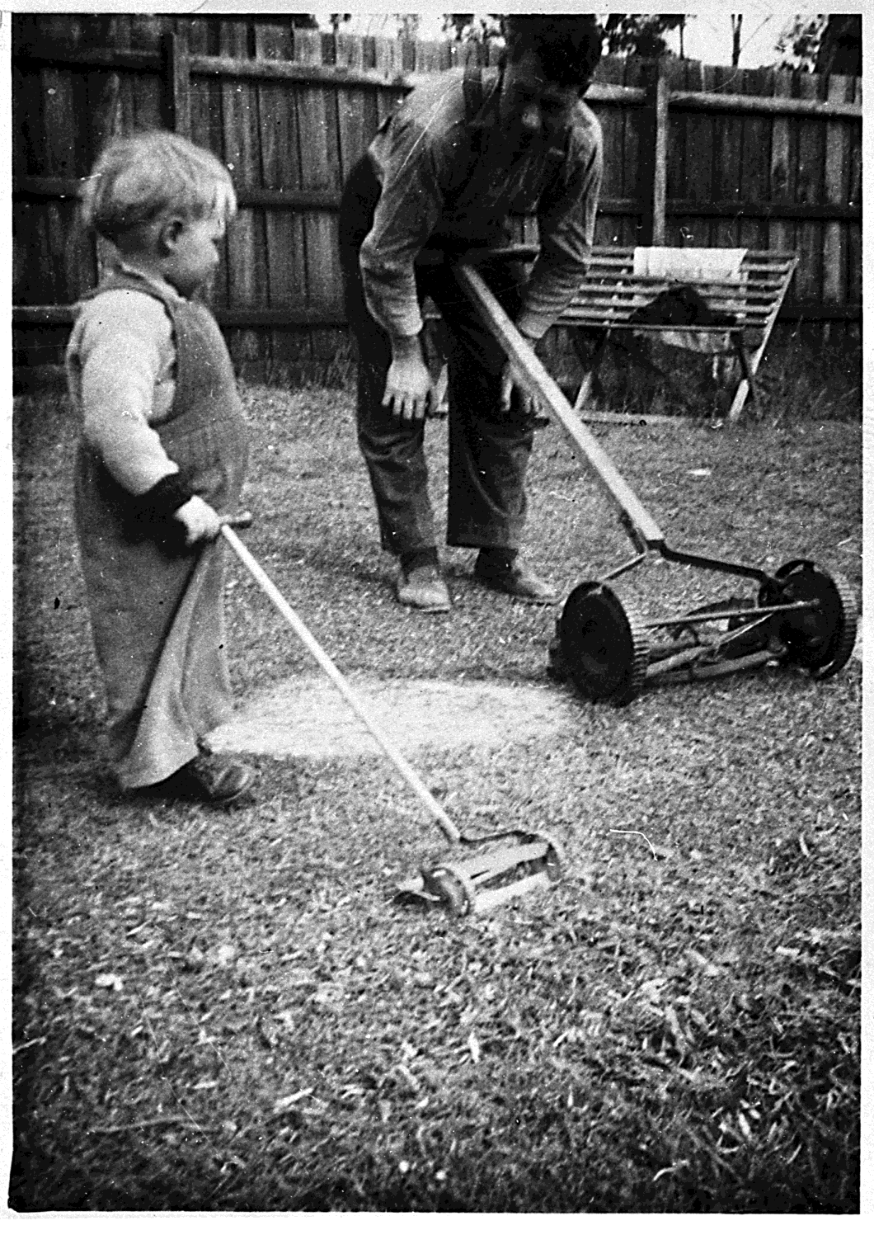
A father and son using lawn mowers in backyard. Child has toy mower, 1956
Photographer: Unknown

Slide 3
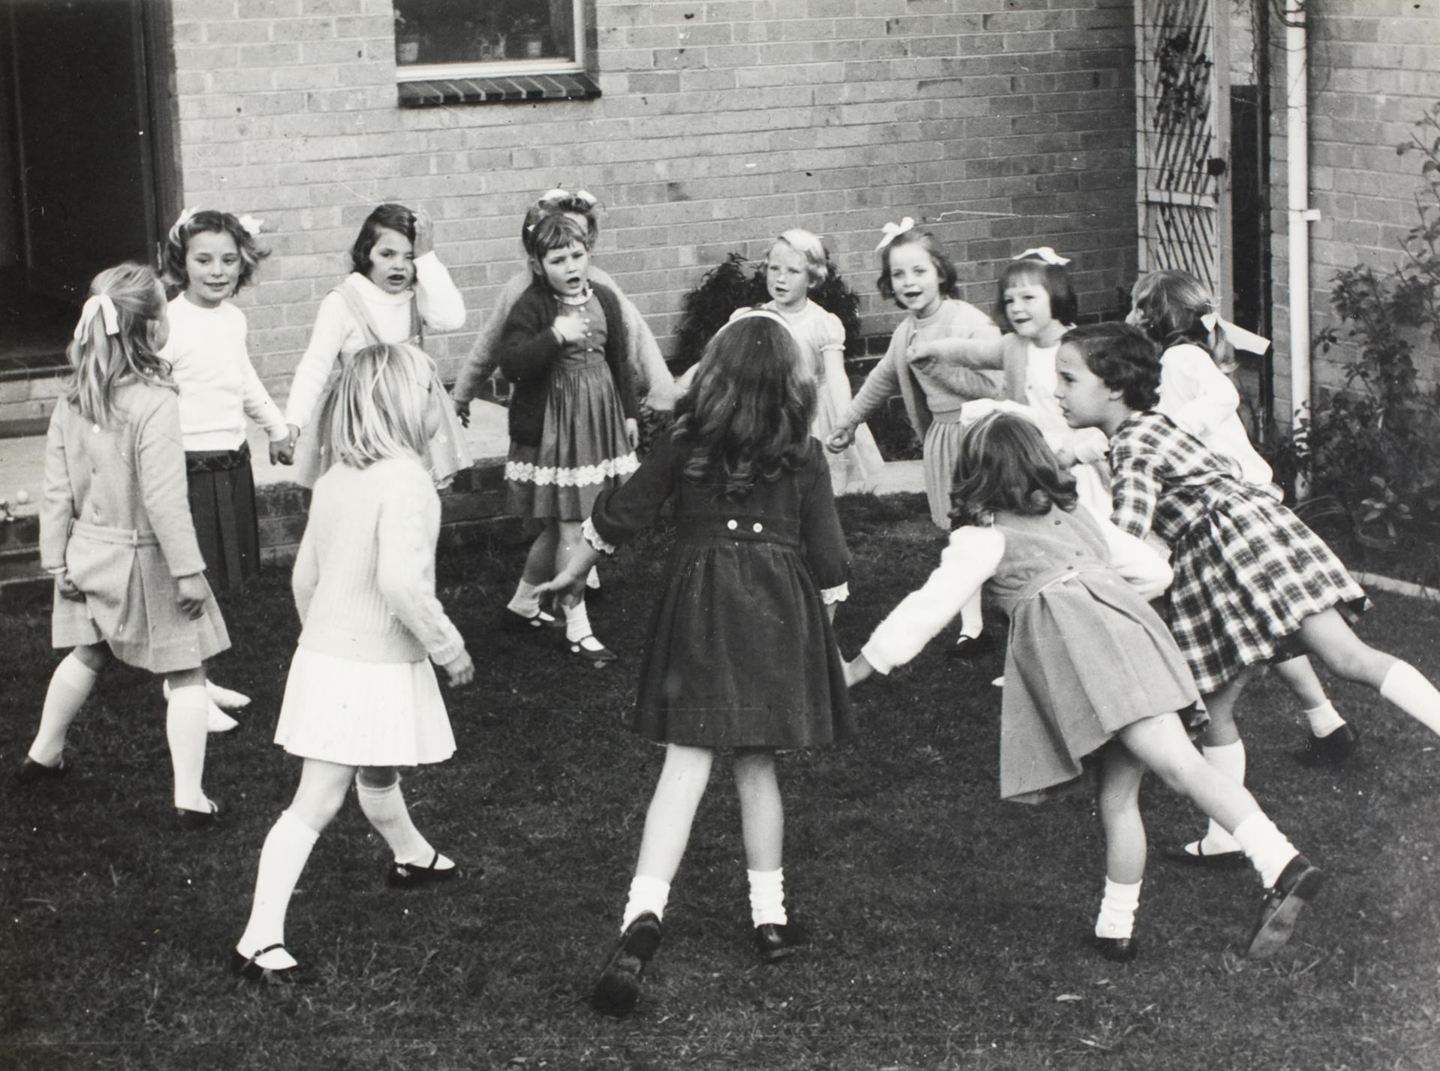
Children about to begin a maypole dance
Photographer: Unknown

Slide 4
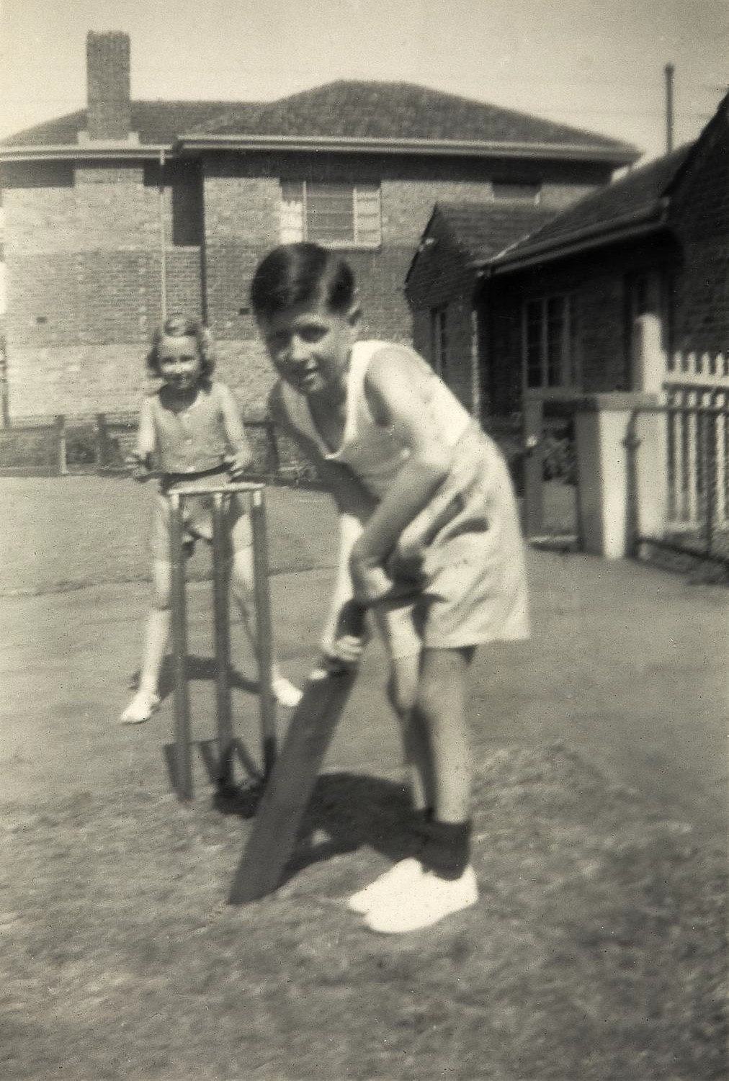
A boy and girl playing cricket in their front yard.
Photographer: Unknown

Slide 5
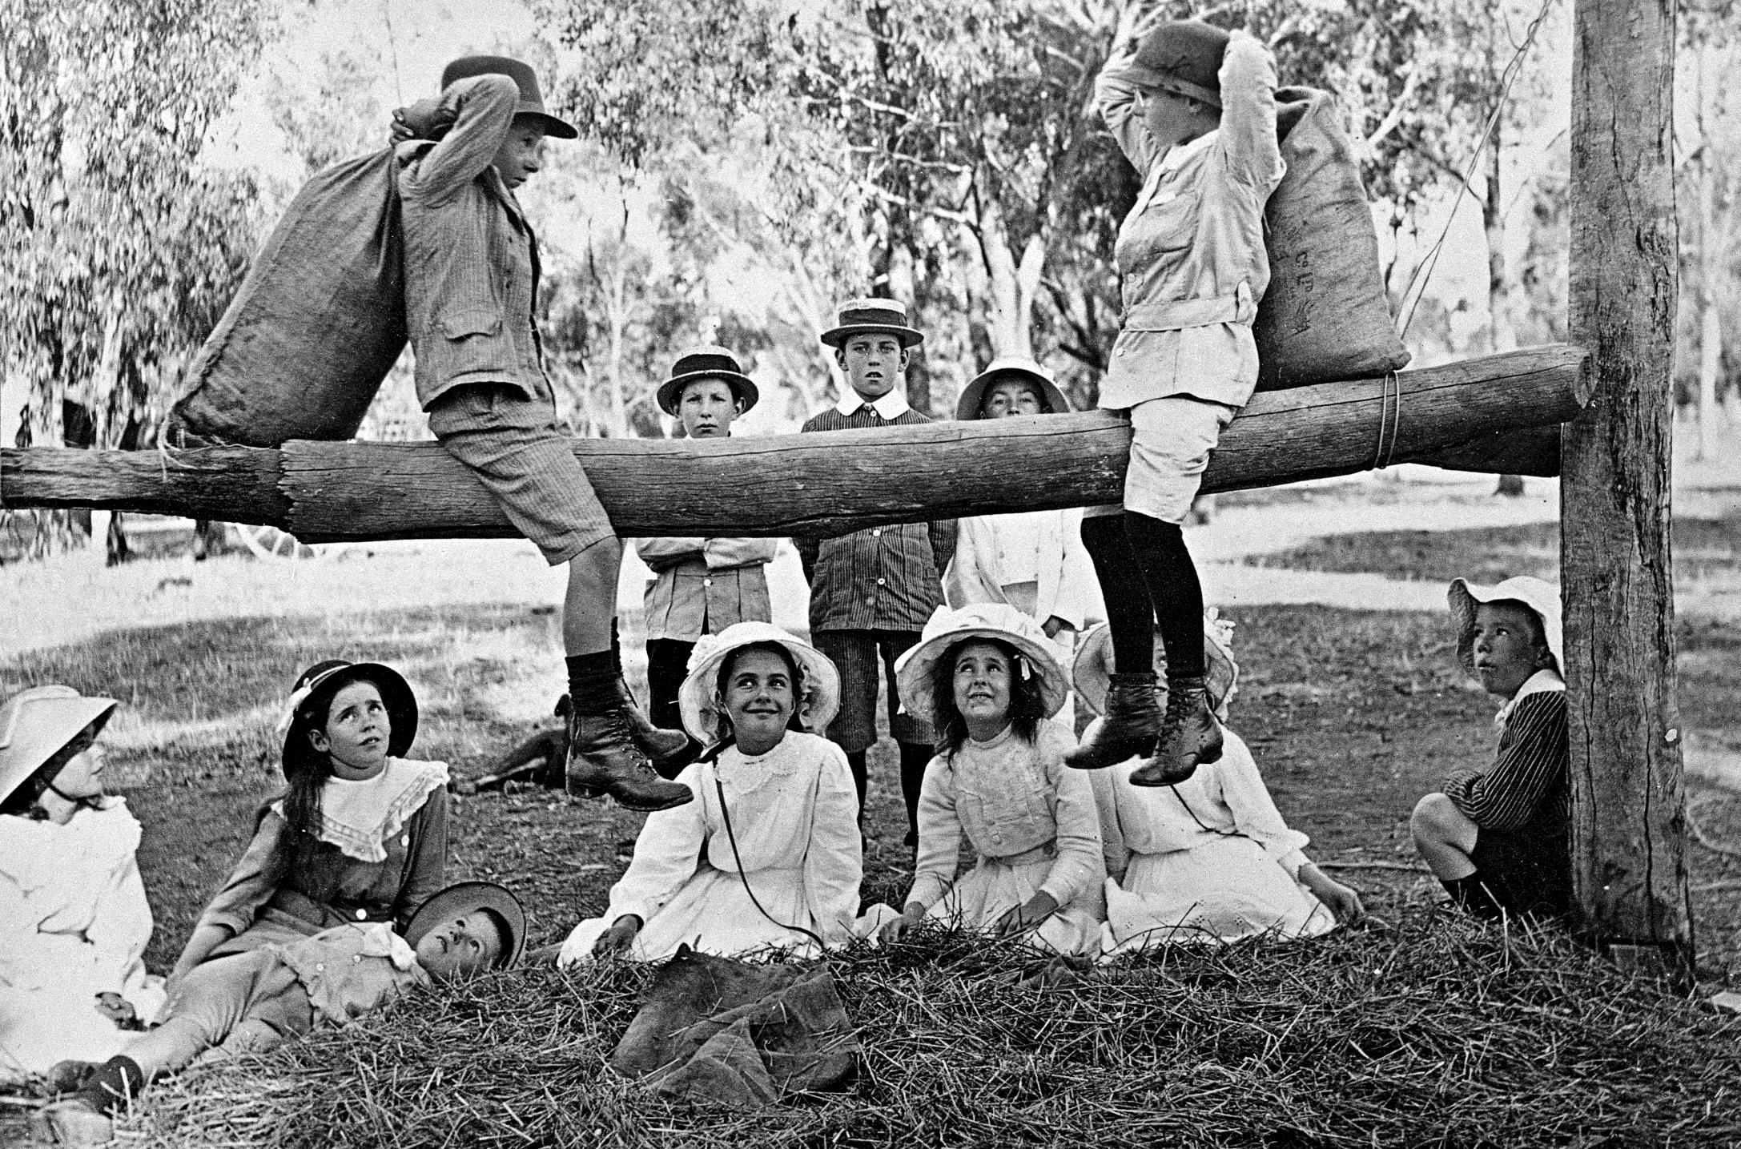
Two boys play fighting with hessian bags on a log.
Photographer: Lilian Louisa Pitts

Slide 6
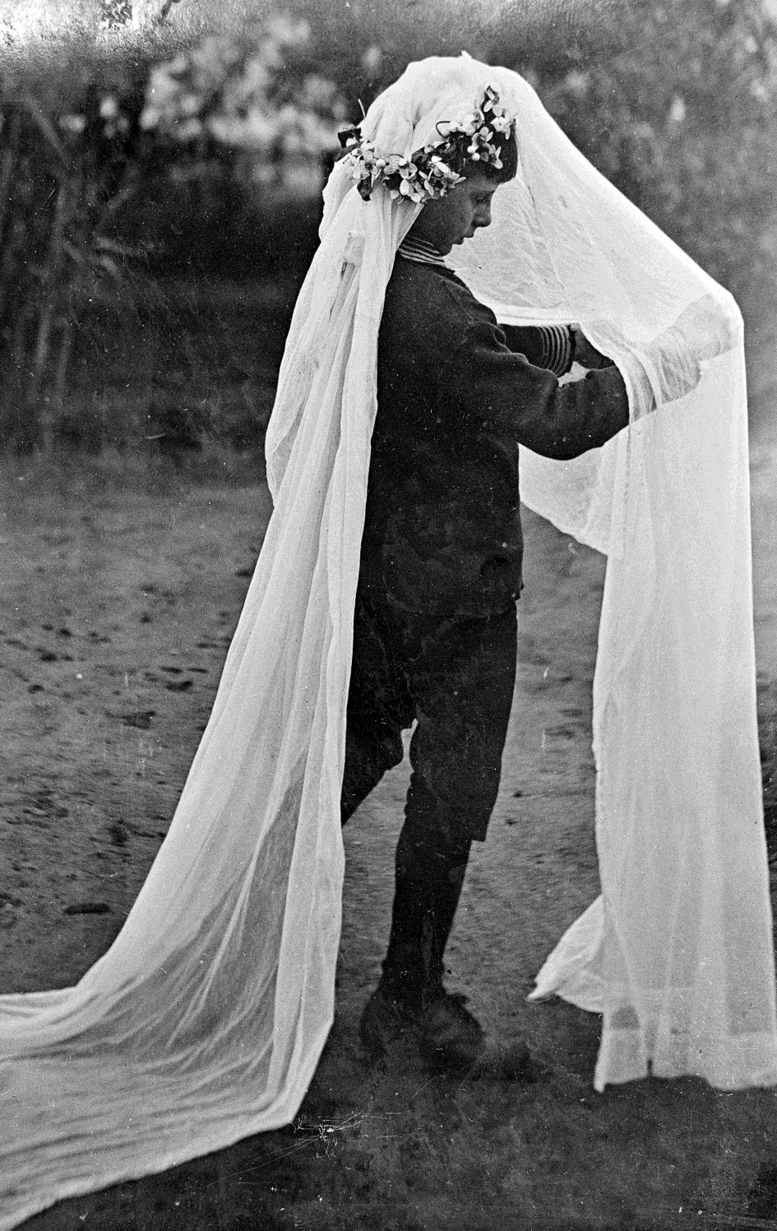
Boy playing dress ups in a bridal veil.
Photographer: Lilian Louisa Pitts

Slide 7
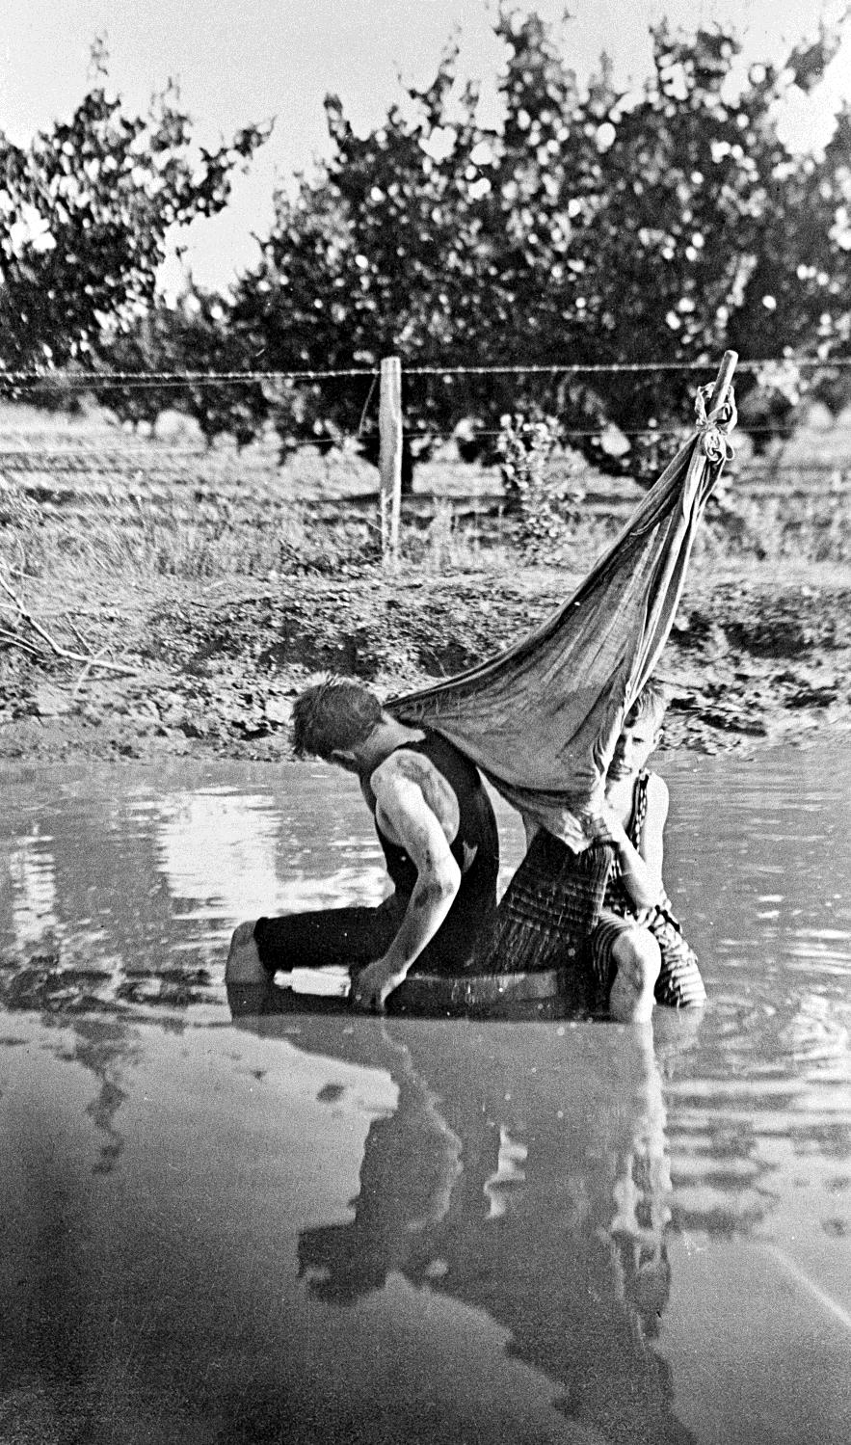
Two boys playing on a barrel boat in a water hole.
Photographer: Lilian Louisa Pitts

Slide 8
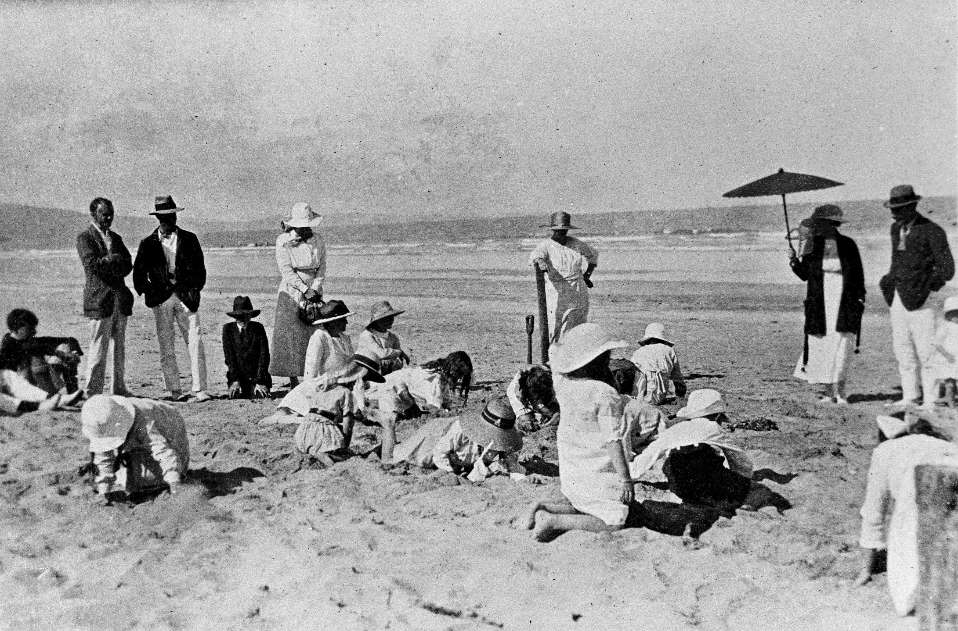
Children at a beach treasure hunt. Lorne beach
Photographer: Hugh P Hall

Slide 9
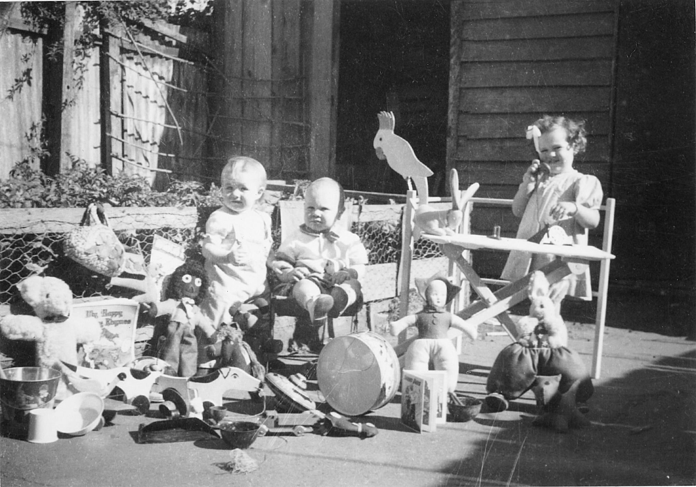
Three children on Christmas Day 1945 with their Christmas toys including golliwog.
Photographer: Unknown

Slide 10
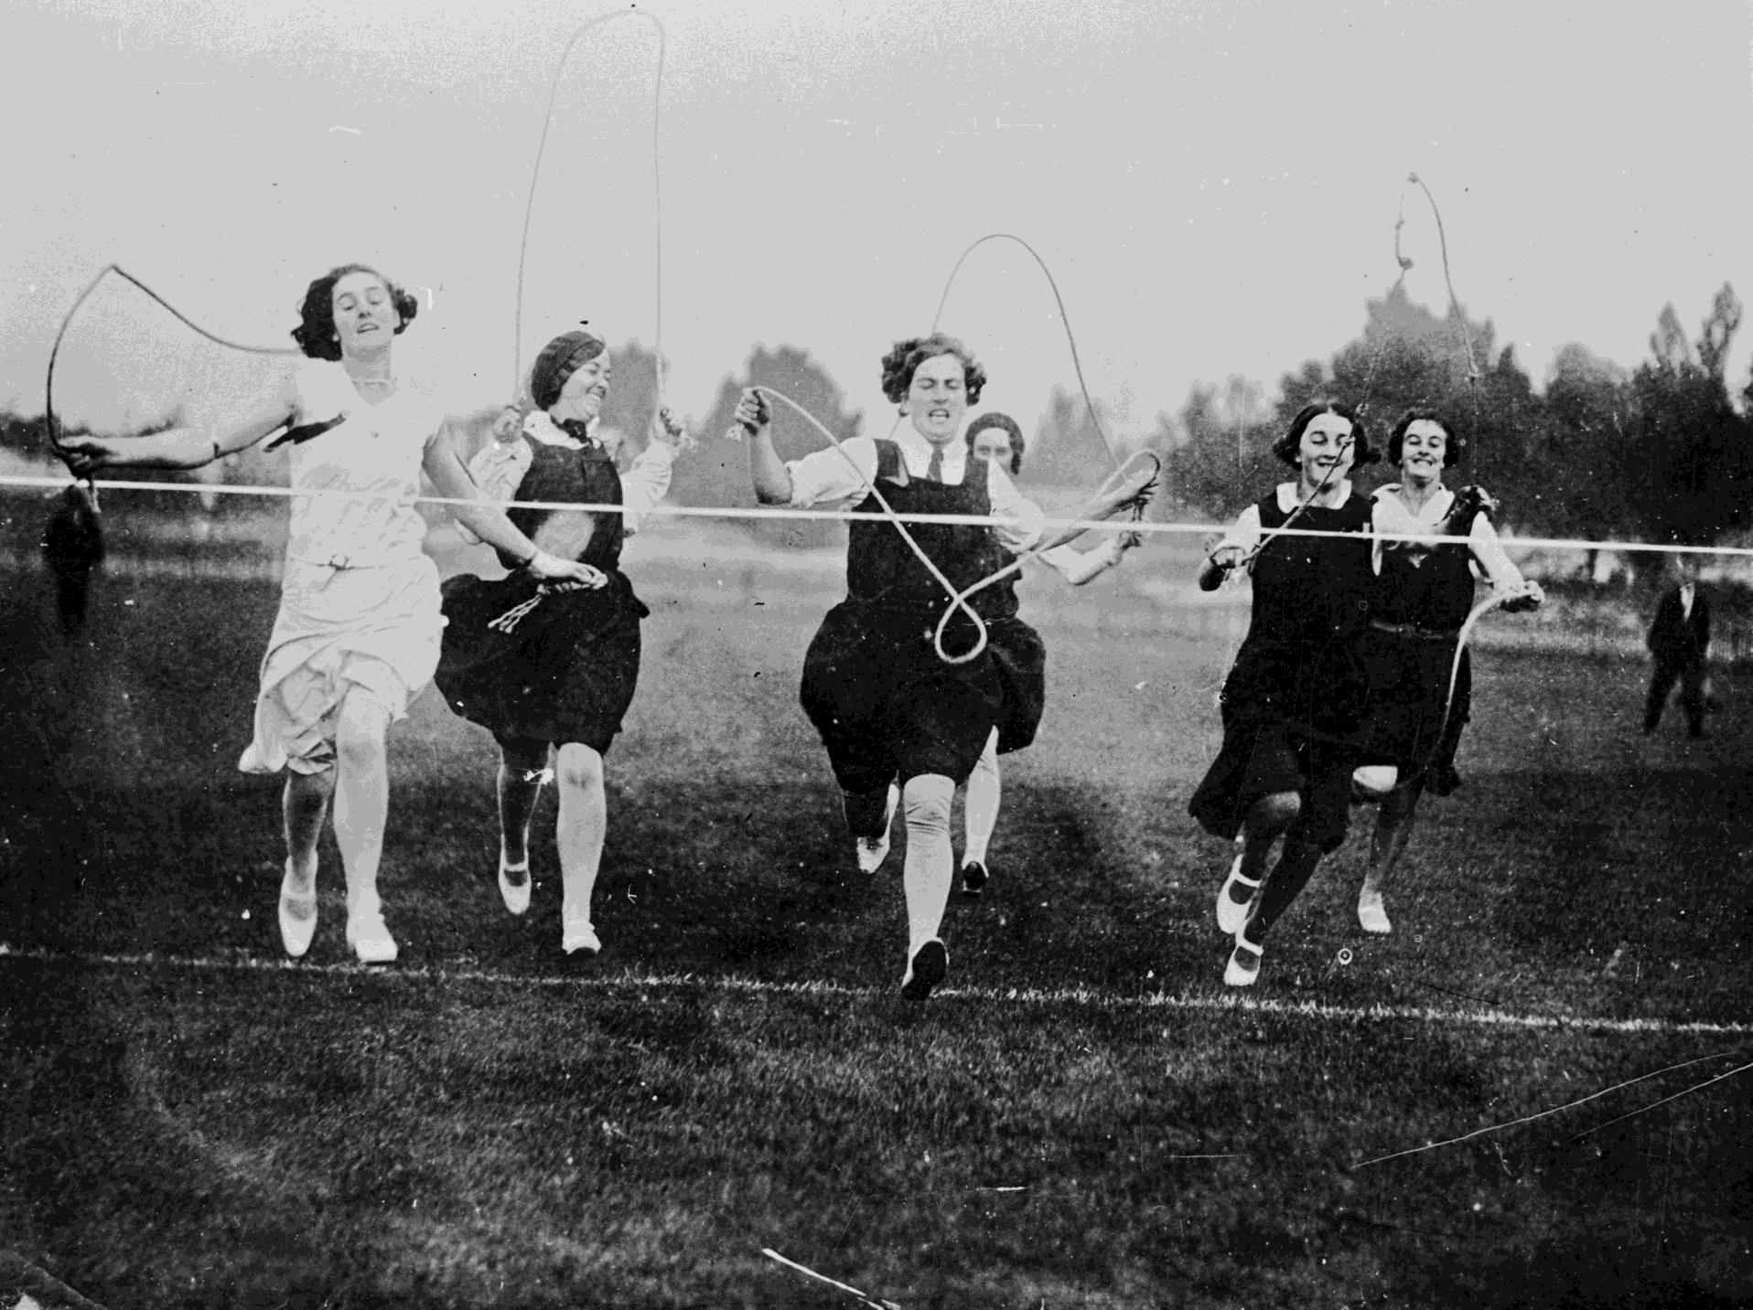
A skipping race.
Photographer: Unknown

Slide 11
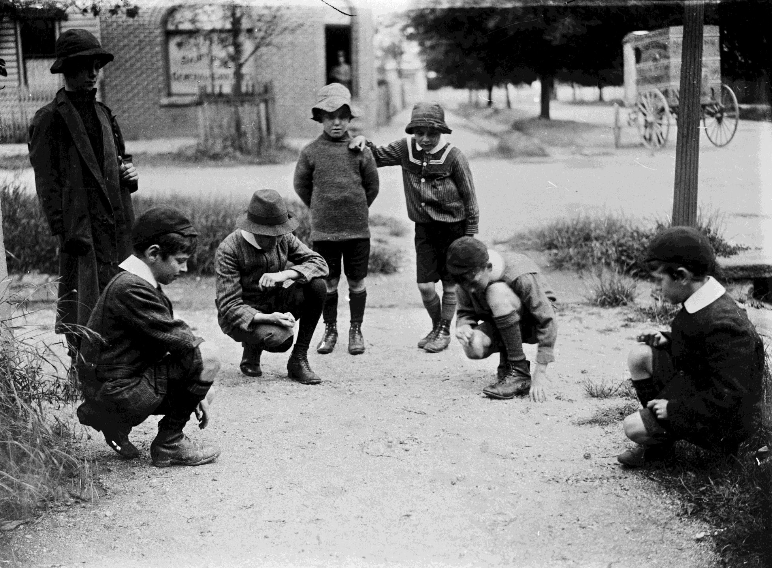
Group of children playing with marbles.
Photographer: Unknown

Slide 12
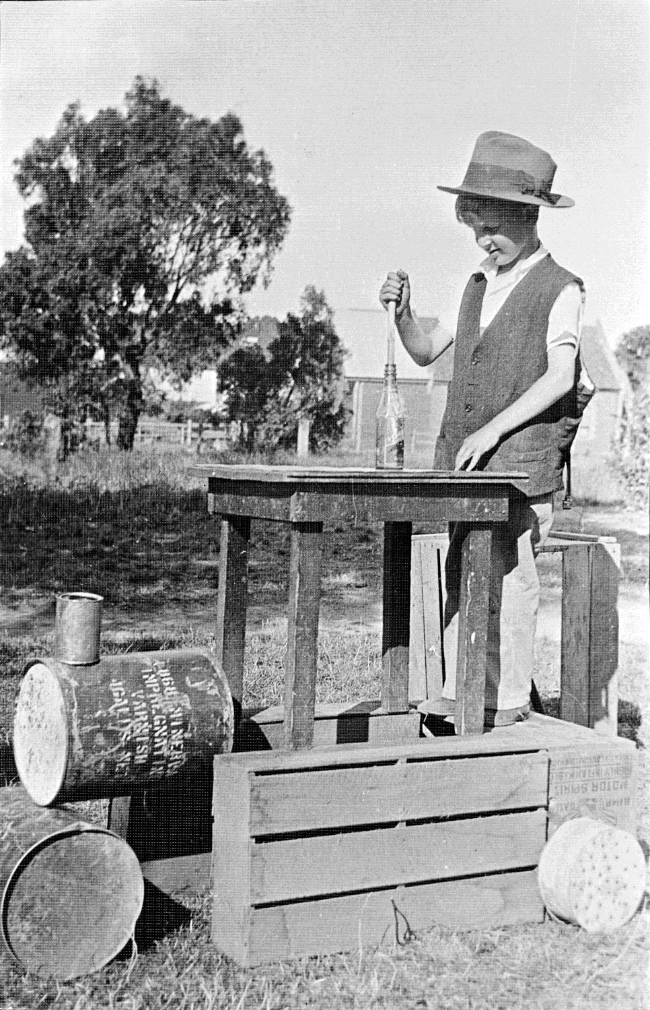
A boy playing with a 'train' constructed from a table, crates, fuel drums and cans.
Photographer: Gordon Binns

Slide 13
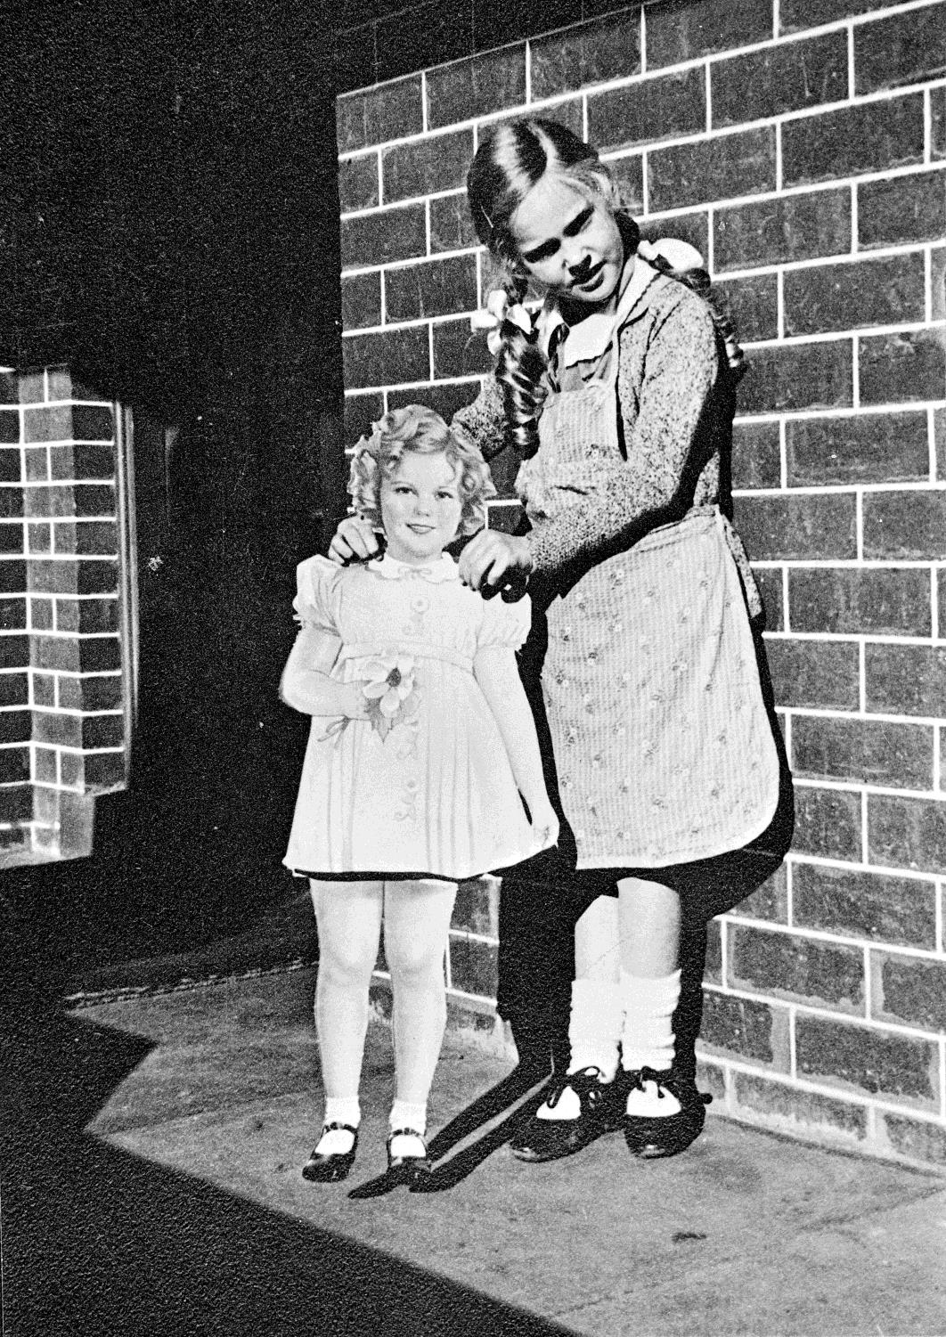
A girl holding a Shirley Temple cut-out.
Photographer: Gregory Binns

Slide 14
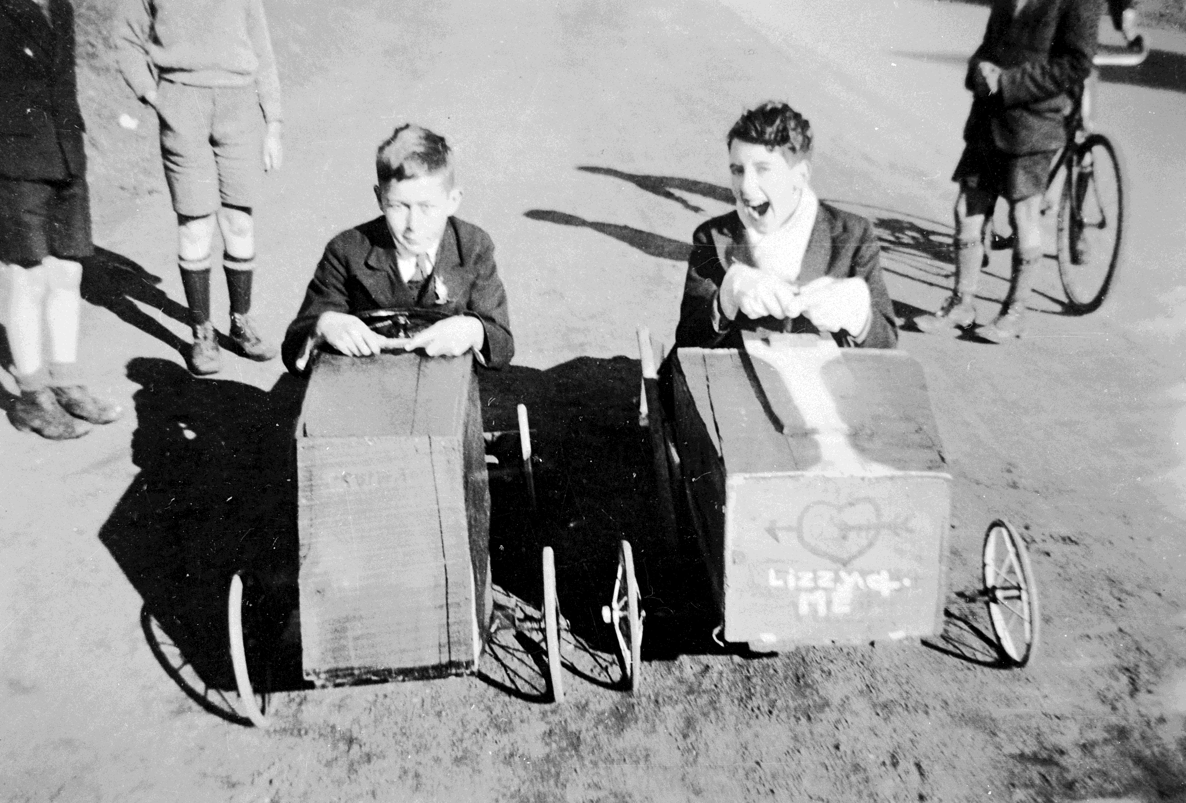
Two young boys in Billy carts.
Photographer: Joan Elijah

Slide 15
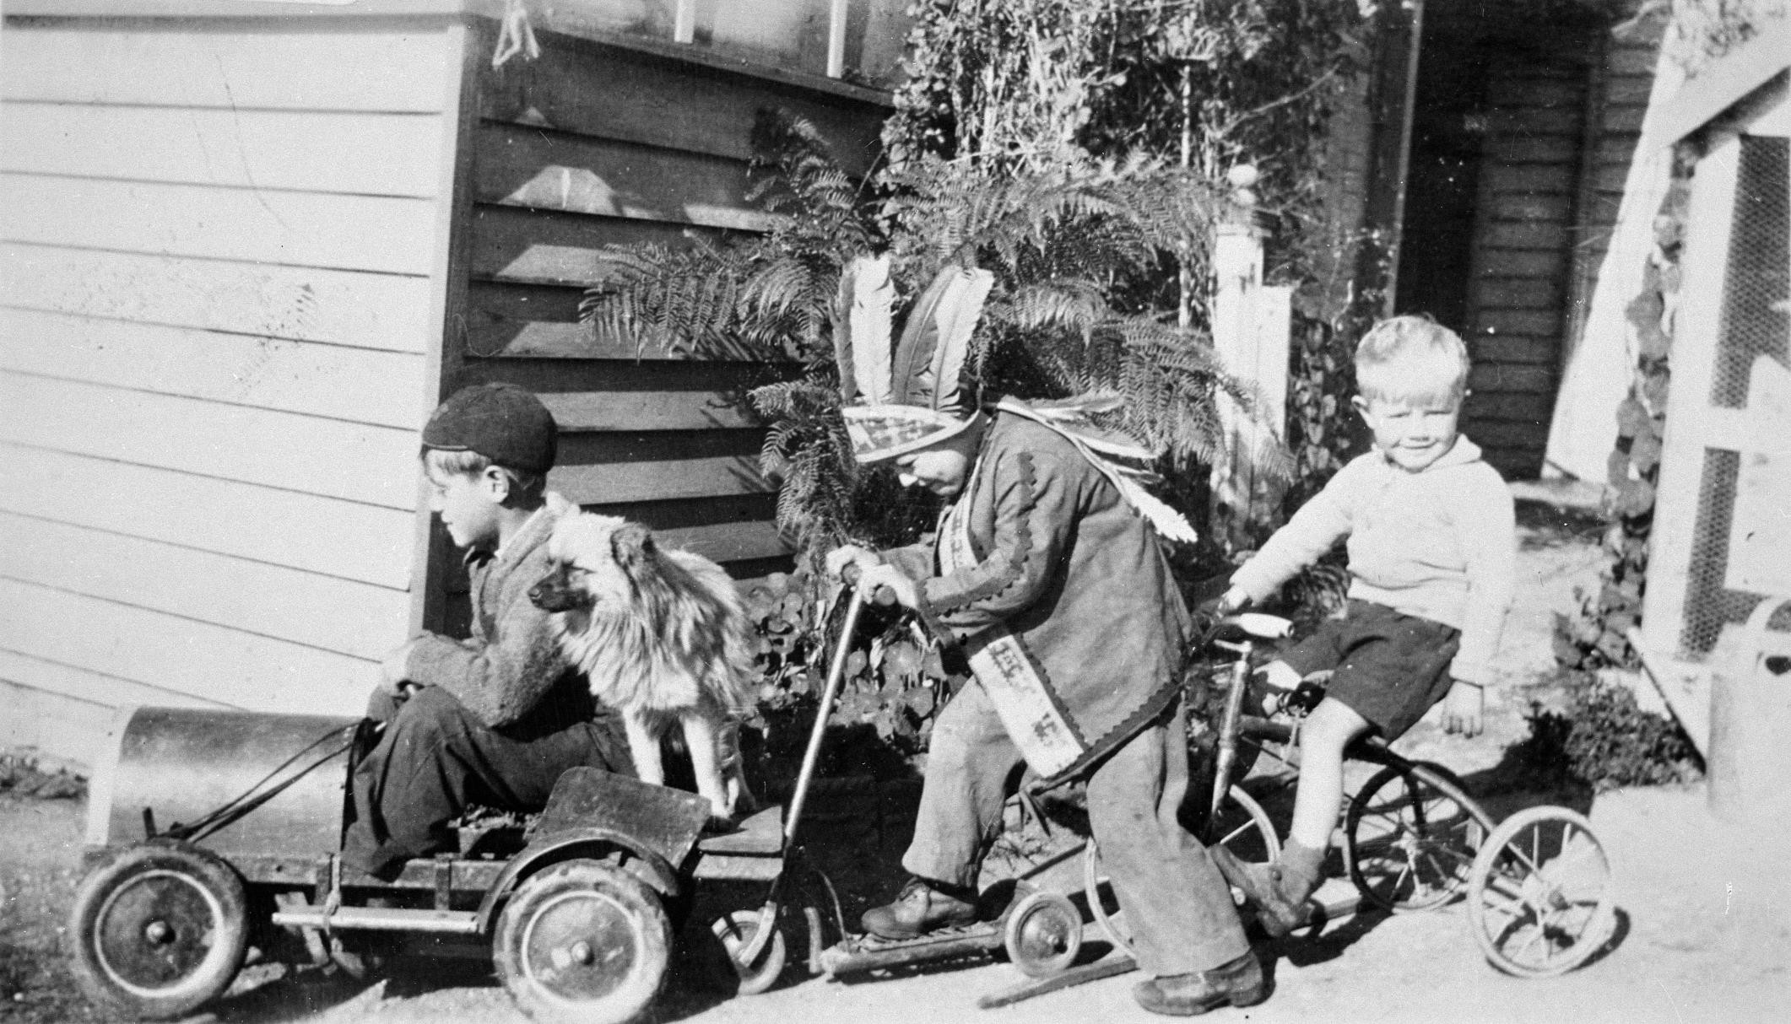
Three small boys playing dress ups.
Photographer: Unknown

Slide 16
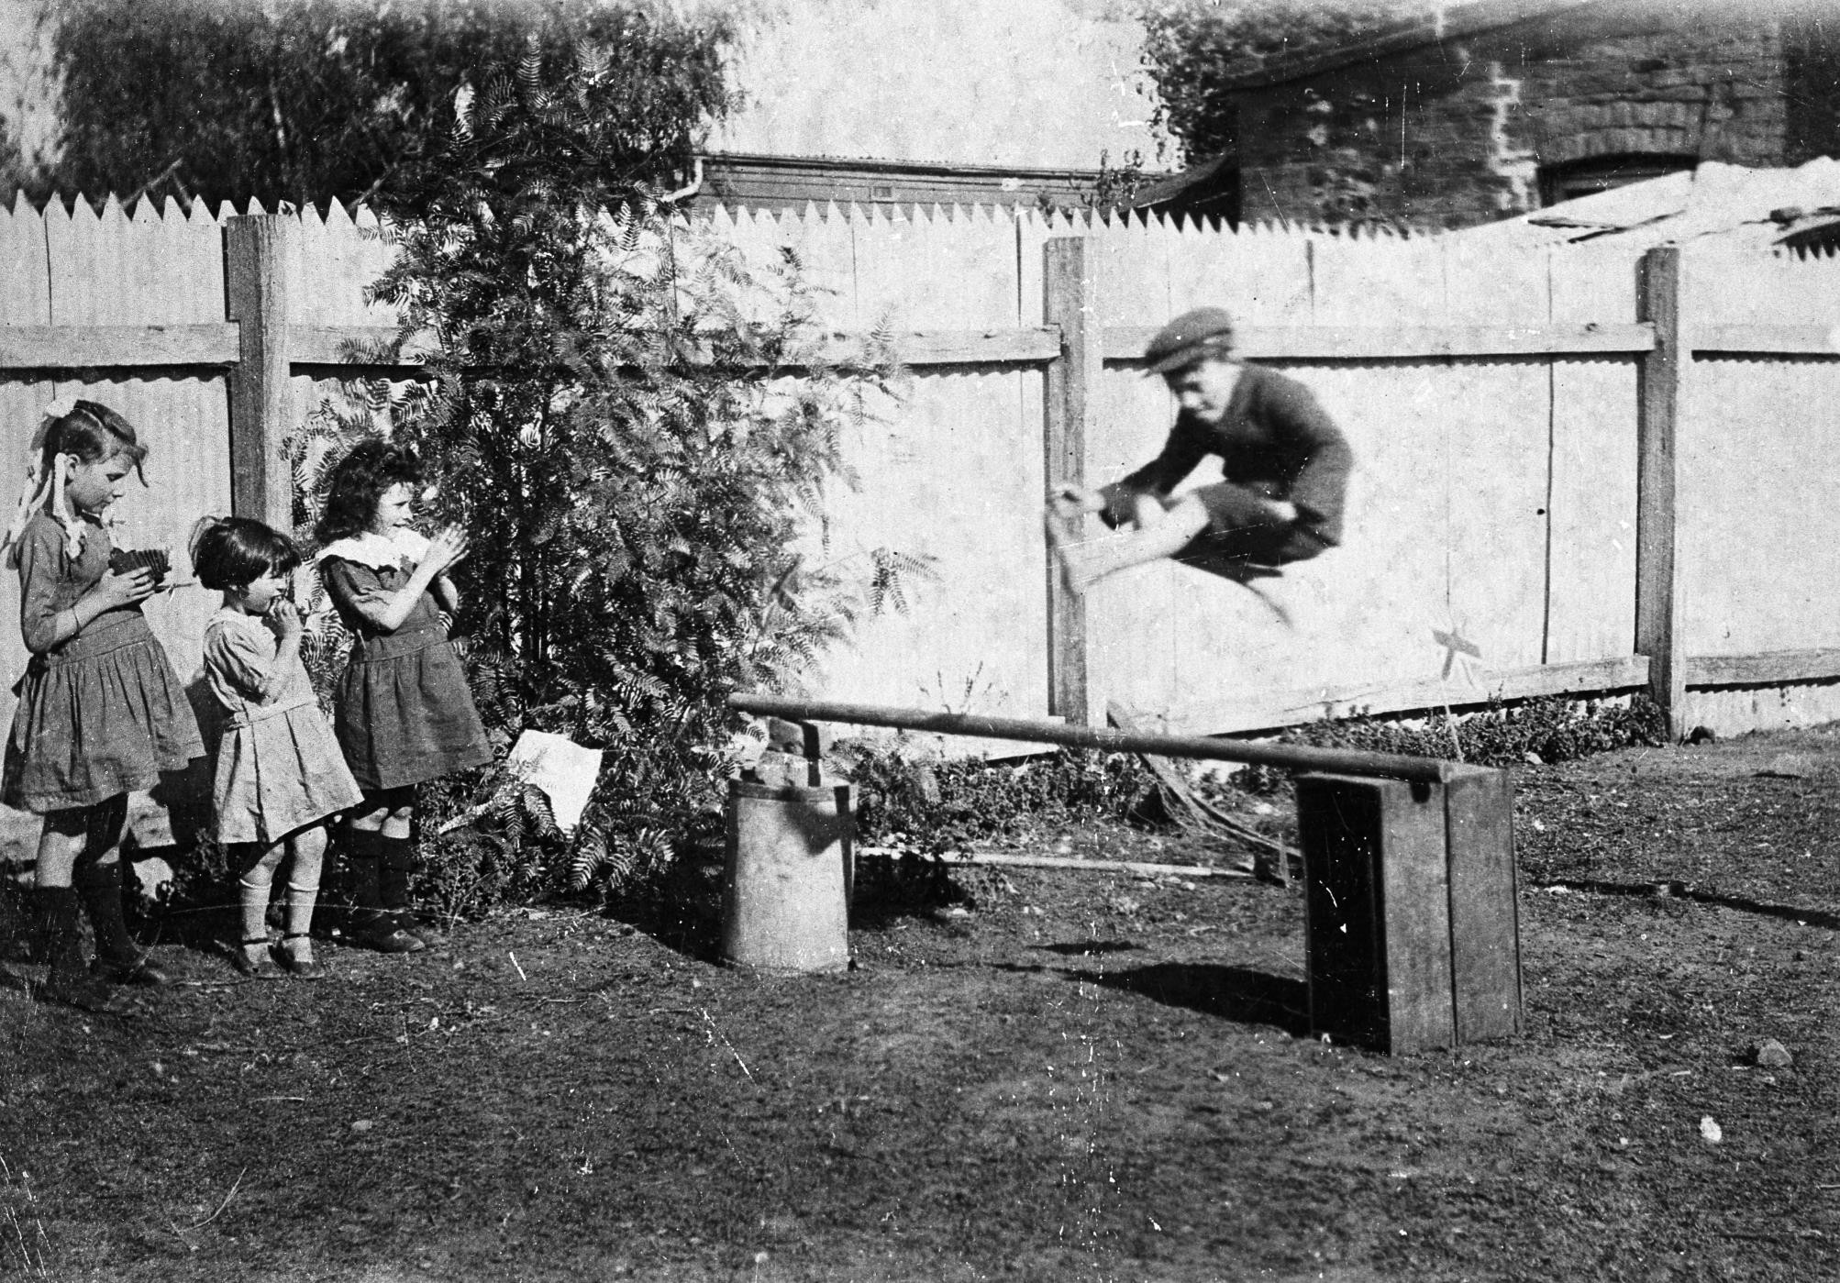
Young boy leaping over a backyard hurdle.
Photographer: Unknown

Slide 17
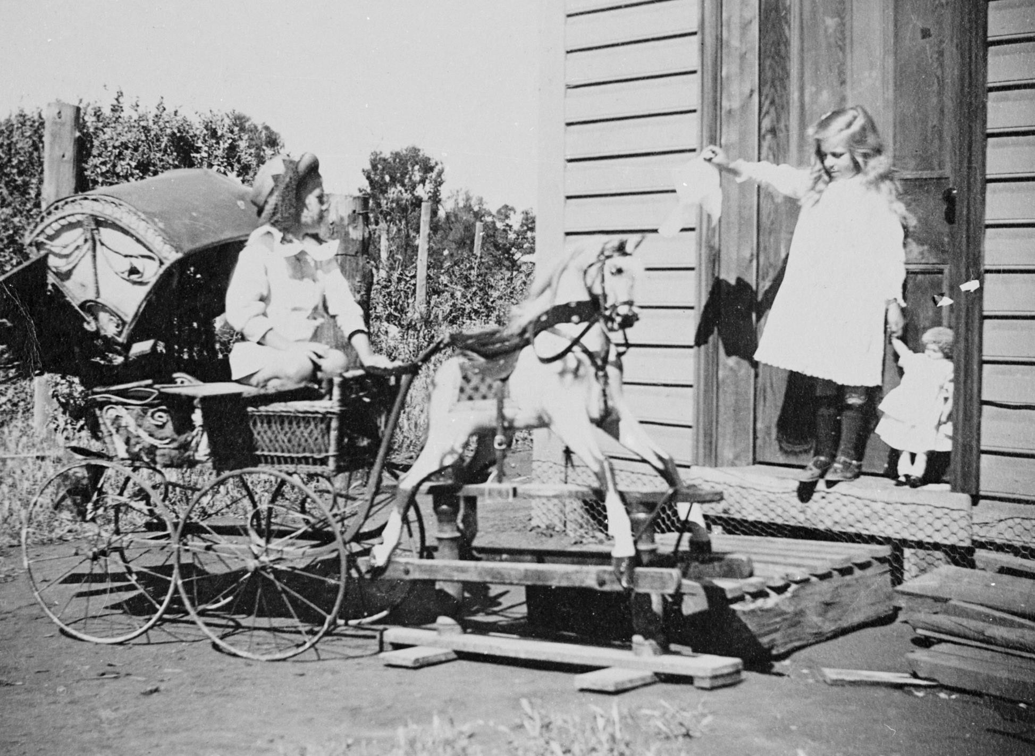
Two children playing with a pram and rocking horse.
Photographer: Unknown

Slide 18
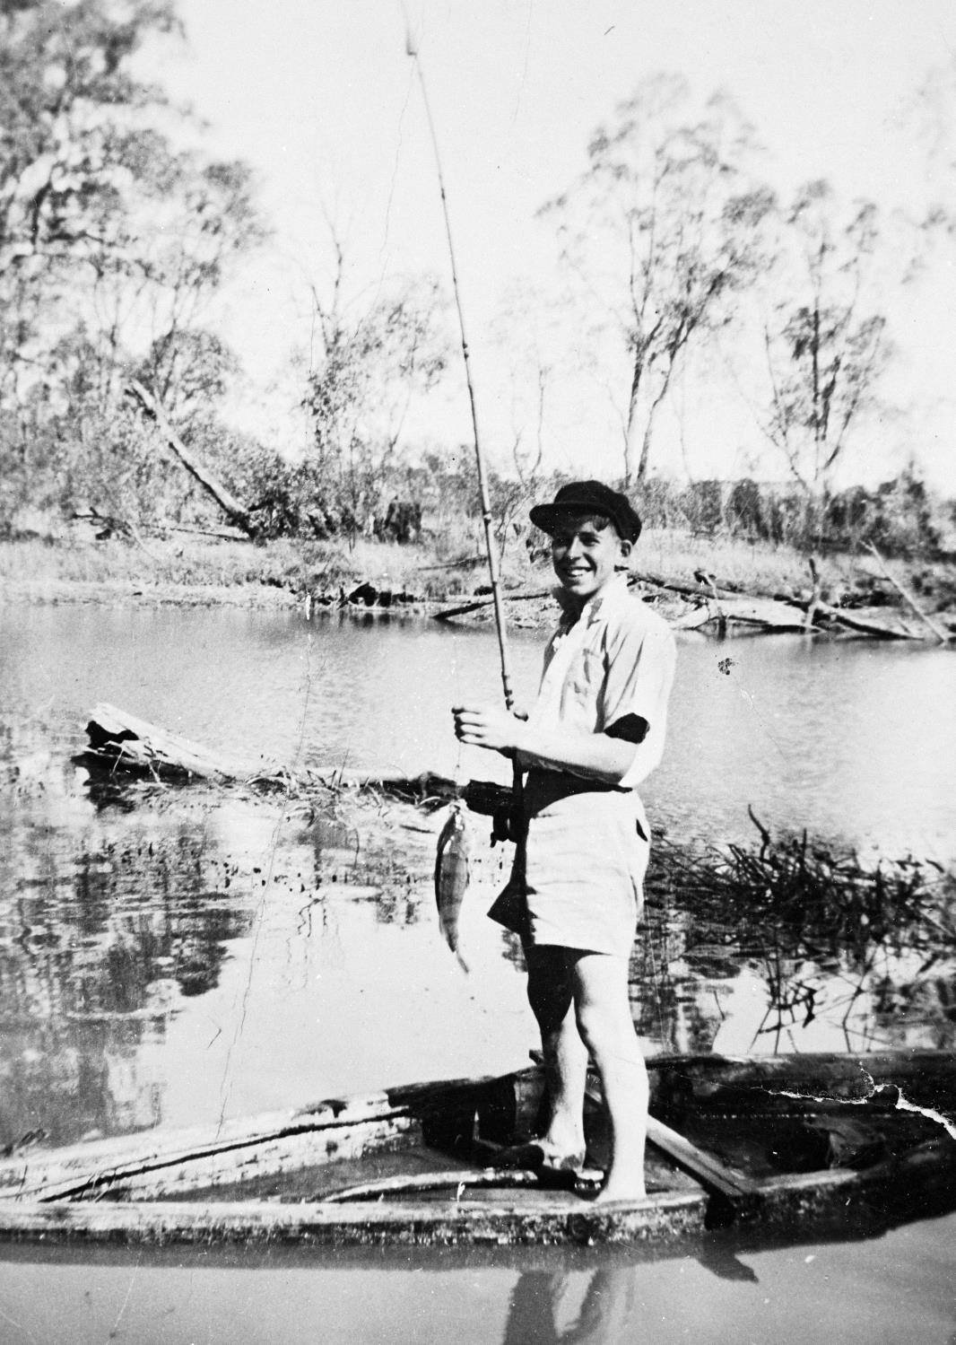
A boy fishing with a boat on Loddon River
Photographer: Z. Matherson

Slide 19
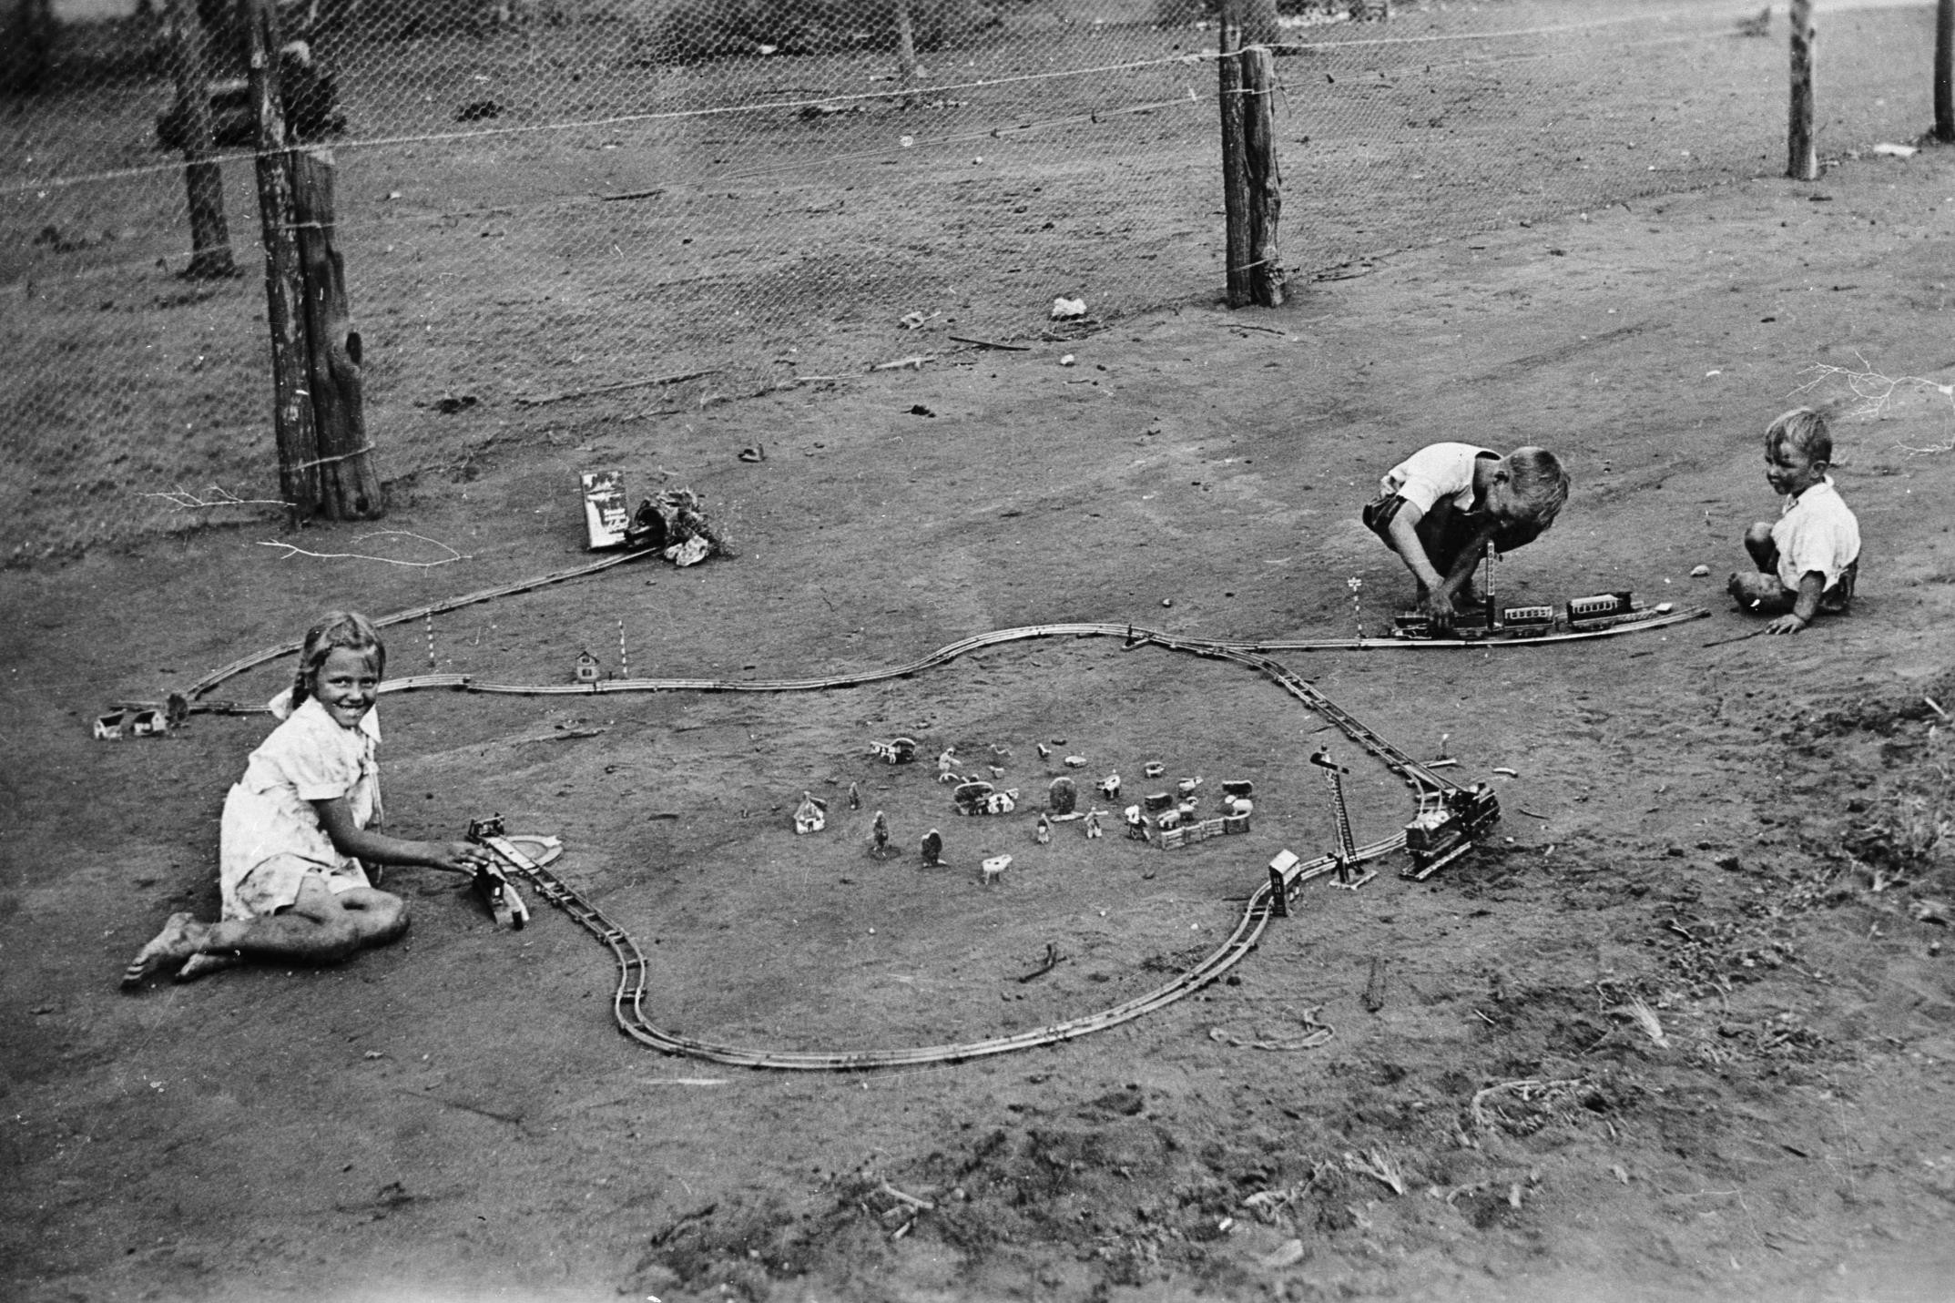
Young children playing outdoors with a train set.
Photographer: Frank March

Slide 20
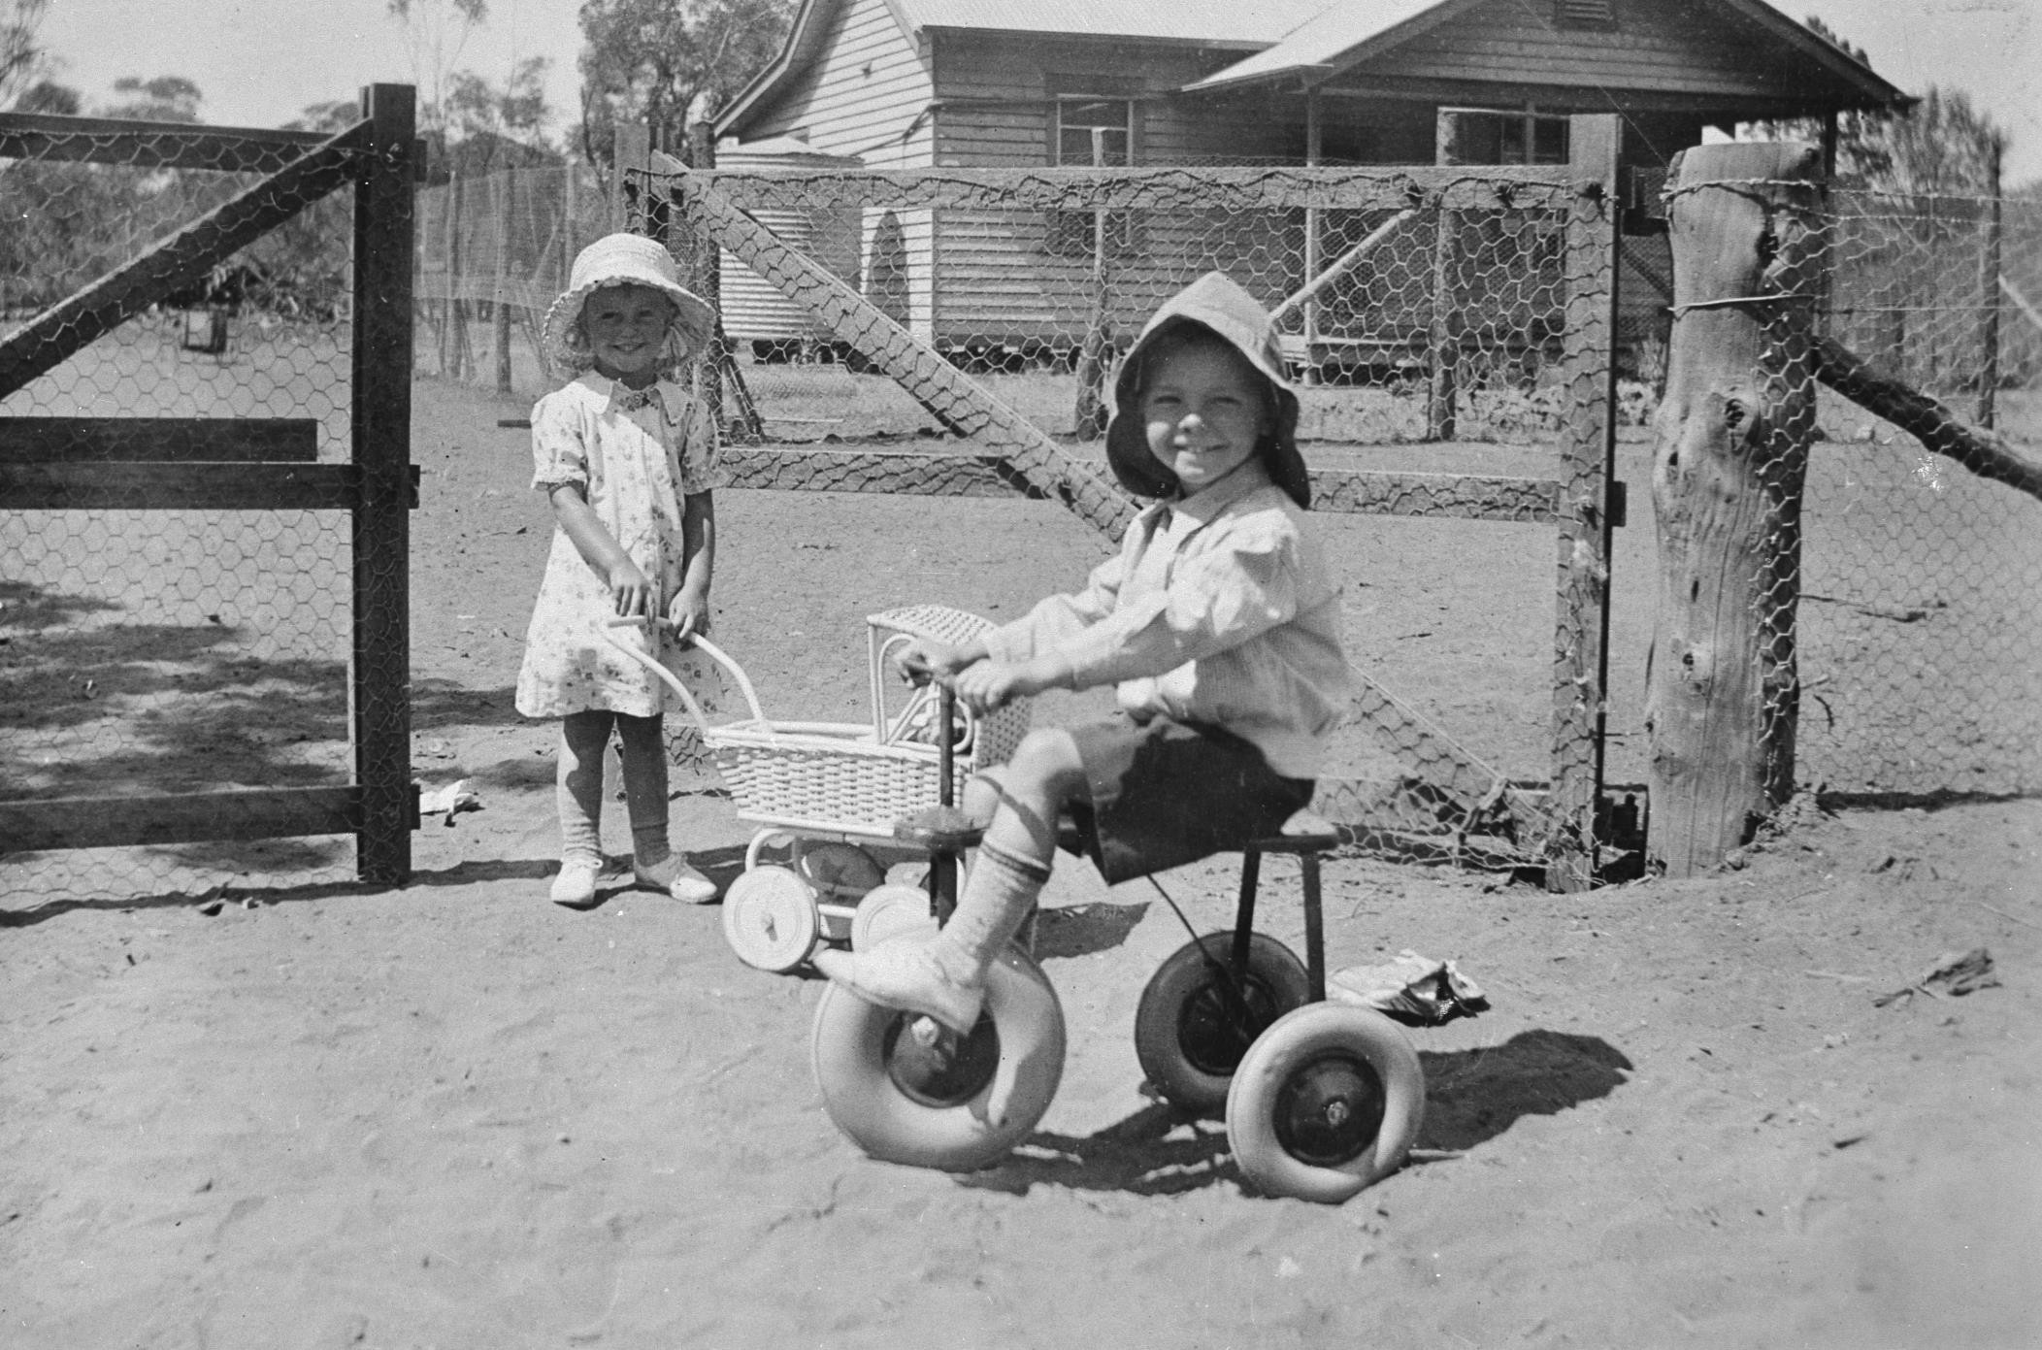
Two young children playing with a tricycle and pram.
Photographer: Frank March

Slide 21
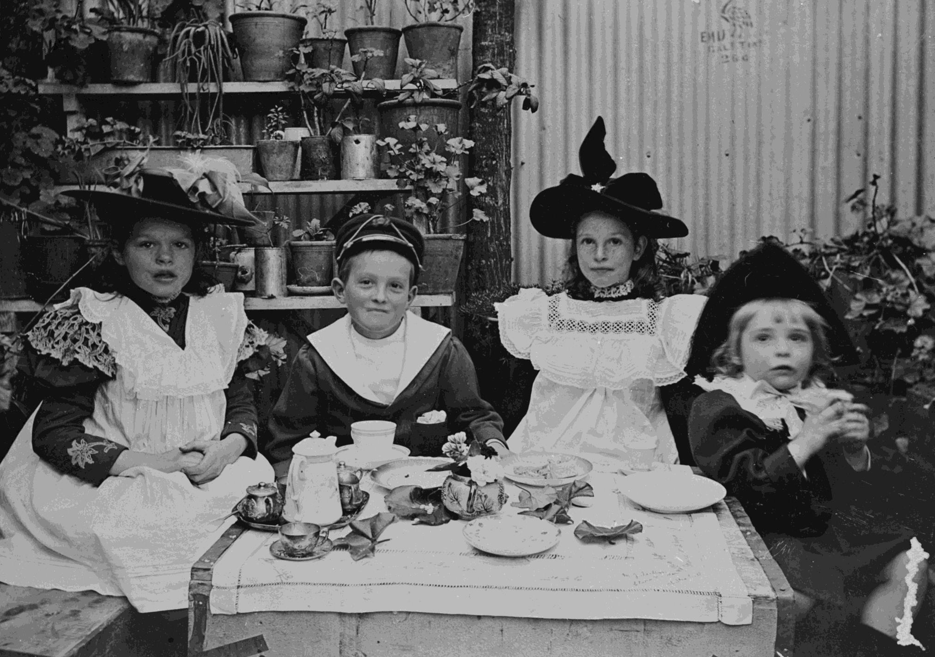
Children having a tea party.
Photographer: Unknown

Slide 22
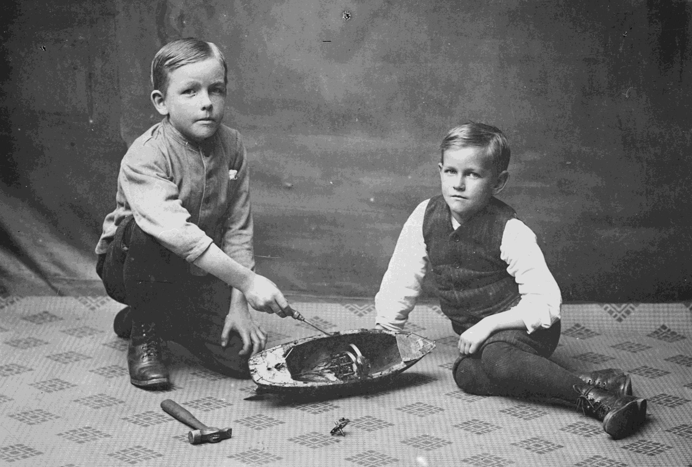
Two boys repairing a toy boat.
Photographer: Unknown

Slide 23
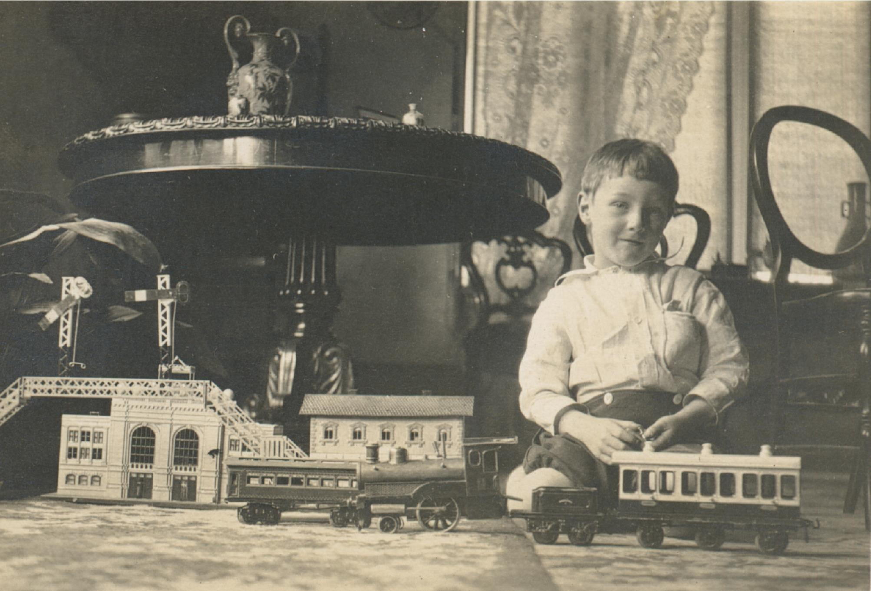
John Wilton Twycross playing with a toy train.
Photographer:
John William Twycross

Slide 24
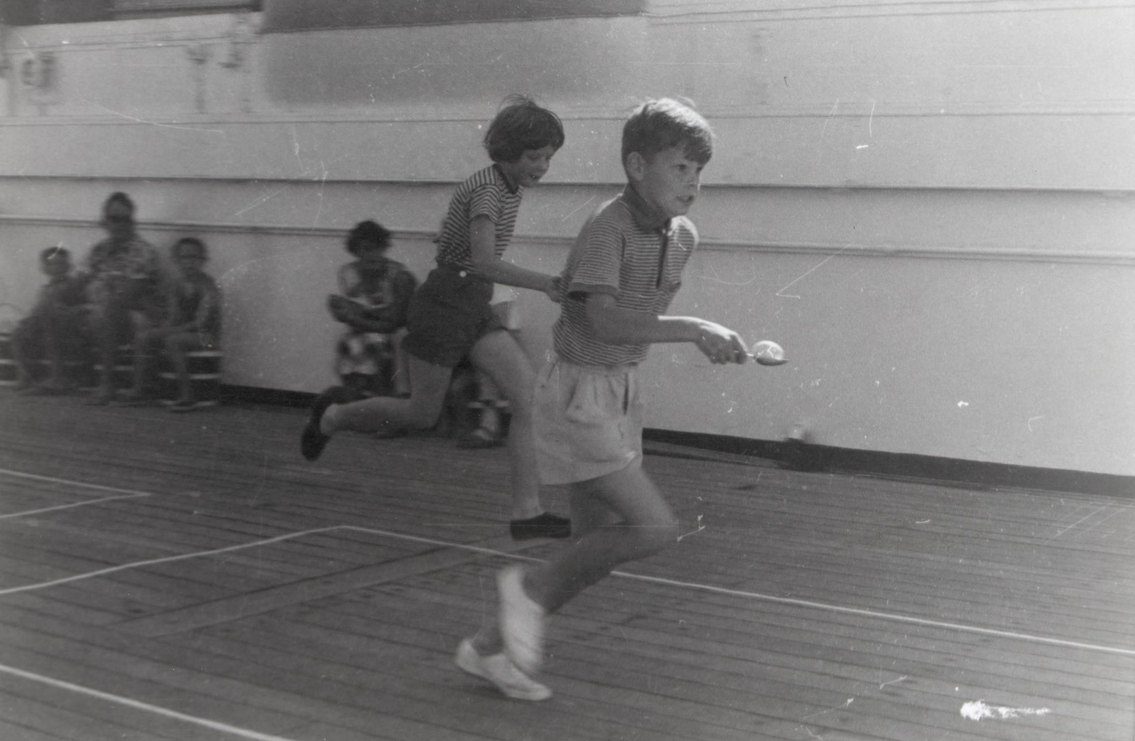
Egg and spoon race.
Photographer: Unknown

Slide 25
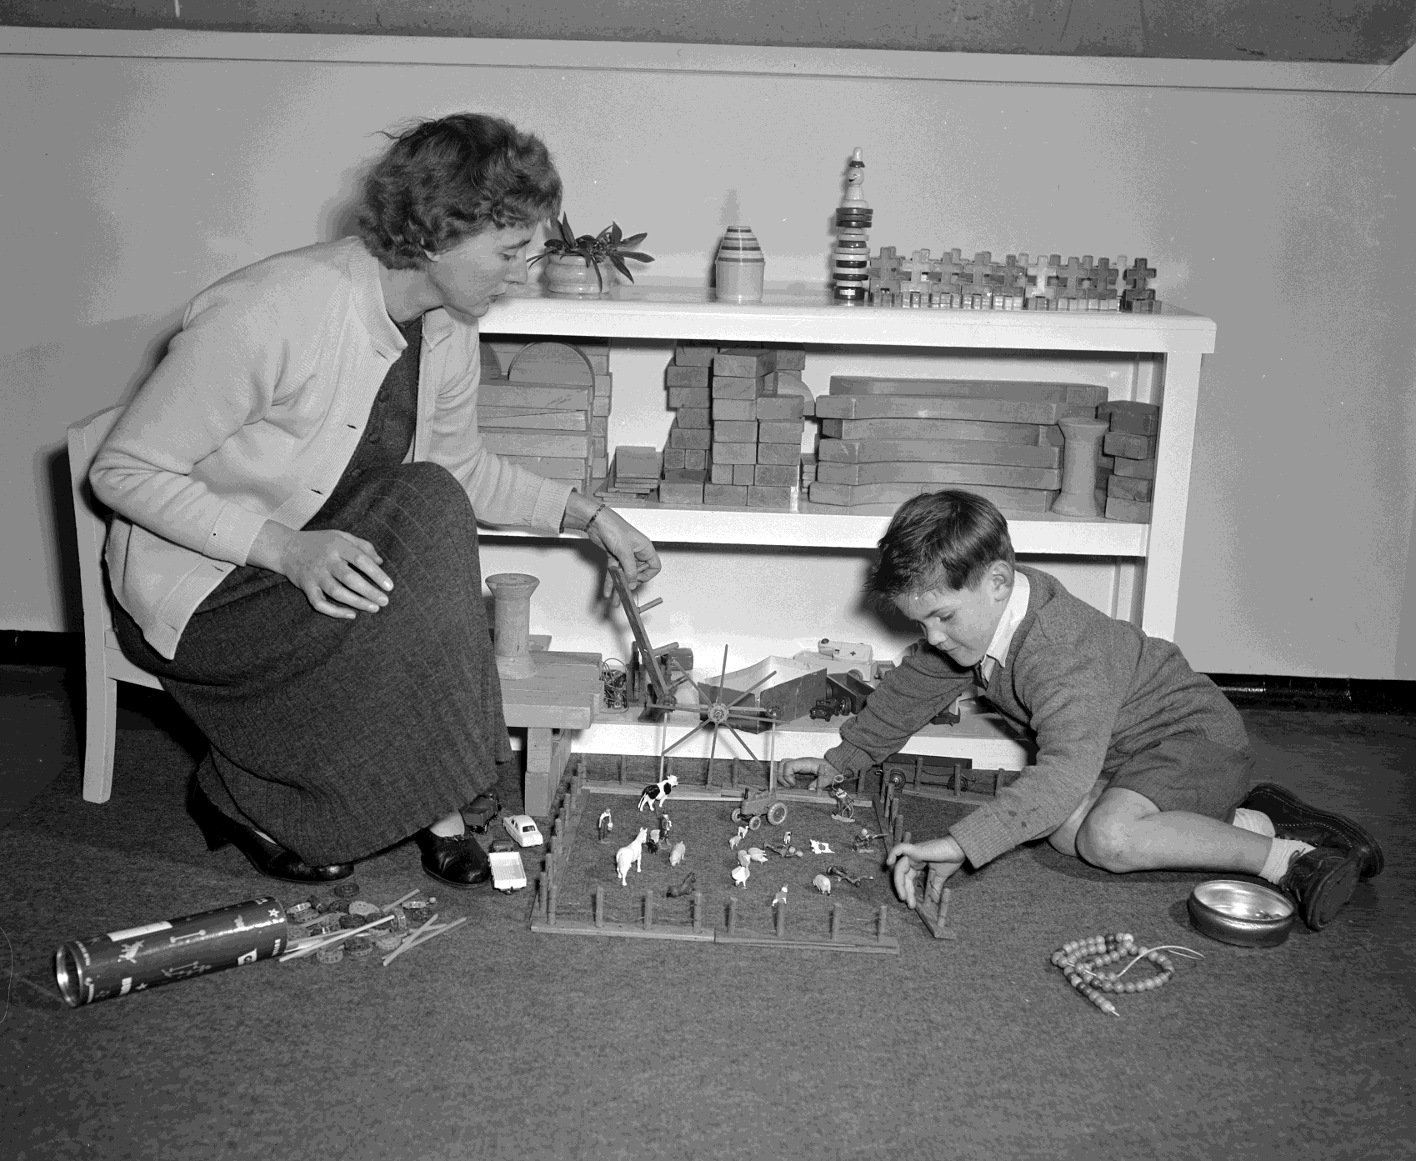
Mother and child playing with a toy farm set.
Photographer: Laurie Richards

Slide 26
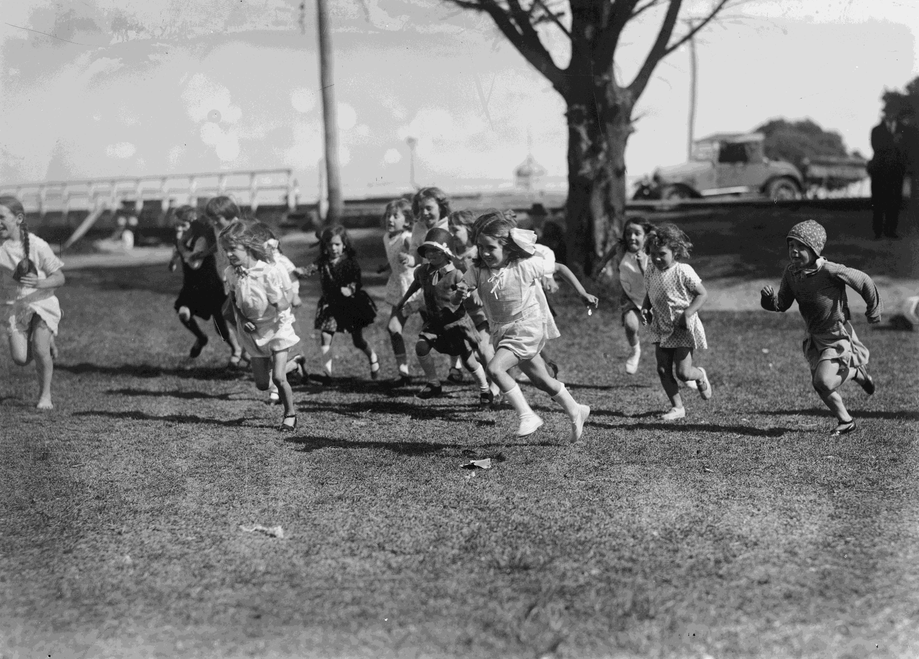
Girls running in a race.
Photographer: Unknown

Slide 27
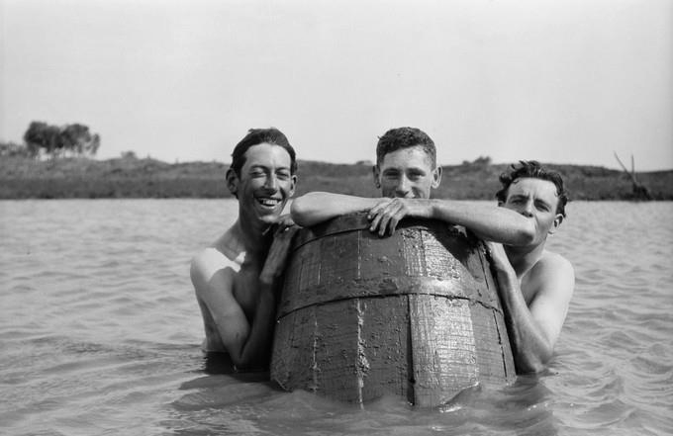
Three boys swimming in a dam with a barrel
Photographer: Bill Boyd

Slide 28
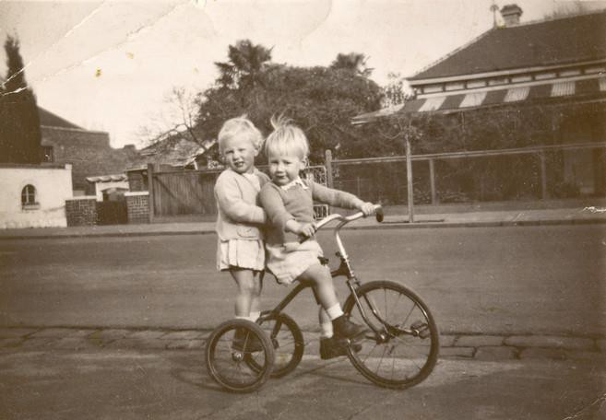
Twin Boy & Girl Riding Tricycle Outside Home, Windsor, circa 1949
Photographer: Unknown

Slide 29
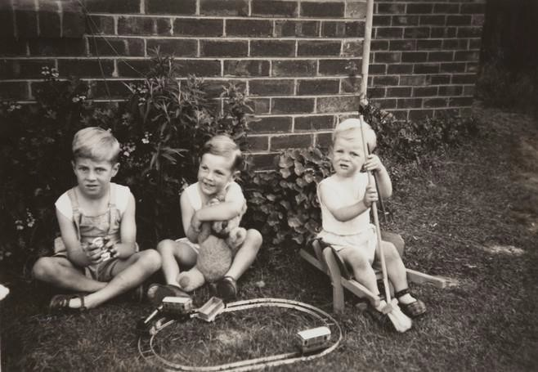
Three Boys with Train Set & Teddy, Backyard, Strathmore, 1949
Photographer: Unknown

Slide 30
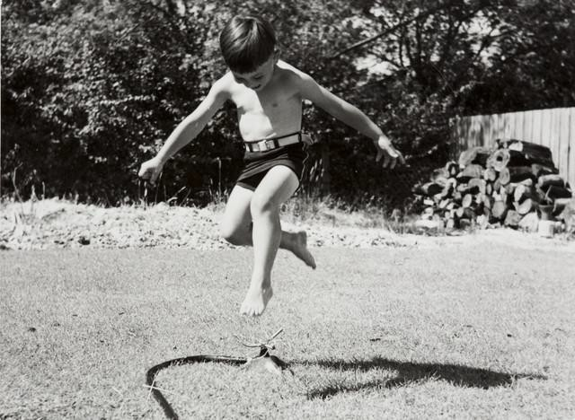
Three Boys with Train Set & Teddy, Backyard, Strathmore, 1949.
Photographer:
Mark Linacre Brocklesby,

Slide 31
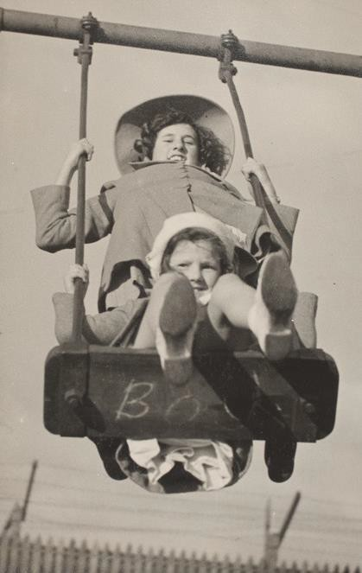
Girl & Infant Girl Playing on Swing, Backyard
Photographer: Roy Leibig

Slide 32
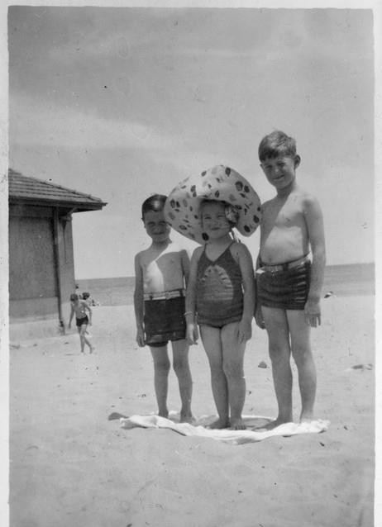
A Girl in Sunhat & Two Boys on St Kilda Beach, 1945
Photographer: Unknown

Slide 33
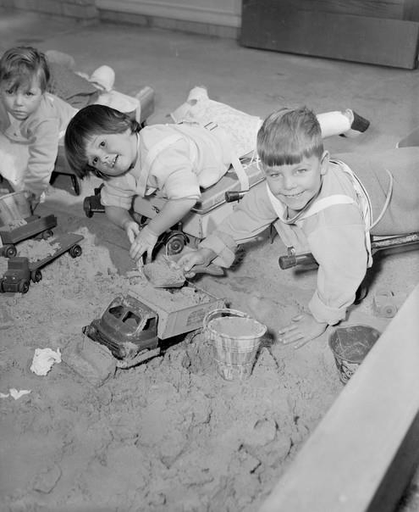
Children Playing in a Sandpit, 1959
Photographer: Laurie Richards

Slide 34
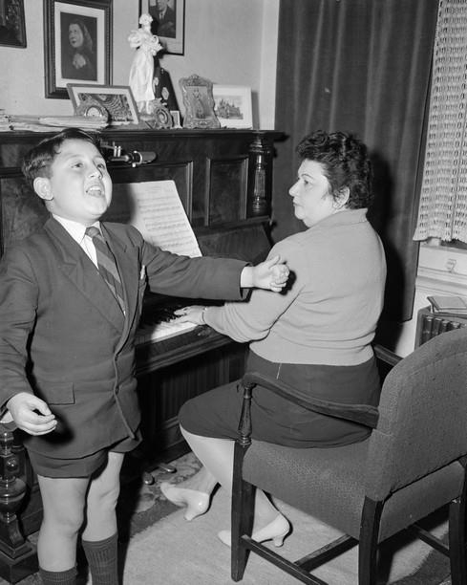
Boy Having Singing Lessons, Richmond, Victoria, 1959
Photographer: Laurie Richards

Slide 35
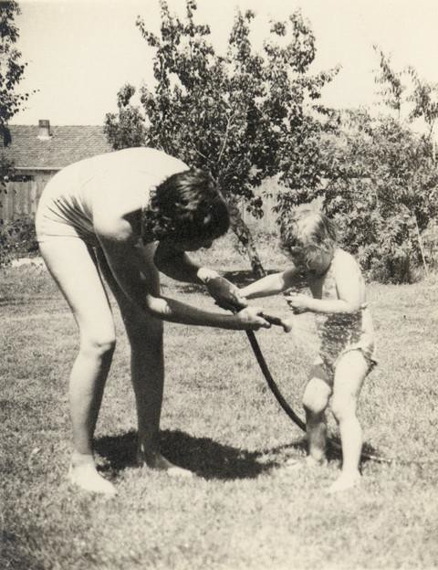
Mother and daughter playing with watering hose in backyard, circa 1954.
Photographer: Unknown

Slide 36
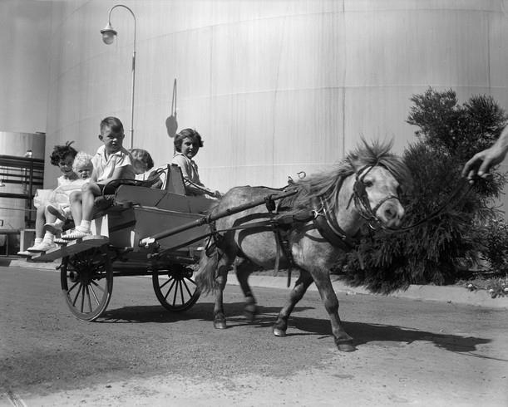
A group of children riding in a small cart drawn by a Shetland pony at a Christmas party
Photographer: Laurie Richards

Slide 37
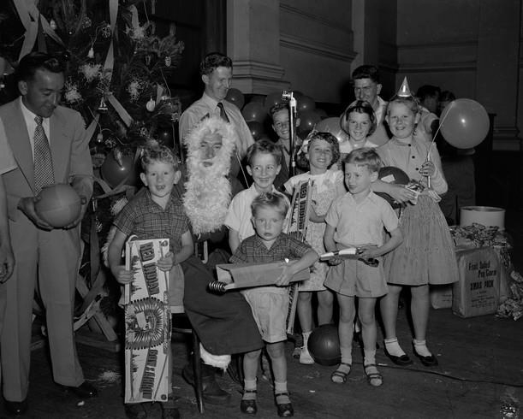
Christmas party a group of children standing next to Santa Claus at a Christmas party
Photographer: Laurie Richards

Slide 38
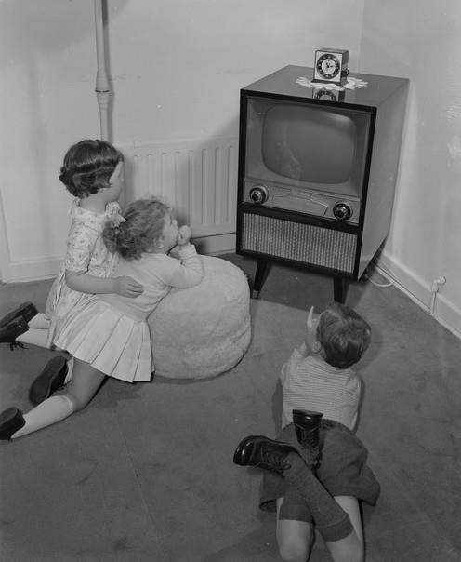
Children Watching Early Model Television Set, 1959
Photographer: Laurie Richards

