Slide 1

Rock ‘n’ Roll
A slideshow of images from Museums Victoria's collection exploring
teenage trends from the 1950s and 60s.

Slide 2
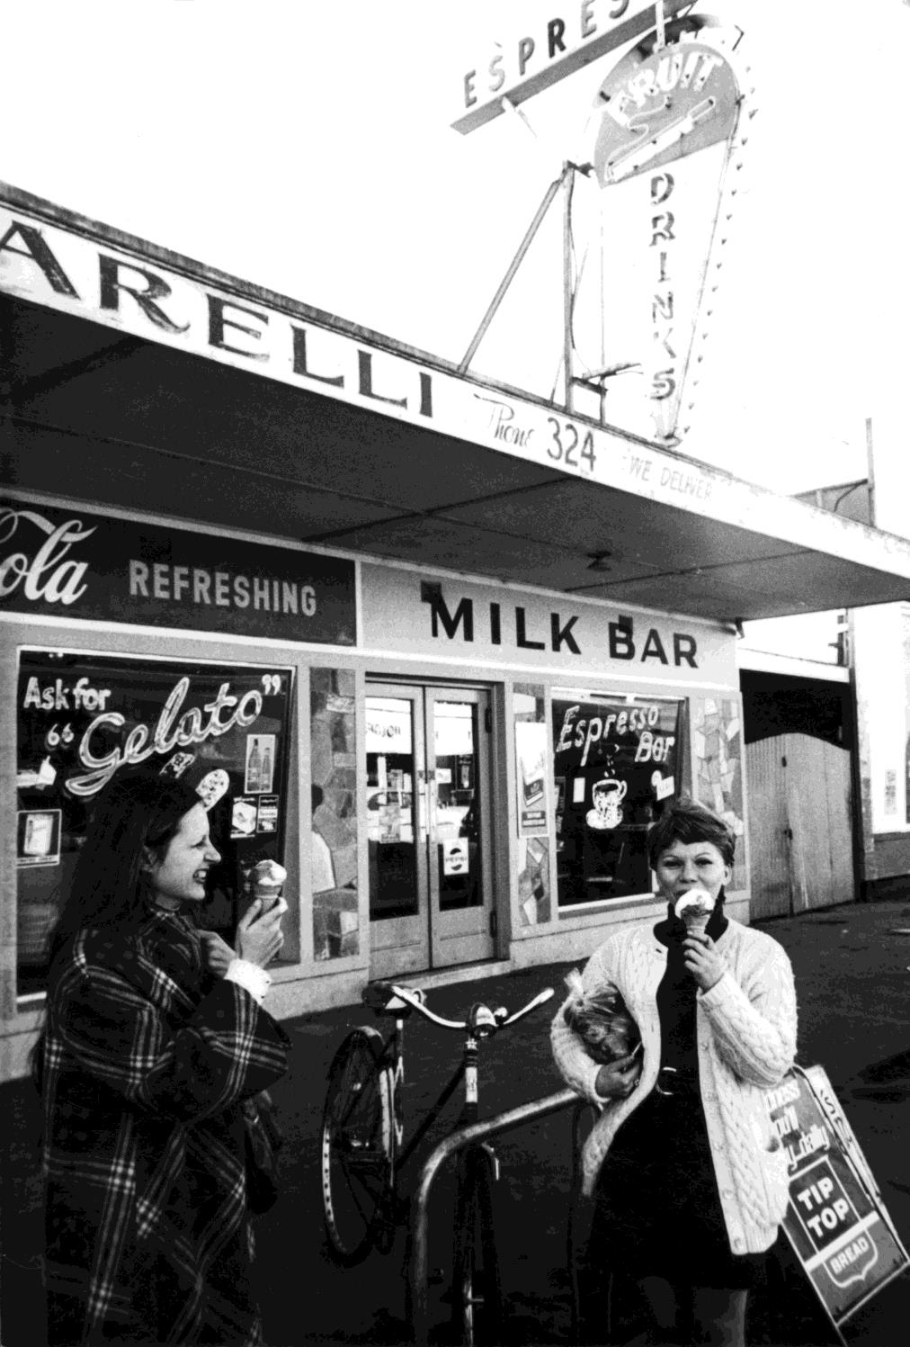
Girls eating ice creams
outside a milk bar.
Werribee, VIC. 1960
Photographer: Unknown

Slide 3
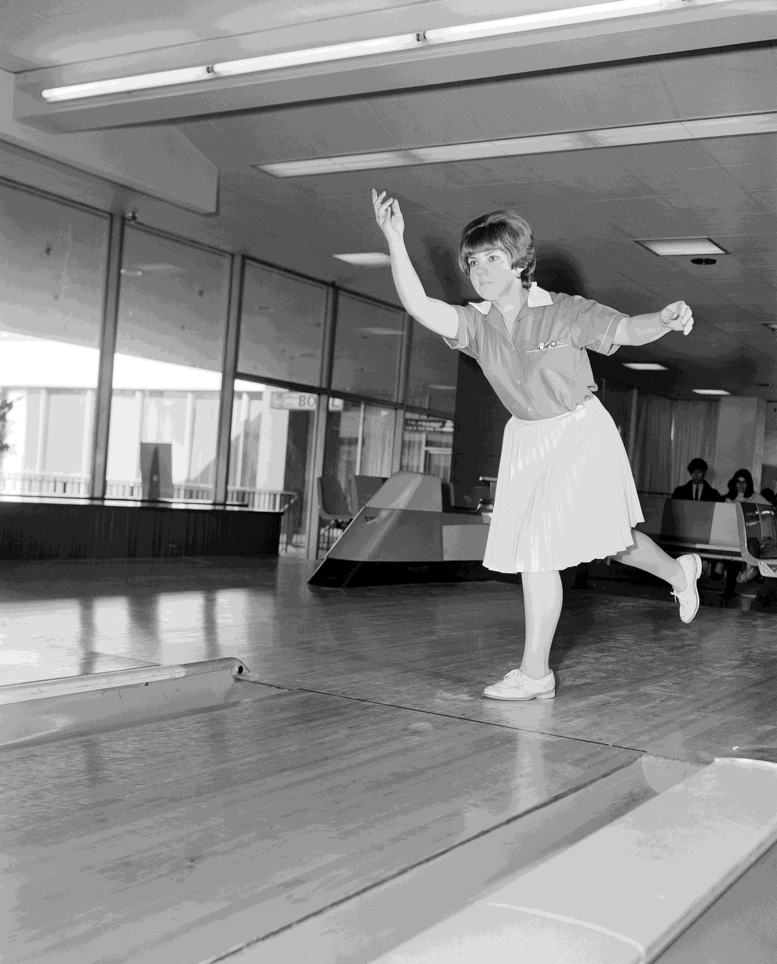
Woman 10-pin bowling. Southern Cross, Melbourne.
Photographer:
Laurie Richards

Slide 4
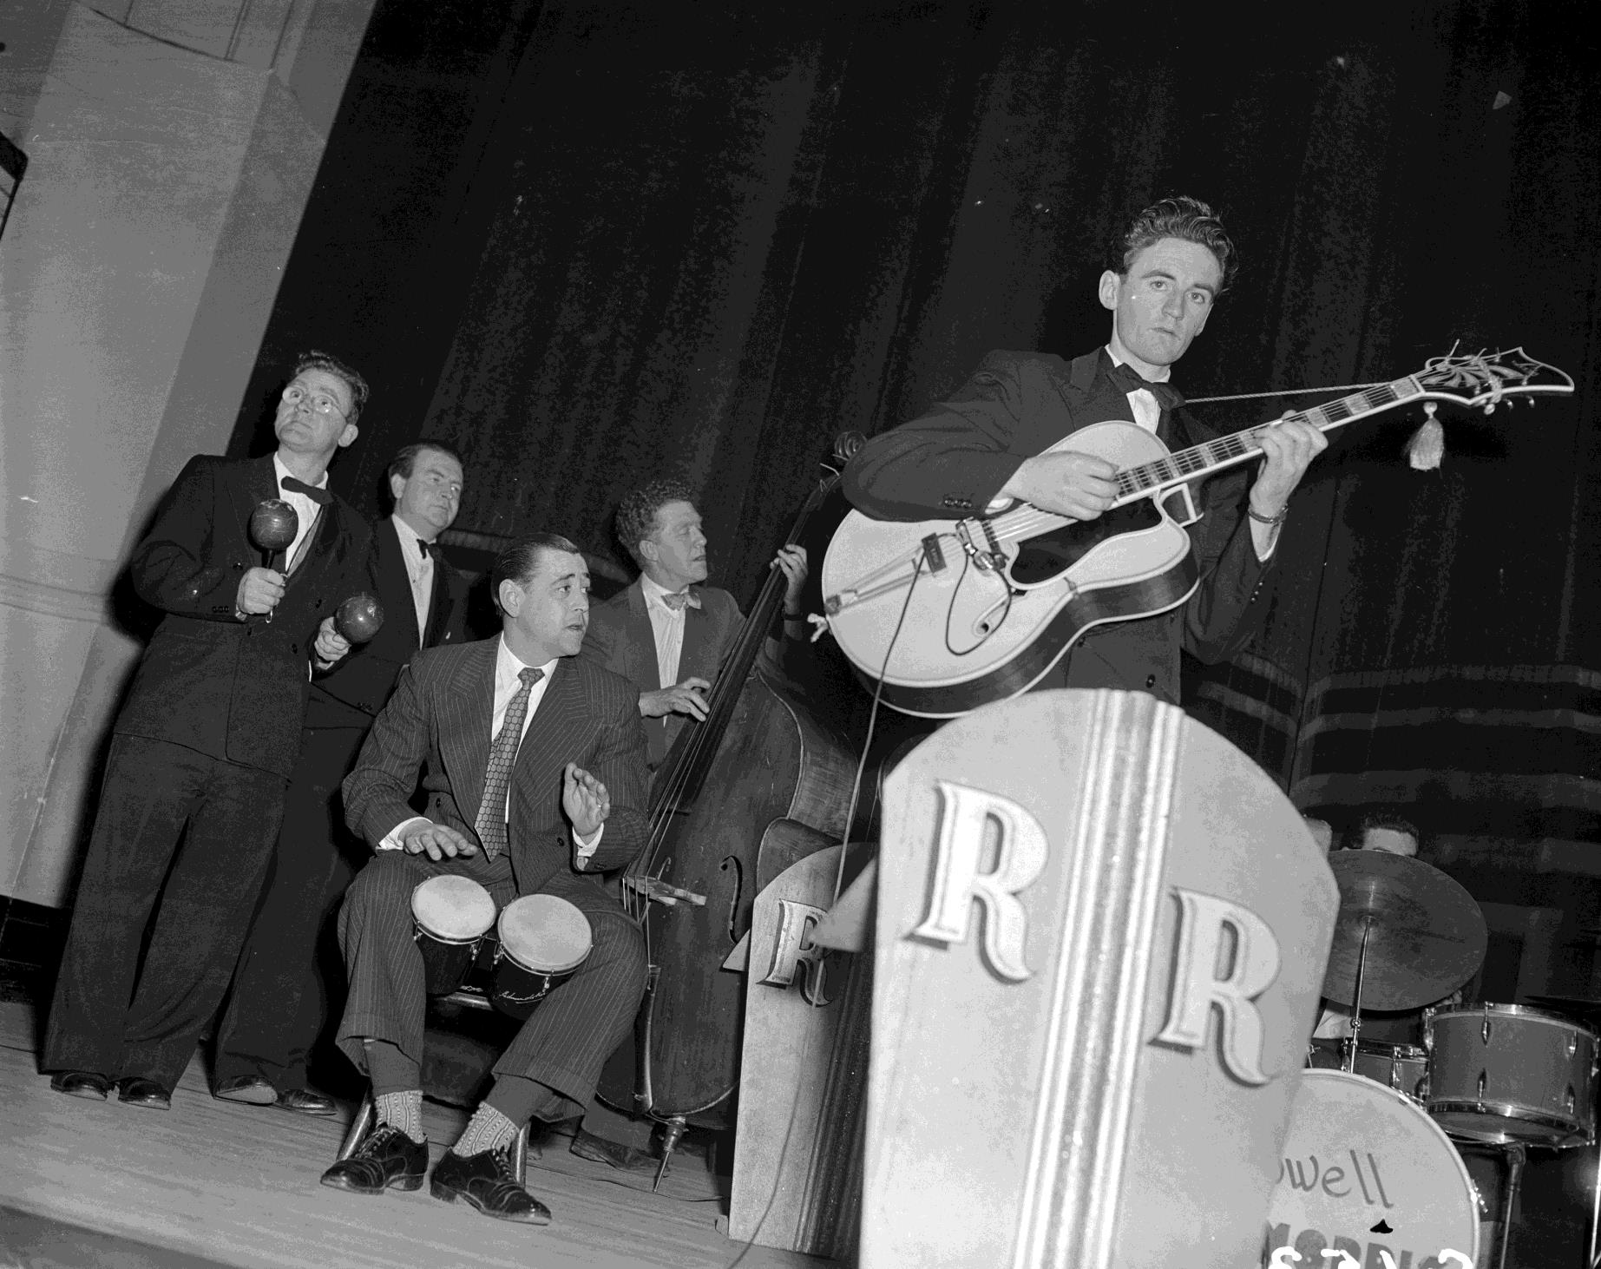
Band performing at the
Melbourne Town Hall.
Melbourne, VIC. 1953
Photographer: Unknown

Slide 5
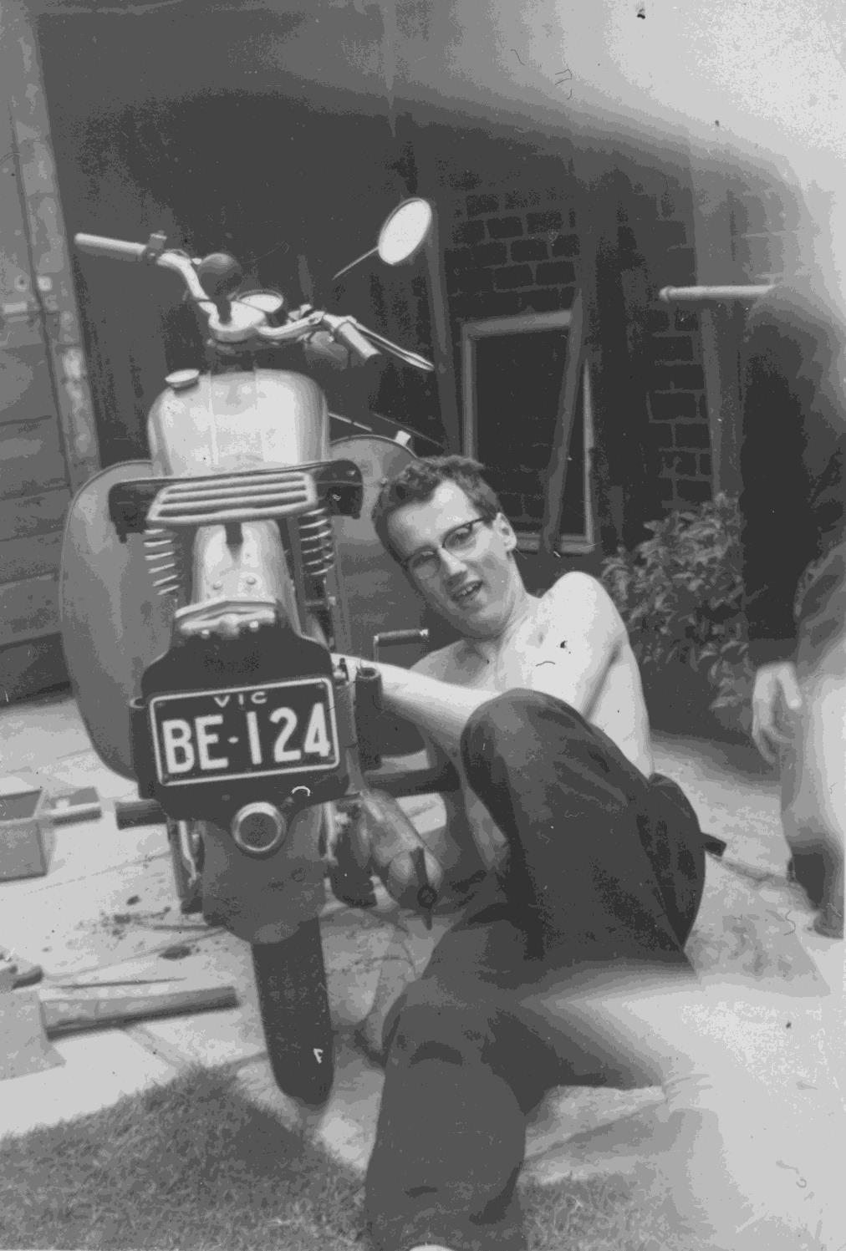
A young man cleaning his BSA Bantam motor bike.
Flemington, VIC. 1956
Photographer: Unknown

Slide 6
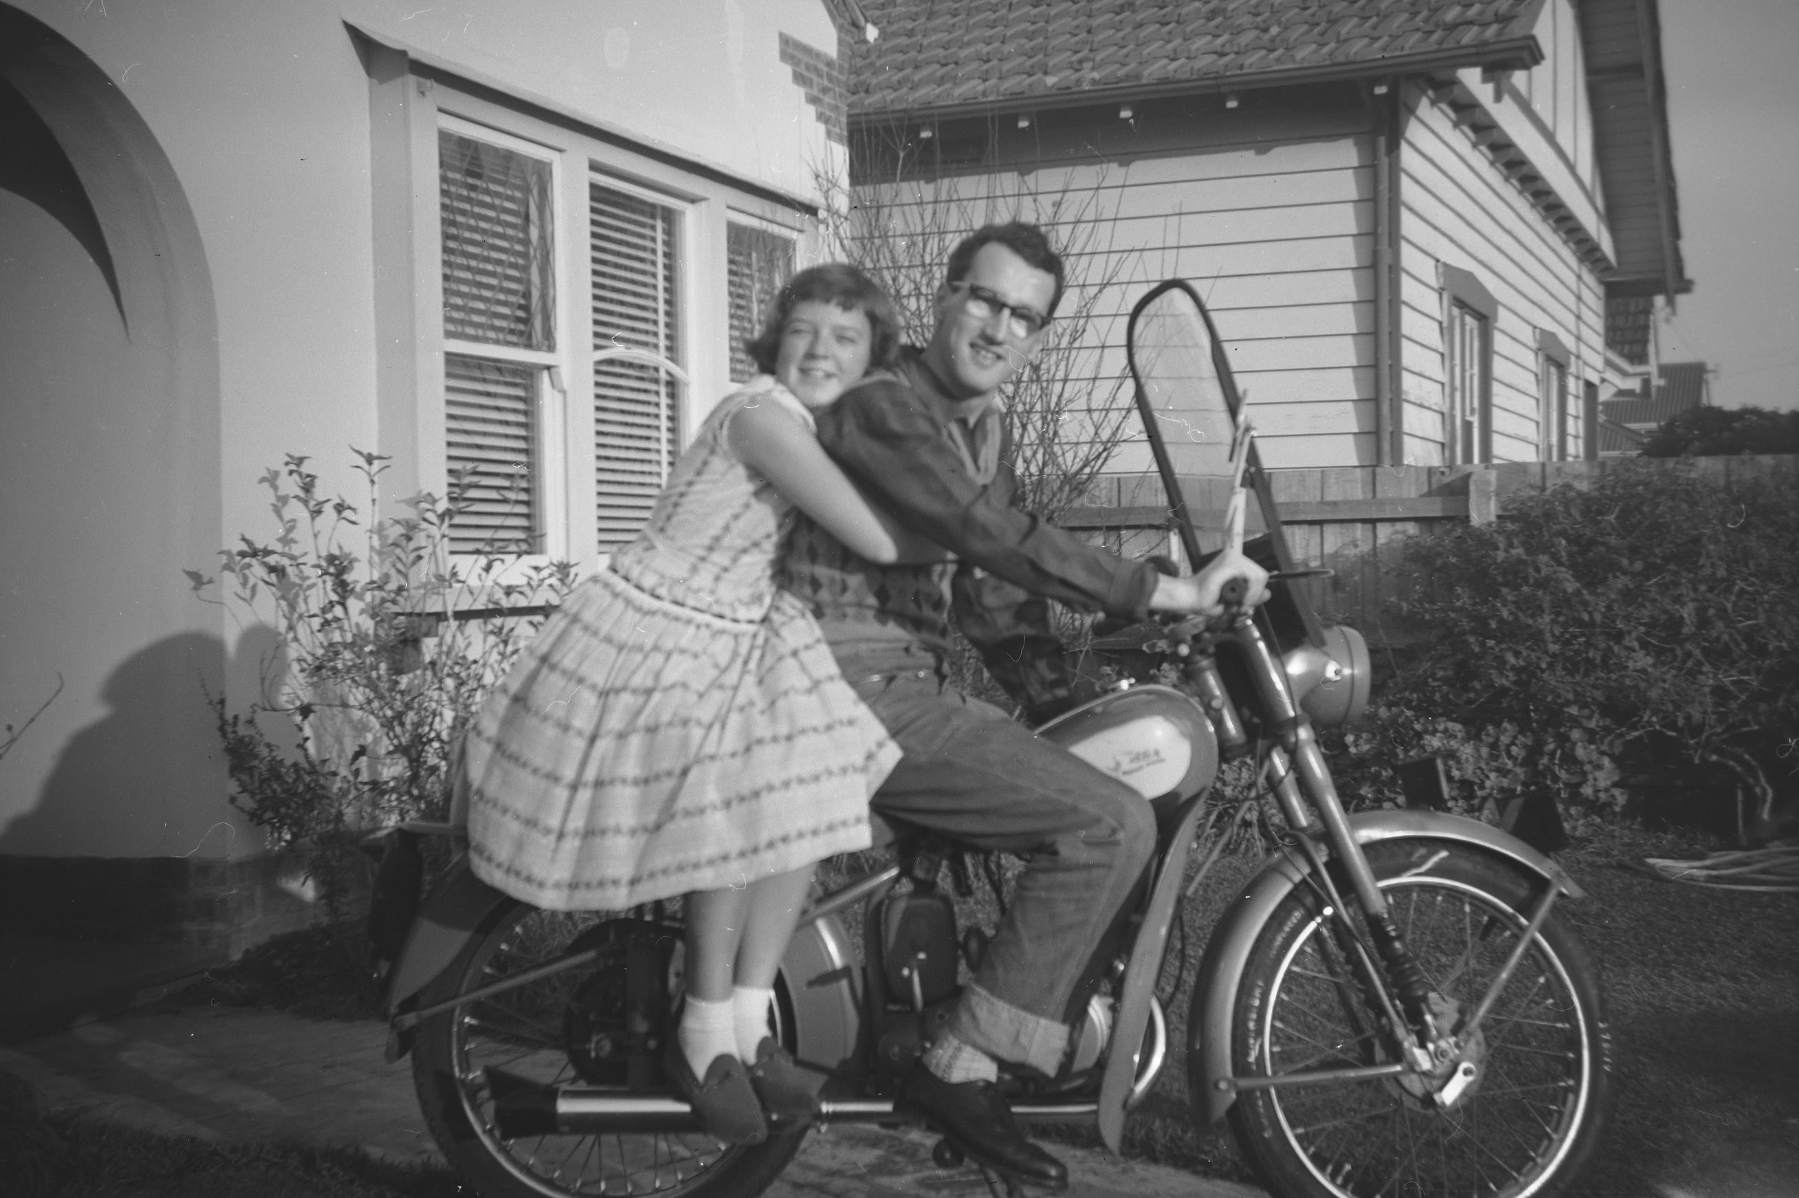
Couple sitting on a motorbike. Yarraville, VIC.
1958
Photographer: Jean Lorraine Moore

Slide 7
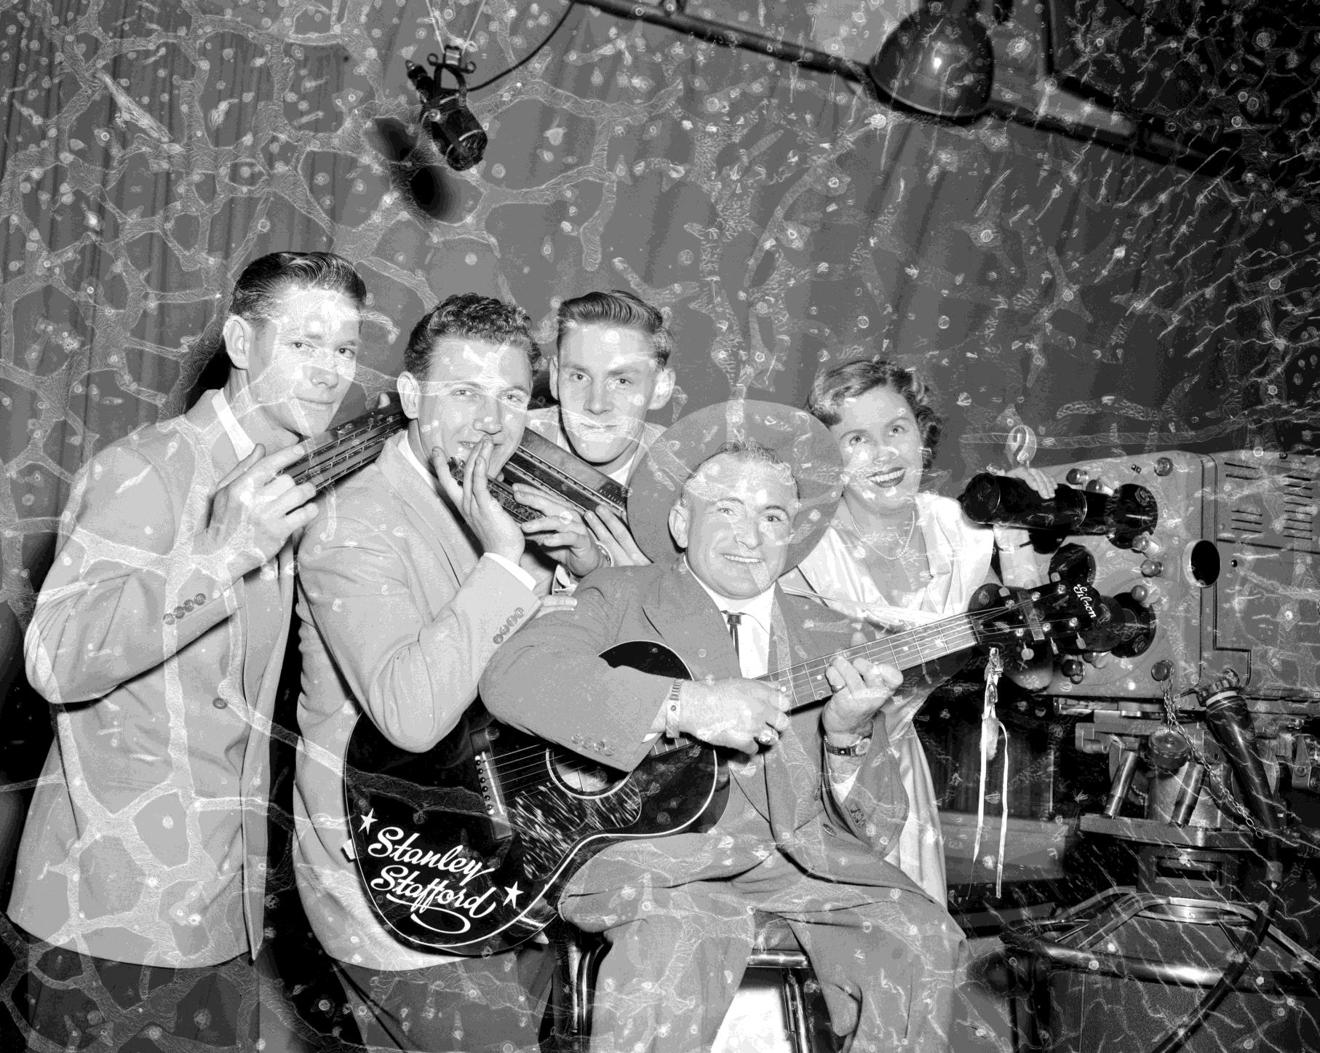
Group of musicians in a recording studio. Melbourne, 1957
Photographer: Laurie Richards

Slide 8
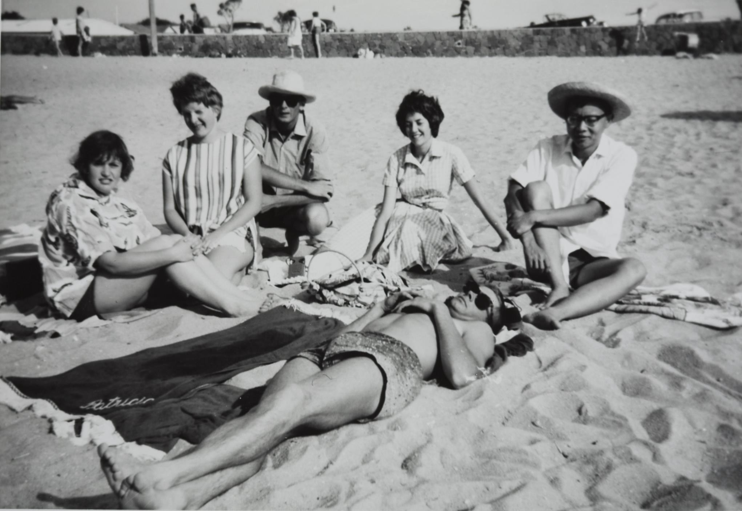
Group of friends at
the beach.
Mordialloc, 1962
Photographer: Patricia Vanstan

Slide 9
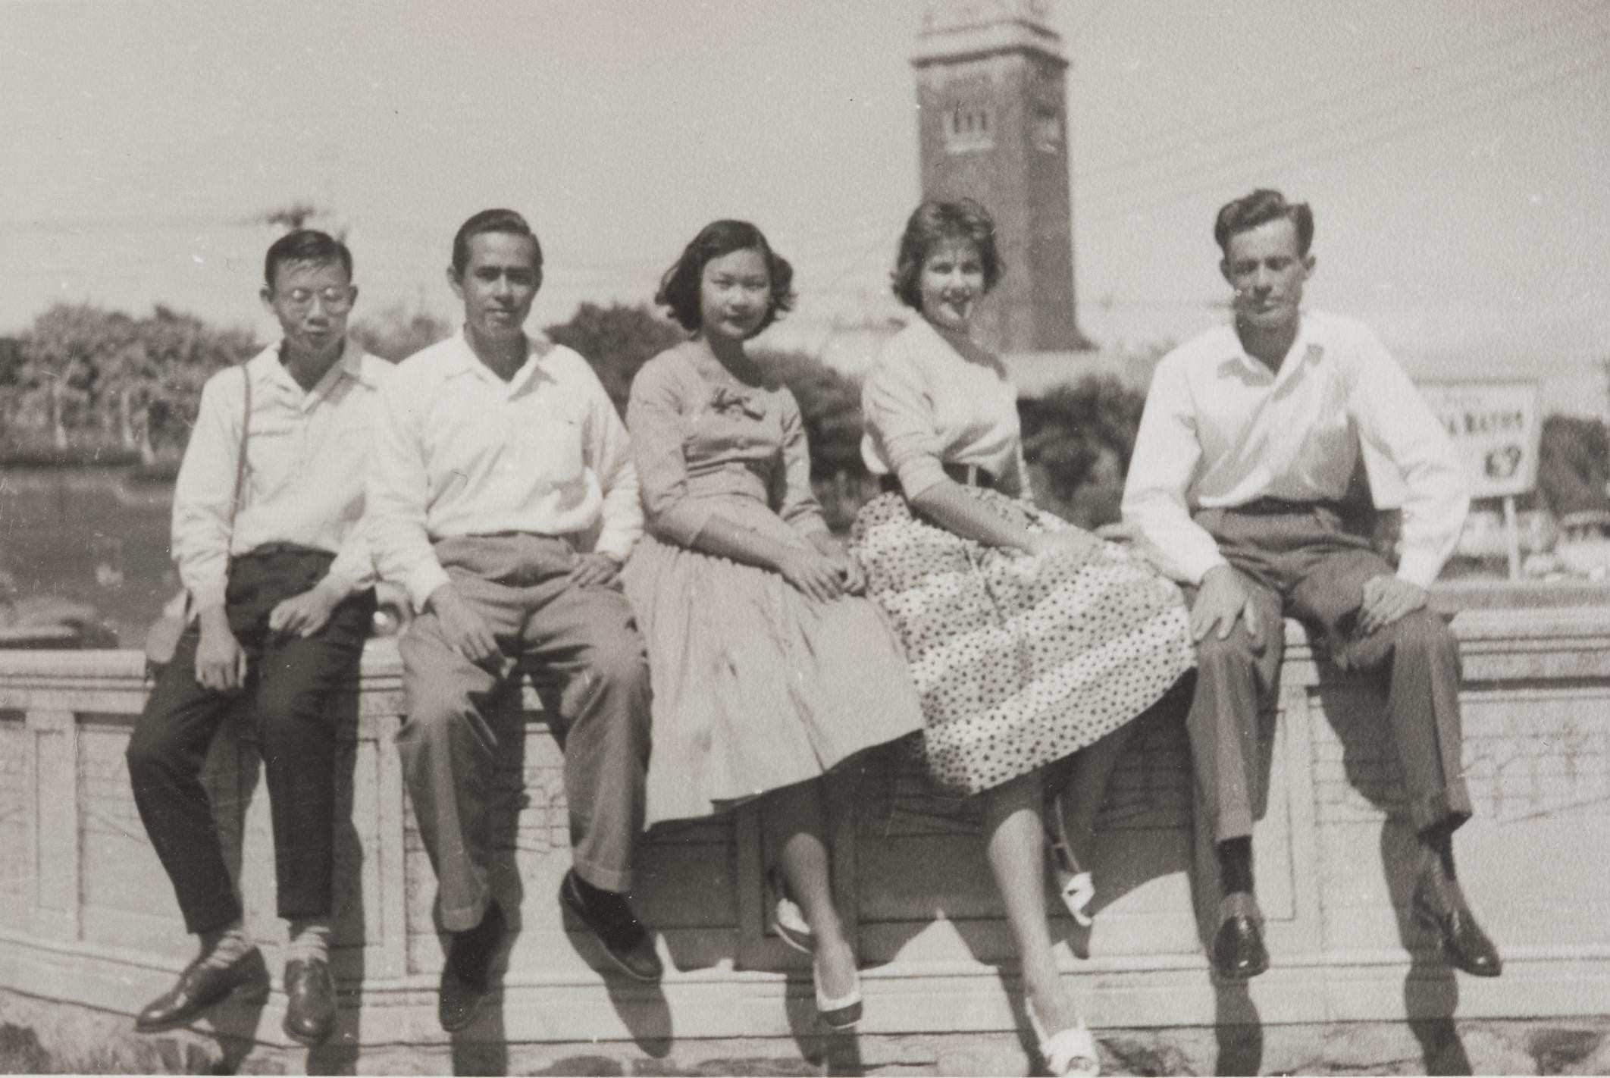
Group of friends hanging out at the Oslo Hotel youth hostel. St Kilda, VIC. 1959
Photographer:
Bob Davis

Slide 10
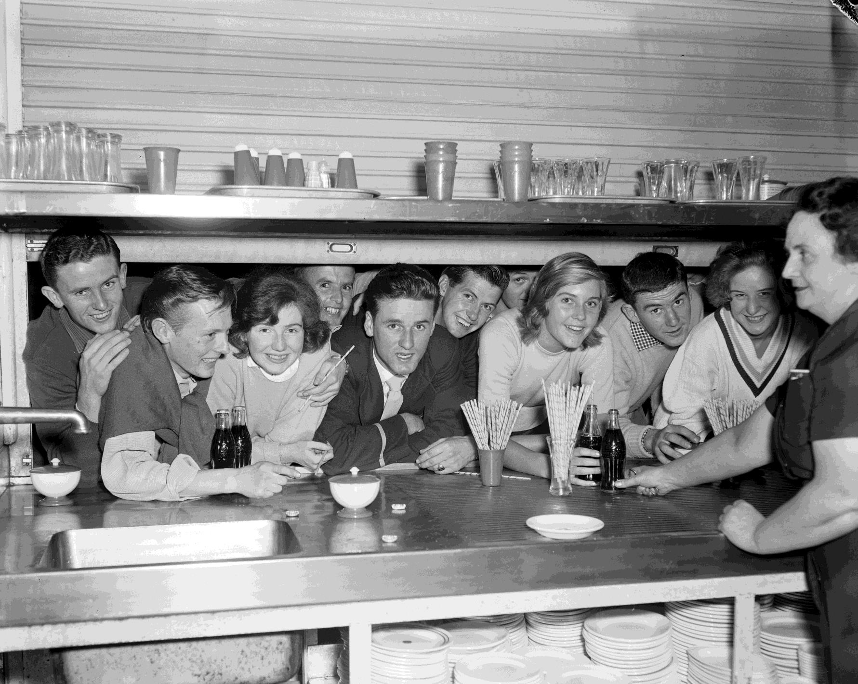
Group of teenagers looking through a kiosk window at a dance. 1959
Photographer: Laurie Richards

Slide 11
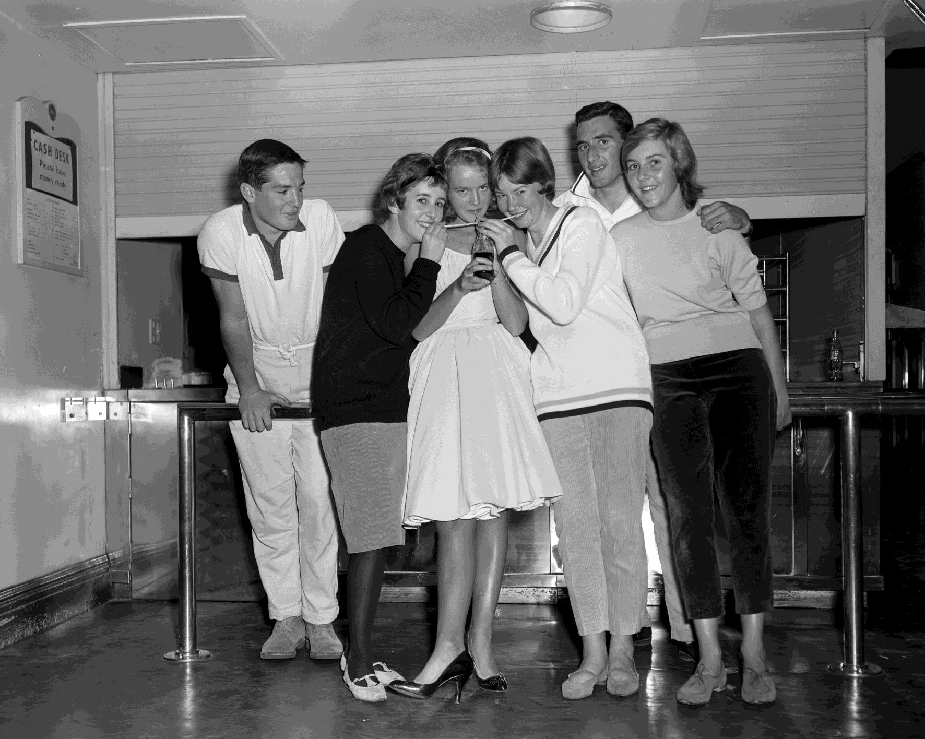
Teenagers drinking soda. 1959
Photographer: Laurie Richards

Slide 12
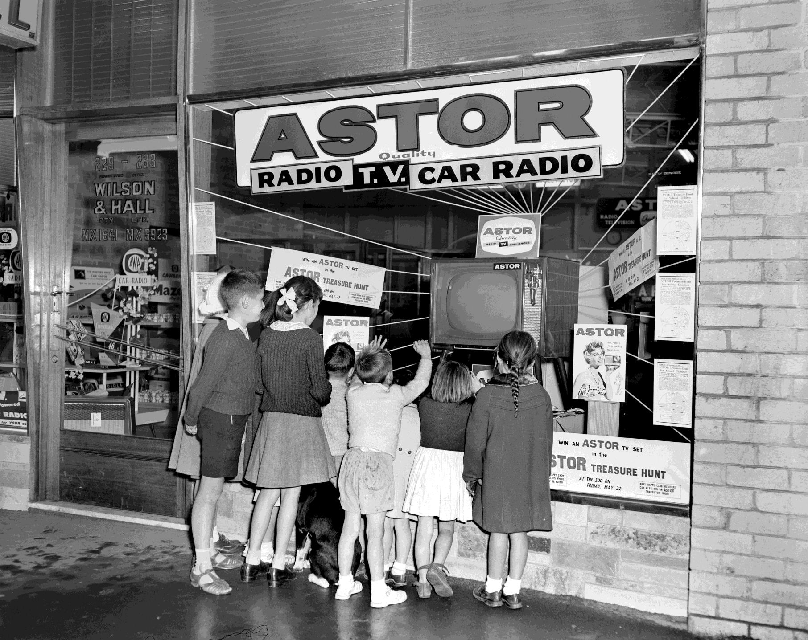
Group of children watching TV through an electronics store window. South Melbourne, VIC. 1959
Photographer: Laurie Richards

Slide 13
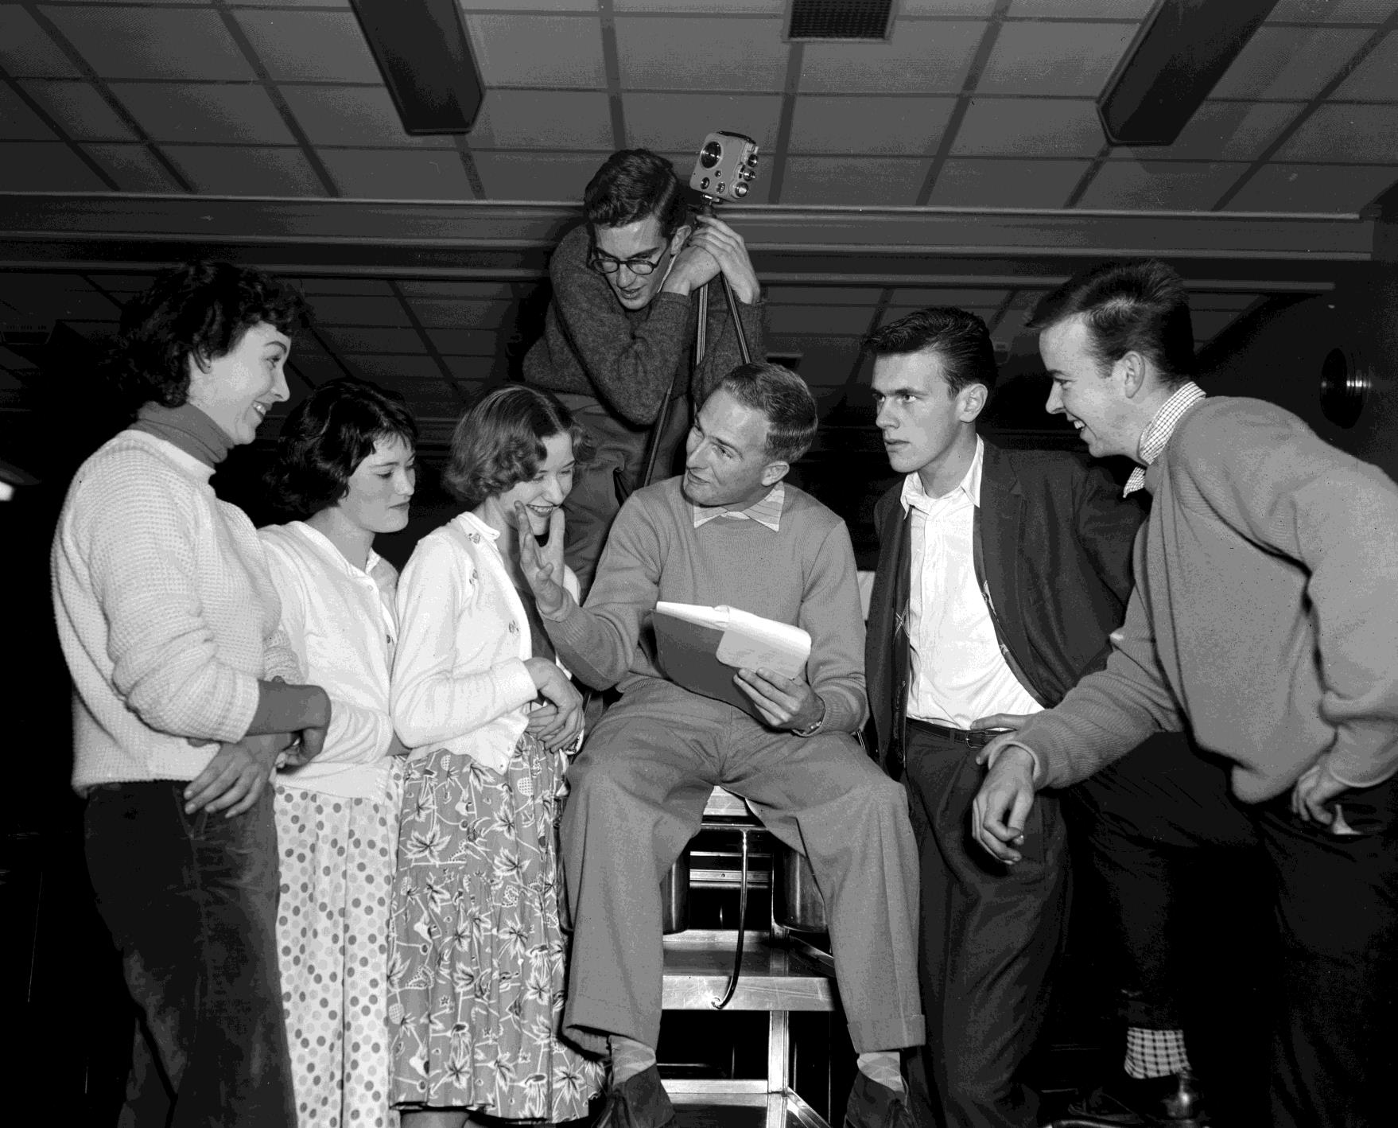
Group of teenagers filming a local dance. 1959
Photographer: Laurie Richards

Slide 14
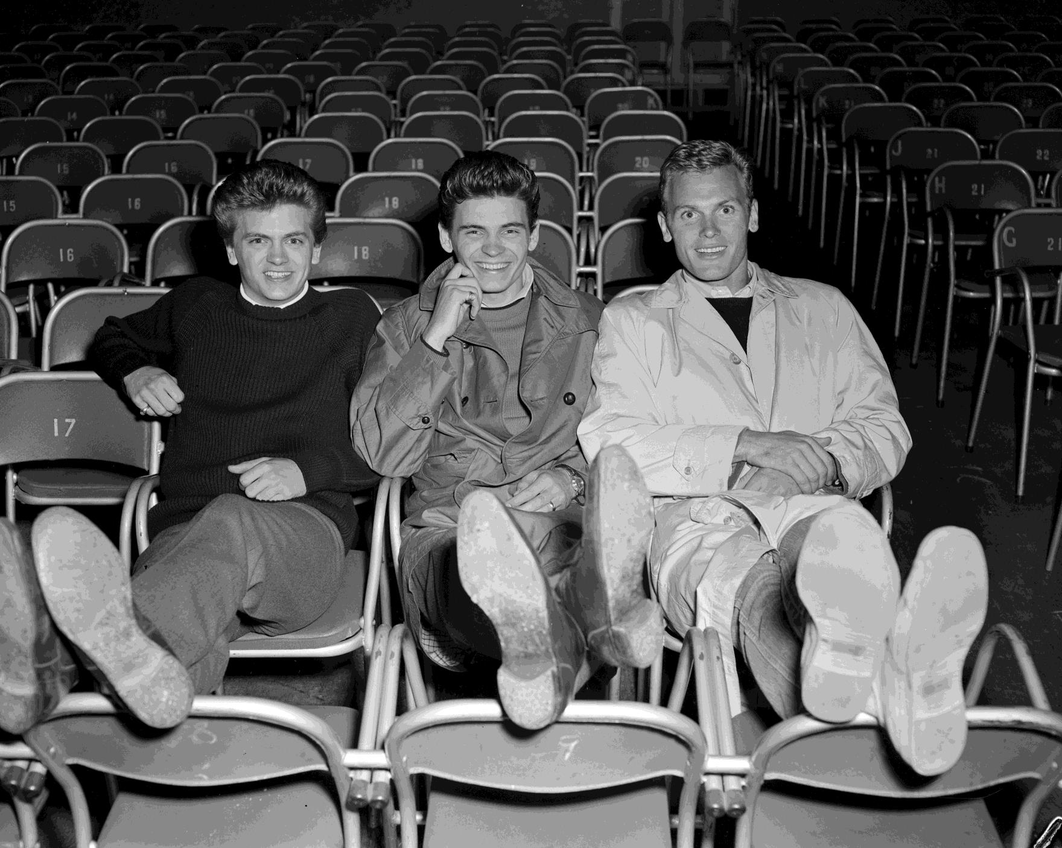
Three boys relaxing at 3XY Radio Station. 1959
Photographer: Laurie Richards

Slide 15
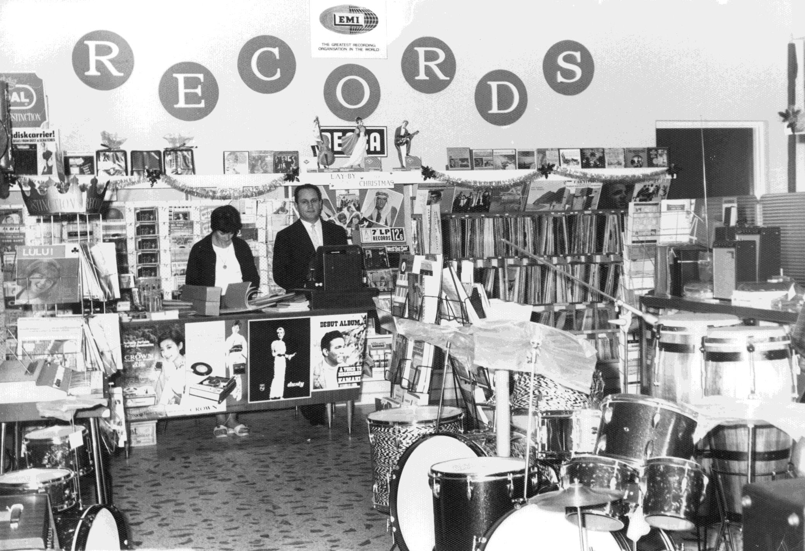
Jo and Ugo Ceresoli behind the counter of their store, Mondo Music, on Lygon Street. Carlton, VIC. 1960
Photographer: Unknown

Slide 16
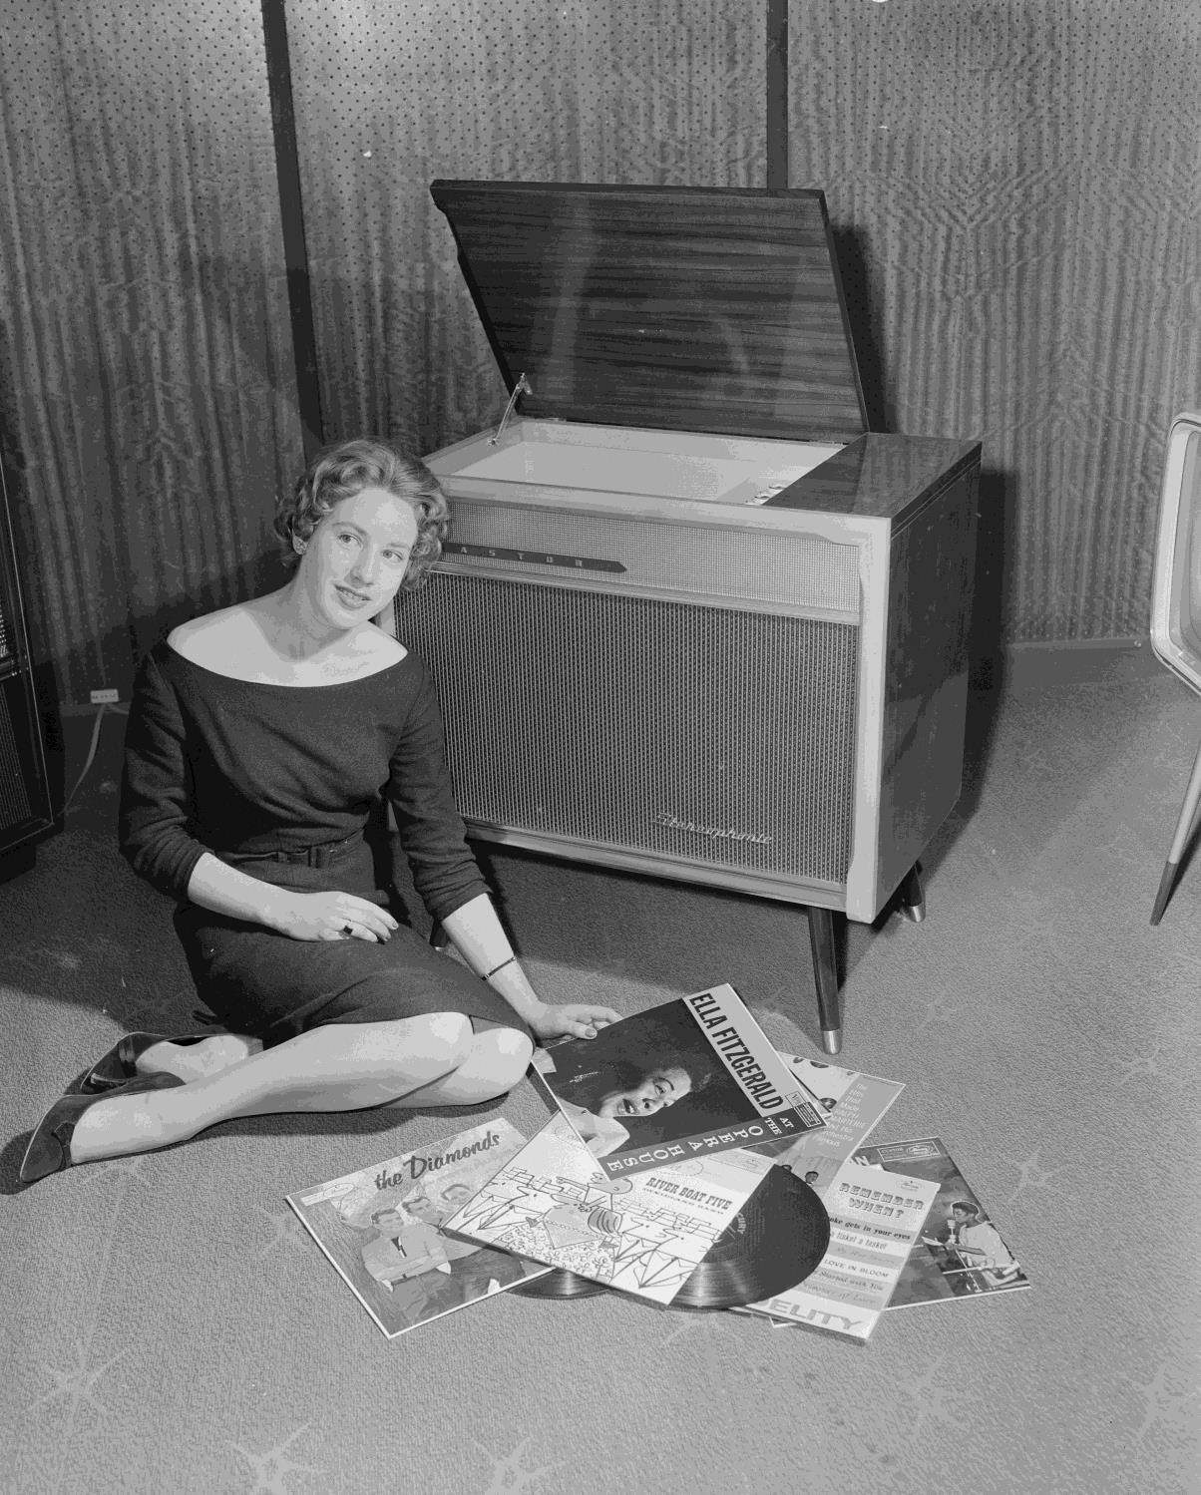
Portrait of Astor Electronics 'Miss Radio' sitting next to a record player and vinyl records. 1959
Photographer:
Laurie Richards

Slide 17
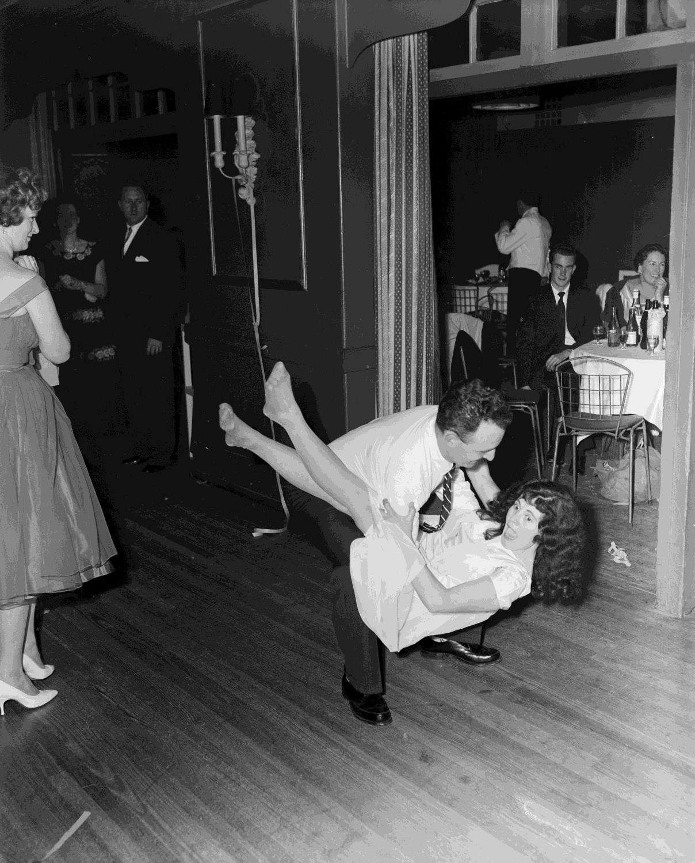
Couple dancing at a social function held at the reception centre at 9 Darling Street, South Yarra. South Yarra, VIC.
1959
Photographer: Laurie Richards

Slide 18
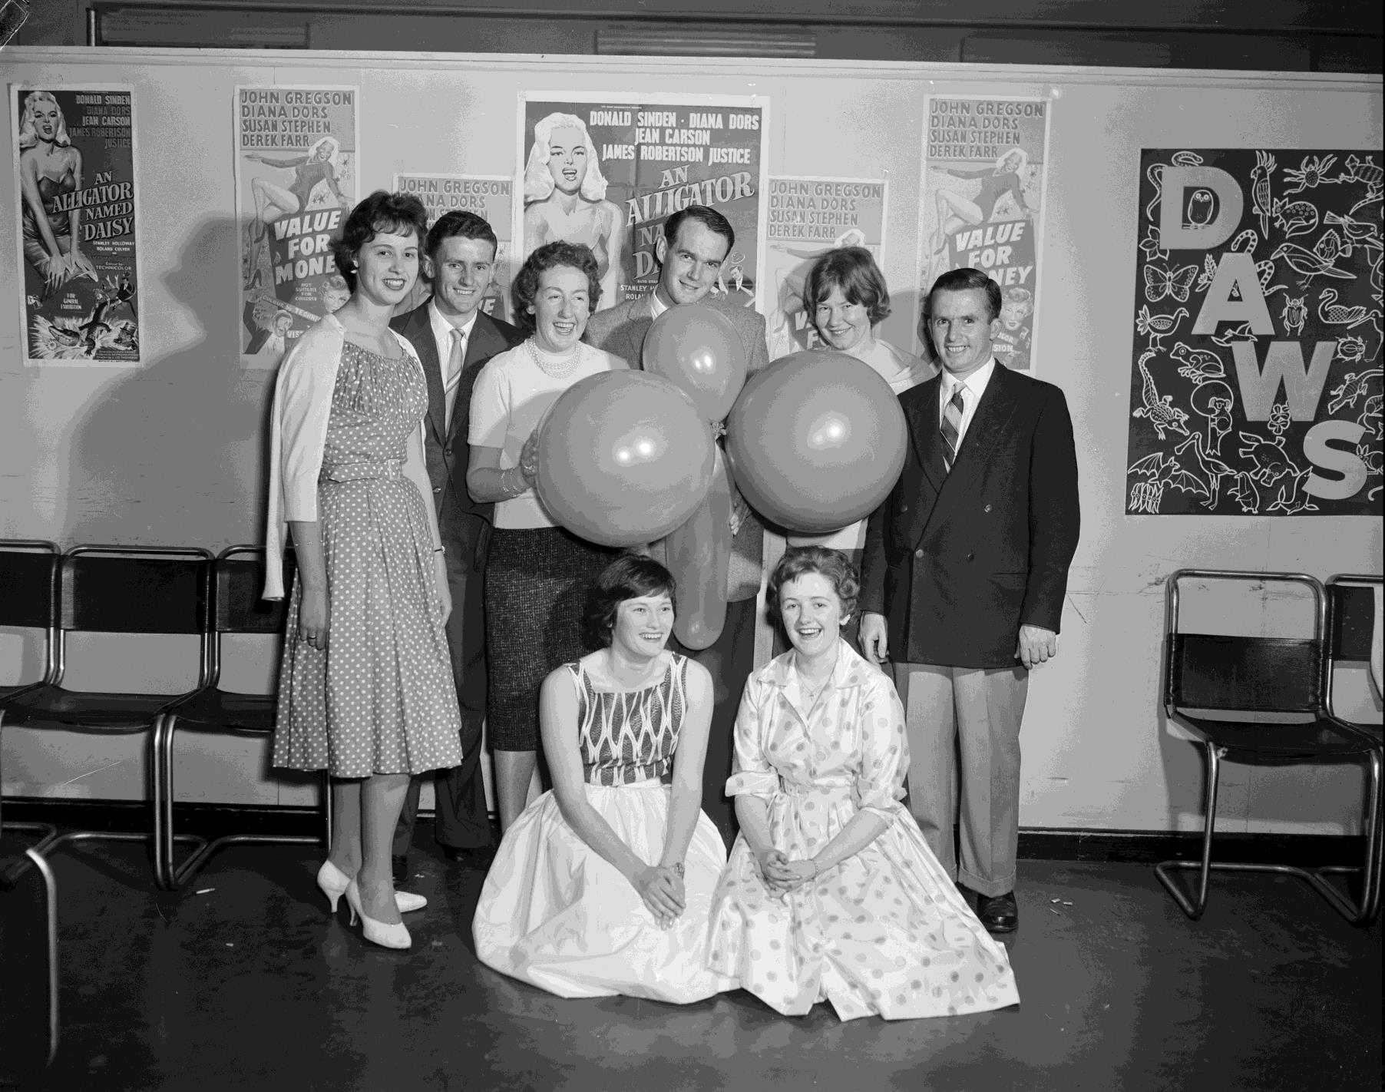
Group of people holding balloons at a social dance. 1959
Photographer:
Laurie Richards

Slide 19
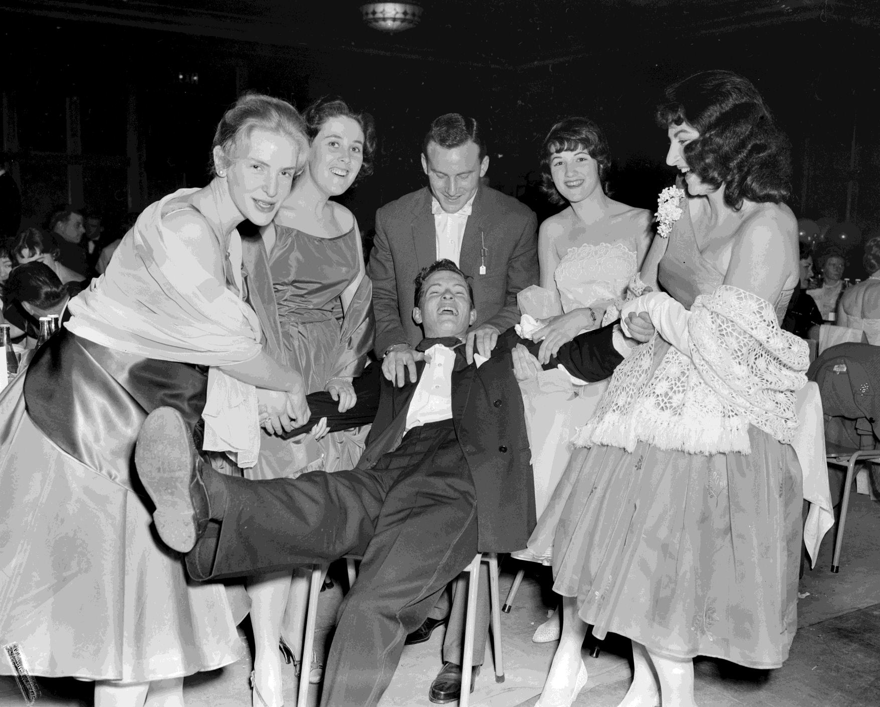
Group celebrating at a social event. Caulfield, VIC. 1959
Photographer:
Laurie Richards

Slide 20
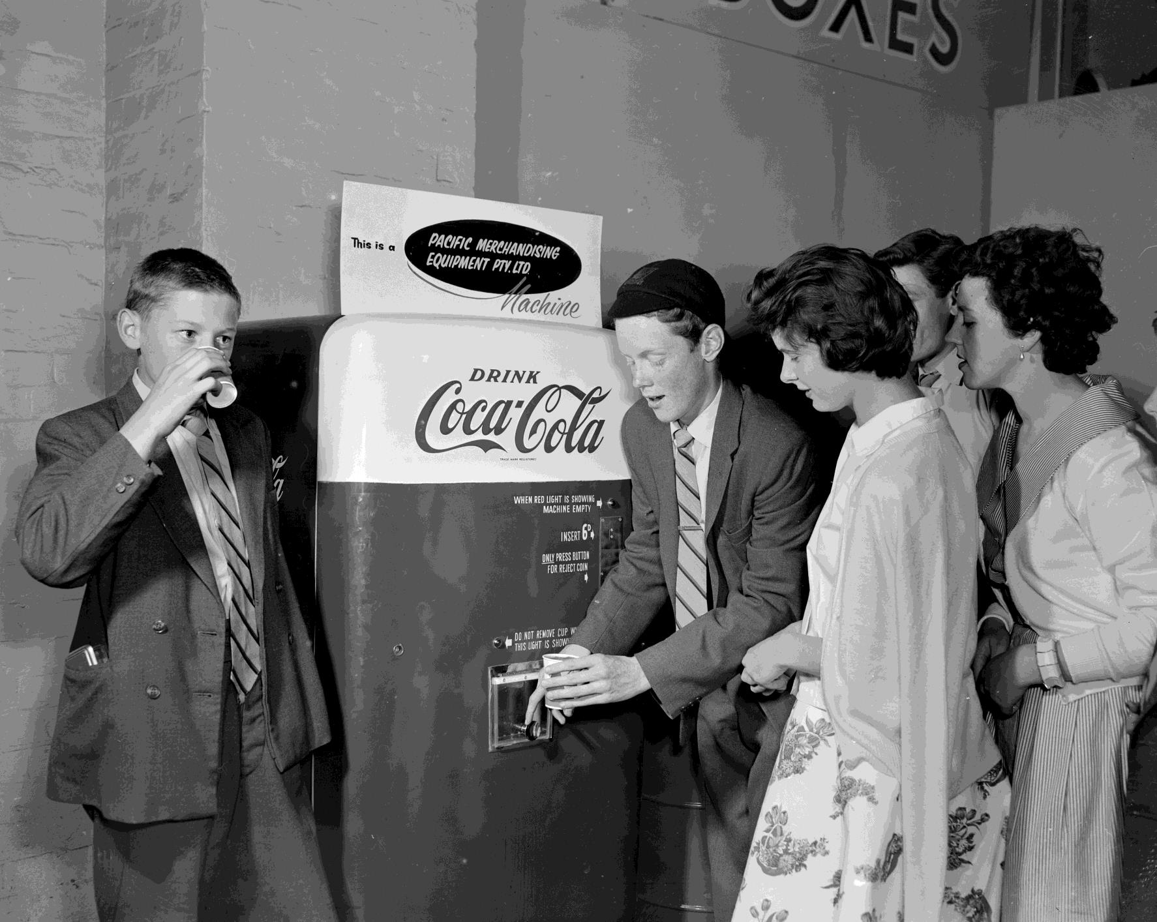
Children standing with a Coca-Cola vending machine. 1959
Photographer:
Laurie Richards

Slide 21
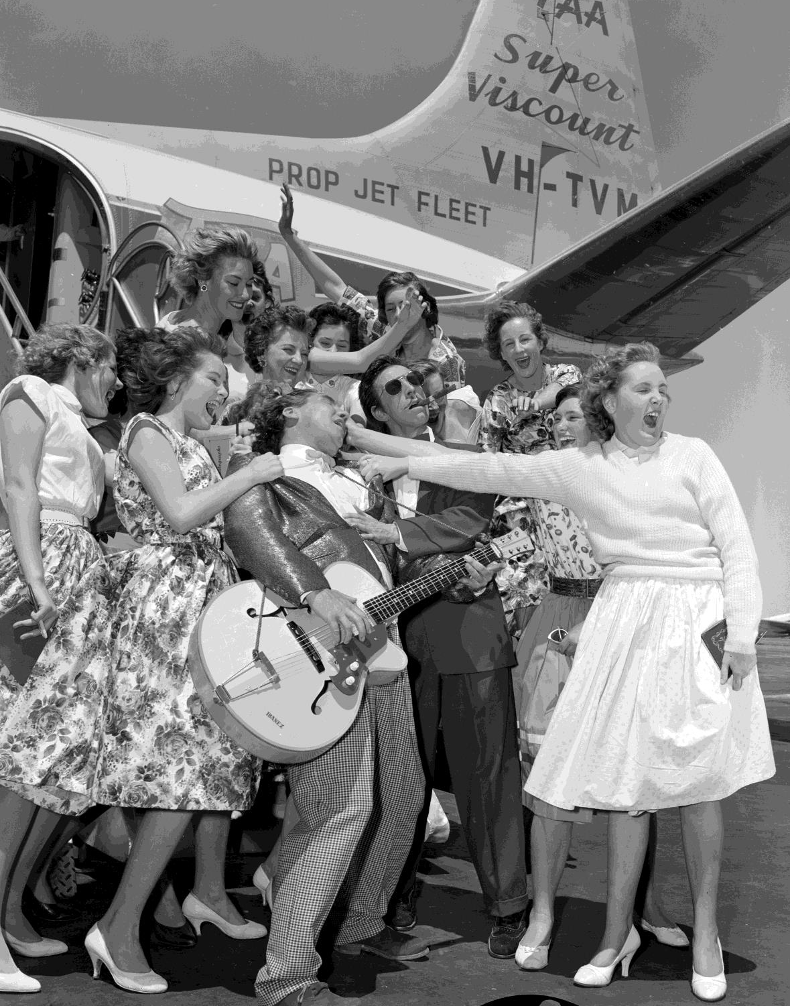
Screaming girls greeting a musician at the airport. Essendon Airport, VIC. 1959
Photographer: Laurie Richards

Slide 22
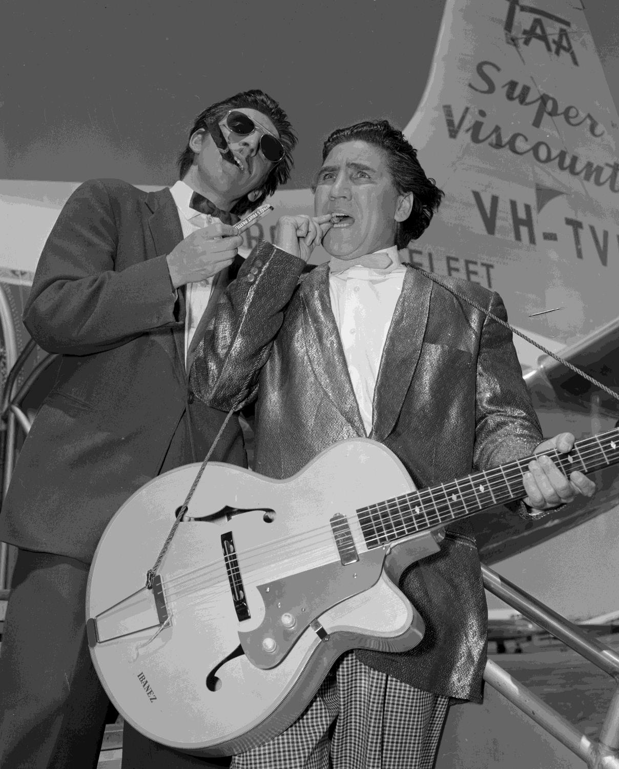
Male performers arriving at the airport. Essendon Airport, VIC. 1959
Photographer:
Laurie Richards

Slide 23
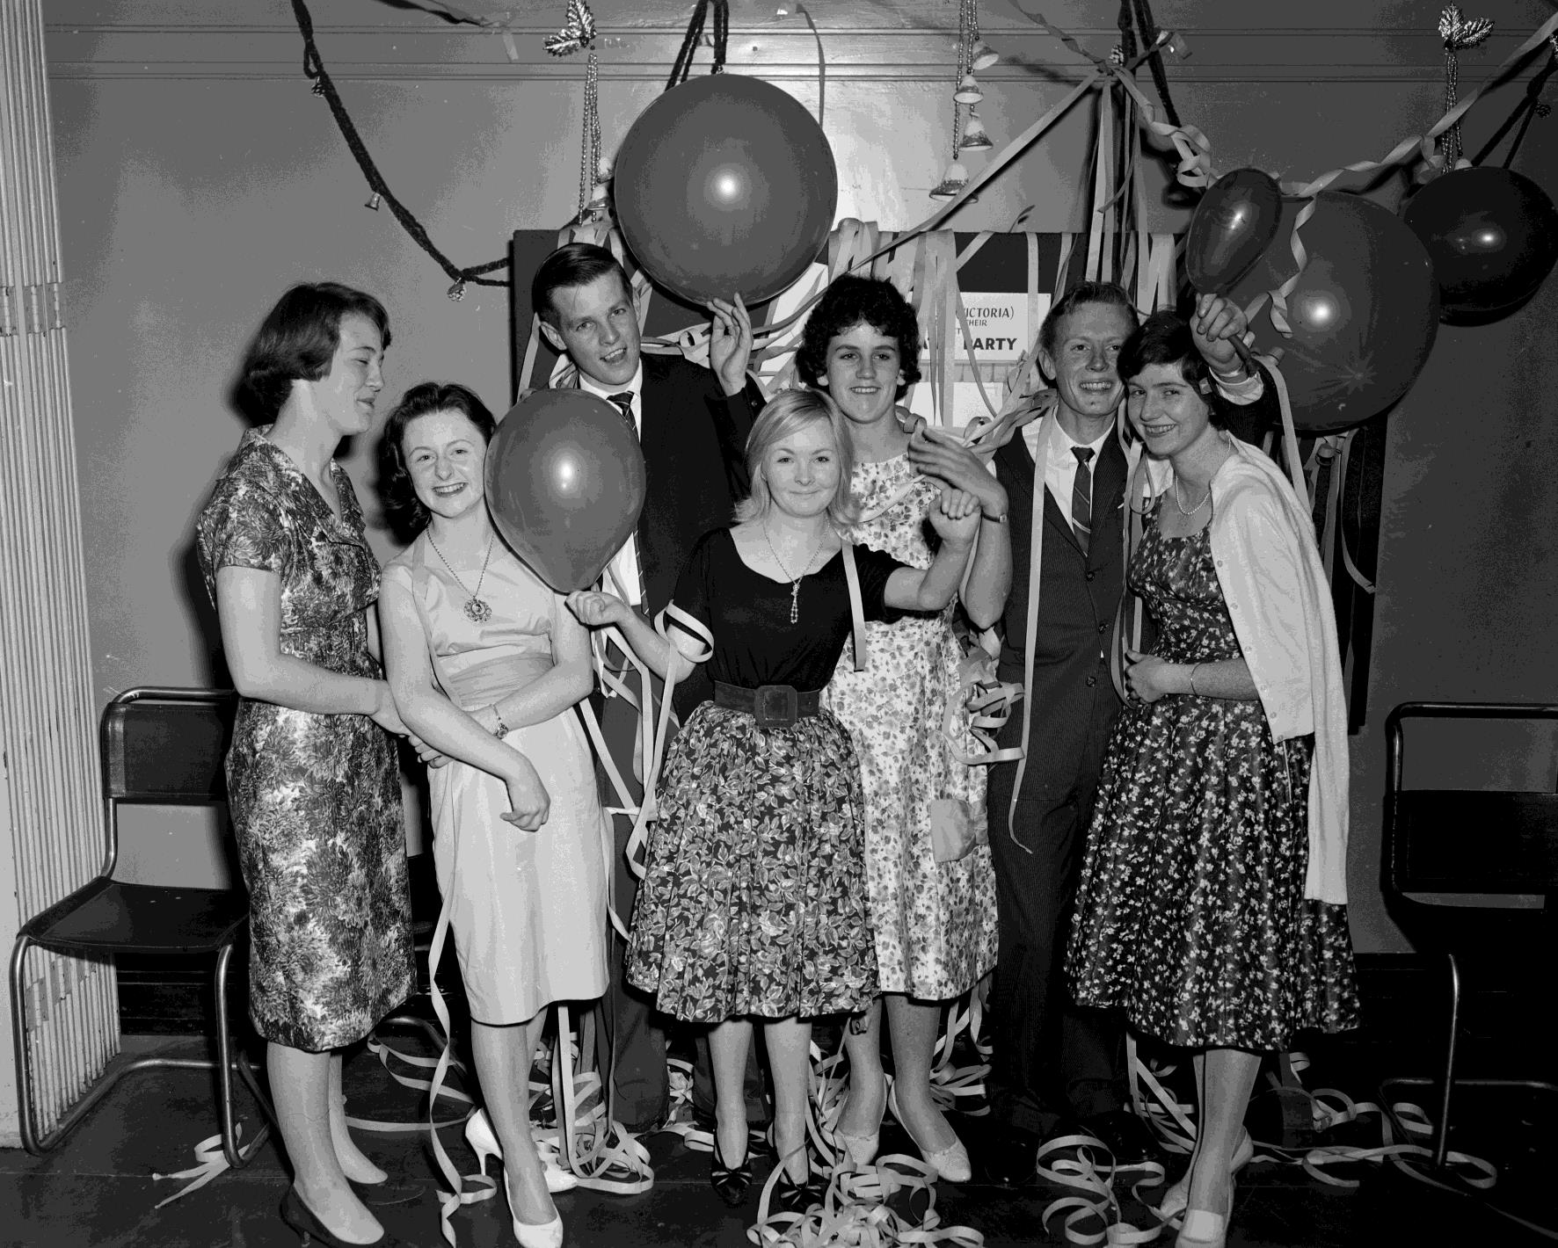
Group covered in streamers and balloons at a social event. 1959
Photographer: Laurie Richards

Slide 24
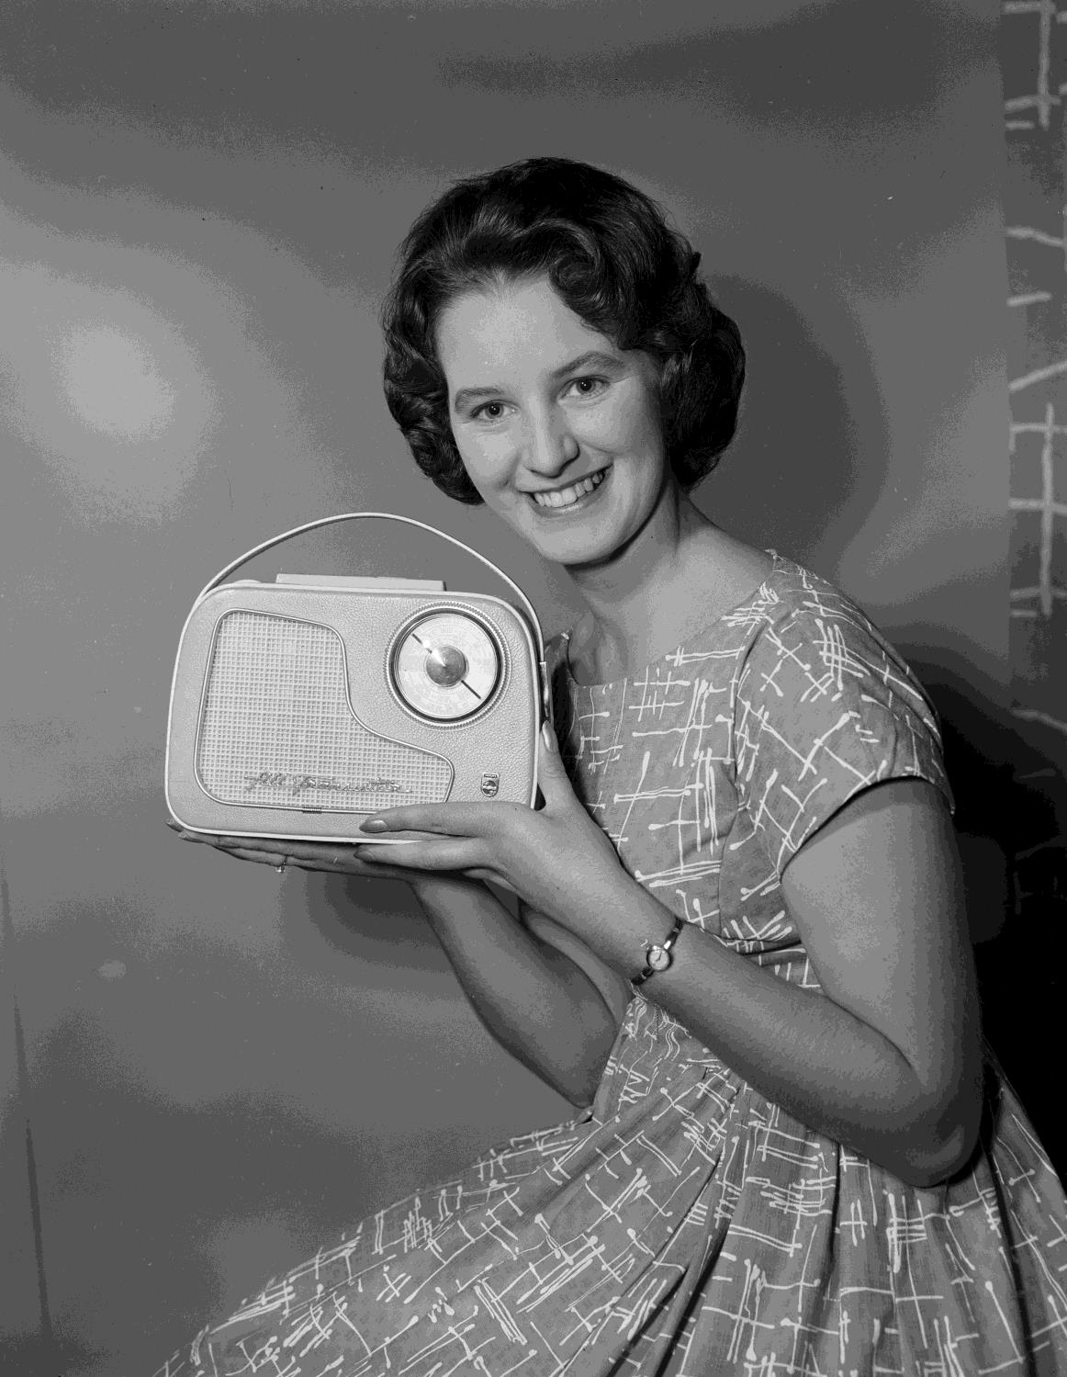
'Miss Victoria' holding up a Philips All Transistor radio. 1960
Photographer: Laurie Richards

Slide 25
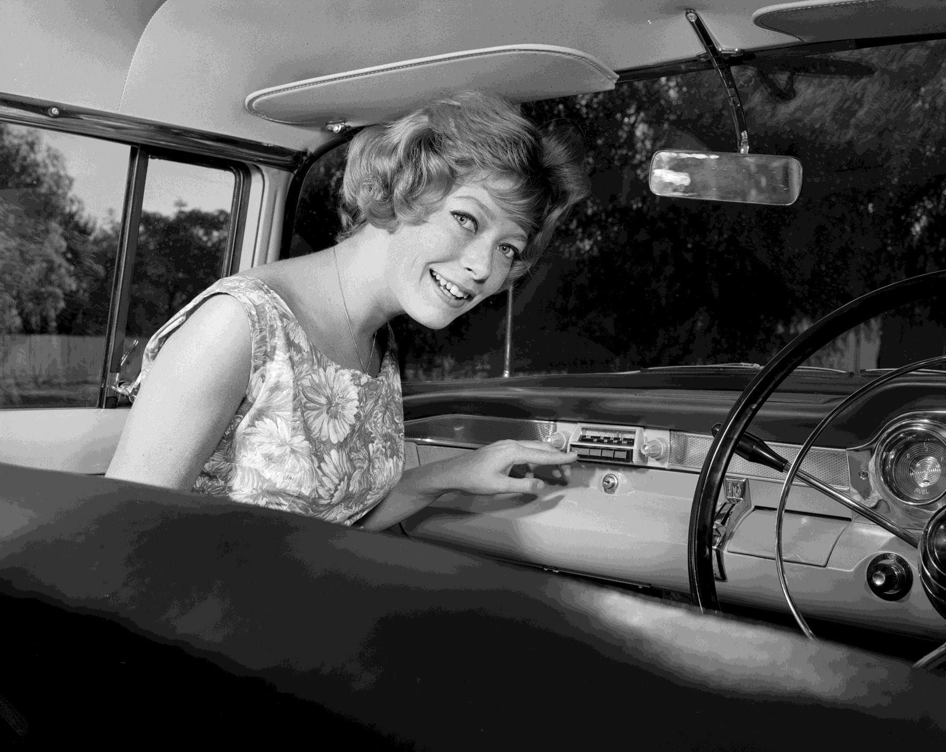
Woman sitting in the front seat of a motor car selecting a radio station.
1960
Photographer:
Laurie Richards

Slide 26
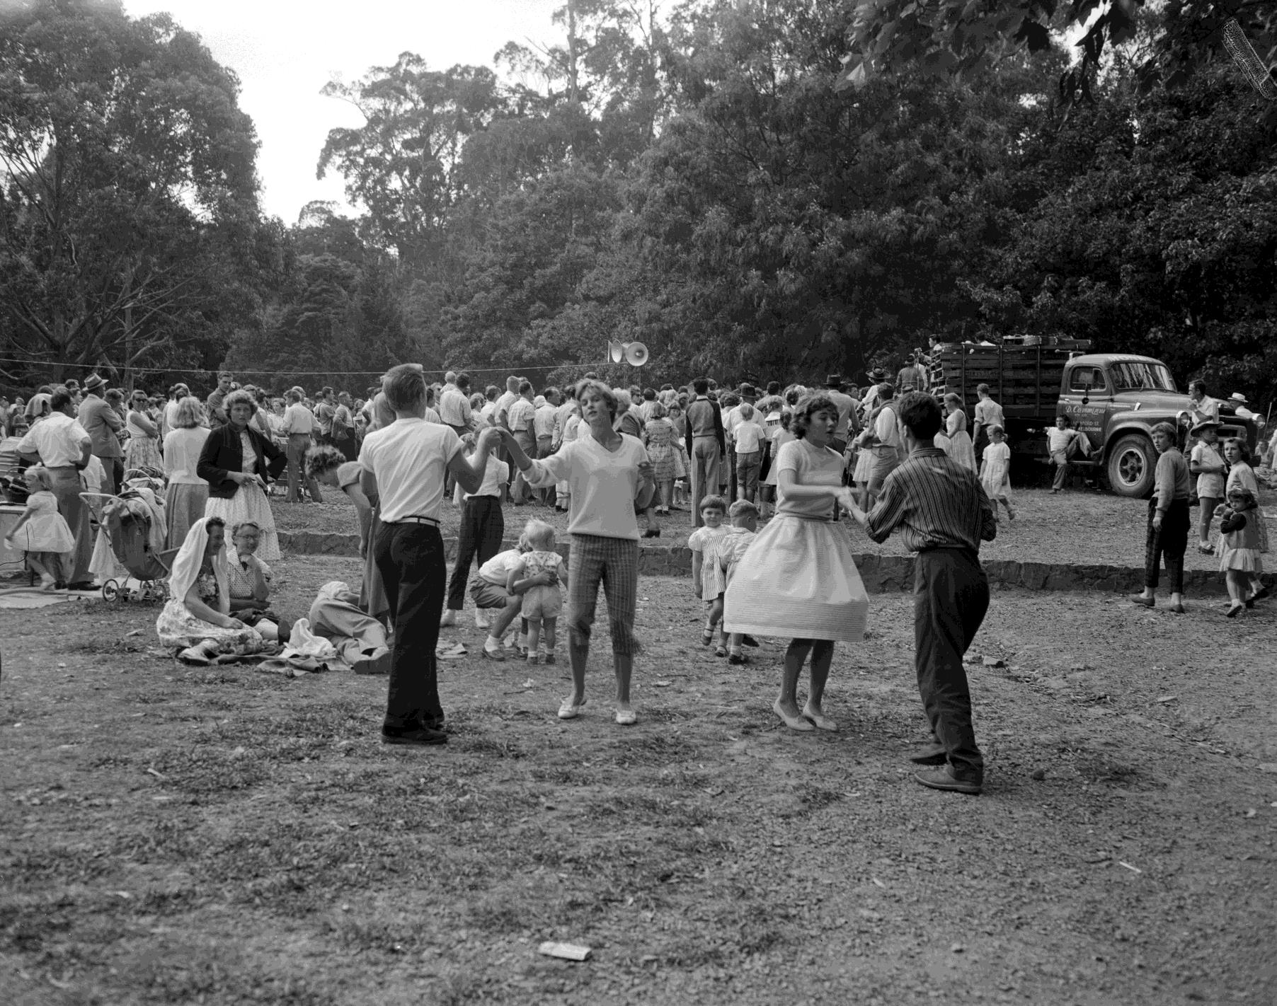
People dancing at a garden party. Ferntree Gully, VIC.
1960
Photographer: Laurie Richards

Slide 27
Popular Celebrity Icons
Can you name the following famous celebrities?

Slide 28
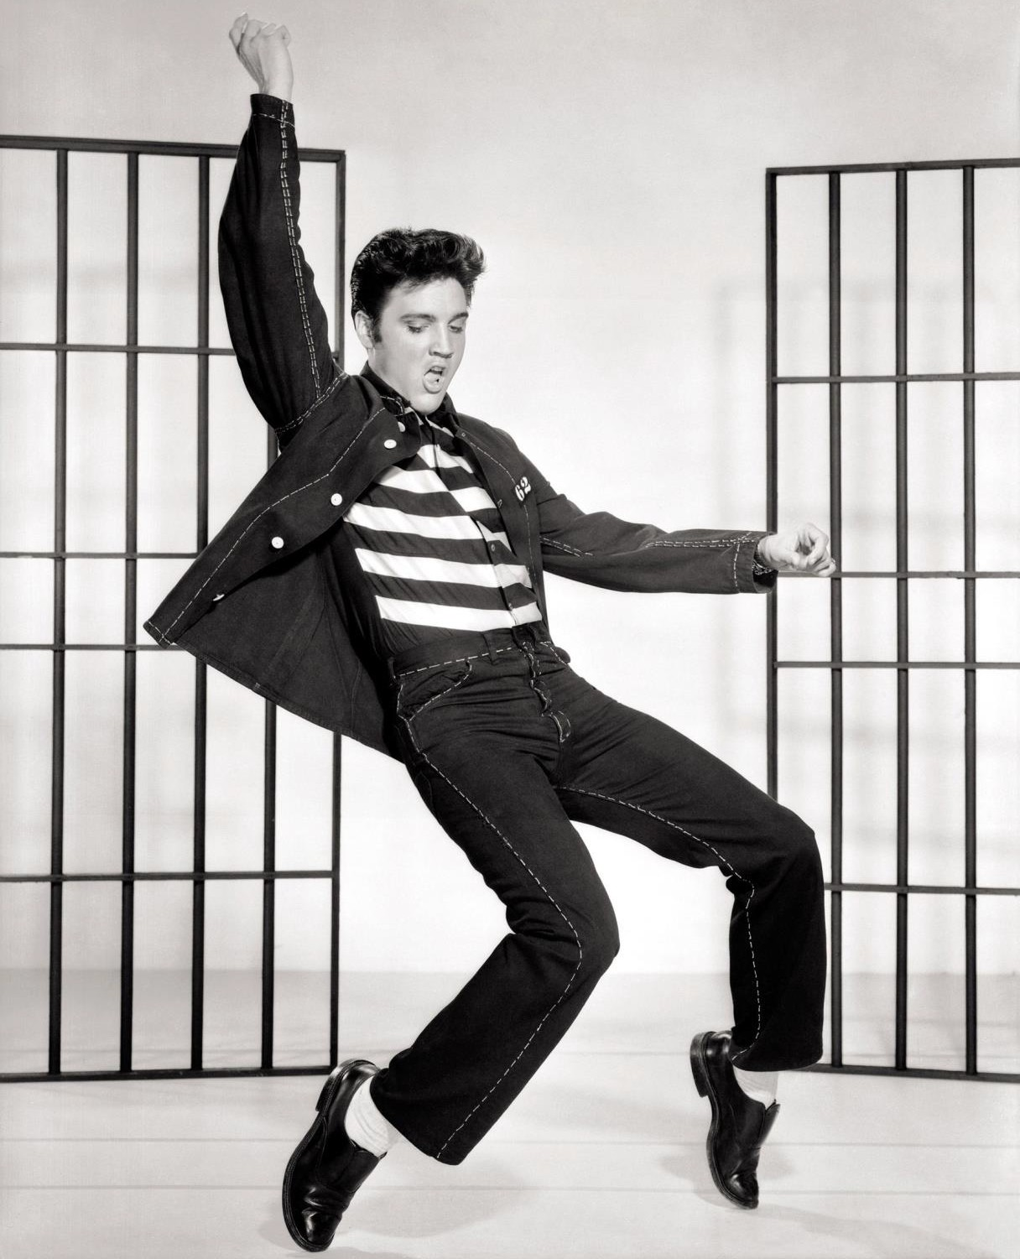

Slide 29
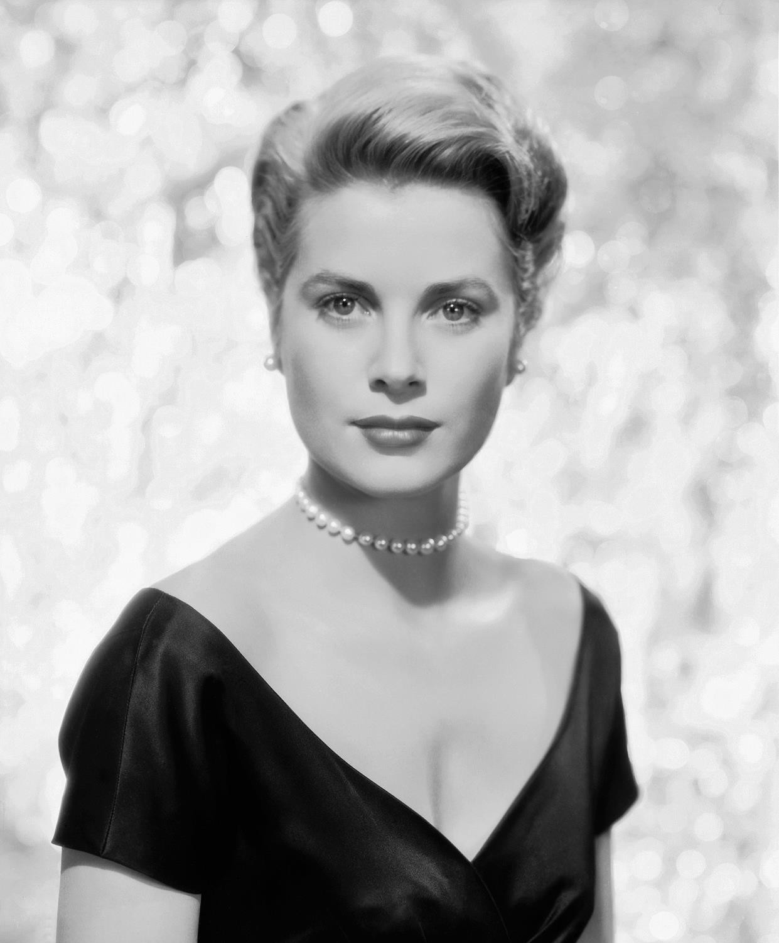

Slide 30
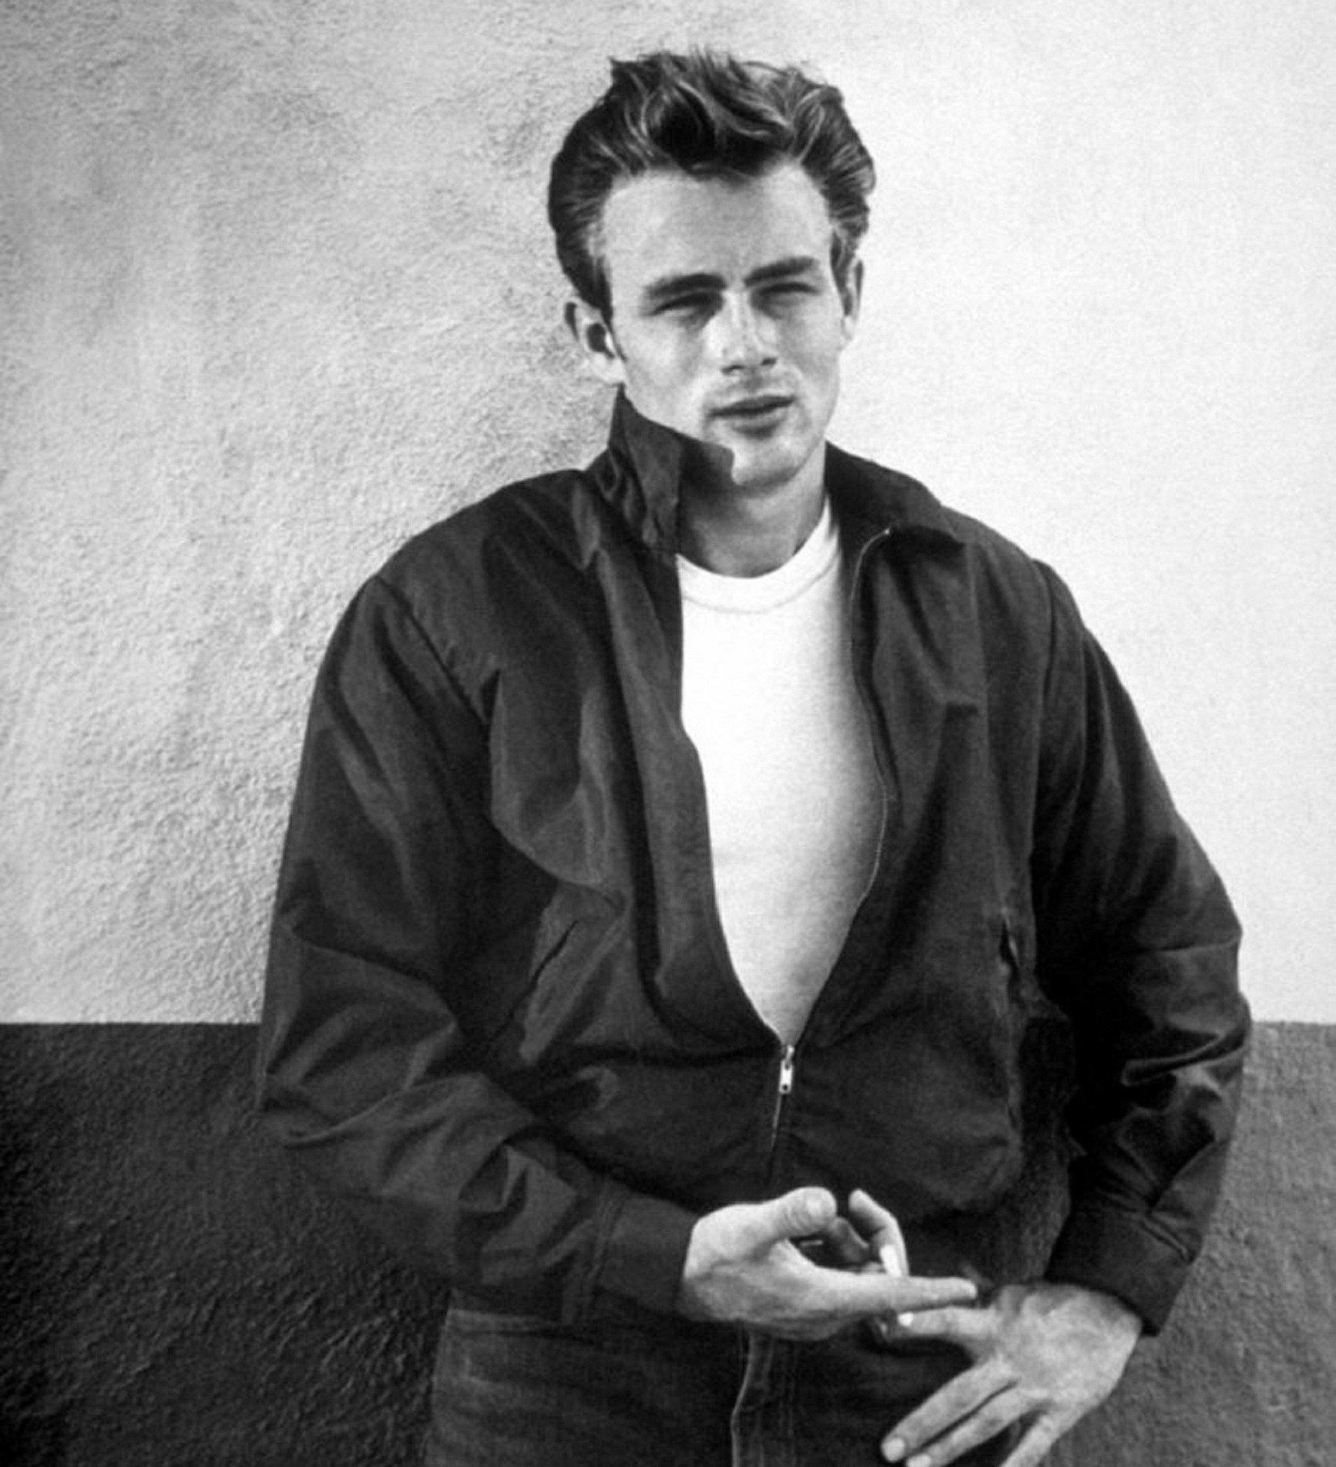

Slide 31
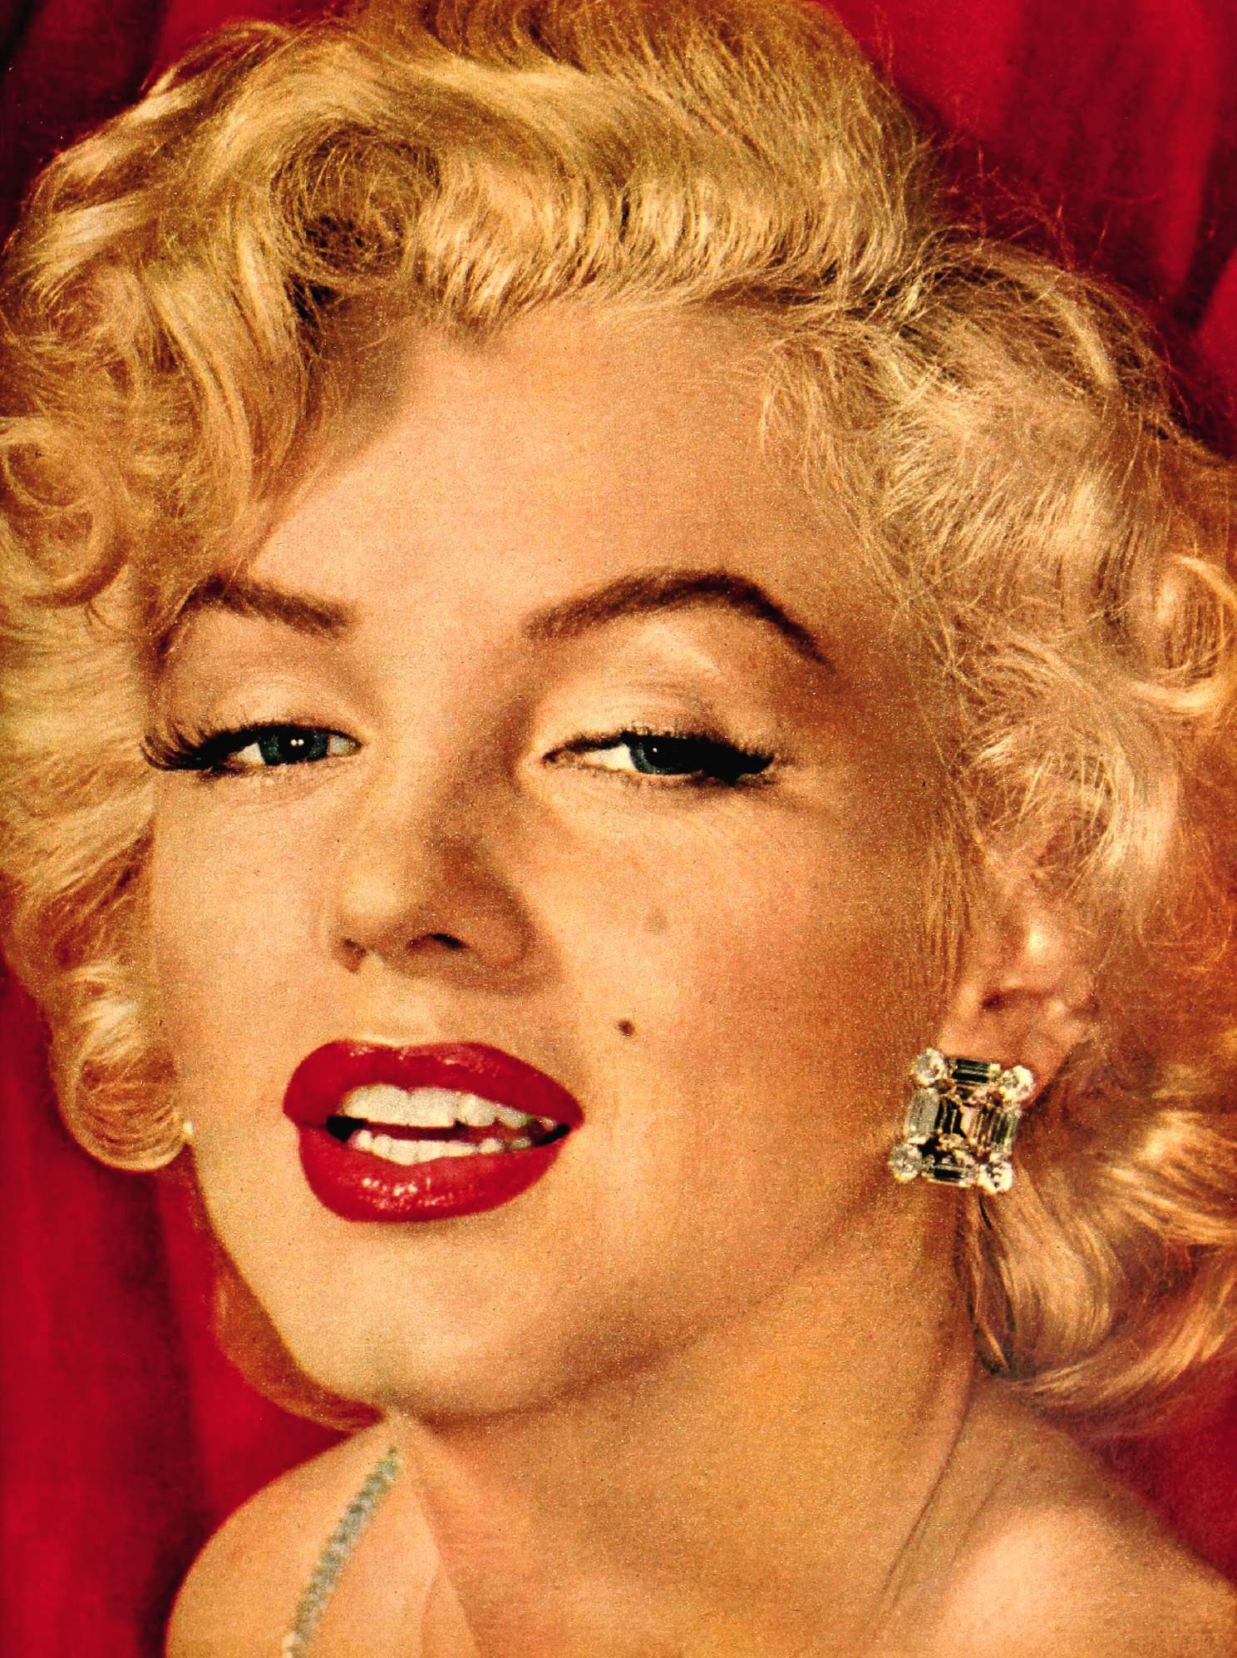

Slide 32
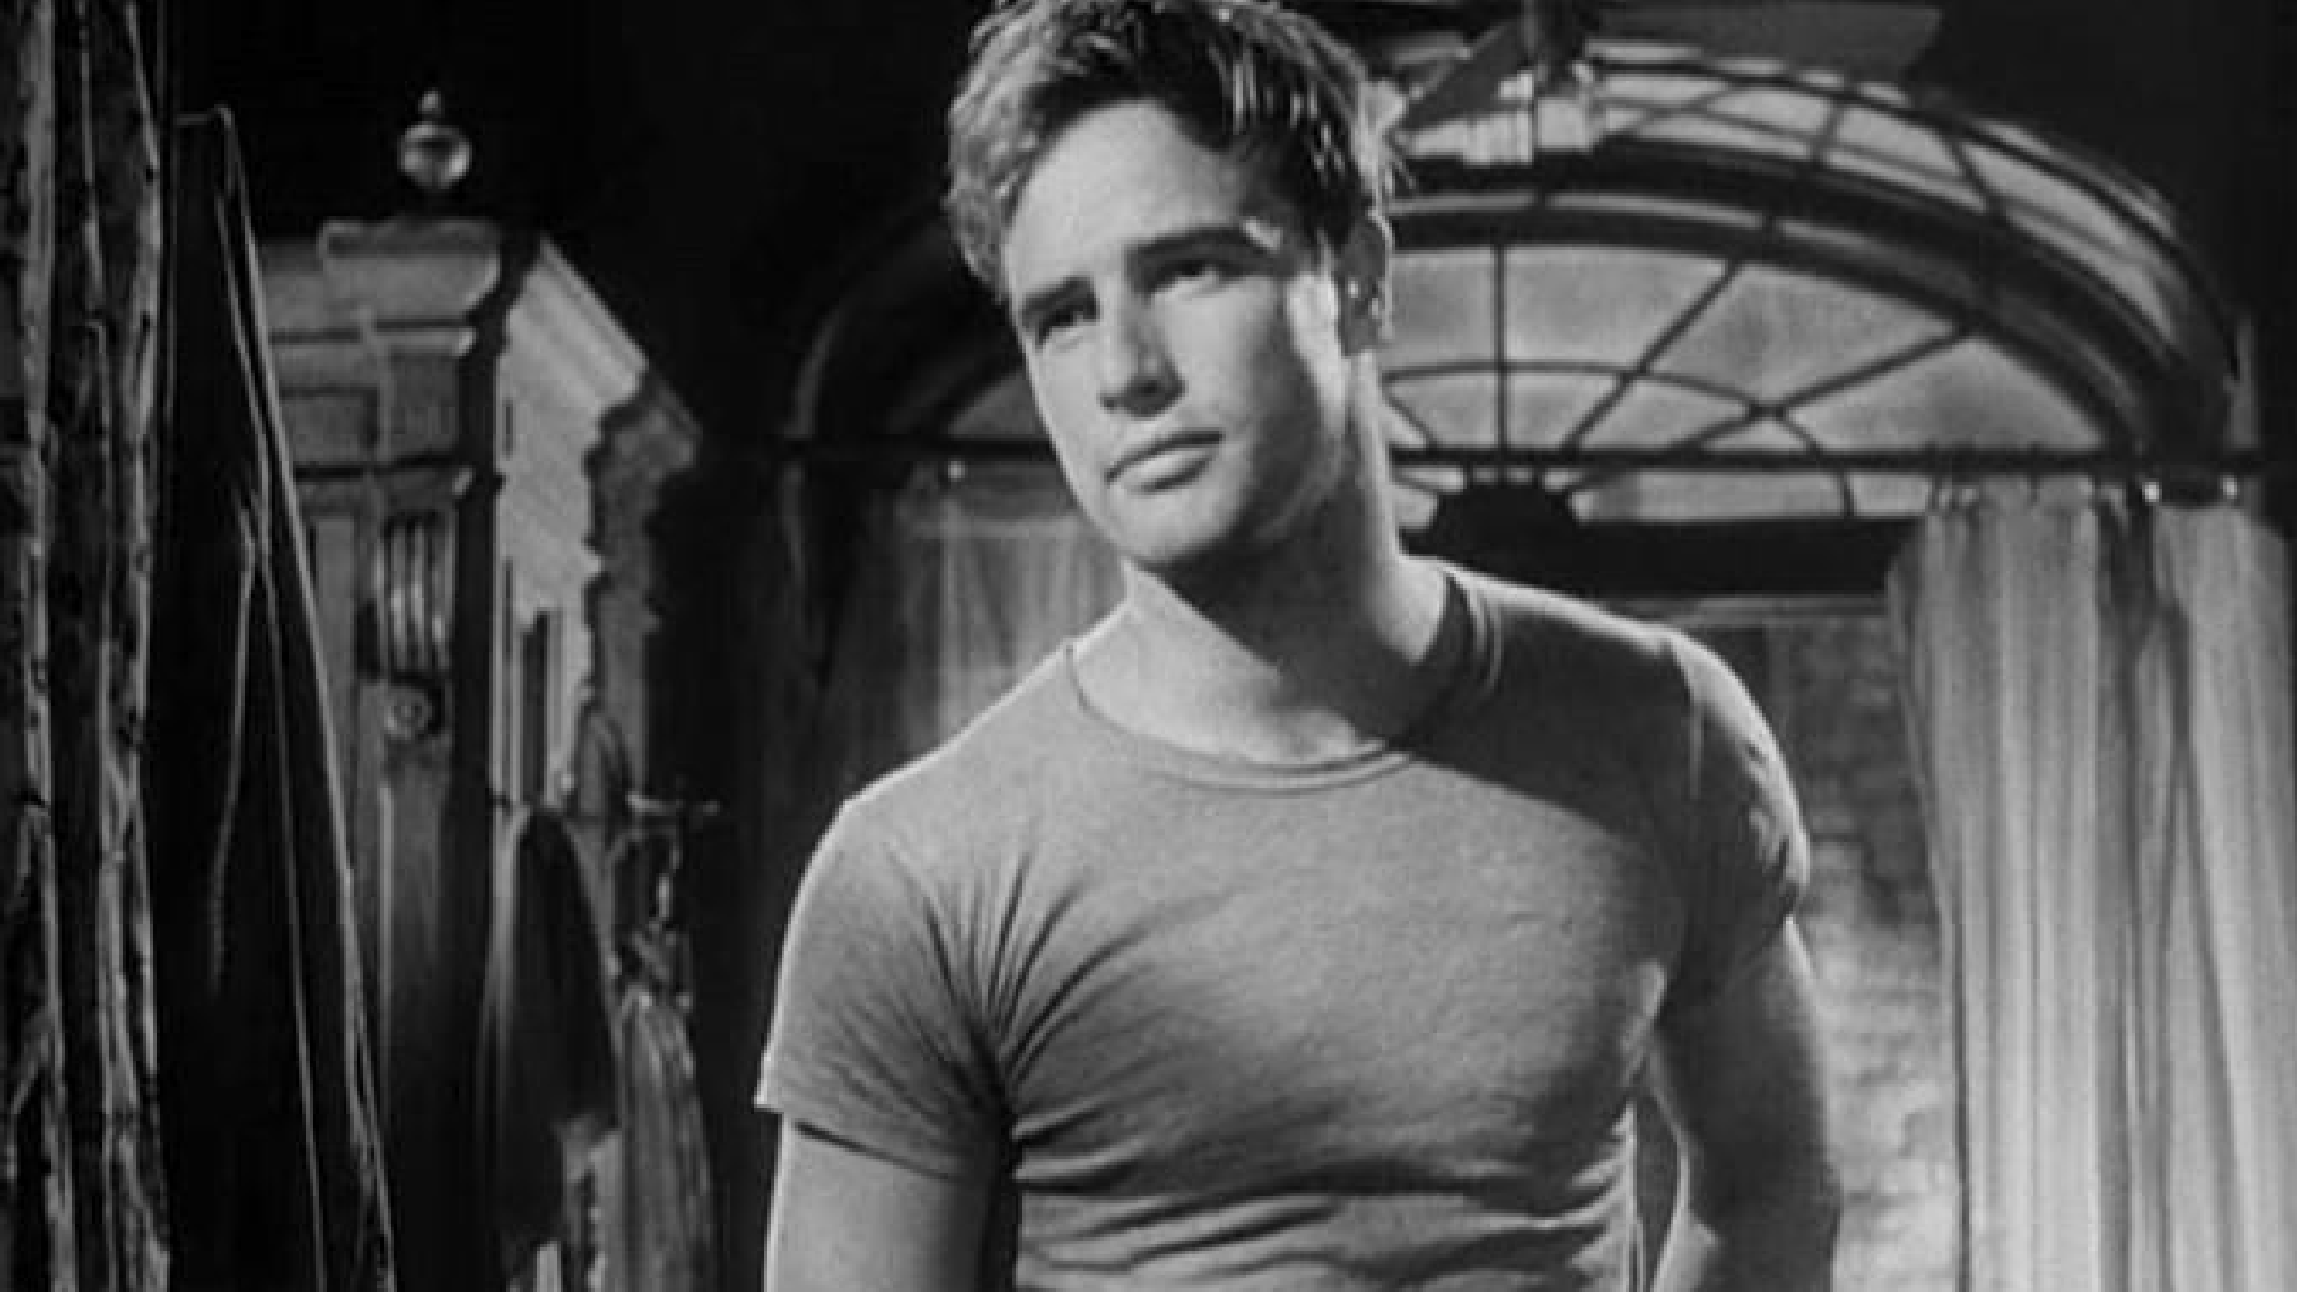

Slide 33
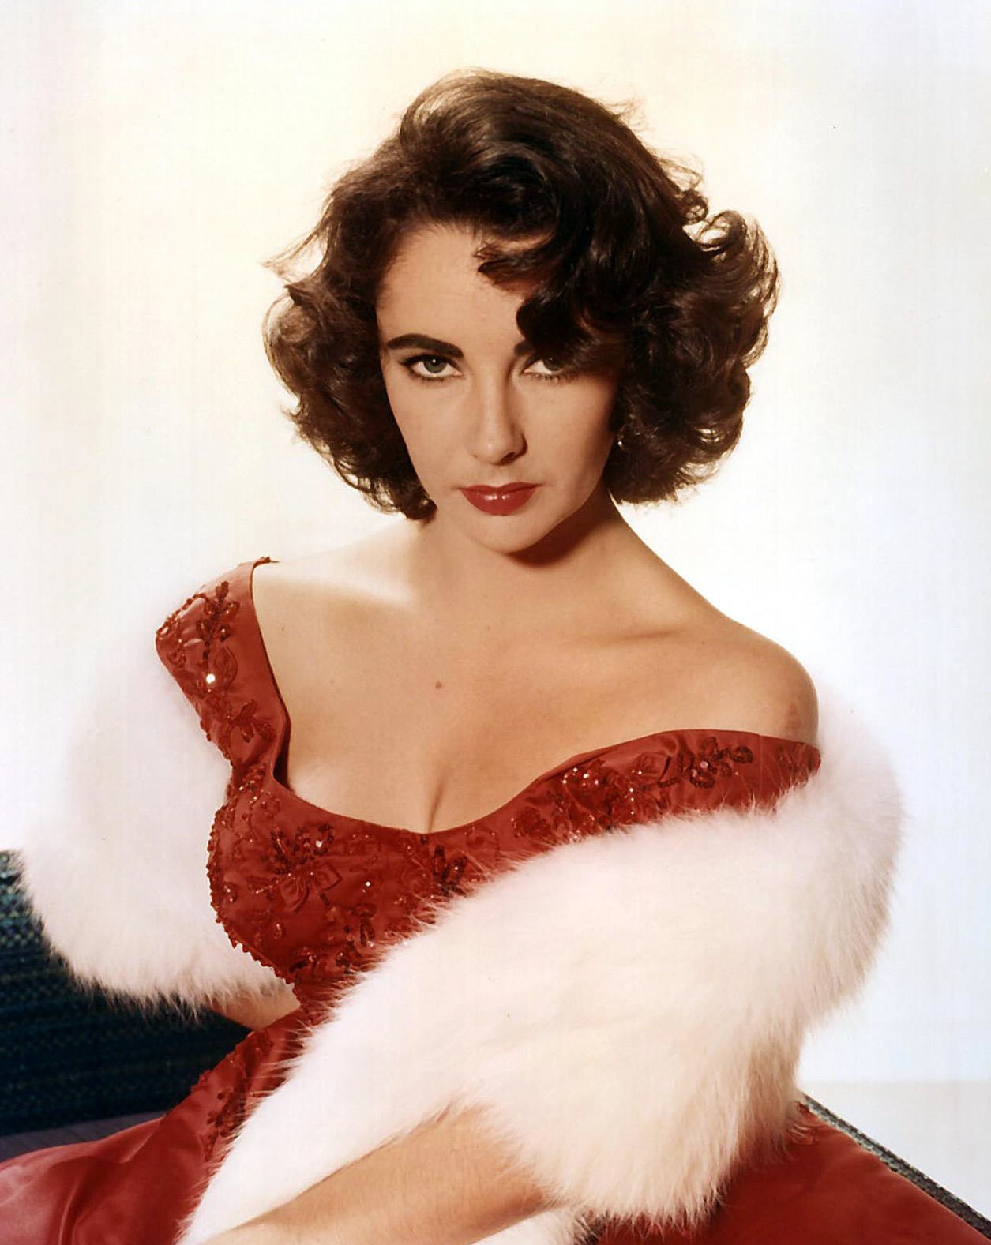

Slide 34
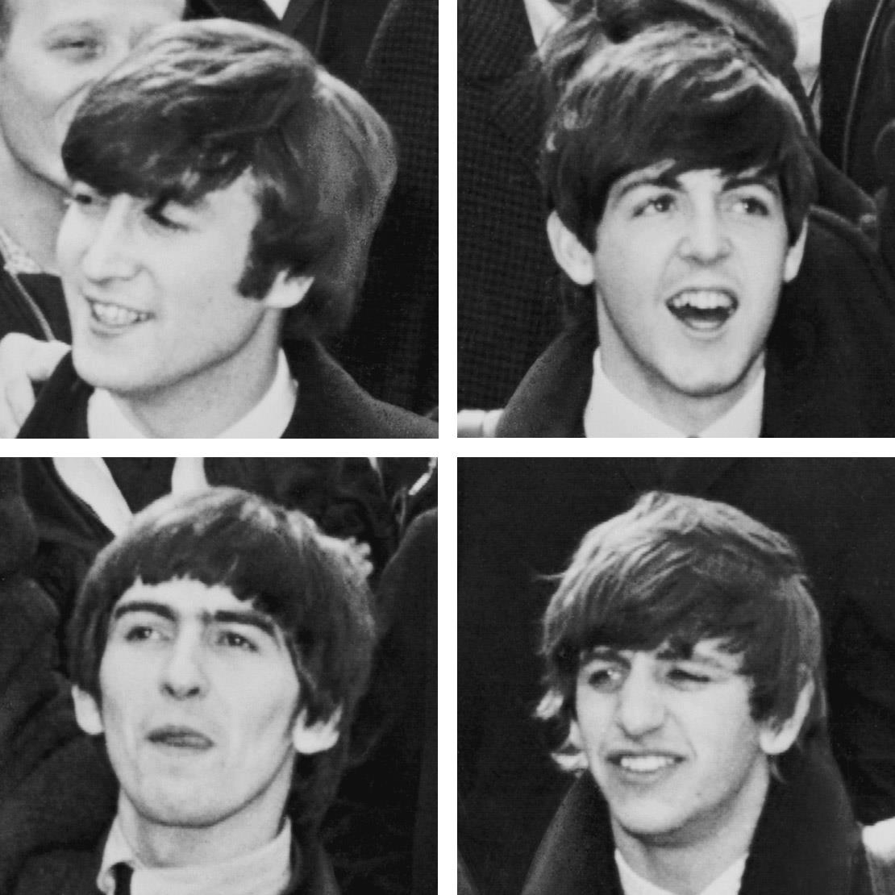

Slide 35
1. Elvis Presley
Grace Kelly
James Dean
Marilyn Monroe
Marlon Brando
Elizabeth Taylor
The Beatles: John Lennon Paul McCartney George Harrison Ringo Starr

