Slide 1
Activity 2 - More power and cleaner too
Student workbook

Slide 2
The Think Ahead gallery at Scienceworks explores innovations past and present that will help shape our future.

Slide 3
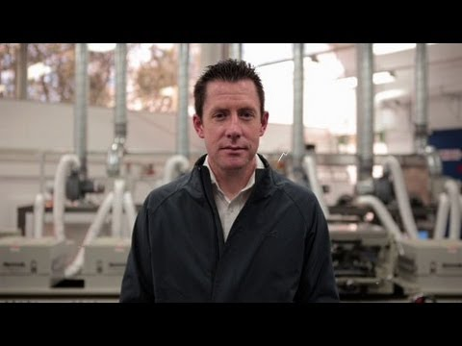
Video resource
Sustainable Cities
Watch this video resource on printable solar panels with Dr Scott Watkins. Dr Watkins describes how solar panels can now be cheaply printed on flexible materials. If we attach these to every available surface that sunlight hits, we could be producing more electricity.
.

Slide 4
Activity
Think of three places where these flexible solar panels could be installed:
1.
2.
3.

Slide 5
My design
Choose one of the ideas and make a drawing, a model from recycled materials or a 3D digital design to communicate your concept.
Ask your teacher to share your design with us on social media.

Slide 6
Energy research task
From your own research:
What does it mean for an energy source to be renewable or non-renewable?

Slide 7
Energy research task
List some energy sources that are non-renewable:
(add some images if you like)
1.
2.
3.
4.

Slide 8
Energy research task
List some energy sources that are renewable:
(add some images if you like)
1.
2.
3.
4.

Slide 9
Energy research task
How is your house powered?
Check with the bill payer in your household. What percentage of your household power comes from renewable and what percentage comes from non-renewable sources?
Some electricity bills can tell you this or the information may be on the website of the energy retailer.

Slide 10
Energy research task
How is your house powered?
Check with the bill payer in your household. What percentage of your household power comes from renewable and what percentage comes from non-renewable sources?
Some electricity bills can tell you this or the information may be on the website of the energy retailer.

Slide 11
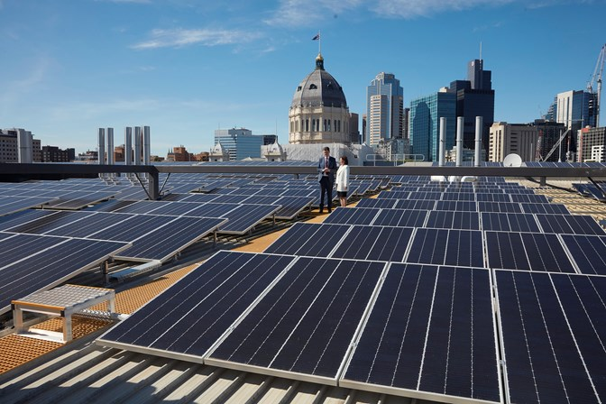
Did you know?
While flexible printed solar panels are not yet widely available, Museums Victoria has installed 2,743 standard solar panels across its different sites to save 1,316,288 kilowatt hours (kWh) per year. You can read more about it in this article here: MV solar panels. For a comparison, a 5 person household uses 7,300 kWh per year.
The Hon. Robin Scott, Assistant Treasurer and The Hon. Lily D'Ambrosio, Minister for Energy, Environment and Climate Change, on the Melbourne Museum roof among the 2,700 new solar panels.

Slide 12
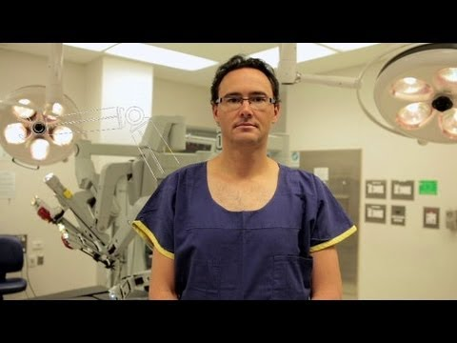
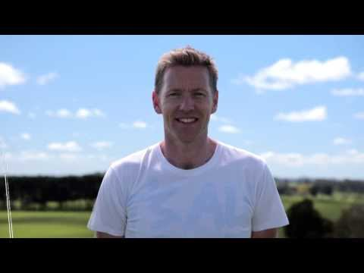
Still curious?
See what experts think the future could look like in medicine, food, building and more in other Think Ahead expert videos.
Eco - architecture
Da Vinci Surgical Robot

Slide 13
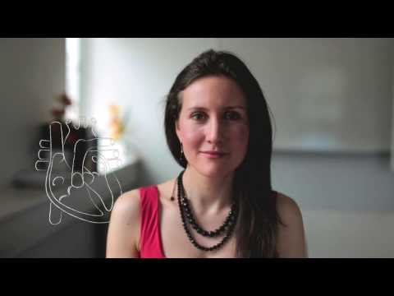
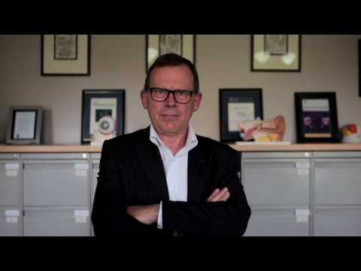
Still curious?
See what experts think the future could look like in medicine, food, building and more in other Think Ahead expert videos.
Food as medicine
Bionic eyes and ears

