Slide 1

Collecting to Think Ahead
Student workbook

Slide 2
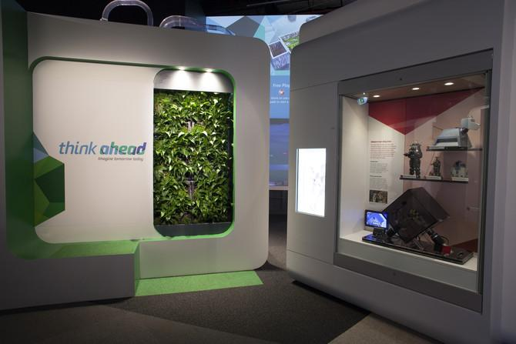
About the Think Ahead gallery at Scienceworks
The Think Ahead gallery at Scienceworks encourages visitors to think about the future and their involvement in it. The exhibition features past innovations that solved problems in transport, medicine, communication, space travel, music and the environment and gives glimpses of futuristic inventions that could become everyday solutions.

Slide 3
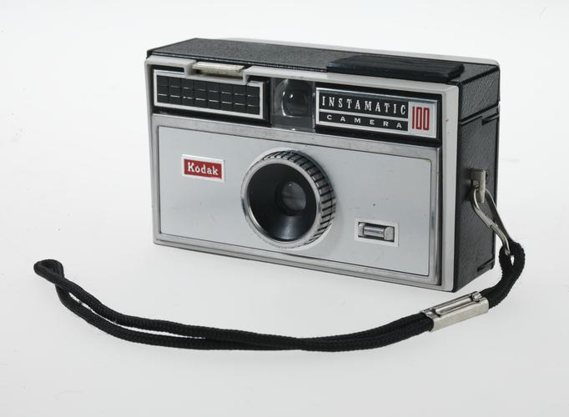
A museum collects things
As a museum, Scienceworks not only has hands-on exhibits to explore science concepts but also collects and displays objects that Museums Victoria has collected over time. These are important to preserve and showcase Victoria’s science and technology history.
Box Camera - Kodak, 'Instamatic', '100'.
Benjamin Healley, Museums Victoria

Slide 4
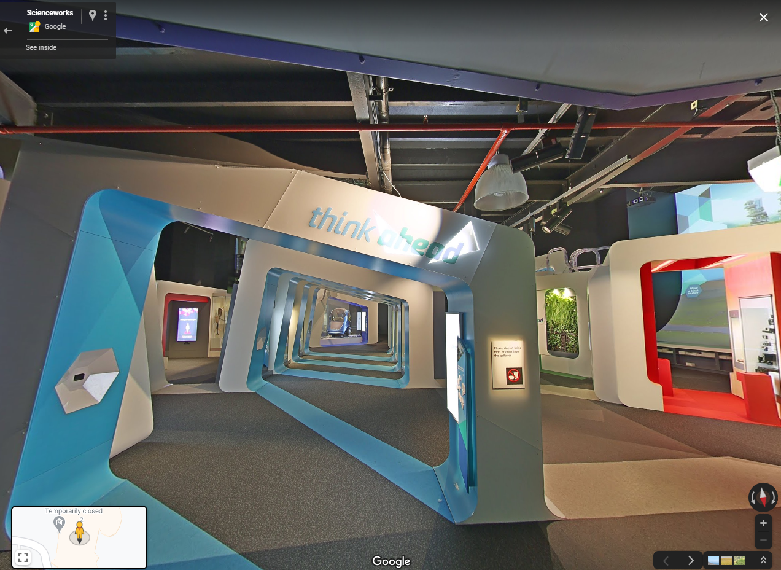
Go on a virtual scavenger hunt
Take a virtual tour of Think Ahead with Google Maps. Looking around, can you find the objects on the next page?
Click the image →
which will take you to the exhibition entrance. Work out how to move, look around, zoom in and out.

Slide 5
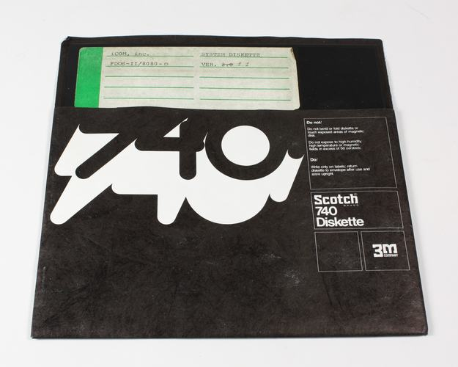
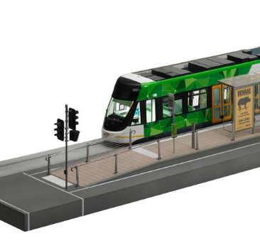
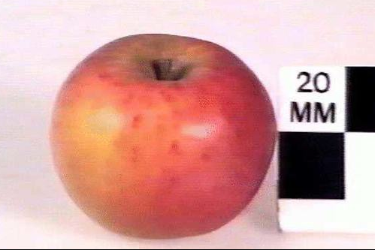
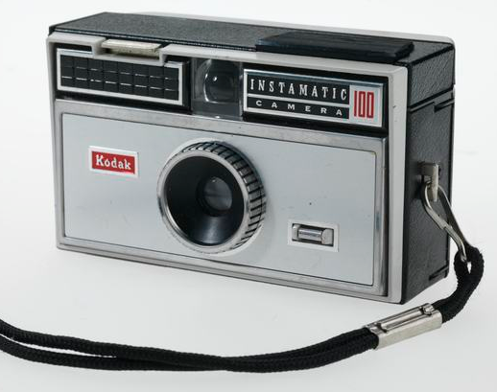
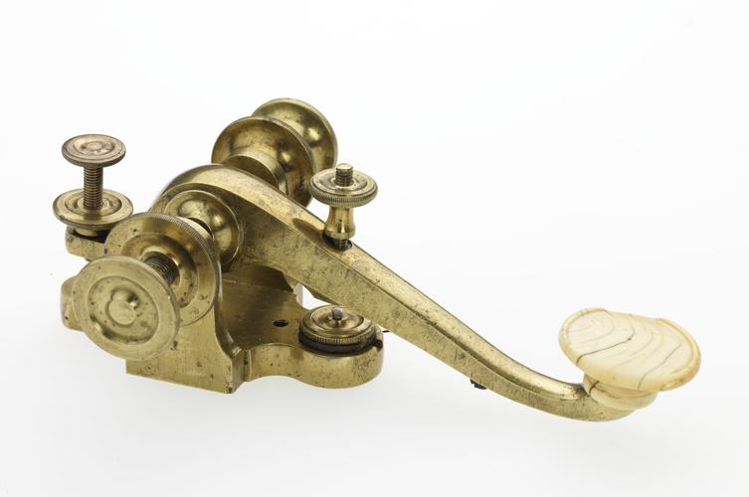
Where are these collection items displayed?
Example object, see next slide
Wax apple model
8 inch Floppy Disk
Model of electric tram
Take a screenshot of where you found it in the exhibition and paste it in the following pages
Click the blue links to read more about the item in our Collection database.
Telegraph key
Kodak Instamatic 100 camera

Slide 6
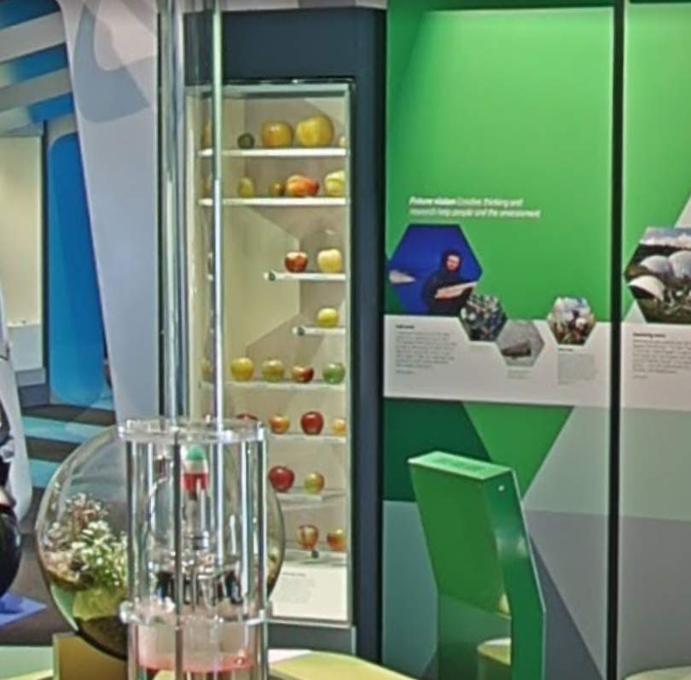
Example answer: Wax apple (Part 1)
Museum Collection Catalogue
Wax apple model
Article on wax fruit collection
What does this invention help us with? What was it used for?
The wax apple model was part of a collection of over 1800 different fruit and vegetable models. It was used by farmers and botanists studying plants to see examples of all the different varieties of fruit as well as the diseases that could happen to them. This was an important physical catalogue during a time when there wasn’t easy access to colour photography. It was useful for people experimenting with growing food in a new colony. It’s important for Victorians to collect this object as it helps us understand the history of local agriculture and is interesting to people who like growing things and reminds us of the biodiversity of food. There are more than the four types of apples we get in our supermarket aisles.
What are some questions you’d ask the creator of this object?
What was your process to make them?
Put your screenshot here:
List 3 groups of people who might be interested in this object.
Botanists
Farmers
People who like growing things

Slide 7

Example answer: Wax apple (Part 2)
Take a photo of something you have at home that serves a similar purpose and paste it here:
What do you think this item might look like in the future?
Draw, make a model out of scrap recycling or use a program like TinkerCAD, Makers Empire to make a 3D design or Marvel program to prototype an app. Attach the design here. Use extra slides if you need to.
This is a picture of a gardening book we have at home
I think in the future this might be an app where you can scan the fruit in front of you and it will tell you what its nutrition is and how to grow it. It will also list all the varieties and possible new varieties if you mix them.
I will make an app prototype with Marvel and share it with you by email.

Slide 8
Your turn
Just pick one, or if you’re keen, find them all!

Slide 9
Floppy disk (Part 1)
Museum Collection Catalogue
8 inch Floppy Disk
What does this invention help us with? What was it used for?
What are some questions you’d ask the creator of this object?
Put your screenshot here:
List 3 groups of people who might be interested in this object.
1.
2.
3.

Slide 10
Floppy disk (Part 2)
Take a photo of something you have at home that serves a similar purpose and paste it here:
What do you think this item might look like in the future?
Draw, make a model out of scrap recycling or use a program like TinkerCAD, Makers Empire to make a 3D design or Marvel program to prototype an app
Use more slides to show your work if you need to.

Slide 11
Tram model (Part 1)
Museum Collection Catalogue
Model of electric tram
What does this invention help us with? What was it used for?
What are some questions you’d ask the creator of this object?
Put your screenshot here:
List 3 groups of people who might be interested in this object.
1.
2.
3.

Slide 12
Tram model (Part 2)
Take a photo of something you have at home that serves a similar purpose and paste it here:
What do you think this item might look like in the future?
Draw, make a model out of scrap recycling or use a program like TinkerCAD, Makers Empire to make a 3D design or Marvel program to prototype an app
Use more slides to show your work if you need to.

Slide 13
Camera (Part 1)
Museum Collection Catalogue
Kodak Instamatic 100 camera
What does this invention help us with? What was it used for?
What are some questions you’d ask the creator of this object?
Put your screenshot here:
List 3 groups of people who might be interested in this object.
1.
2.
3.

Slide 14
Camera (Part 2)
Take a photo of something you have at home that serves a similar purpose and paste it here:
What do you think this item might look like in the future?
Draw, make a model out of scrap recycling or use a program like TinkerCAD, Makers Empire to make a 3D design or Marvel program to prototype an app
Use more slides to show your work if you need to.

Slide 15
Telegraph key (Part 1)
Museum Collection Catalogue
Telegraph key
Article: The Australian Telegraph Network
What does this invention help us with? What was it used for?
What are some questions you’d ask the creator of this object?
Put your screenshot here:
List 3 groups of people who might be interested in this object.
1.
2.
3.

Slide 16
Telegraph key (Part 2)
Take a photo of something you have at home that serves a similar purpose and paste it here:
What do you think this item might look like in the future?
Draw, make a model out of scrap recycling or use a program like TinkerCAD, Makers Empire to make a 3D design or Marvel program to prototype an app
Use more slides to show your work if you need to.

